Slide 1
Stand-Alone Software Developer
Solving day to day life problems with technology.

Slide 2
Table of contents
01
About me
03
Our Product
02
My History
04
Business Plan
Know who we are ?
Know our Proposed Product
Know what we did in past ?
How to acquire the targeted market ?

Slide 3
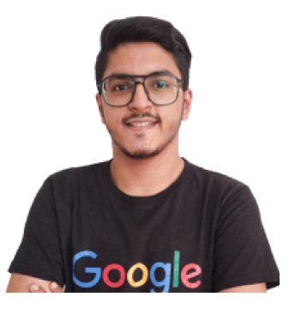




About me
I am a innovator who solves regular life problem using technology & technically Associate Product Manager at Open Source Program.

Slide 4
My History !
2022
2023
1 of 1200 International Contributor in Open Source
USA – Silicon Valley Mentor Summit Delegate
2022
2023
2024
Smart Blood Donation Project ranked #1 at State level
Mentor at Google Open Source Program
Associat Product Manager at Open Source

Slide 5

Our Product
Automating USA Visa Slot Booking Process with unbeliveable benefits

Slide 6
Benefit of using Automation?
Early Dates
Quick Dates
Quick Support
Using my software you will get earliest slots available in US Visa. Open for B1/B2, F1, Dropbox, etc.
Client can get Appointment with average waiting period time of 2 - 4 Weeks instead of 12 – 14 Months
Learn how to use software as well as contact any time to get live support for you Site related Queries.

Slide 7
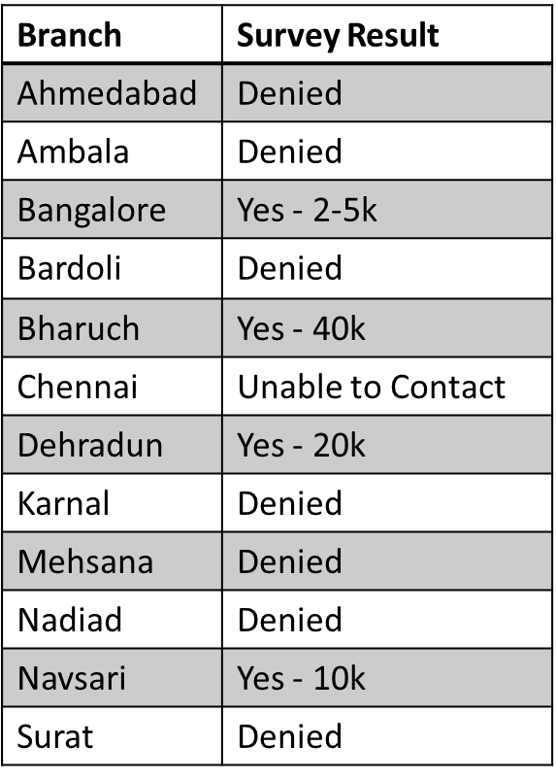
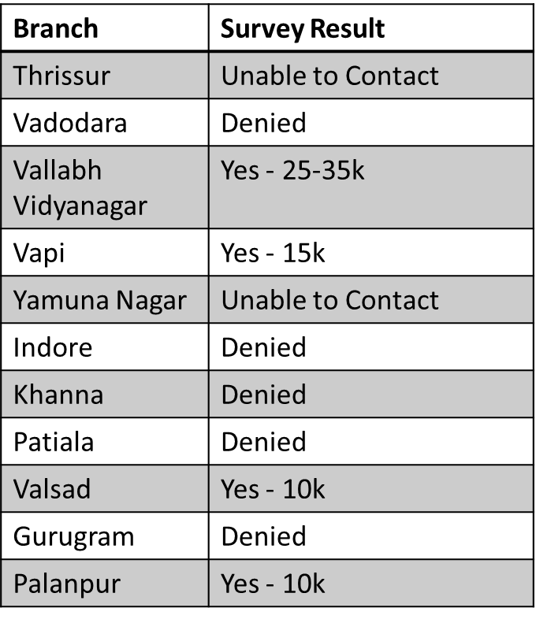
Business Plan
Current Kannan’s Scenario (according to my Survey)
More details would be discussed in Meeting.
Hiding data due to Privacy Reasons
With 0 % Benefit to Home Branch – Kannan Vadodara.

Slide 8
Business Plan
Proposed Solution
Build Centralized System for Date Booking
Keep control at Home Branch - Vadodara
Estimation :
Out of 13 Branch, say 10 Branch gives 2 client/month with average rate of 15k/Client => Generating 300k Revenue each month.
More details would be discussed in Meeting.
Hiding data due to Privacy Reasons
Total Branch | 20+
Current Number of Branch booking Dates | 8
Branch Interested in Booking Dates | 5
Potential Branch | 13

Slide 9
Business Plan
Assets checklist :
More details would be discussed in Meeting.
Hiding data due to Privacy Reasons
Get the source code of Automation from Cheap Market
Build Plans for distributing charges & Policy for Profit Distribution.
Directly Rent software to each branch and monitor it.(Optional)

Slide 10
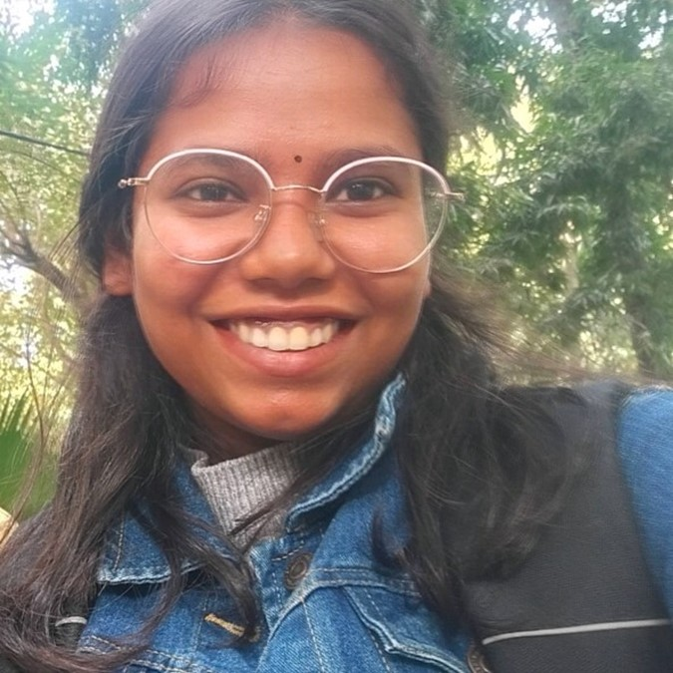
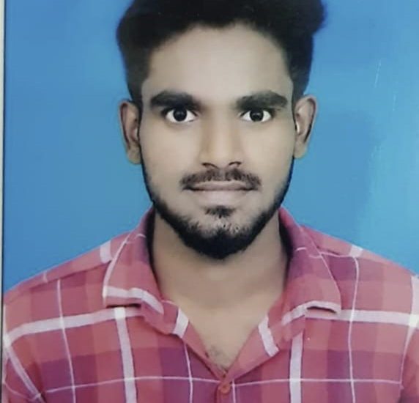
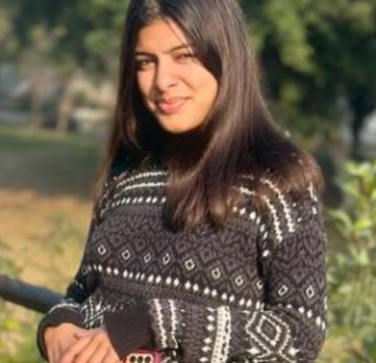
Our team
Yashi Gupta
Ravi Ranjan
Vanshika Bansal
Freelancing Team behind the updated version of my Software.

Slide 11

Thanks!
Does anyone have any questions?
adityabathani.4478@gmail.com
+91 83208 01488
https://linktr.ee/adityabathani
Please keep this slide as attribution

