Slide 1
Capstone Project
Play store data analysis
By: Aditya Gajanan Dambale

Slide 2
Let’s Dive into Analysis
Case study overview and defining problem statement
Data sourcing
Data handling and cleaning
Sanity checks
Outliers analysis with boxplots
Univariate analysis
Bivariate analysis
Multivariate analysis

Slide 3

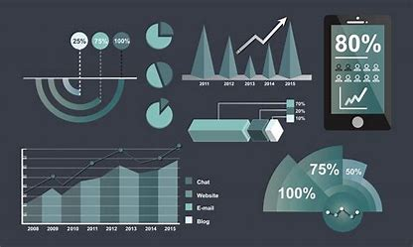
Overview and Defining problem statement
The Play Store apps data has enormous potential and insights to drive app-making businesses to success. Actionable insights can be drawn for developers to work on and capture the Android market. Each app (row) has values for catergory,rating, size, and more. Another dataset contains customer reviews of the android apps. Explore and analyze the data to discover key factors responsible for app engagement success.

Slide 4
Description of the columns
App : The name of the app
Category : The category of the app
Rating : The rating of the app in the Play Store
Reviews : The number of reviews of the app
Size : The size of the app
Install : The number of installs of the app
Type : The type of the app (Free/Paid)
The price of the app (0 if it is Free)
Content Rating :The appropiate target audience of the app
Genres: The genre of the app
Last Updated : The date when the app was last updated
Current Ver : The current version of the app
Android Ver : The minimum Android version required to run the app

Slide 5
Data sourcing
Data Sourcing is the process of data collection from the different sources for a specific target and to achieve a specific goal. This process is performed to know the target’s behavior and to deliver a better service to them. Data sourcing is a crucial part of successfully achieving business objectives.
mounting drive to access the data set
from google.colab import drive
drive.mount('/content/drive')
From above code Data is mounted from google drive

Slide 6
Data handling and cleaning
Remove duplicate or irrelevant observations. Remove unwanted observations from your dataset, including duplicate observations or irrelevant observations.
App 0 Category 0 Rating 40 Reviews 0 Size 0 Installs 0 Type 0 Price 0 Content Rating 0 Genres 0
df.isnull().sum()
Last Updated 0 Current Ver 0 Android Ver 0 Translated_Review:50057
Sentiment: 50047 Sentiment_Polarity 50047 Sentiment_Subjectivity 50047

Slide 7
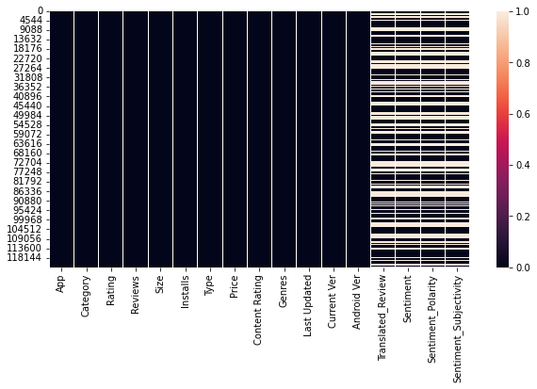
Heatmap for checking null values

Slide 8
Sanity checks
A sanity check or sanity test is a basic test to quickly evaluate whether a claim or the result of a calculation can possibly be true. It is a simple check to see if the produced material is rational
1)Sanity checks are found in the “Ratings” column
It check and dropo the ratings above 5
# Remove wich app reating is more than 5 un used entry
x=df[df['Rating']>5].index
df=df.drop(x)

Slide 9
Sanity checks
2) Removing '+' from the values of number of installs converting it to numeric
df['Installs'] =df['Installs'].map(lambda x: x.rstrip('+'))
3) Converting install coloumn it to numeric
df['Installs'] = pd.to_numeric(df['Installs'].str.replace(',',''))
4)Removing '$' from the values of Price and converting it to numeric
df['Price'] = pd.to_numeric(df['Price'].str.replace('$',''))

Slide 10
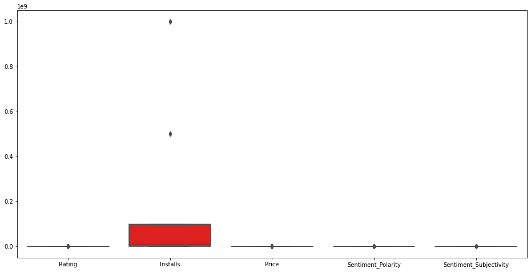
Outliers analysis with boxplots

Slide 11
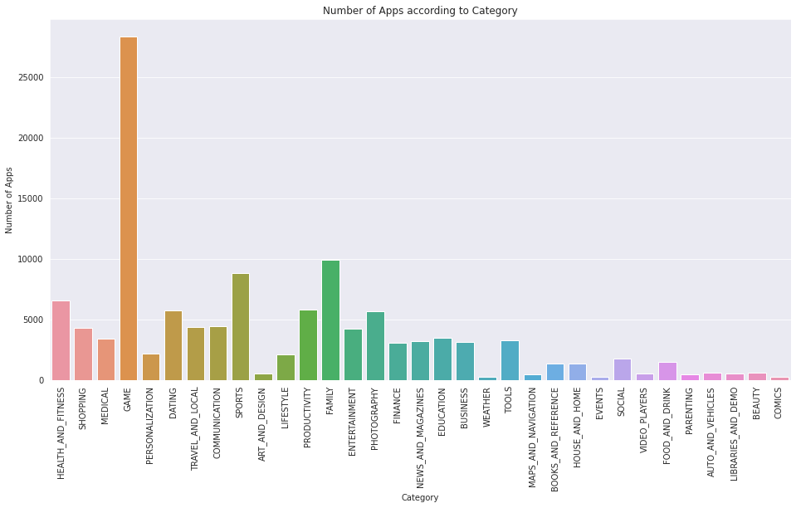
Univariate analysis
Number of apps according to their category
Game,Family and sports category having high amount of apps as compare to others

Slide 12
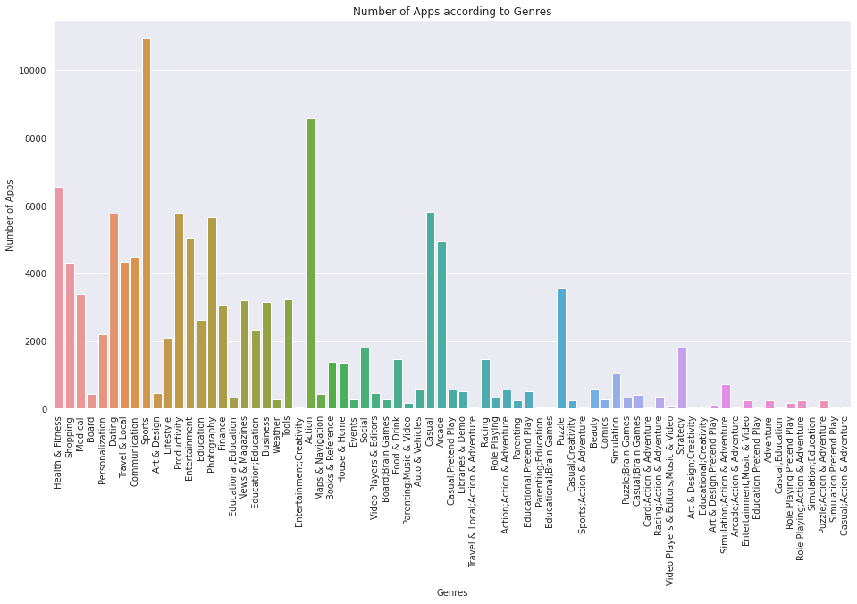
Number of apps according to Genres

Slide 13
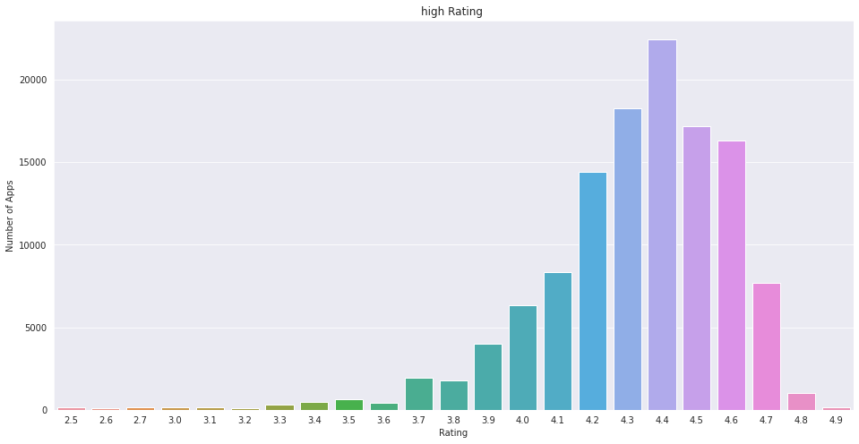
High ratings given by consumers
The average ratings are generally given between 4.2 to 4.6

Slide 14
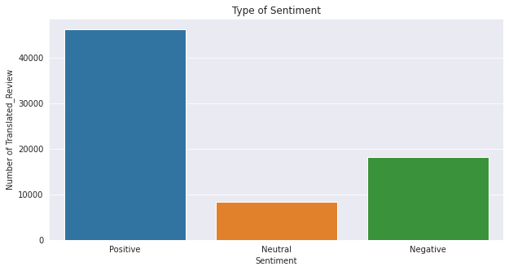
Type of review provided by consumer

Slide 15
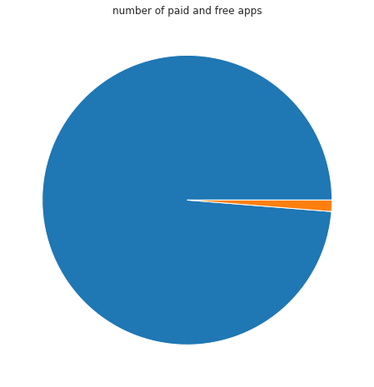
Apps according to their type

Slide 16
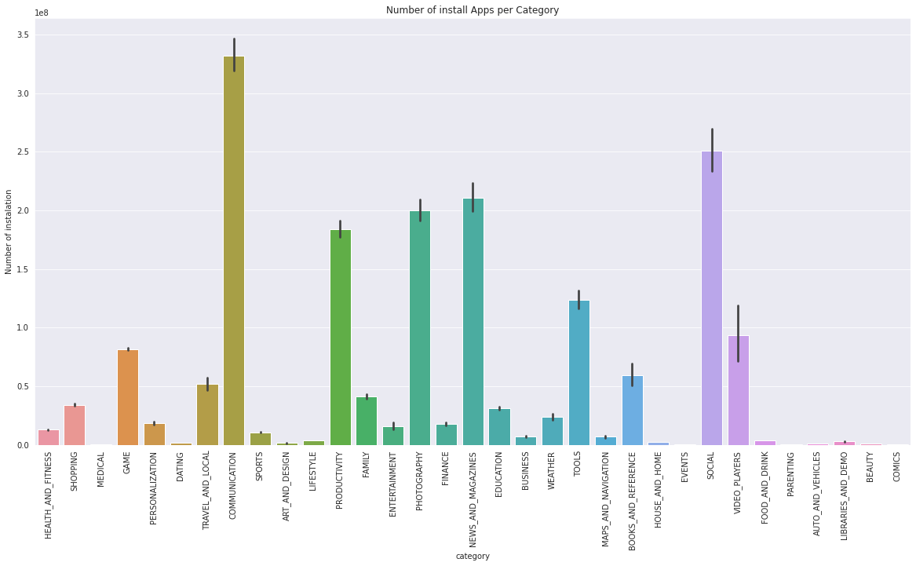
Bivariate Analysis
Number of apps installed per category

Slide 17
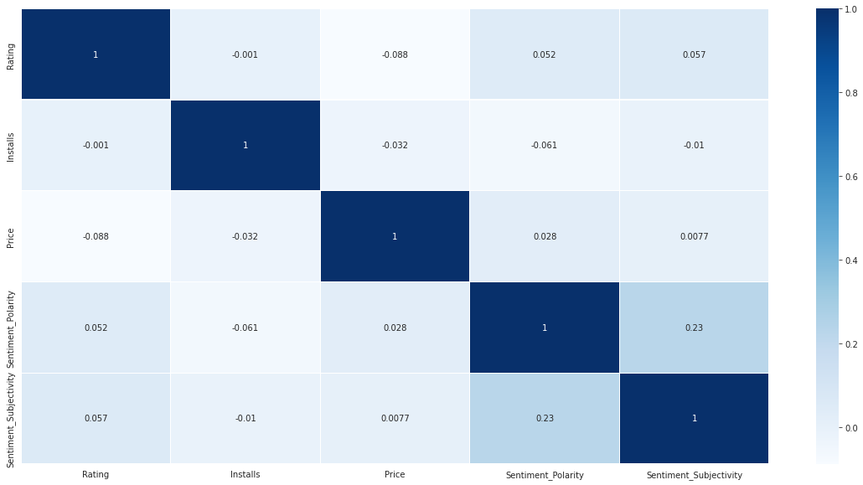
Multivariate Analysis
Relation between the varibales by using heatmap

Slide 18
Which are the top 10 installed apps ?
1)Facebook
2)Google+
3)Google
4)Google Play Movies & TV
5)Google Play Books
6)Google Photos
7)Google Street View
8)Gmail
9)Google Drive
10)Hangouts

Slide 19
B) Top 10 high rated apps ?
1)CDL Practice Test
2)Edition
3)FREE LIVE TALK
4)DMV Permit Practice Test
5)Edition
6)Down Dog: Great Yoga Anywhere
7)Free Books - Spirit Fanfiction and 8)Even - organize your money, get paid
9)FreePrints – Free Photos Delivered
10)30 Day Fitness Challenge - Workout at GoodRx Drug Prices and Coupons1

Slide 20
C)Top 10 expensive apps ?
1)A Manual of Acupuncture
2)Golfshot Plus: Golf GPS
3)EMT Review Plus
4)Essential Anatomy 3
5)BIG Launcher
6)Diabetes & Diet Tracker
7)Acupuncture Assistant
8)Calculator
9)Call of Duty:Black Ops Zombies
10)Farming Simulator 18

Slide 21
D) Which are the top 10 installed games?
1)Candy Crush Saga
2)Garena Free Fire
3)Angry Birds Rio
4)Angry Birds 2
5)Dream League Soccer 2018
6)Flow Free
7)Cut the Rope FULL FREE
8)Hill Climb Racing
9)Farm Heroes Saga
10)Asphalt 8: Airborne

