Slide 1

Project Presentation on Query-Based Text Summarization Using Averaged Query Summarization
Group Members Name with registration Number
M.S.L.V. Saranya - FET/BCE/2021-25/005
Aditya Narayan Panda - FET/BCE/2021-25/005
Dibyanshu Mohapatra - FET/BCE/2021-25/008
Shreya Adya - FET/BCE/2021-25/047
Mentor / Supervisor’s Name
Prof. Gopinath Palai
Faculty of Engineering & Technology, Sri Sri University, Cuttack.

Slide 2
Contents:
Abstract Proposed Title
Introduction
Objective Literature Review
Motivation
Literature Survey/ Existing Work
Problem Statement
Work Plan and Timeline
Conclusion
References

Slide 3
Abstract
Automatic text summarization aims to condense text while retaining key meaning.
We propose a query-based summarization system using word frequencies and cosine similarities.
This method provides concise, query-relevant summaries, improving information retrieval efficiency.
This project also aims to summarize multiple documents simultaneously saving time and resources.

Slide 4
Introduction
Problem Statement: Traditional summarization gives a brief version of the whole document which, in many case, is still more than necessary.
Importance and relevance of the project
Text summarization is a crucial problem in NLP, involving extractive and abstractive approaches.
Query-based summarization focuses on retrieving only relevant content, aiding faster knowledge extraction.

Slide 5
Objective
Develop an efficient method for query-based text summarization.
Extract relevant information while reducing redundancy.
Improve readability using cosine similarity for redundancy removal.
Use abstractive method to maintain context and coherence.
Add the function to summarize multiple documents at the same time.

Slide 6
motivation
The increasing volume of unstructured data makes manual information retrieval difficult.
Query-based summarization helps users focus only on relevant content, reducing time and cognitive load.

Slide 7
Literature Survey/ Existing Work
S. No. | Author(s) | Year | Title | Objective | Methodology | Key Findings | Gaps Identified
1 | Verberne et al. | 2020 | Query-Based Summarization of Discussion Threads | Improve query-based summarization for forum discussions | Used MMR, centroid-based ranking, TF-IDF for query relevance | Query-independent features performed better than query-based MMR | Weak query relevance modeling, lacks abstractive summarization, no user adaptation
2 | Baumel et al. | 2018 | Query-Focused Abstractive Summarization | Integrate query relevance into seq2seq models for better QFS | Used pointer-generator networks, query attention, length control | Improved relevance but still highly extractive, abstractive models need better coherence | Lacks training data, over-reliance on ROUGE, limited evaluation on diverse datasets
3 | Suleiman et al. | 2020 | Deep Learning Based Abstractive Text Summarization | Generate query-specific summaries while reducing redundancy using simple statistical methods | Uses word frequency analysis for extraction and cosine similarity for redundancy removal | Produces unique summaries per query, improves readability over purely extractive approaches | Does not use deep learning, lacks abstractive generation, may struggle with complex sentence restructuring

Slide 8
Problem statement
Finding relevant information within large text datasets is challenging.
Existing summarization techniques either extract too much or miss key details.
Only one document summarized at a time may have biased information about the query.
A hybrid approach is needed to improve precision and readability.

Slide 9
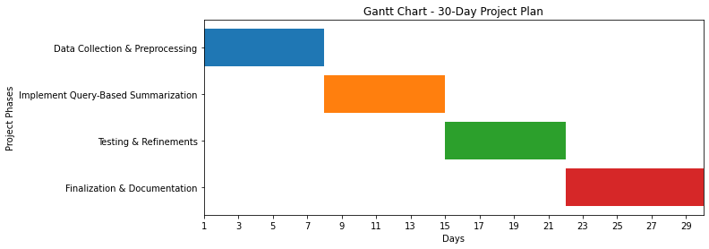
Work Plan and Timeline

Slide 10
Conclusion
Develop a method for efficient query-based summarization.
Enhance readability with abstractive techniques.
Implement deep learning models for better sentence generation.
Enable multi-document summarization.

Slide 11
references
Verberne, S., Krahmer, E., Wubben, S., & van den Bosch, A. (2020). Query-Based Summarization of Discussion Threads. Natural Language Engineering. DOI: 10.1017/S1351324919000123
Baumel, T., Eyal, M., & Elhadad, M. (2018). Query-Focused Abstractive Summarization: Incorporating Query Relevance, Multi-Document Coverage, and Summary Length Constraints into seq2seq Models. ArXiv Preprint, arXiv:1801.07704v2
Suleiman, D., & Awajan, A. (2020). Deep Learning-Based Abstractive Text Summarization: Approaches, Datasets, Evaluation Measures, and Challenges. Journal of Artificial Intelligence and Soft Computing Research.

Slide 12
Thank you

