Slide 1
DETECTION OF ONSET DISTURBANCE FOR INERTIA ESTIMATION USING KERNEL DENSITY ESTIMATION
Presented By: Aditya Kumar (2001EE85)
Supervised By: Dr. S.K. Parida, SMIEEE (Associate Professor)

Slide 2
TABLE OF CONTENTS
Why is the detection of disturbances important in power systems for estimating inertia?
The old method: Fix Threshold Detection (Literature Review)
Our methodology: Kernel Density Estimation
1. Introduction to Kernel Density Estimation(KDE)
2. Data collection: Two area system
3. Bandwidth calculation
4. Model fitting
5. Log likelihood calculation and its visualization
6. Threshold selection and onset detection
Results
Conclusion and Future works
References

Slide 3
IMPORTANCE OF DETECTING DISTURBANCES IN POWER SYSTEMS FOR ESTIMATING INERTIA
Inertia refers to the system's ability to resist changes in frequency.
When a disturbance occurs, like a sudden loss of generation or load change, the power balance is disrupted.
Accurate and early detection of disturbance is crucial for isolating the "inertial response" from the overall frequency response.
This isolation allows for a more precise estimation of synchronous inertia of the system using swing equation.

Slide 4
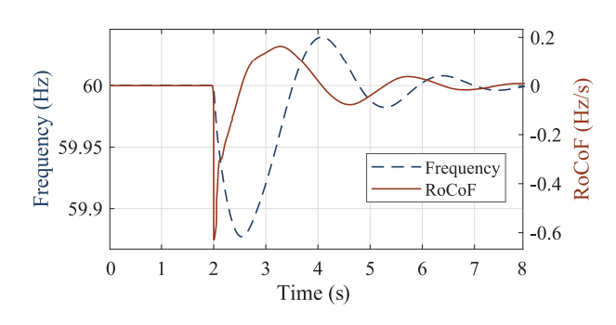
FIX THRESHOLD DETECTION METHOD (LITERATURE REVIEW)
In the paper, Measurement-Based Estimation of Inertia in AC Microgrids (IEEE TRANSACTIONS ON SUSTAINABLE ENERGY, VOL. 11, NO. 3, JULY 2020), the authors used a RoCoF threshold of 0.05 Hz/s to identify the exact starting time of the onset of disturbance.
A moving average filter of 50 ms was applied to the measured RoCoF value to minimize the effect of measurement errors or noise.
Any sample exceeding this threshold value was considered as disturbance.

Slide 5
FIX THRESHOLD DETECTION METHOD (DISADVANTAGES)
Requires careful selection of the threshold and window length, which can be challenging and system-dependent.
Inaccurate for small disturbances that may not exceed the threshold.
Very susceptible to PMU noise.
The method is not reliable for low inertia power systems.

Slide 6
OUR METHODOLOGY: KERNEL DENSITY ESTIMATION

Slide 7
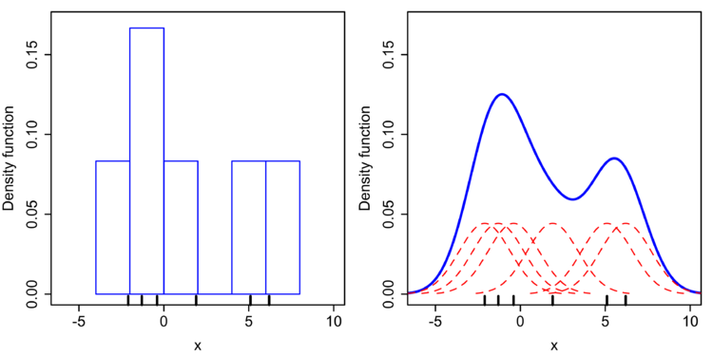
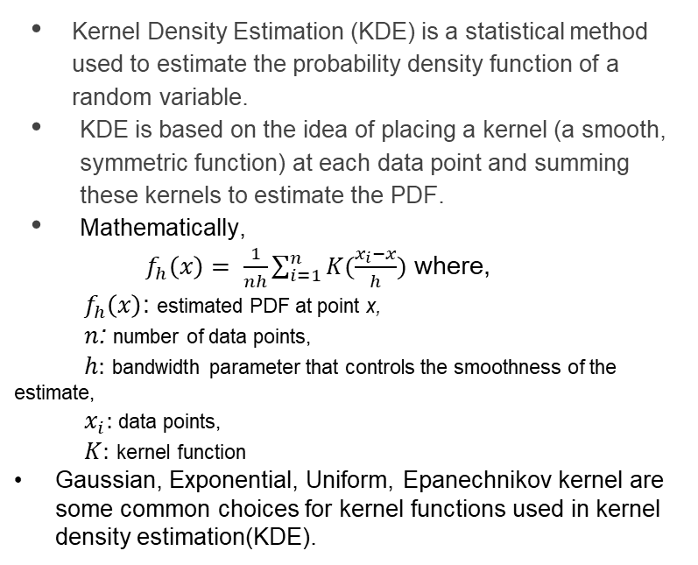
INTRODUCTION
Kernel Density Estimation (KDE) is a statistical method used to estimate the probability density function of a random variable.
KDE is based on the idea of placing a kernel (a smooth, symmetric function) at each data point and summing these kernels to estimate the PDF.
Mathematically,
$f_{h}\left(x\right)= \frac{1}{nh}\sum_{i=1}^{n}{K(\frac{x_{i}−x}{h})}$ where,
${ f}_{h}\left(x\right)$: estimated PDF at point x,
$n$: number of data points,
$h:$ bandwidth parameter that controls the smoothness of the estimate,
${ x}_{i}:$data points,
$K:$ kernel function
Gaussian, Exponential, Uniform, Epanechnikov kernel are some common choices for kernel functions used in kernel density estimation(KDE).
Histogram and KDE of a continous random variable

Slide 8
HOW IT WILL HELP IN DETECTING THE ONSET DISTURBANCE?
Modelling PDF: KDE models the underlying probability distribution of system features, such as the center of inertia frequency, under normal operating conditions.
Detection of Deviations: When a disturbance occurs, KDE can detect deviations in these features from their normal patterns, which manifest as outliers in the estimated PDF.
Threshold-based Detection: By setting an appropriate threshold based on the PDF, KDE can identify outliers that correspond to the onset of disturbances.
Early Detection: This enables the early detection of disturbances, such as faults or sudden load changes, allowing for timely corrective actions to maintain system stability.
Flexibility and Adaptability: KDE provides a flexible and data-driven approach, making it well-suited for detecting anomalies like the onset of disturbances in power systems.

Slide 9
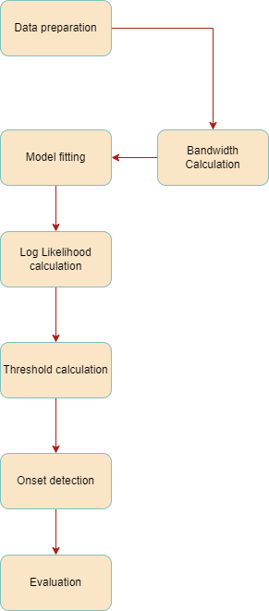
Flowchart of the implementation

Slide 10
DATA COLLECTION: TWO AREA SYSTEM
A two-area system was simulated.
Synthetic Data generation
Introduced step disturbances of varying magnitudes to mimic faults or disturbances.
Generated time series data for the center of inertia frequency.
Dataset composition
Collected 15 signals, each containing around 1500 samples.
Applied step disturbances at 0.35 pu, 0.65 pu, and 0.85 pu levels.
Varied the duration of disturbances from 100 ms to 500 ms for each magnitude.

Slide 11
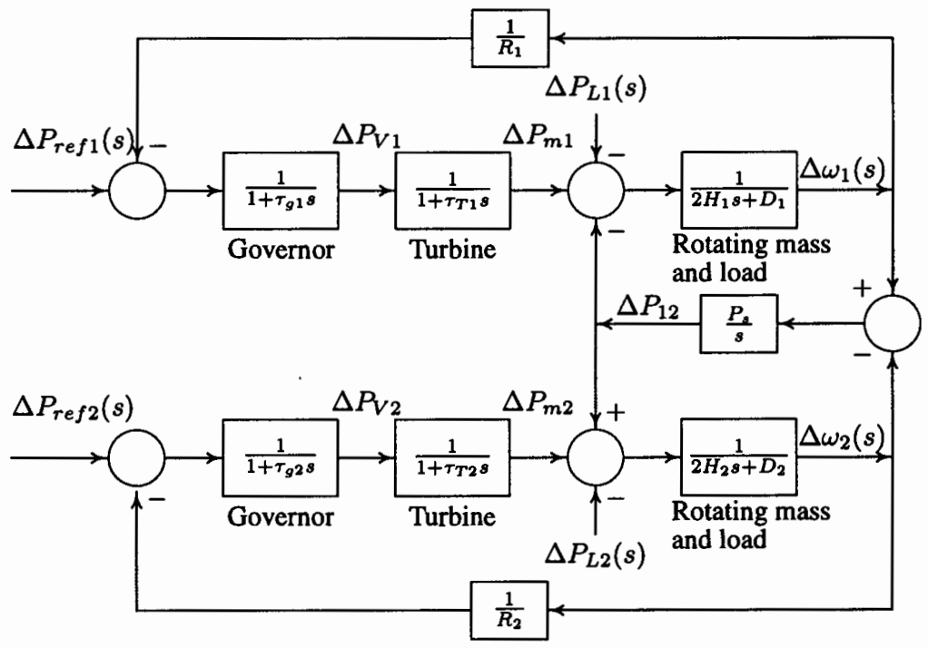
Transfer function model of a two area system

Slide 12
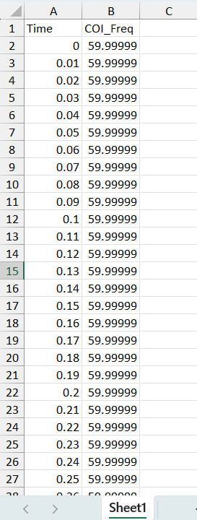
Snapshot of the collected dataset

Slide 13
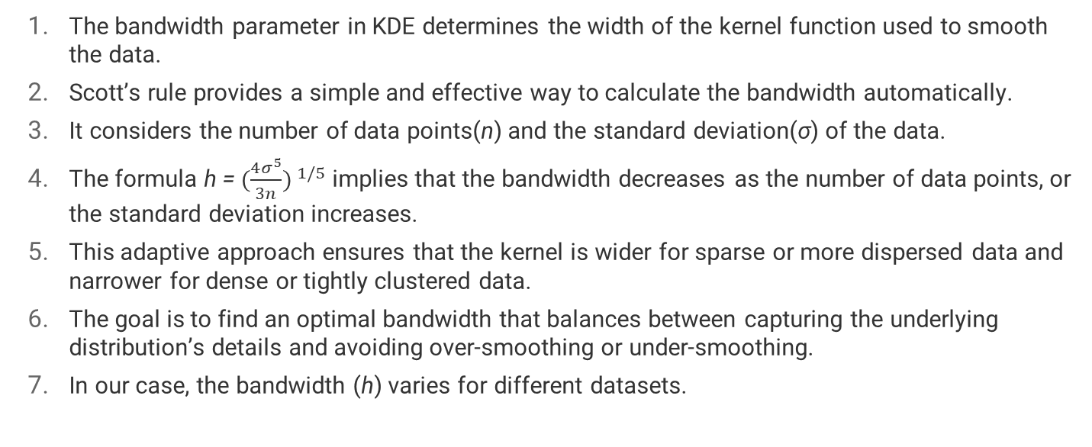
BANDWIDTH CALCULATION
The bandwidth parameter in KDE determines the width of the kernel function used to smooth the data.
Scott’s rule provides a simple and effective way to calculate the bandwidth automatically.
It considers the number of data points(n) and the standard deviation(σ) of the data.
The formula h = ${(\frac{4σ^{5}}{3n}) }^{1/5}$ implies that the bandwidth decreases as the number of data points, or the standard deviation increases.
This adaptive approach ensures that the kernel is wider for sparse or more dispersed data and narrower for dense or tightly clustered data.
The goal is to find an optimal bandwidth that balances between capturing the underlying distribution’s details and avoiding over-smoothing or under-smoothing.
In our case, the bandwidth (h) varies for different datasets.

Slide 14
MODEL FITTING
Select a kernel function, such as Gaussian, Exponential etc., to determine the shape of the probability density estimate.
In our case, we choose Gaussian as the kernel function.
Fit the KDE model to the data by placing a kernel function at each data point.
Sum the contributions from all kernel functions to estimate the density at any given point in the data space.
The resulting KDE model provides a smoothed estimate of the underlying probability density function.
Use the KDE model for anomaly detection by identifying regions of low density as potential anomalies.

Slide 15
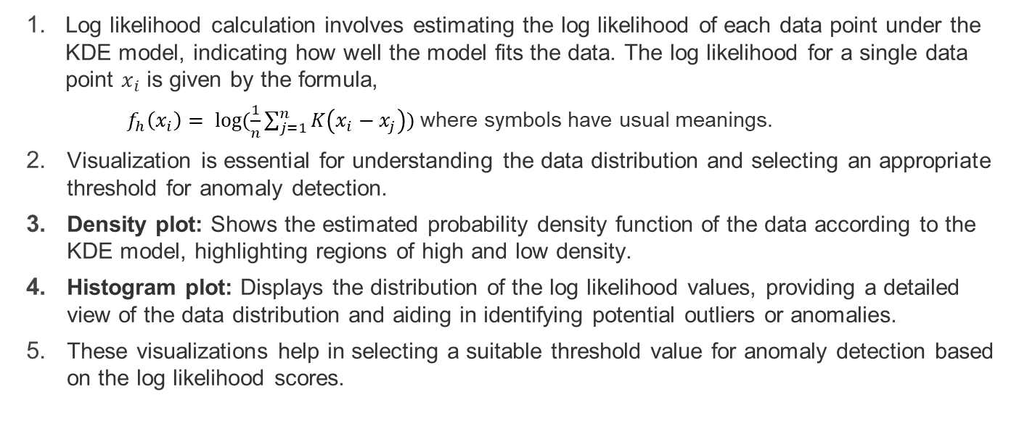
LOG LIKELIHOOD CALCULATION AND ITS VISUALIZATION
Log likelihood calculation involves estimating the log likelihood of each data point under the KDE model, indicating how well the model fits the data. The log likelihood for a single data point $x_{i}$ is given by the formula,
$f_{h}\left(x_{i}\right)= \log{(\frac{1}{n}\sum_{j=1}^{n}{K\left(x_{i}−x_{j}\right)})}$ where symbols have usual meanings.
Visualization is essential for understanding the data distribution and selecting an appropriate threshold for anomaly detection.
Density plot: Shows the estimated probability density function of the data according to the KDE model, highlighting regions of high and low density.
Histogram plot: Displays the distribution of the log likelihood values, providing a detailed view of the data distribution and aiding in identifying potential outliers or anomalies.
These visualizations help in selecting a suitable threshold value for anomaly detection based on the log likelihood scores.

Slide 16
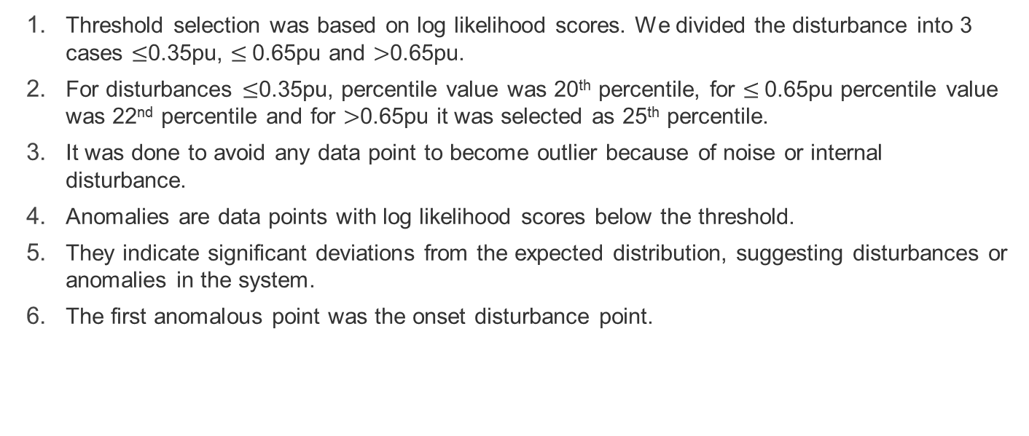
THRESHOLD SELECTION AND ONSET DETECTION
Threshold selection was based on log likelihood scores. We divided the disturbance into 3 cases $≤$0.35pu, $≤$0.65pu and $>$0.65pu.
For disturbances $≤$0.35pu, percentile value was 20th percentile, for $≤$0.65pu percentile value was 22nd percentile and for $>$0.65pu it was selected as 25th percentile.
It was done to avoid any data point to become outlier because of noise or internal disturbance.
Anomalies are data points with log likelihood scores below the threshold.
They indicate significant deviations from the expected distribution, suggesting disturbances or anomalies in the system.
The first anomalous point was the onset disturbance point.

Slide 17
RESULTS

Slide 18
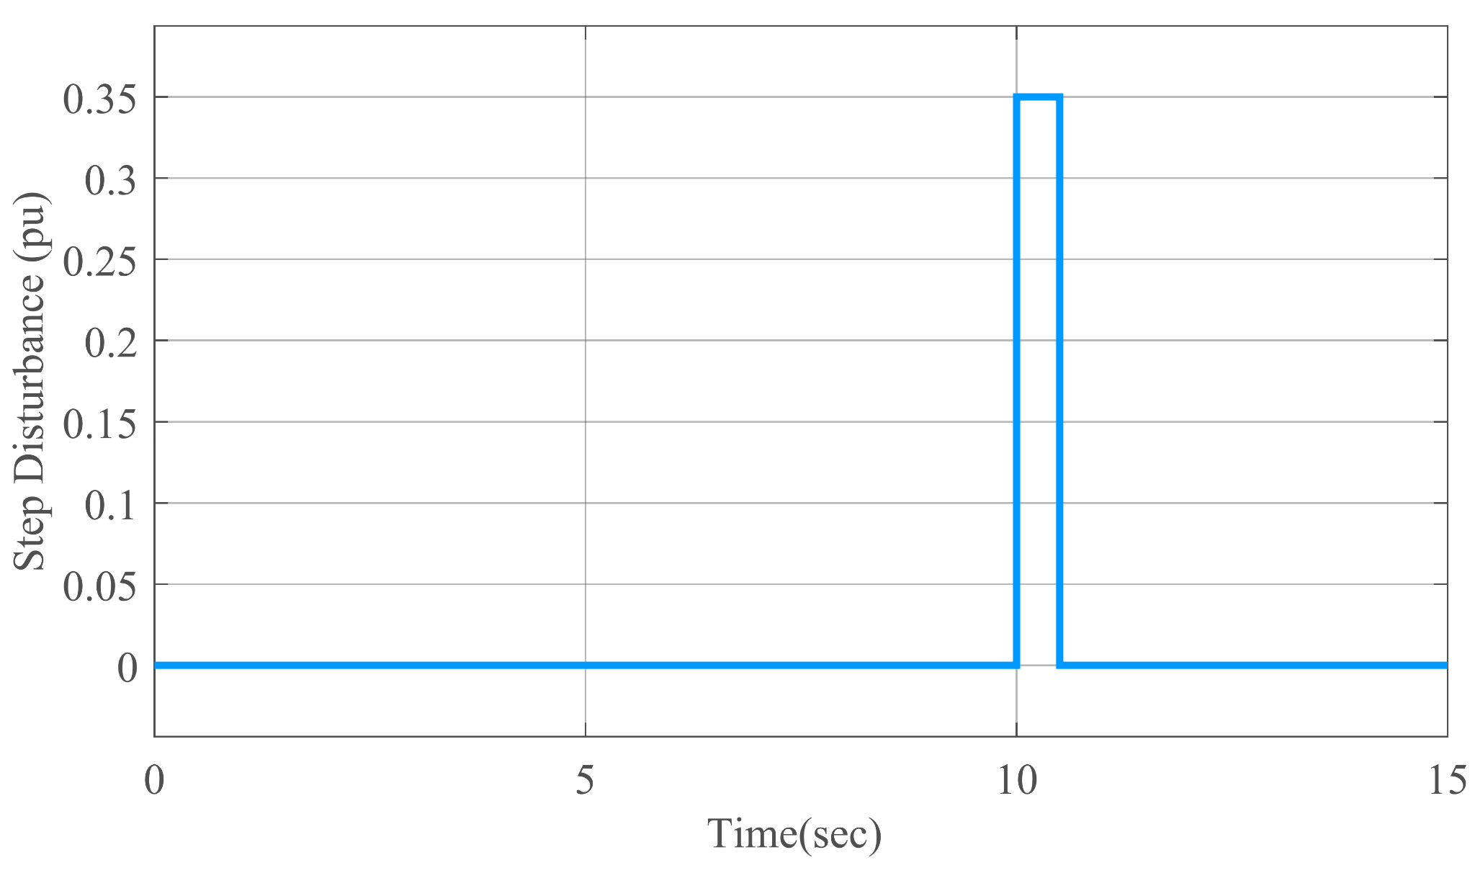
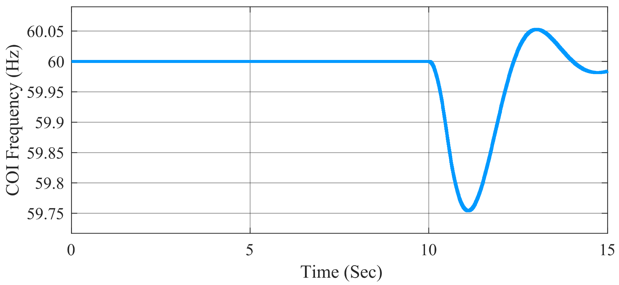
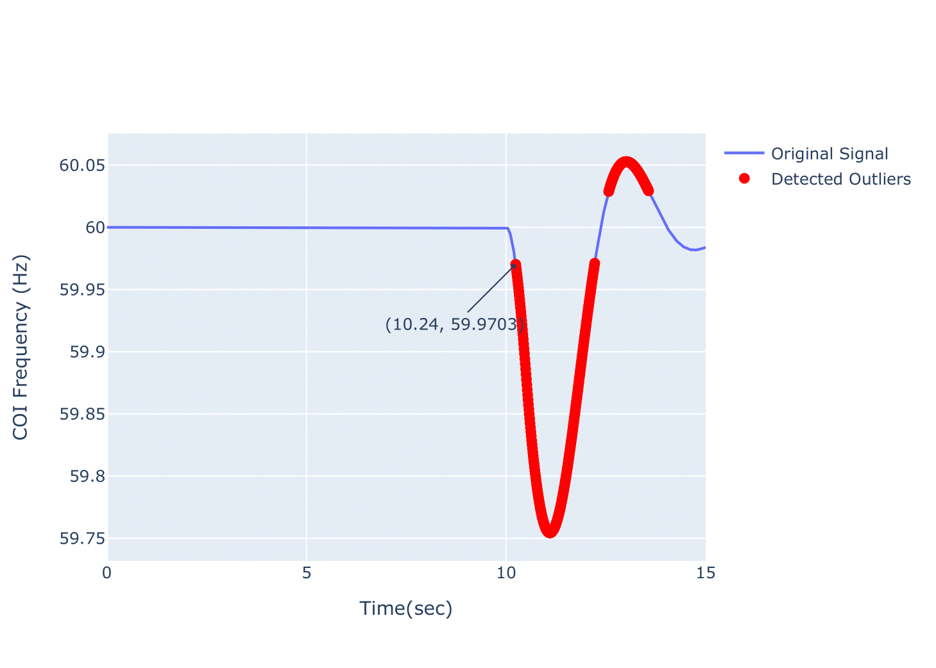
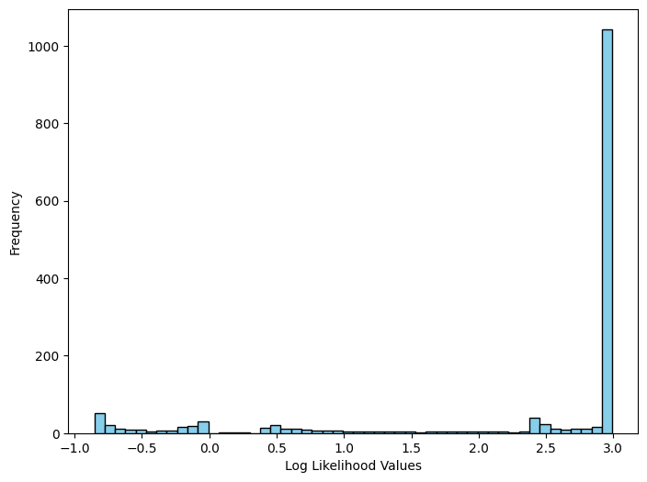
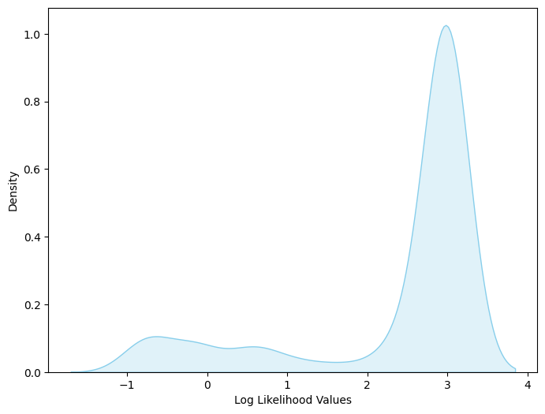
A step disturbance of 0.35pu at t=10 sec
COI frequency of system for step disturbance of 0.35pu
COI Frequency vs time plot with outliers marked as red when 0.35pu disturbance was applied for 500ms
Histogram of log likelihood values
Density plot of log likelihood values

Slide 19
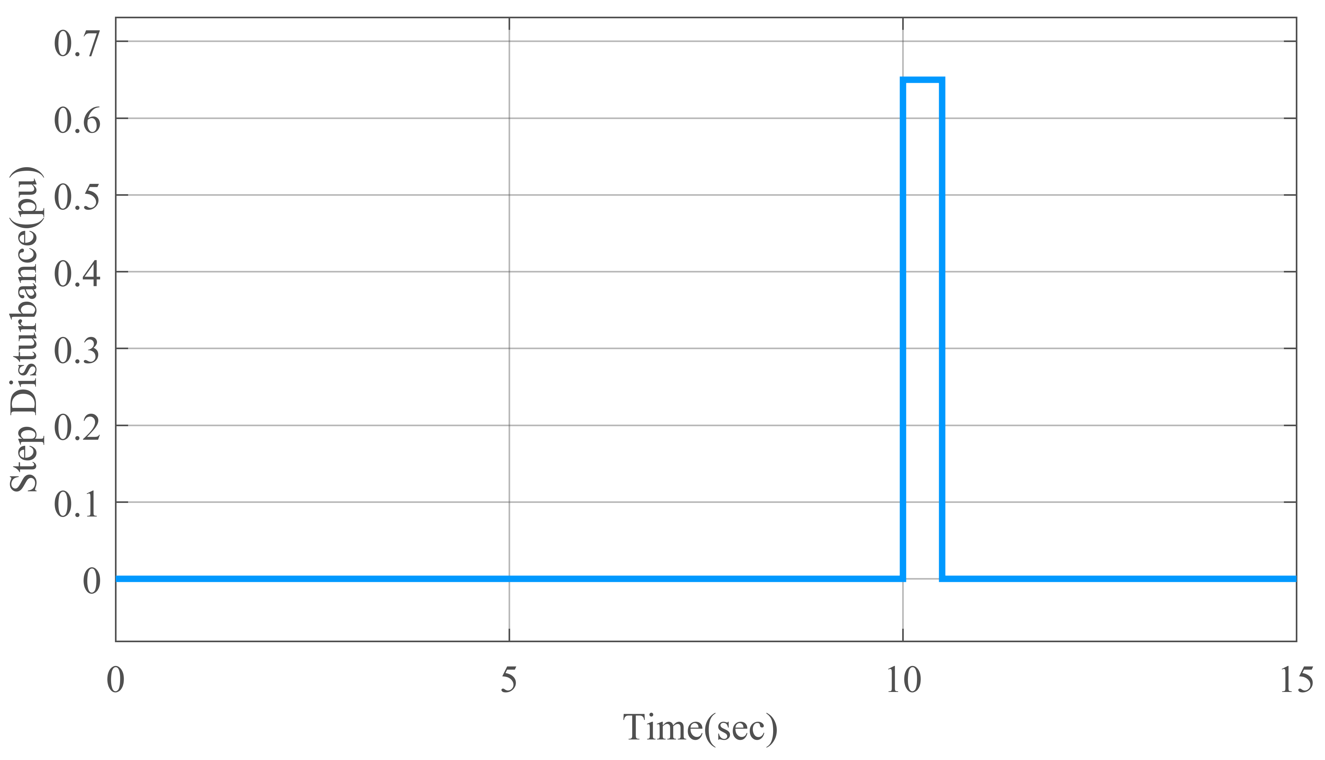
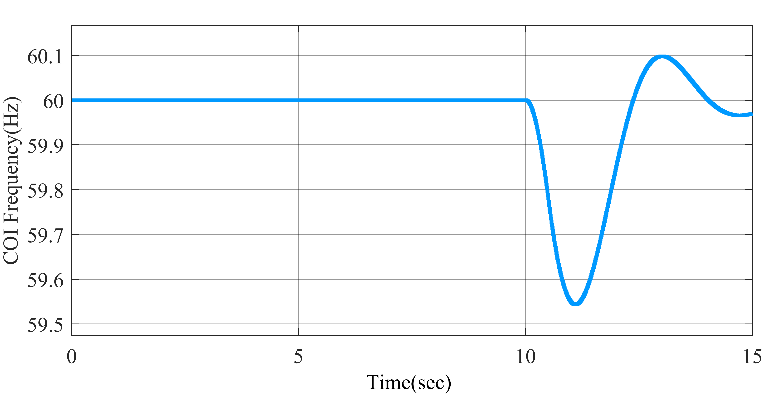
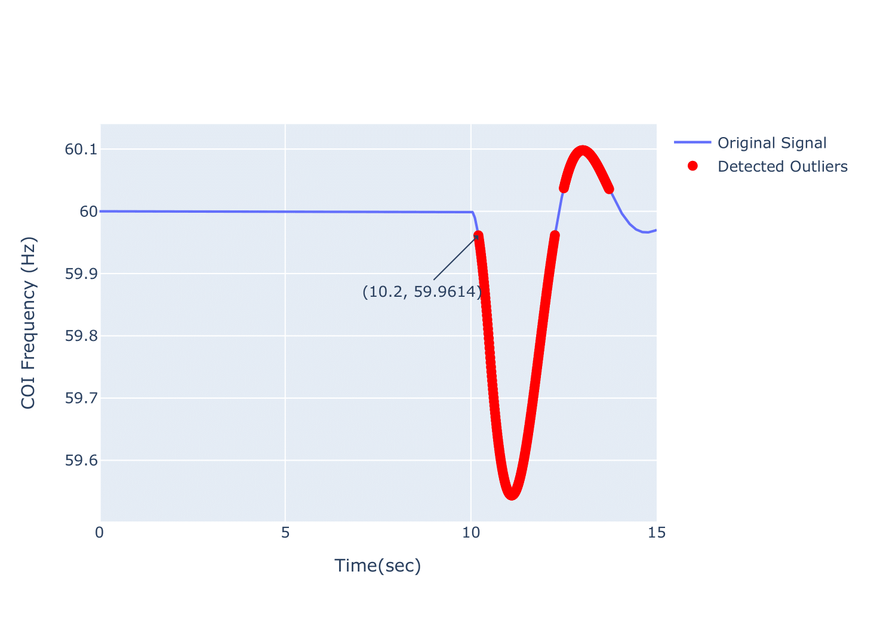
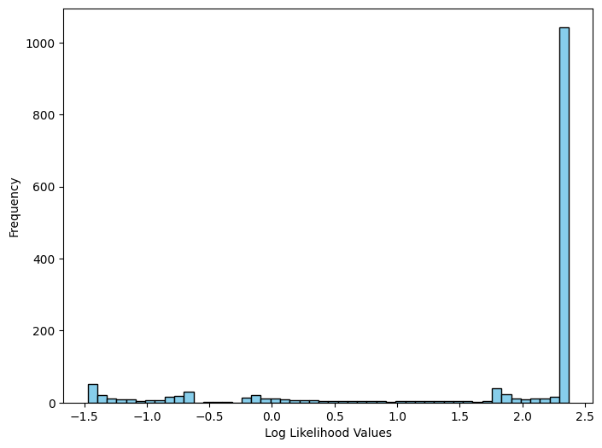
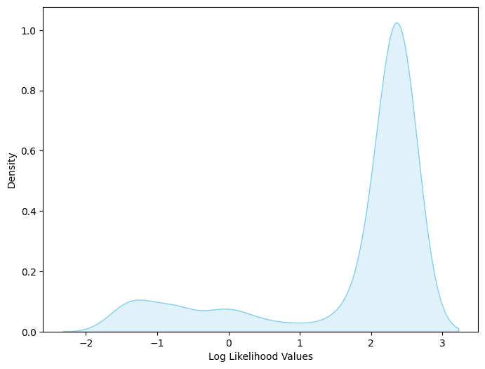
A step disturbance of 0.65pu at t=10 sec
COI frequency of system for step disturbance of 0.65pu
COI Frequency vs time plot with outliers marked as red when 0.65pu disturbance was applied for 500ms
Histogram of log likelihood values
Density plot of log likelihood values

Slide 20
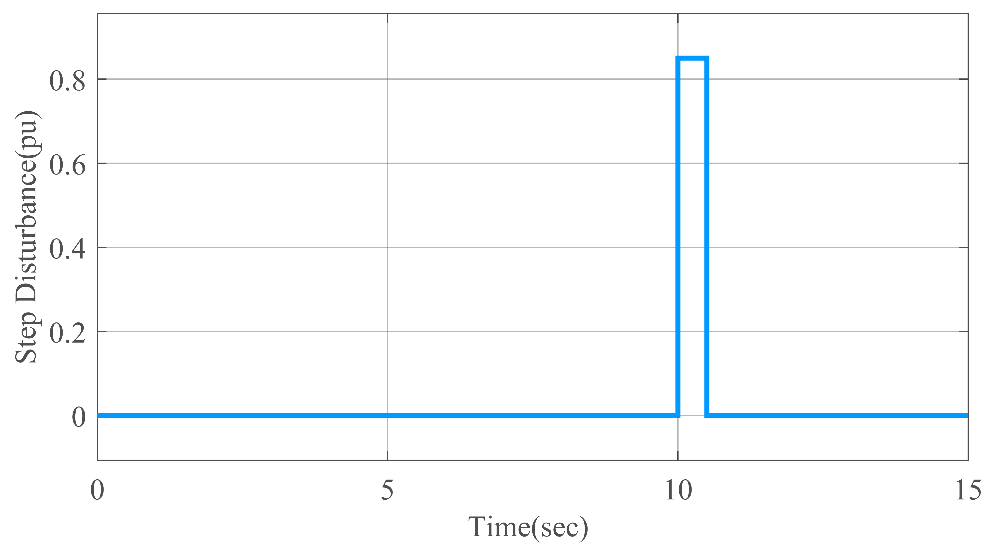
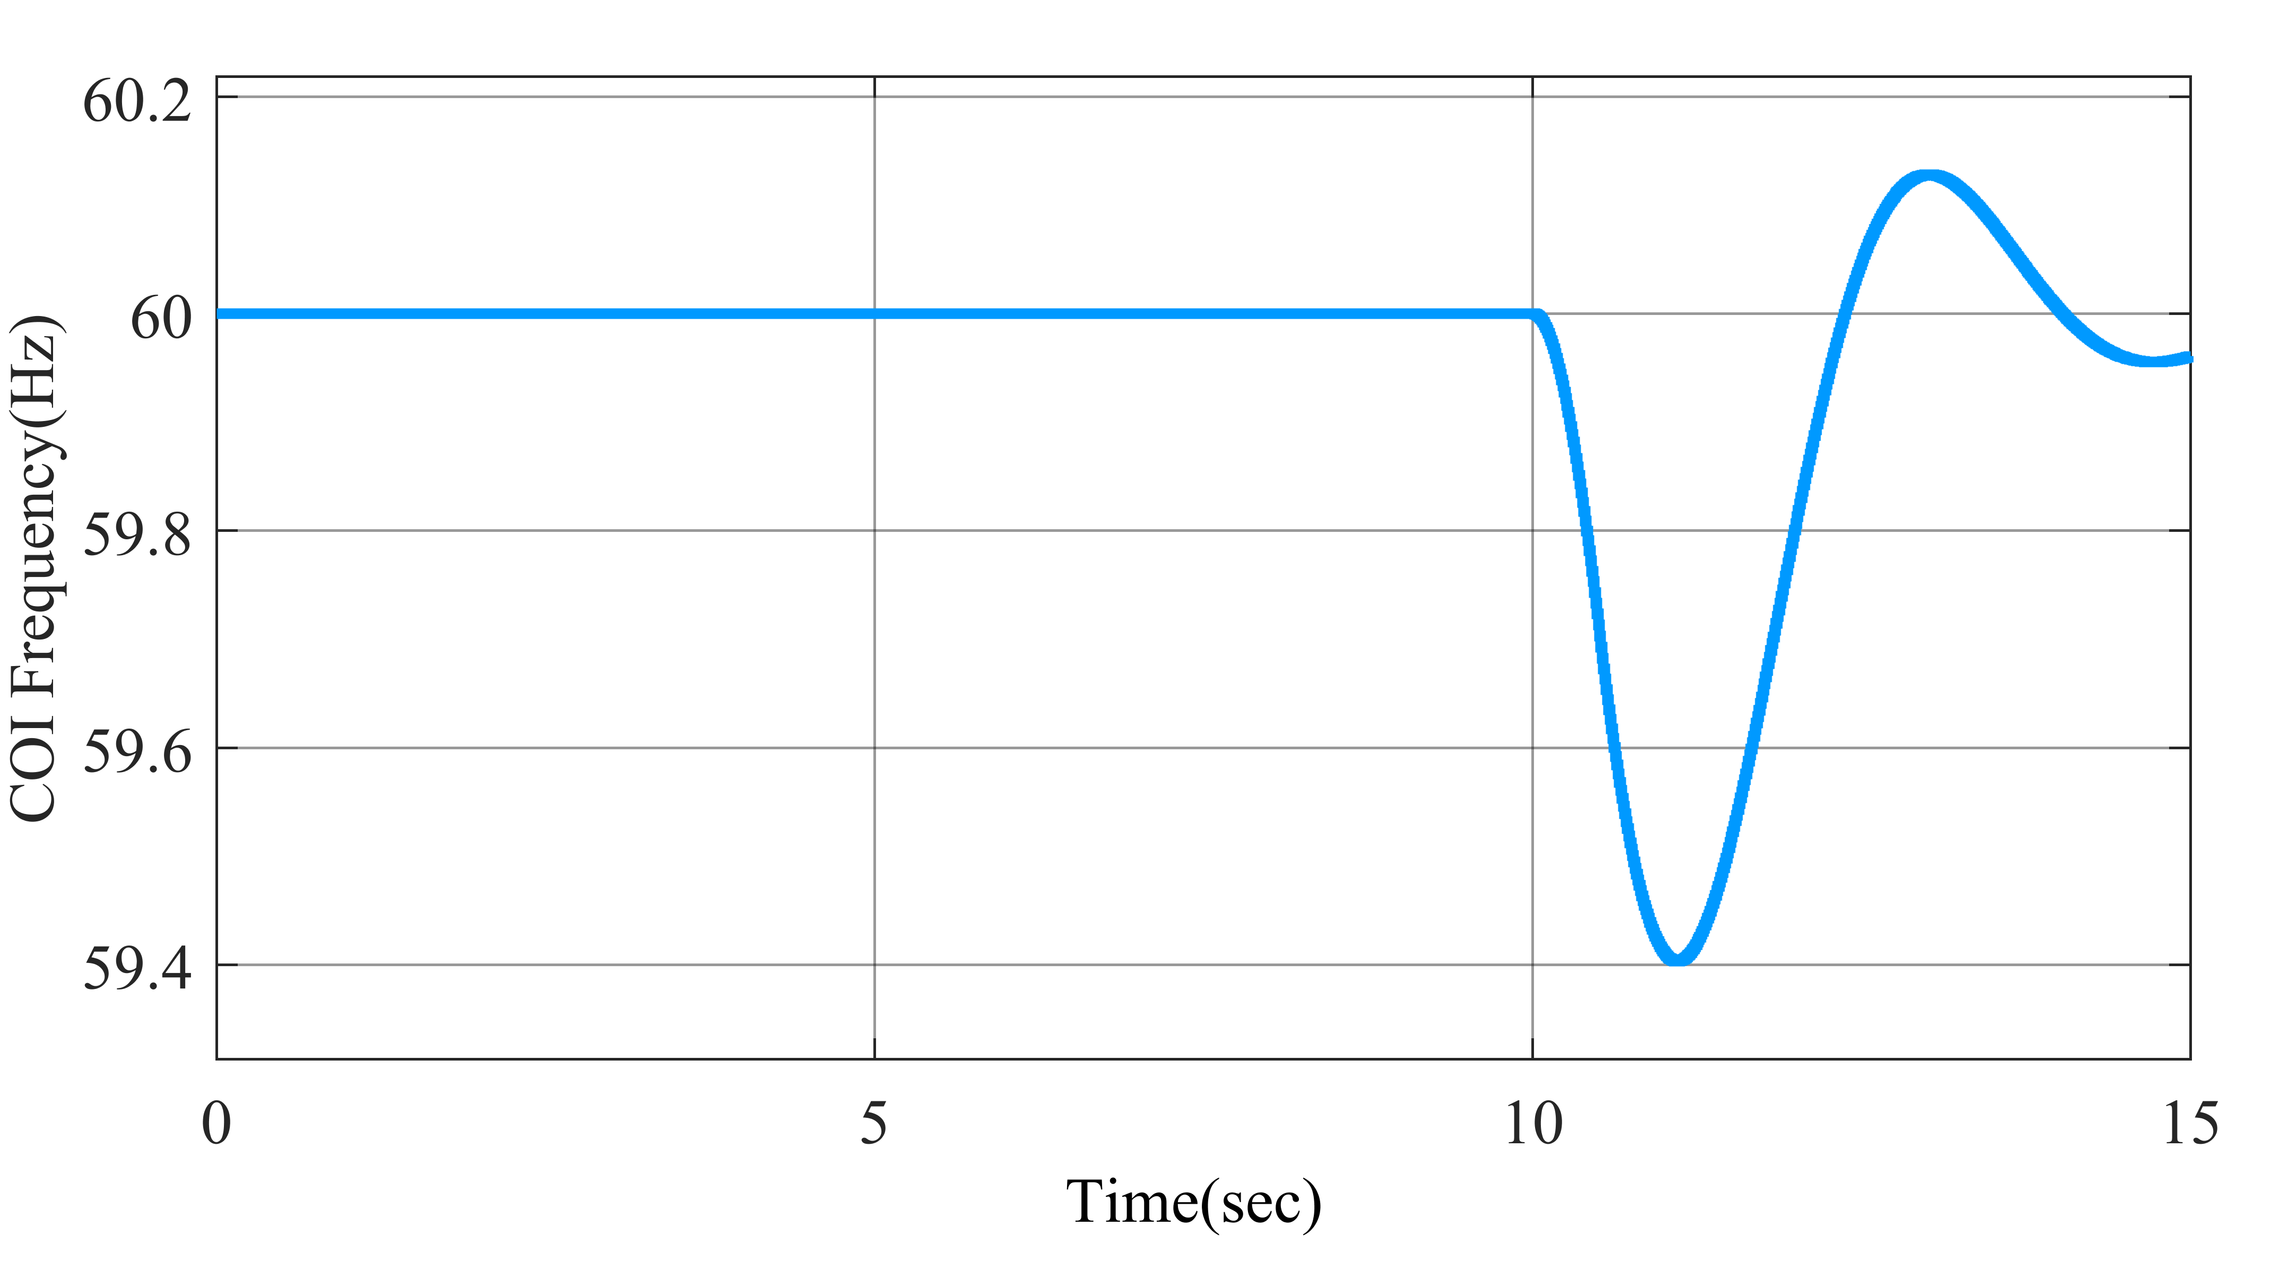
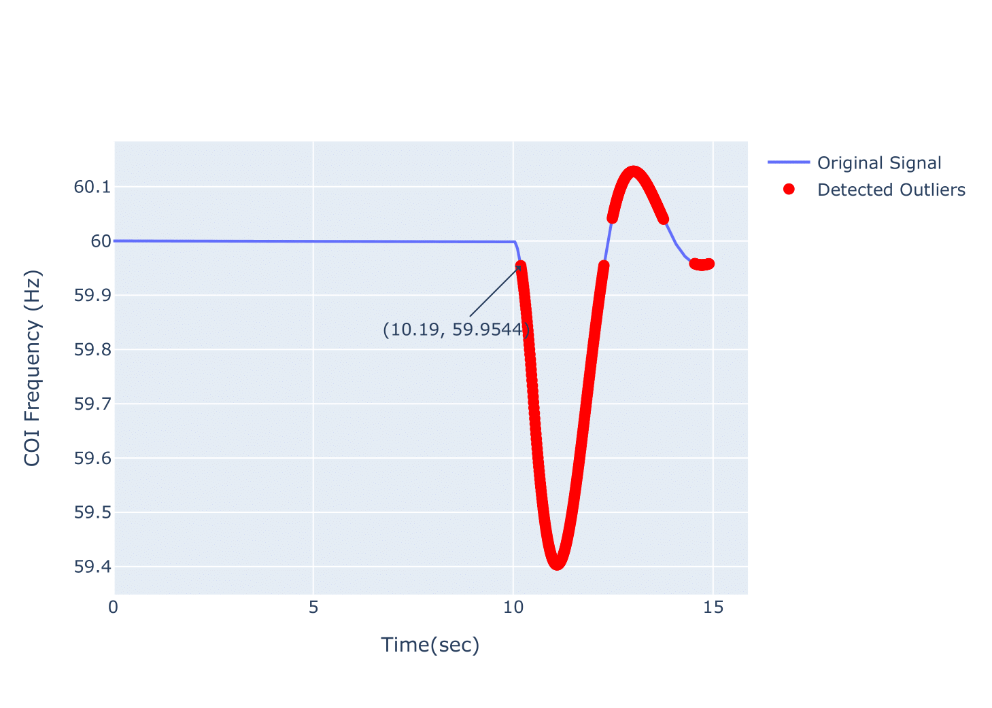


A step disturbance of 0.85pu at t=10 sec
COI frequency of system for step disturbance of 0.85pu
COI Frequency vs time plot with outliers marked as red when 0.85pu disturbance was applied for 500ms
Histogram of log likelihood values
Density plot of log likelihood values

Slide 21
Step Disturbance (pu) | Disturbance Duration (ms)
 | 100 | 200 | 300 | 400 | 500
0.35 | 10.33s | 10.3s | 10.28s | 10.24s | 10.24s
0.65 | 10.3s | 10.27s | 10.24s | 10.22s | 10.2s
0.85 | 10.28s | 10.25s | 10.23s | 10.21s | 10.19s
Table 1. Onset disturbances predicted when different disturbance were applied for different time duration
Step Disturbance (pu) | Disturbance Duration (ms)
 | 100 | 200 | 300 | 400 | 500
0.35 | 3.3% | 3% | 2.8% | 2.4% | 2.4%
0.65 | 3% | 2.7% | 2.4% | 2.2% | 2%
0.85 | 2.8% | 2.5% | 2.3% | 2.1% | 1.9%
Table 2. Percentage error between actual onset disturbance and predicted onset disturbance

Slide 22
CONCLUSION AND FUTURE WORK
Explored KDE for detecting disturbances in power systems, focusing on inertia estimation.
Successfully applied KDE to simulated data, identifying anomalies corresponding to disturbances.
Found that detection becomes easier with increased disturbance magnitude or duration.
Future works
Refine threshold selection process, possibly using domain knowledge or system-specific optimization.
Explore different kernel functions and bandwidth selection methods for improved accuracy.
Validate KDE-based anomaly detection on real-world data and integrate other ML techniques for enhanced performance.

Slide 23
REFERENCES
Measurement-Based Estimation of Inertia in AC Microgrids (IEEE TRANSACTIONS ON SUSTAINABLE ENERGY, VOL. 11, NO. 3, JULY 2020).
T. Inoue, H. Taniguchi, Y. Ikeguchi, and K. Yoshida, “Estimation of power system inertia constant and capacity of spinning-reserve support generators using measured frequency transients,” IEEE Trans. Power Syst., vol. 12, no. 1, pp. 136–143, Feb. 1997.
P. Wall and V. Terzija, “Simultaneous estimation of the time of disturbance and inertia in power systems,” IEEE Transactions on Power Delivery, vol. 29, no. 4, pp.2018–2031, 2014.
C. Heinz and B. Seeger, “Cluster kernels: Resource-aware kernel density estimators over streaming data,” IEEE Transactions on Knowledge and Data Engineering, vol. 20, no. 7, pp. 880–893, 2008.
D. W. Scott, Multivariate Density Estimation: Theory, Practice, and Visualization. Wiley, aug 1992.
B. W. Silverman, “Density estimation for statistics and data analysis,” 1986.

Slide 24
THANK YOU!!!

