Slide 1
DETECTION OF ONSET OF DISTURBANCE FOR INERTIA ESTIMATION USING MACHINE LEARNING
Presented By: Aditya Kumar (2001EE85)
Supervised By: Dr. S.K. Parida, SMIEEE (Associate Professor)

Slide 2
TABLE OF CONTENTS
Why is the detection of disturbances important in power systems for estimating inertia?
The old method: Fix Threshold Detection (Literature Review)
Our methodology: A Machine Learning approach to solve this problem
Data collection from Two-Area System (Transfer function model)
Exploration of a machine learning model
Conclusion and Future Work
References

Slide 3
IMPORTANCE OF DETECTING DISTURBANCES IN POWER SYSTEMS FOR ESTIMATING INERTIA
Inertia refers to the system's ability to resist changes in frequency.
When a disturbance occurs, like a sudden loss of generation or load change, the power balance is disrupted.
Accurate and early detection of disturbance is crucial for isolating the "inertial response" from the overall frequency response.
This isolation allows for a more precise estimation of synchronous inertia of the system using swing equation.

Slide 4
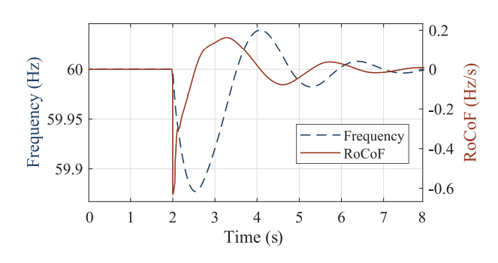
FIX THRESHOLD DETECTION METHOD (LITERATURE REVIEW)
In the paper, Measurement-Based Estimation of Inertia in AC Microgrids (IEEE TRANSACTIONS ON SUSTAINABLE ENERGY, VOL. 11, NO. 3, JULY 2020), the authors used a RoCoF threshold of 0.05 Hz/s to identify the exact starting time of the onset of disturbance.
A moving average filter of 50 ms was applied to the measured RoCoF value to minimize the effect of measurement errors or noise.
Any sample exceeding this threshold value was considered as disturbance.

Slide 5
FIX THRESHOLD DETECTION METHOD (DISADVANTAGES)
Requires careful selection of the threshold and window length, which can be challenging and system-dependent.
Inaccurate for small disturbances that may not exceed the threshold.
Very susceptible to PMU noise.
The method is not reliable for low inertia power systems.

Slide 6
OUR METHODOLOGY: A MACHINE LEARNING APPROACH

Slide 7
IMPLEMENTATION IDEA
Data Collection | Simulate a 2-area system and apply step disturbances of varying magnitudes. Collect disturbance signal, disturbance level, and center of inertia frequency (3 features).
Data Preprocessing | Preprocess the data for other purposes, such as scaling features or encoding categorical variables.
Model Selection | Choose an appropriate machine learning model for detecting the approximate time of a fault occurrence based on the dataset.
Hyperparameters Calculation | Calculate optimal values of hyperparameters involved in the chosen Machine Learning model.
Model Training | Train the selected model using the preprocessed dataset. Tune hyperparameters if necessary to improve model performance.
Anomaly Detection | Identify anomalies (disturbances) in the dataset using the chosen Machine Learning model.
Result Analysis | Analyze the results to determine the approximate time of fault occurrence based on the detected disturbances.

Slide 8
DATA COLLECTION: TWO AREA SYSTEM
A two-area system was simulated.
Step disturbance was applied for 0.5 seconds for each 20 secs simulation.
Disturbance magnitude varied from 0.1 to 1 pu i.e, 19 different signals.
Each signal contains 2000 samples, resulting in a total of 38,000 samples.
Three features are collected for each sample:
Disturbance Signal: Represents the step disturbance samples.
Center of Inertia Frequency: Samples of reference frequency representing the system's inertia.
Disturbance Magnitude: Magnitude of the applied disturbance.

Slide 9
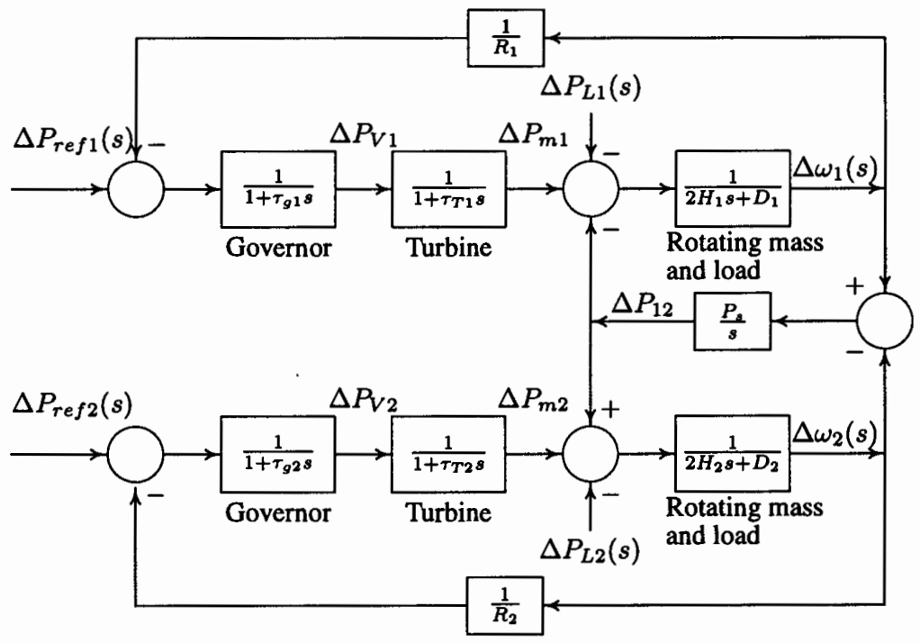
Transfer function model of a two area system

Slide 10
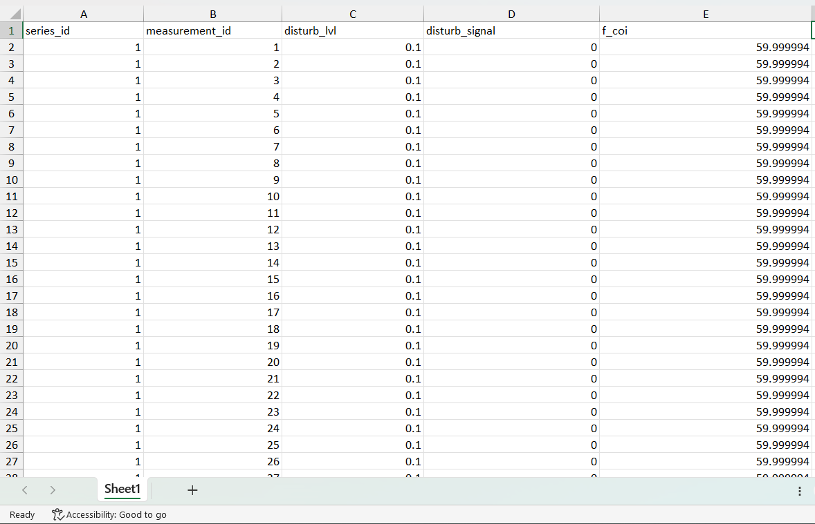
Snapshot of the collected dataset

Slide 11
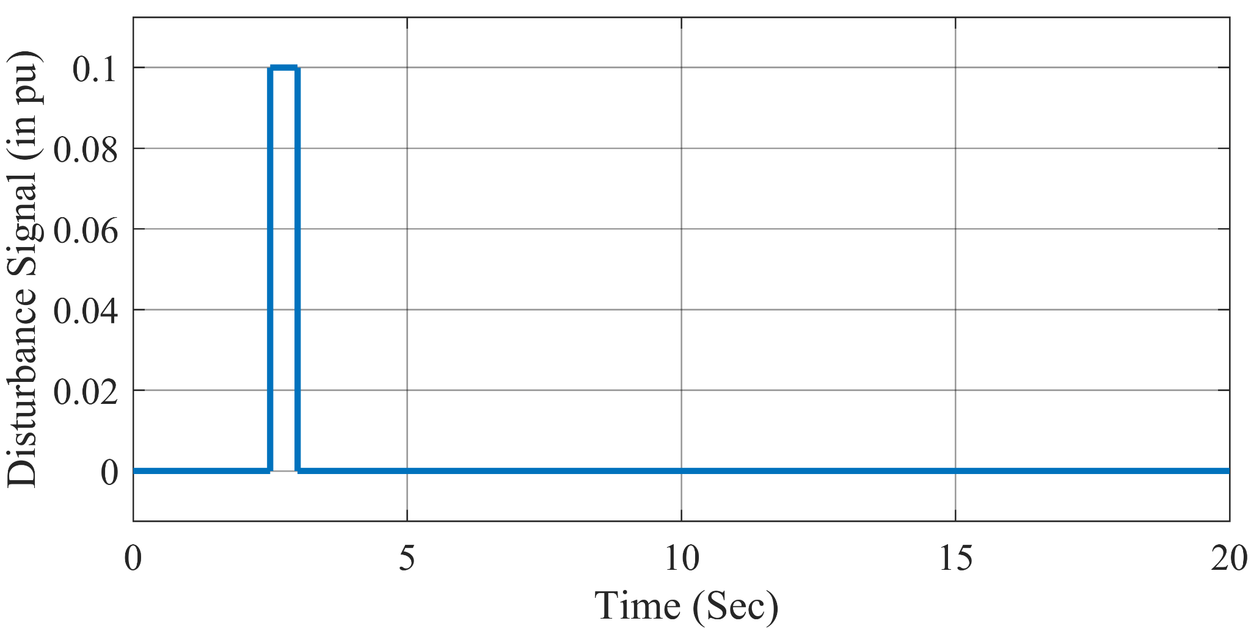
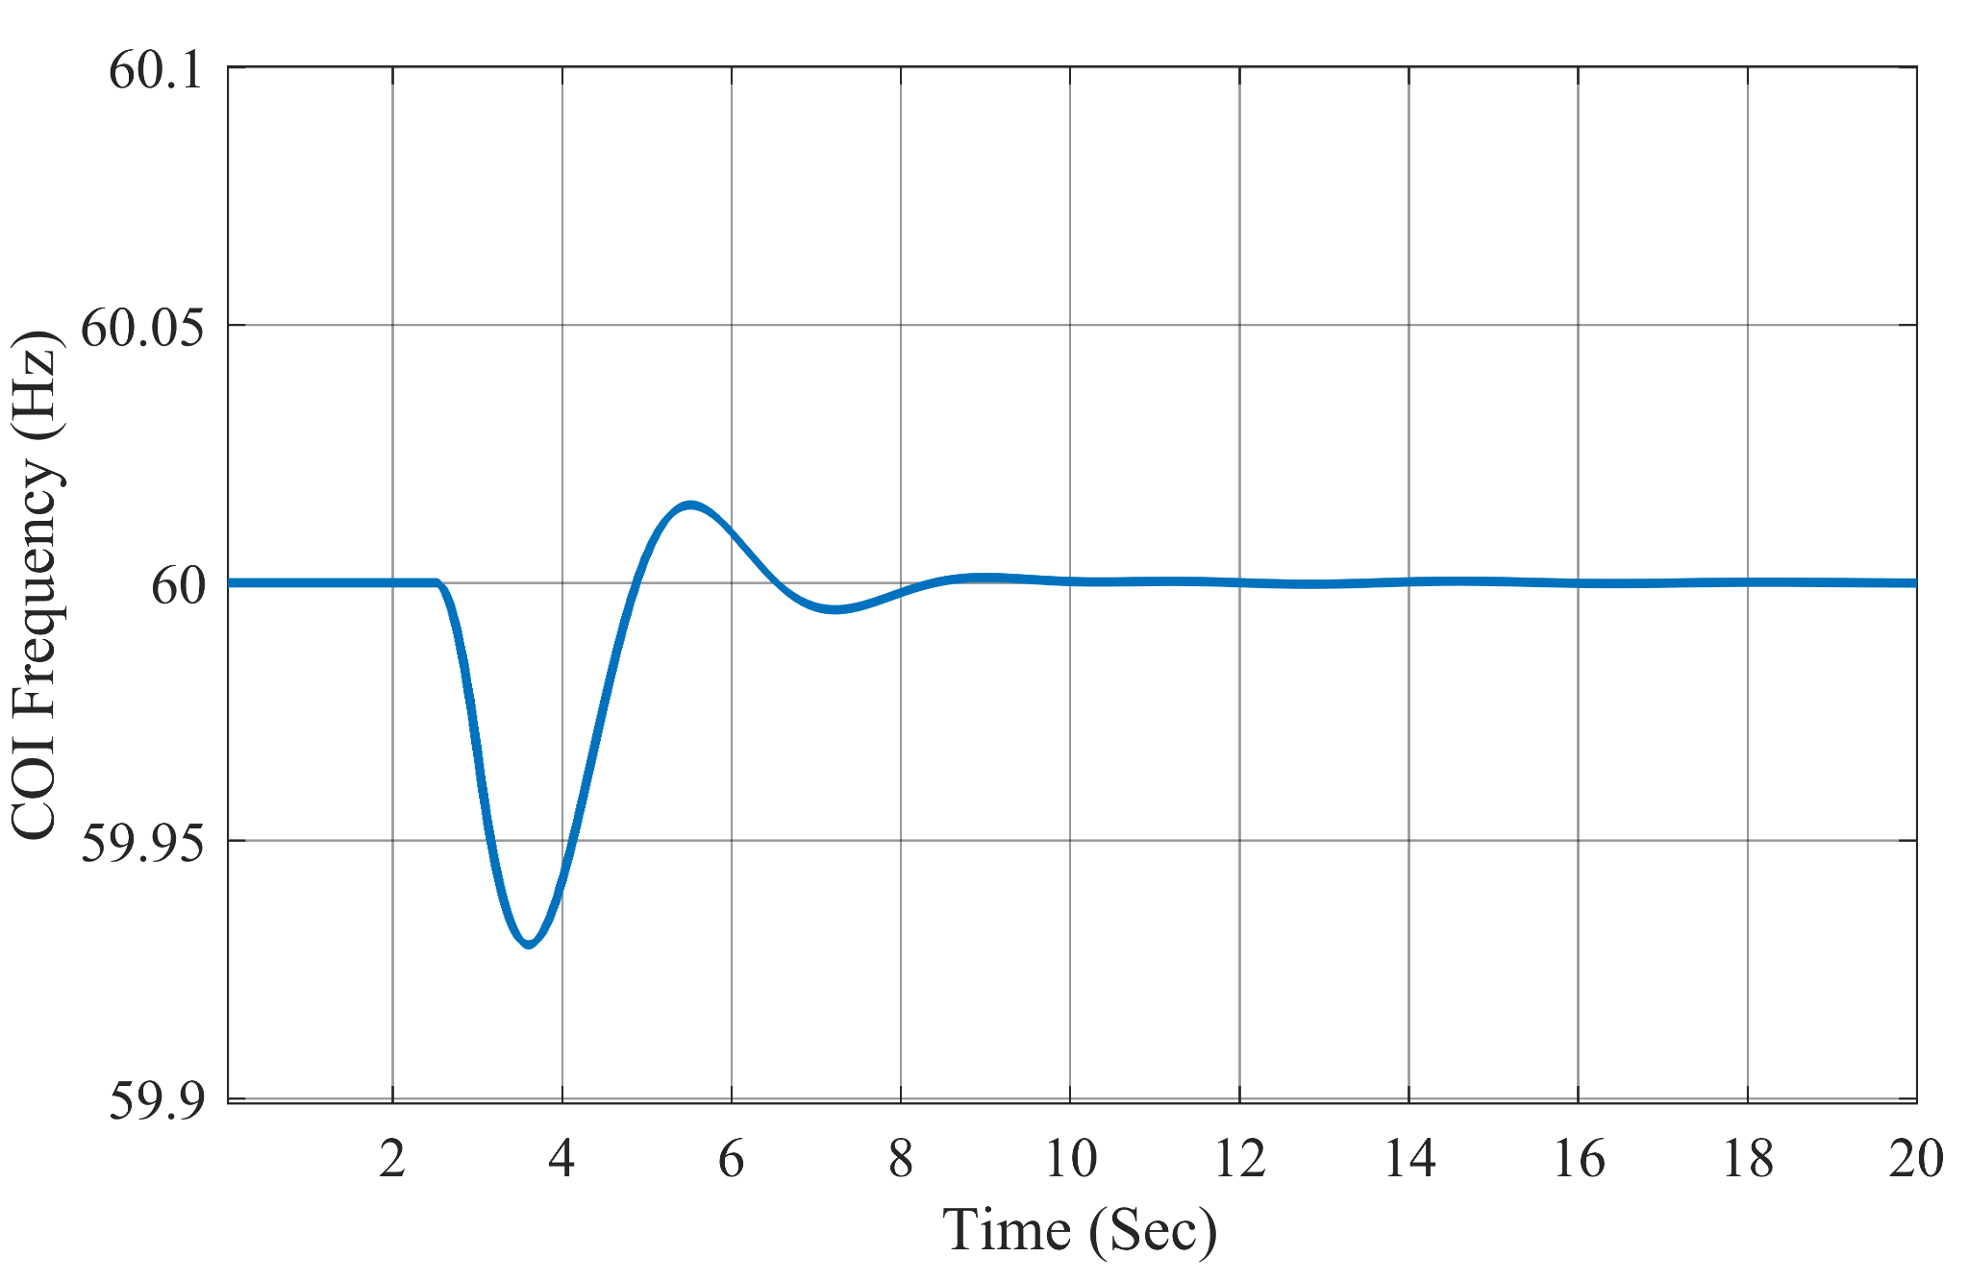
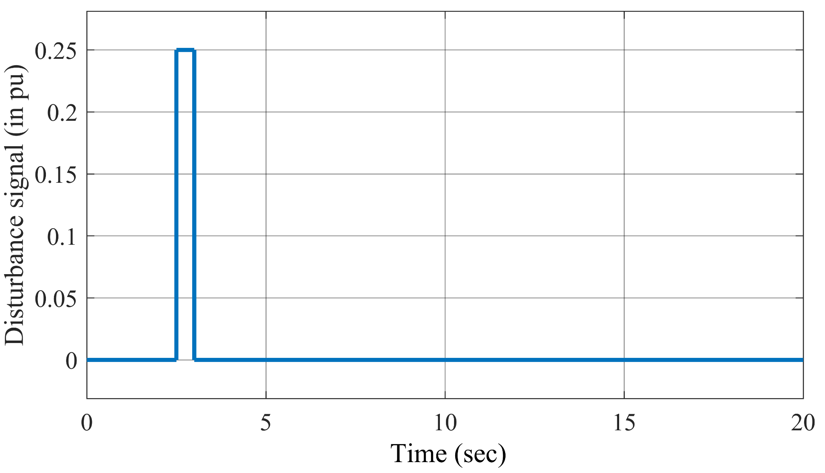
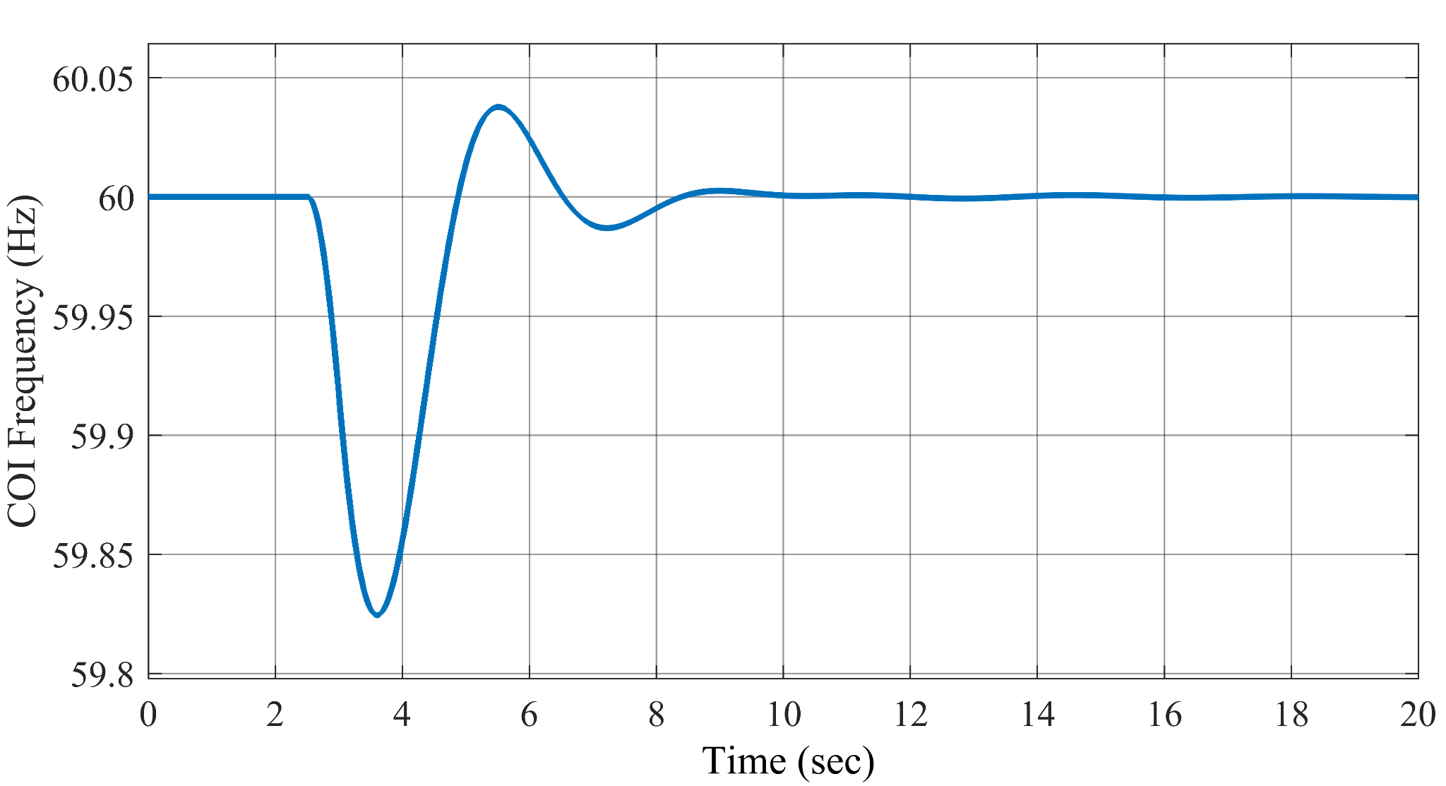
A step disturbance of 0.1pu at t=2.5sec
COI frequency of system for step disturbance of 0.1pu
A step disturbance of 0.25pu at t=2.5sec
COI frequency of system for step disturbance of 0.25pu

Slide 12
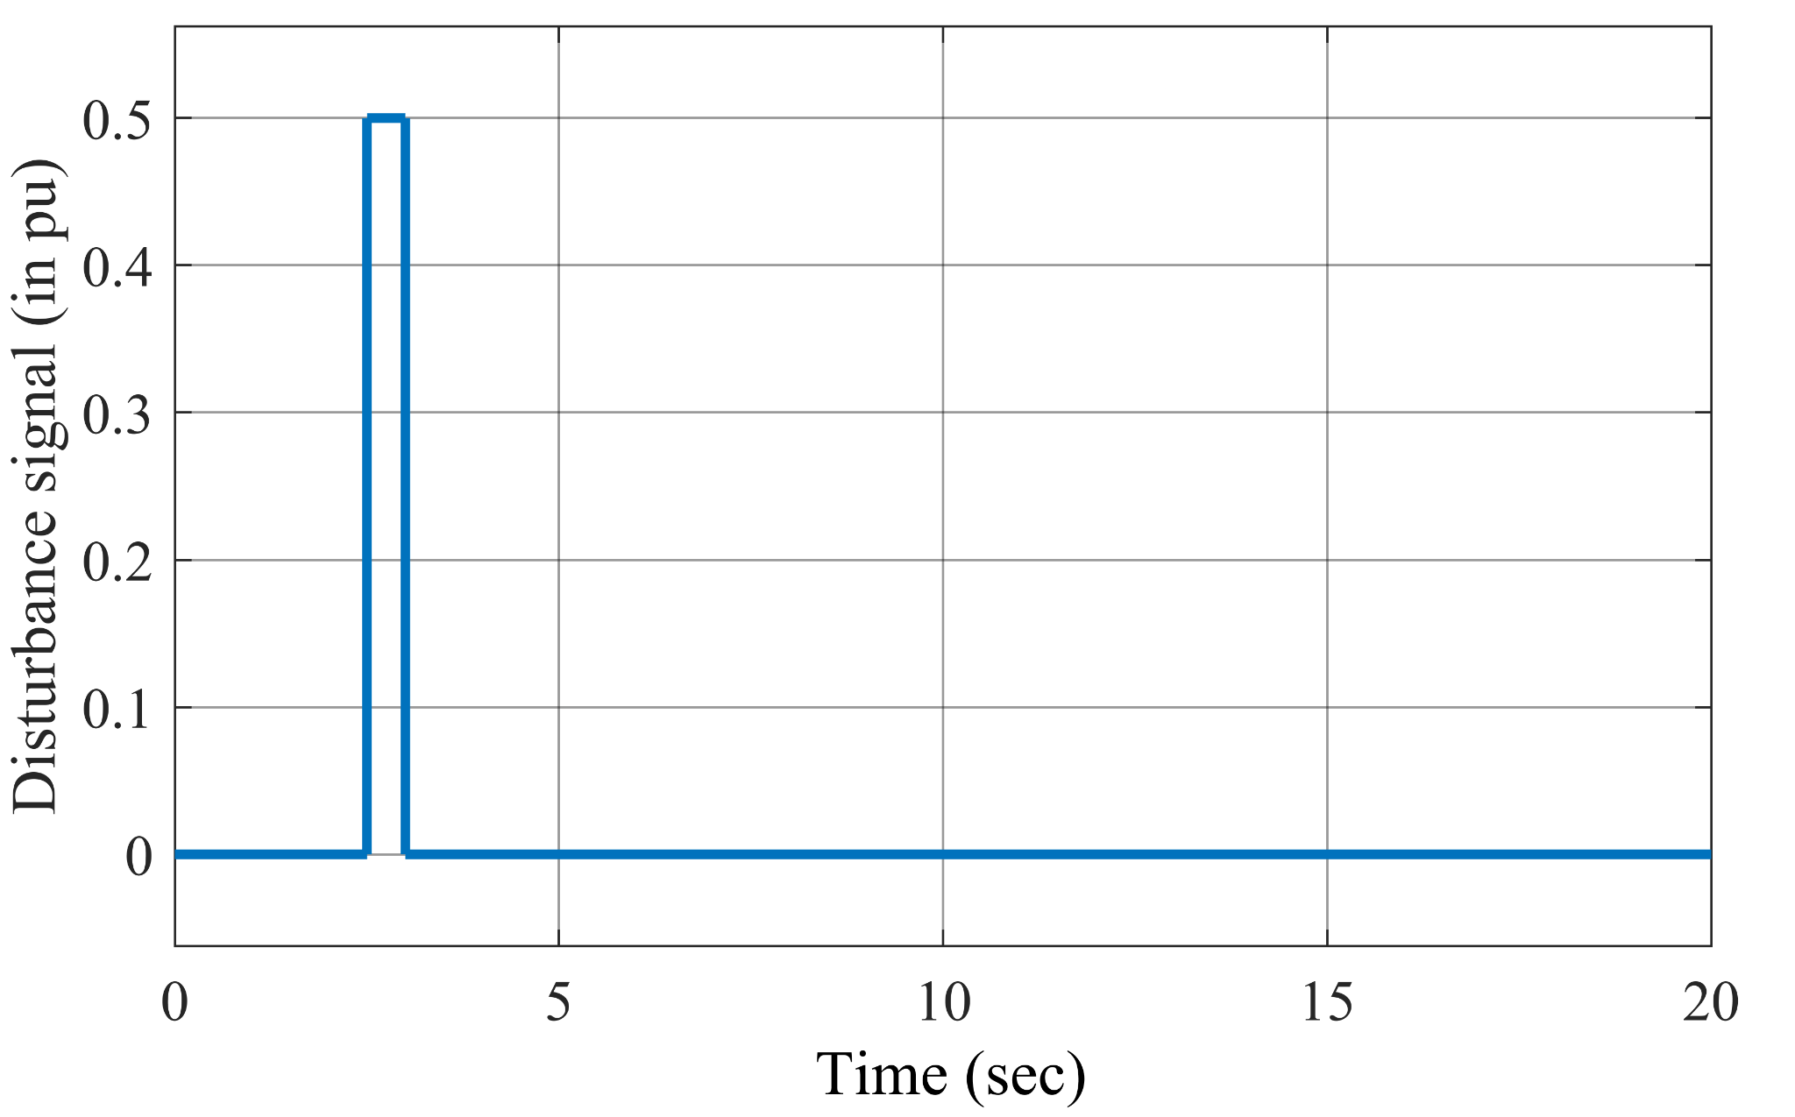
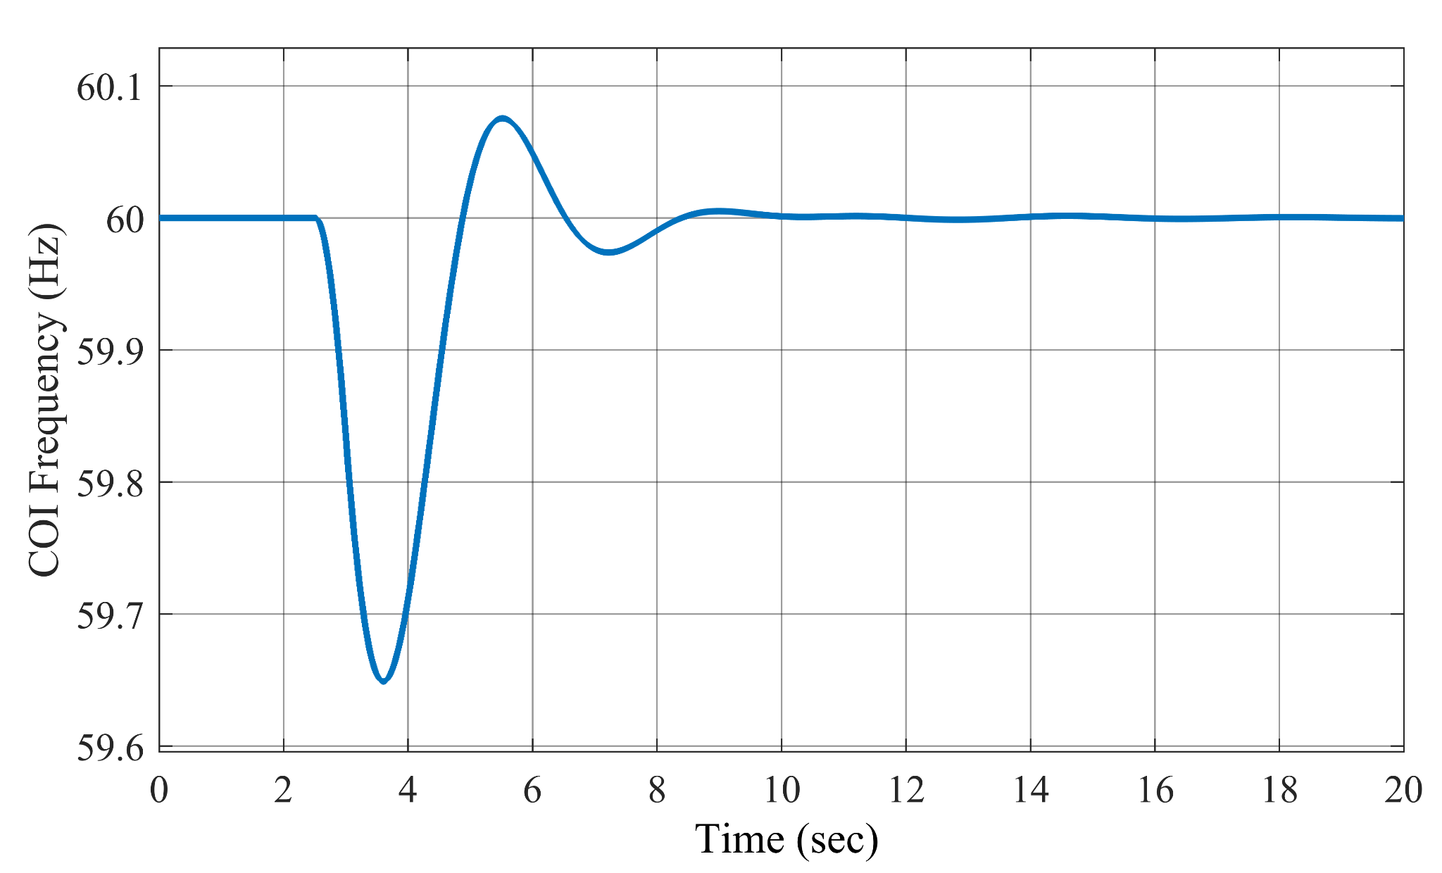
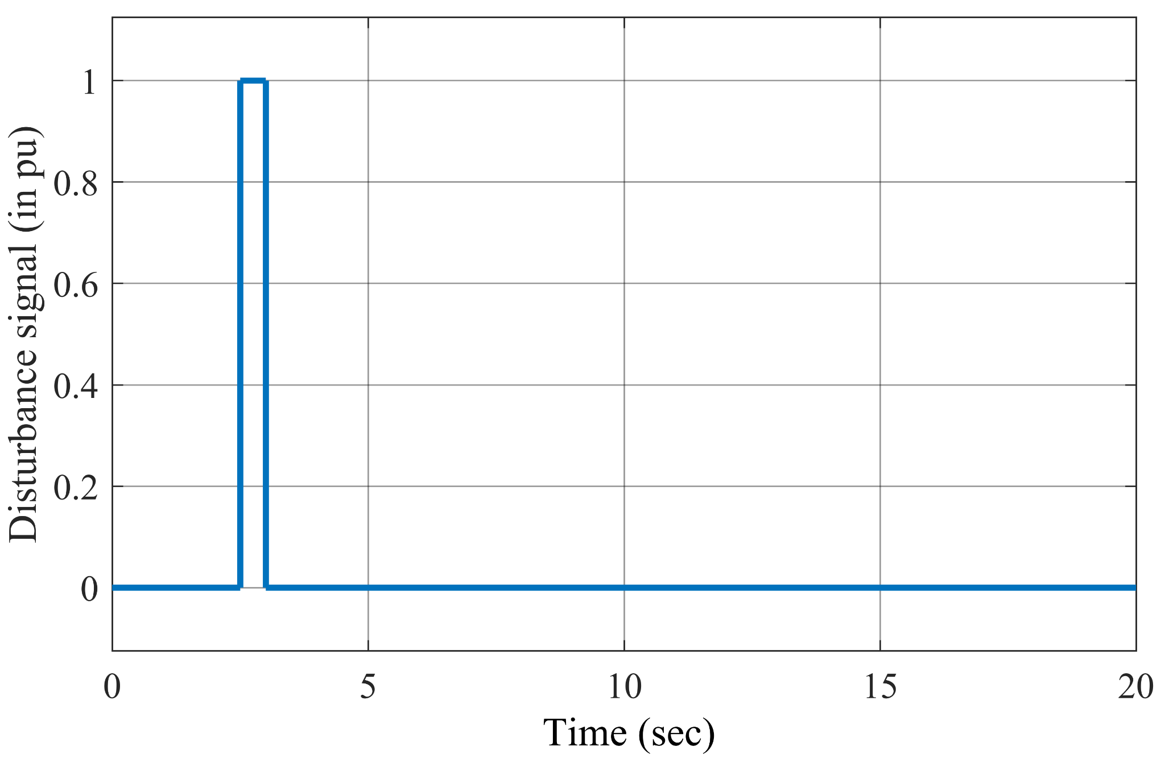
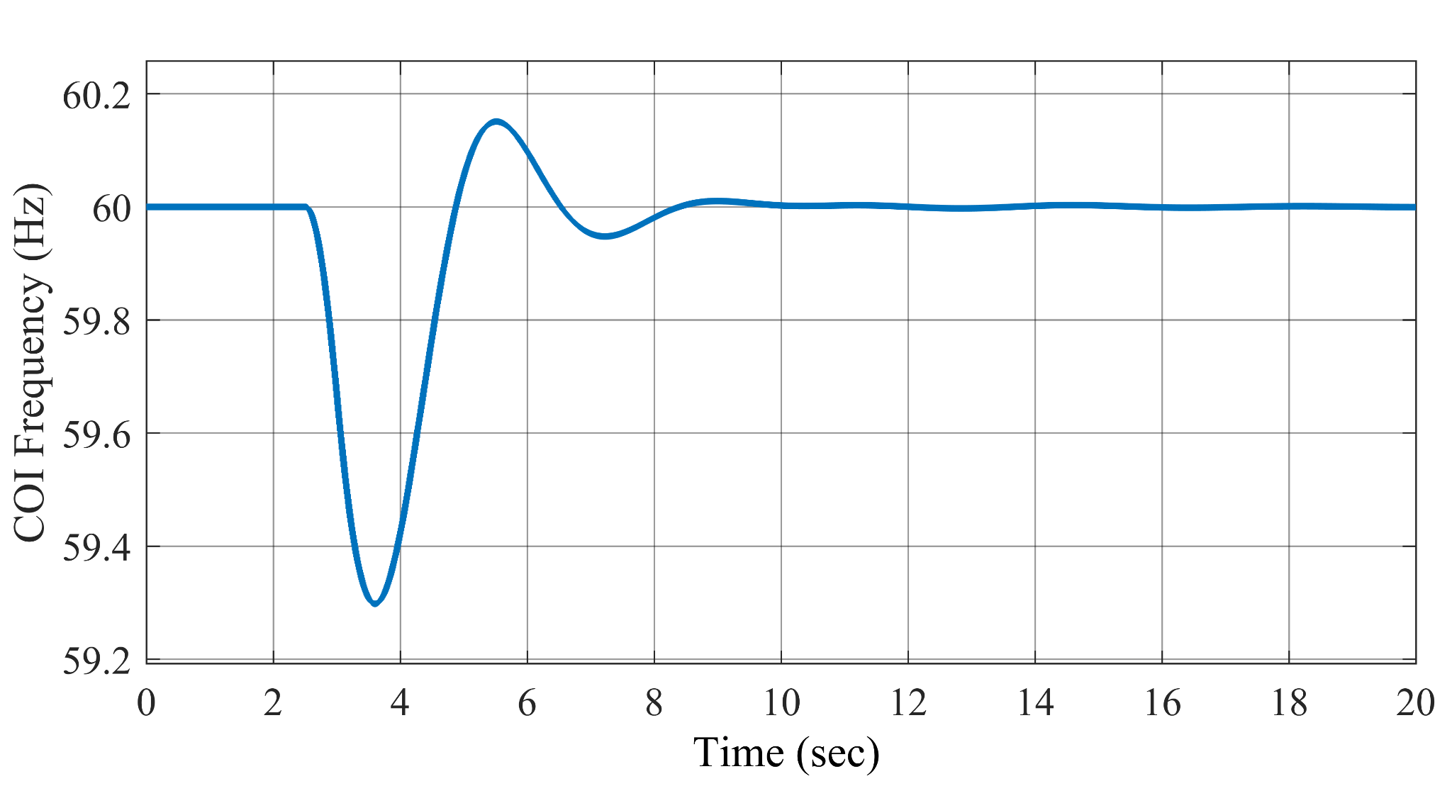
A step disturbance of 0.5pu at t=2.5sec
COI frequency of system for step disturbance of 0.5pu
A step disturbance of 1pu at t=2.5sec
COI frequency of system for step disturbance of 1pu

Slide 13
CHOOSING THE MODEL AND ITS HYPERPARAMETERS

Slide 14
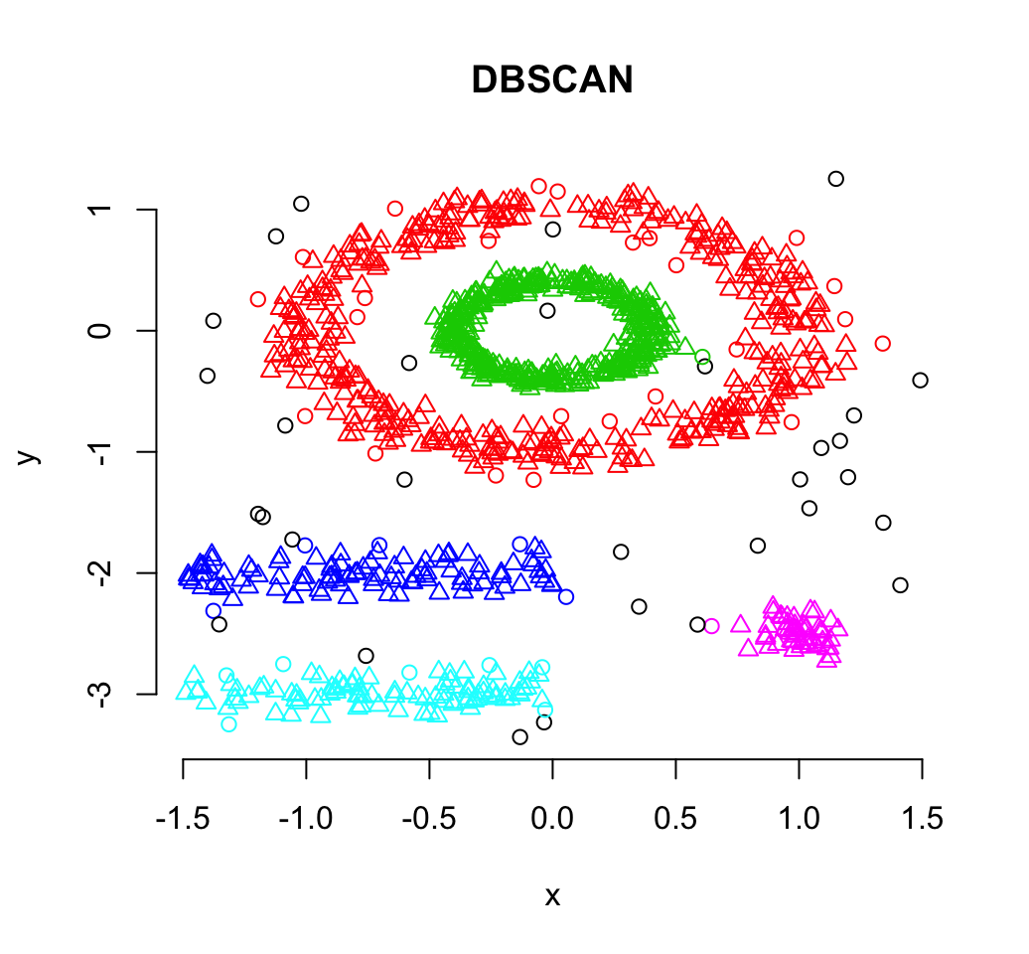
Density-Based Spatial Clustering of Applications with Noise (DBSCAN)
DBSCAN is a data clustering algorithm proposed by Martin Ester, Hans-Peter Kriegel, Jörg Sander and Xiaowei Xu.
It is a density-based clustering algorithm: given a set of points in some space, it groups together points that are closely packed together, marking as outliers points that lie alone in low-density regions.
Key Hyperparameters: -
epsilon (ε): defines the maximum distance between two points to be considered neighbors.
minpts (minimum points): defines the minimum number of points required within the ε-neighborhood of a point to consider it a core point.

Slide 15
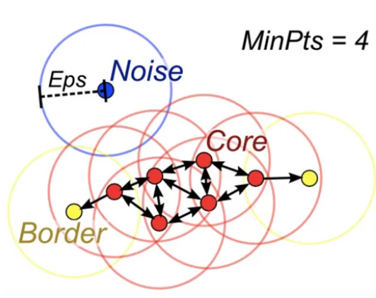
MORE ABOUT DBSCAN
For the purpose of DBSCAN clustering, the points are classified as core points, border points and noise(outliers), as follows:
Core Points: These are points that have at least a minimum number of points (minPts) within a specific radius (ε) of them. These points are considered to be dense areas and form the core of the clusters.
Border Points: These are points that are reachable from a core point but have fewer than minPts points within their ε-neighborhood. They lie on the edges of the clusters.
Noise(outliers): These are points that are not core points and are not reachable from any core point. They are considered to be outliers or isolated points.

Slide 16
DBSCAN ADVANTAGES AND HOW IT WILL HELP IN ONSET DETECTION ?
Unlike k-means clustering, for DBSCAN number of clusters need not be specified.
In case of k-means, problems arises as anomalous points will be assigned to the same cluster as “normal” data points.
Density Estimation: It calculates the distance between each data point and its neighboring points. If the distance is less than a specified threshold (epsilon), the point is considered part of a cluster.
Cluster Formation: Points that are within epsilon distance of each other are grouped into the same cluster.
Outlier Detection: Points not within epsilon distance of any other point are considered disturbances.
Pinpointing Disturbance Time: By identifying clusters associated with deviations, it essentially isolates the time period when those deviations occurred helping in pinpointing the exact time of a disturbance within the data.

Slide 17
CONCLUSION AND FUTURE WORK
Data Collection: Collected simulated data from a 2-area system, comprising 19 signals with 2000 samples each, including disturbance signals, center of inertia frequency, and disturbance magnitude.
Model Exploration: Explored Density-Based Spatial Clustering of Applications with Noise (DBSCAN).
Future Works:
Calculation and optimization of hyperparameters involved in DBSCAN.
Implementation of the DBSCAN for the detection of onset of disturbance.
Explore and implement other clustering algorithms like HDBSCAN and OPTICS.
Expand dataset with additional features to enhance model performance.

Slide 18
REFERENCES
Measurement-Based Estimation of Inertia in AC Microgrids (IEEE TRANSACTIONS ON SUSTAINABLE ENERGY, VOL. 11, NO. 3, JULY 2020)
T. Inoue, H. Taniguchi, Y. Ikeguchi, and K. Yoshida, “Estimation of power system inertia constant and capacity of spinning-reserve support generators using measured frequency transients,” IEEE Trans. Power Syst., vol. 12, no. 1, pp. 136–143, Feb. 1997.
Schubert E, Sander J, Ester M, Kriegel H P, Xu X. DBSCAN revisited, revisited: why and how you should (still) use DBSCAN. ACM Transactions on Database Systems, 2017, 42(3): 19

Slide 19
THANK YOU!!!

