Slide 1
CLASSIFICATION OF SHORT CIRCUIT FAULTS IN MODERN POWER SYSTEM USING MACHINE LEARNING
Presented By: Aditya Kumar (2001EE85)
Supervised By: Dr. S.K. Parida, SMIEEE (Associate Professor)

Slide 2
TABLE OF CONTENTS
Importance of Fault classification
Literature Review
Methodology
Simulation of Two Area Kundur System for Data Collection
Manipulation of generated data
Choosing the model and its hyperparameters
Prediction and Evaluation of the Model
Confusion Matrix and the Line Plot
Conclusion and Future Work

Slide 3
Why do we need to classify faults?
Minimize Downtime: Swift fault classification enables quick response and reduces downtime, ensuring continuous power supply.
Enhance Safety: Accurate fault identification enhances safety for both equipment and personnel within the power system.
Optimize Maintenance: Proactive fault classification supports targeted and cost-effective maintenance strategies, extending equipment lifespan.
Improve Customer Satisfaction: Rapid fault resolution leads to quicker power restoration, contributing to higher customer satisfaction.
Reduce Financial Losses: Timely fault identification minimizes financial losses associated with power outages and costly repairs.
Enable Predictive Analytics: Fault data supports advanced technologies like predictive analytics, contributing to smarter grid management.

Slide 4
LITERATURE REVIEW

Slide 5
Paper Name | Publication | Methodology | Research Gap
Fault Detection and Classification in Power System Using Artificial Neural Network. | 2nd International Conference on Intelligent Technologies (CONIT)’22 | Uses 2 ANN, one for detection and one for classification.The detection and classification are done with the help of bus voltages, currents, zero sequence components of current and voltage, used as input to the neural network to train the ANN. | They can reach better results by increasing the number of buses, creating more fault locations, and finding exact locations of fault. ANN models tends to overfit as the size of data increases which is particularly the case with practical power system.
Fault Detection and Classification in Power Transmission Lines using BPNN. | 2020 International Conference on Smart Electronics and Communication (ICOSEC) | Uses BPNN model with Levenberg-Marquardt algorithm for fault detection and classification. | The study is done on a small 3-phase transmission line for only A-G and A-B-G type faults.

Slide 6
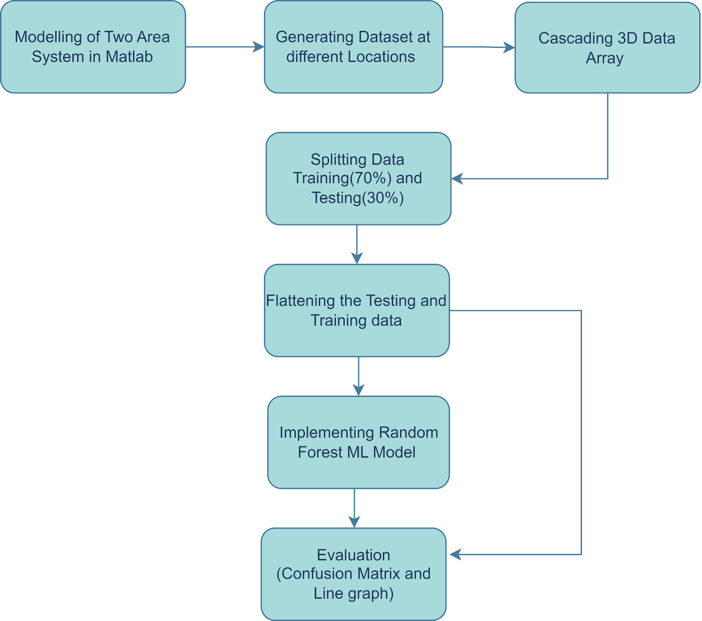
METHODOLOGY

Slide 7
DATA COLLECTION USING KUNDUR TWO AREA SYSTEM

Slide 8
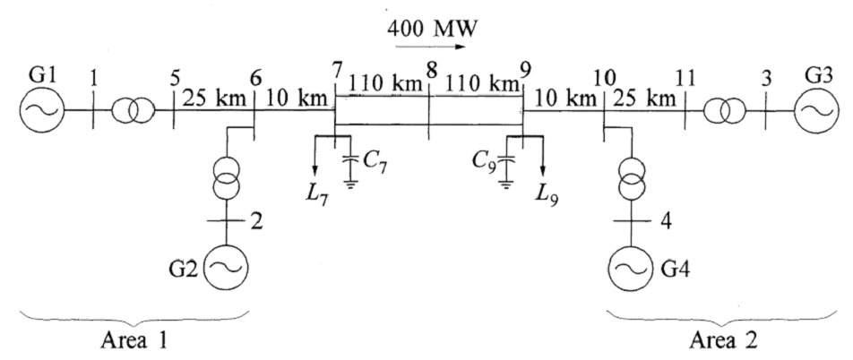
SINGLE DIAGRAM OF KUNDUR TWO AREA SYSTEM

Slide 9
MANIPULATION OF THE GENERATED DATASET
A three-dimensional array was generated by grouping the data set based on the Series_ID.
This resulting 3D array was subsequently partitioned into training and testing data sets, maintaining a ratio of 70:30.
The dimensions of these arrays are delineated as the total number of Series_IDs, the number of samples within one signal, and the number of features.
The process of flattening the 3D arrays training and testing data involves reshaping them by applying a flattening operation.
This operation is carried out by multiplying the number of samples within an individual signal by the total number of features present in that particular signal.
The reshaping ensures structural integrity while converting the data to a two-dimensional format, facilitating compatibility with subsequent processing steps.

Slide 10
CHOOSING THE MODEL AND ITS HYPERPARAMETERS

Slide 11
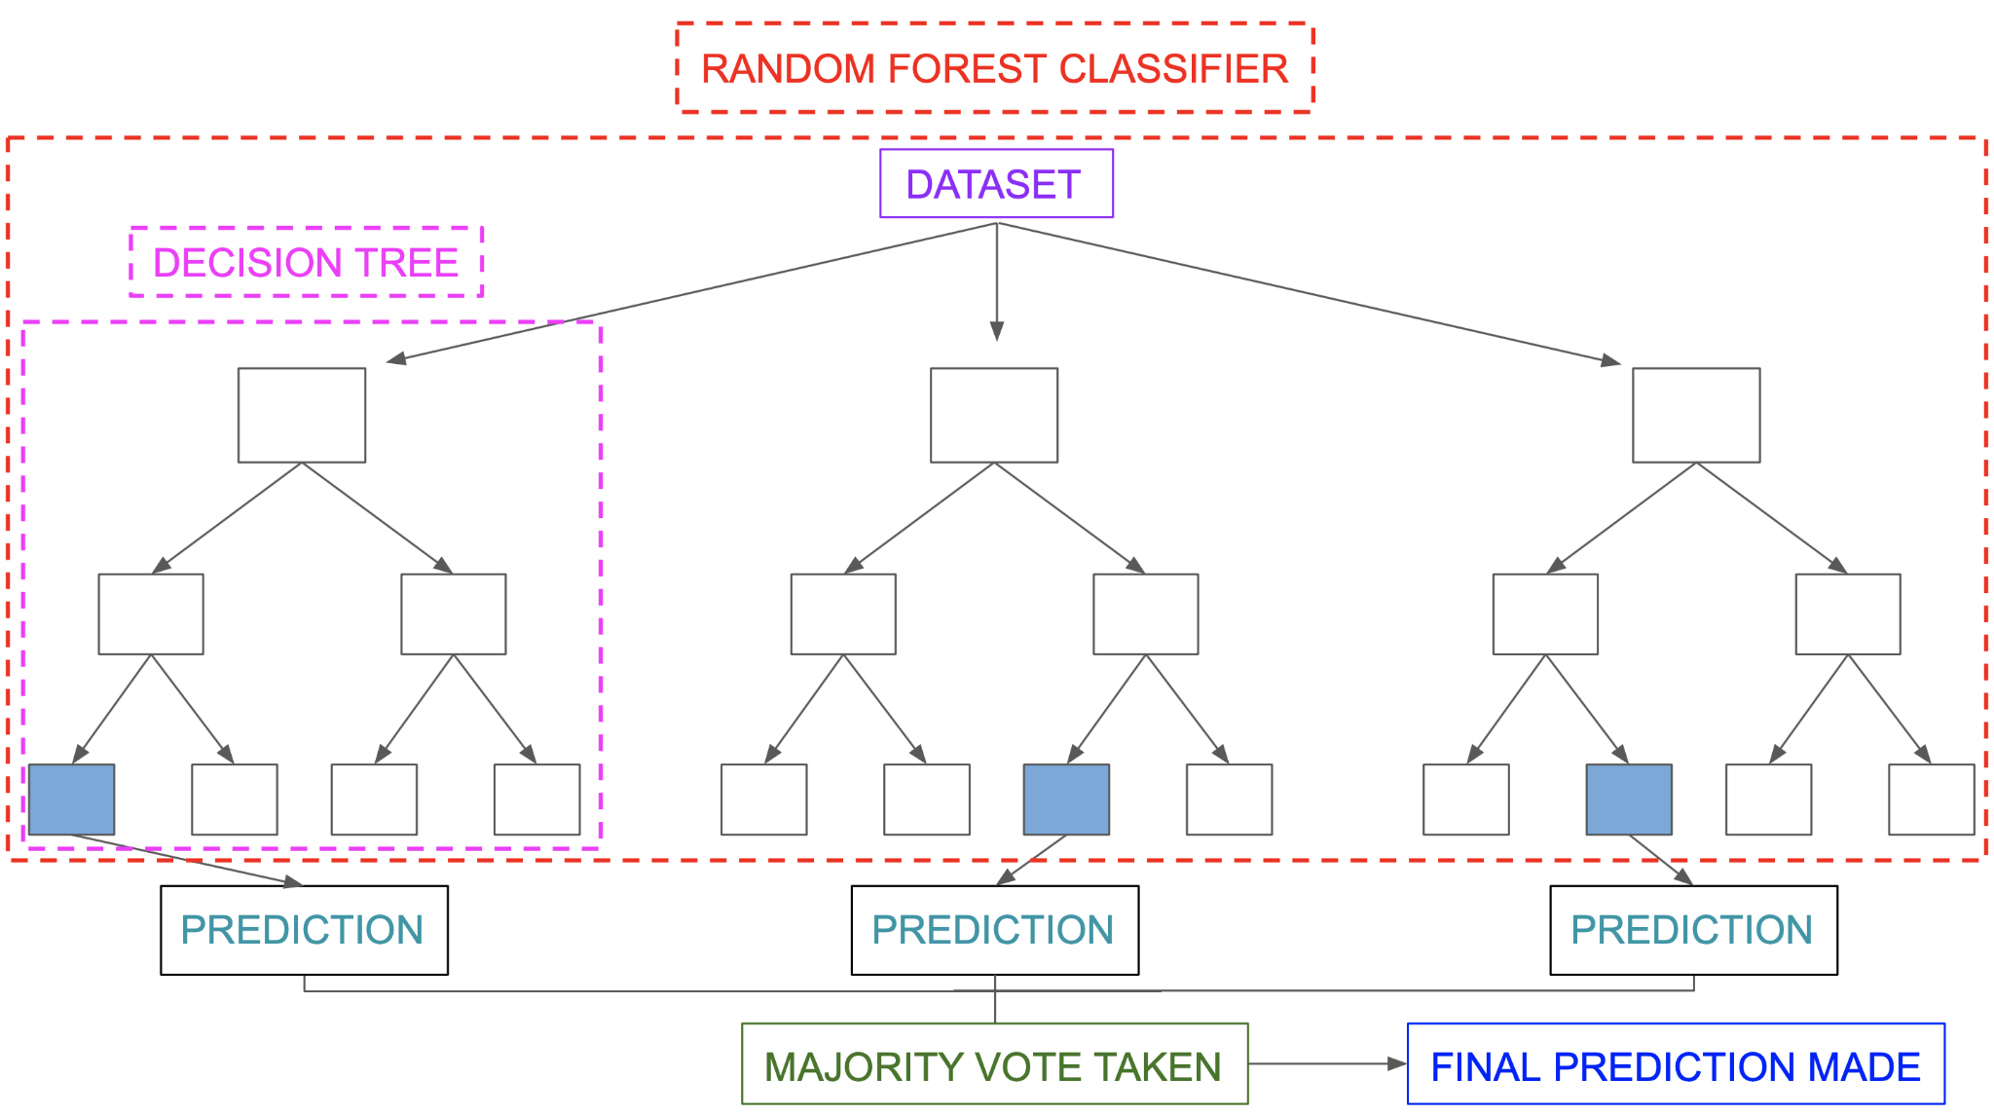
RANDOM FOREST CLASSIFIER AND ITS HYPERPARAMETERS
Random Forest is an ensemble learning algorithm widely used for both classification and regression tasks in machine learning. It operates by constructing a multitude of decision trees during training and outputting the mode (for classification) or mean prediction (for regression) of the individual trees.
Key hyperparameters of a random forest classifier: -
Number of Trees (n_estimators): Determines the total number of decision trees in the forest. For our model, we have chosen 500 decision trees.
Tree Depth (max_depth): Governs the maximum depth of each decision tree. For our model, we have use max_depth as 10.
Minimum Samples Split (min_samples_split): Specifies the minimum samples needed to split an internal node. For our model, we have use min_samples_split as 5.
Minimum Samples Leaf (min_samples_leaf): Sets the minimum samples for a leaf node. For our model, we have use min_samples_leaf as 2.
Maximum Features (max_features): Limits the number of features considered for each split. For our model, we have use max_features as log2.

Slide 12
ADVANTAGES OF RANDOM FOREST CLASSIFIER
Robust to Overfitting: Random Forest is less prone to overfitting compared to individual decision trees.
Handle Large Feature sets: Effective in handling a large number of features, which is advantageous for power system fault classification where multiple parameters may influence the outcomes.
Reduced sensitivity to hyperparameters: Hyperparameters can be easily tuned leading to reduction in sensitivity of hyperparameters.
Ensemble Learning for Improved Accuracy: Utilizes ensemble learning by combining multiple decision trees, leading to improved accuracy and reliability.
Versatility in Data types: Provides flexibility as it can accommodates both numerical and categorical data.

Slide 13
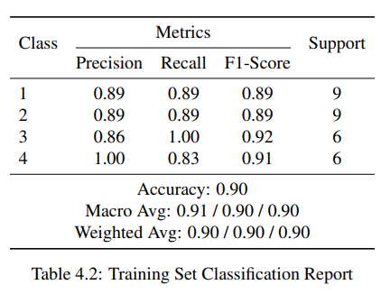
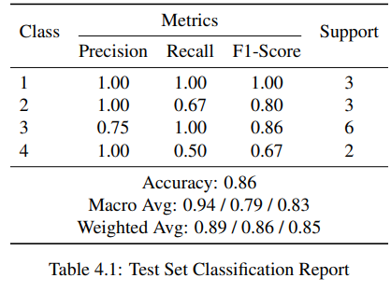
PREDICTION AND EVALUATION OF THE MODEL

Slide 14
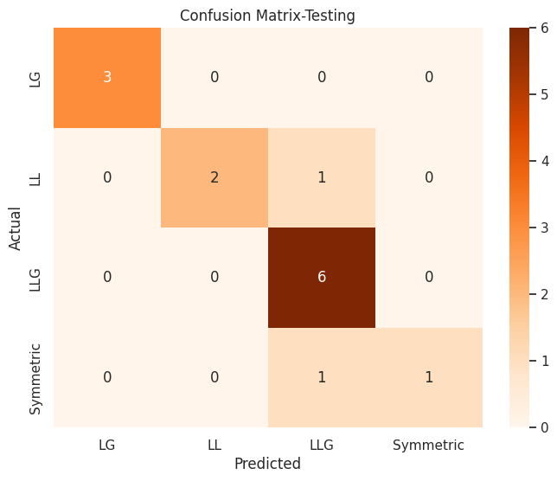
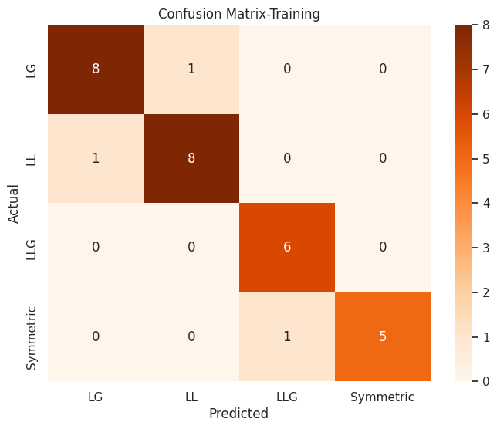
CONFUSION MATRIX AND LINE PLOT

Slide 15
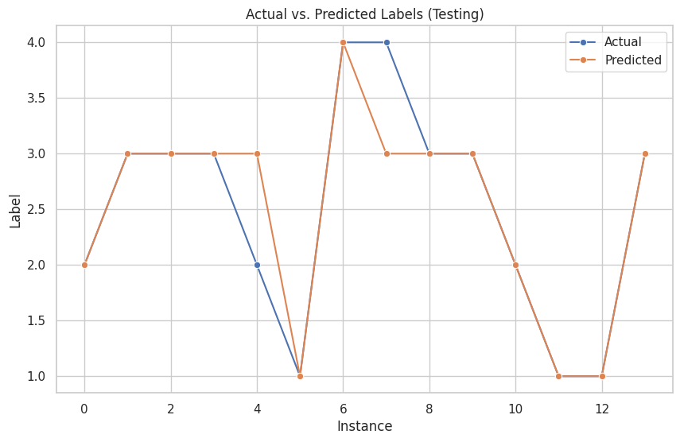
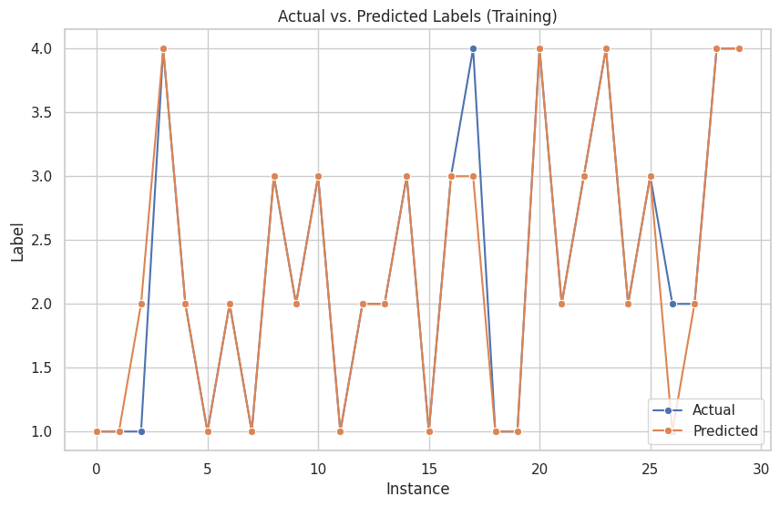
CONFUSION MATRIX AND LINE PLOT

Slide 16
CONCLUSION AND FUTURE WORK
A two area system was simulated to generate data set containing voltages and currents at different locations.
The dataset was grouped based on Series_ID to obtain a 3D array which was split into training and testing before flattening it to reduce its dimension.
The training data was feed to the random forest classifier model to train it then model was run on testing data yielding an accuracy of 86% and training accuracy of 90%.
As of future works, we will work upon improving the accuracy by extracting sequence currents from every location as well.
Source location of the fault will also be done in future.
Instead of 11 Bus system, we may use a 32 bus system as well.

Slide 17
REFERENCES
S. M. Chopdar and A. K. Koshti, "Fault Detection and Classification in Power System Using Artificial Neural Network," 2022 2nd International Conference on Intelligent Technologies (CONIT), Hubli, India, 2022, pp. 1-6, doi: 10.1109/CONIT55038.2022.9848016.
O. N. Teja, M. S. Ramakrishna, G. B. Bhavana and K. Sireesha, "Fault Detection and Classification in Power Transmission Lines using Back Propagation Neural Networks," 2020 International Conference on Smart Electronics and Communication (ICOSEC), Trichy, India, 2020, pp. 1150-1156, doi: 10.1109/ICOSEC49089.2020.9215253.

Slide 18
THANK YOU!!!

