Slide 1

DETECTION, CLASSIFICATION AND IDENTIFYING SOURCE LOCATION OF SHORT CIRCUIT FAULTS IN MODERN POWER SYSTEMS USING MACHINE LEARNING
DETECTION, CLASSIFICATION AND IDENTIFYING SOURCE LOCATION OF SHORT CIRCUIT FAULTS IN MODERN POWER SYSTEMS USING MACHINE LEARNING
Department of Electrical Engineering
Indian Institute of Technology Patna
Supervised by: Dr. S.K. Parida, SMIEEE
(Associate Professor)
Presented by: Adarsh Pandey (B.Tech, 2001EE84) Aditya Kumar (B.Tech, 2001EE85)

Slide 2
TABLE OF CONTENTS
Introduction
Literature Review
Methodology Overview
Data Set Collection from Kundur Two Area System
Different Locations
Different Faults
Different instant
Feature Extraction and Feature Selection
Classification
Future Work
Accuracy with Different Algorithms
Model Validation on IEEE 39 Bus system

Slide 3
INTRODUCTION
The Importance of Fault Management
Electrical power systems are essential for modern society but are susceptible to faults and disturbances.
Faults can jeopardize safety, system reliability, and service continuity.
Ensuring Continuity and Safety
Faults, if unaddressed, can disrupt services and lead to life-threatening situations.
Minimizing Downtime and Economic Loss
Electrical faults can result in economic losses due to downtime and equipment damage.
Effective fault management reduces losses by identifying and addressing issues promptly.
The Complexity of Fault Detection
Some faults are obvious and trigger protection devices.
High Impedance Faults (HIFs) are subtle and require specialized detection methods
Future Work
Discussion will cover detection methods, fault classification, and source location techniques.

Slide 4
MOTIVATION
Reliability of Power Supply
Consistent power supply is crucial for daily life, industries, and critical infrastructure.
Effective fault management ensures uninterrupted electricity distribution.
The Challenge of High Impedance Faults
High Impedance Faults (HIFs) are elusive and often overlooked.
They can persist, causing damage and fires, making their detection critical
Technological Advancements
Recent advancements in sensors, analytics, and machine learning offer new opportunities for improved fault detection and source location.
Preventing Catastrophes
Prompt fault detection can prevent minor issues from escalating into catastrophic events.
Our efforts contribute to safer and more resilient power systems
Economic Impact
Electrical faults result in downtime, equipment damage, and repair costs.

Slide 5
LITERATURE REVIEW

Slide 6
Paper Name | Publication | Methodology | Research Gap
1. Deep Neural Network Based Fault Classification and Location Detection in Power Transmission Line. | International Conference on Electrical and Computer Engineering (ICECE) | 2 DNN are used separately, one for fault detection and classification and another for fault location identification. | Individual accuray for classifying fault is not mentioned in the paper. Also, Identifying Source Location is not explained properly.
2. Multi-class Support Vector Machine approach for fault classification in power transmission line. | IEEE International Conference on Sustainable Energy Technologies, ICSET | Uses information obtained from the wavelet decomposition of post fault current signals as input to SVM for classification of various faults. | Only classification has been done. SVM algorithm is not suitable for large data sets. SVM does not perform very well when the data set has more noise i.e. target classes are overlapping.
3. Fault Detection and Classification in Power System Using Artificial Neural Network. | 2nd International Conference on Intelligent Technologies (CONIT)’22 | Uses 2 ANN, one for detection and one for classification. The detection and classification are done with the help of bus voltages, currents, zero sequence components of current and voltage, used as input to the neural network to train the ANN. | They can reach better results by increasing the number of buses, creating more fault locations, and finding exact locations of fault. ANN models tends to overfit as the size of data increases which is particularly the case with practical power system.
4. Fault Detection and Classification in Power Transmission Lines using BPNN. | 2020 International Conference on Smart Electronics and Communication (ICOSEC) | Uses BPNN model with Levenberg-Marquardt algorithm for fault detection and classification. | The study is done on a small 3-phase transmission line for only A-G and A-B-G type faults.

Slide 7

IMPLEMENTATION IDEA
Data Collection | Gather data generated by simulating a 2 area 11 bus system for 5 secs from various fault location.
Data Preprocessing | Clean, normalize, and handle missing values in the collected data to prepare it for analysis.
Feature Extraction | Extract relevant features from the preprocessed data, such as waveform characteristics.
Feature Selection | Choose informative features and reduce dimensionality to improve model efficiency.
Labeling | Assign fault type and region labels to the data points.
Model Selection | Choose a suitable machine learning or deep learning model for the task, considering algorithms like SVMs, CNNs, or RNNs.
Training and Validation | Train the selected model using labeled data, monitor performance on a validation set, and employ early stopping to prevent overfitting.
Testing and Evaluation | Assess model performance on a separate testing dataset using metrics like accuracy and precision.

Slide 8
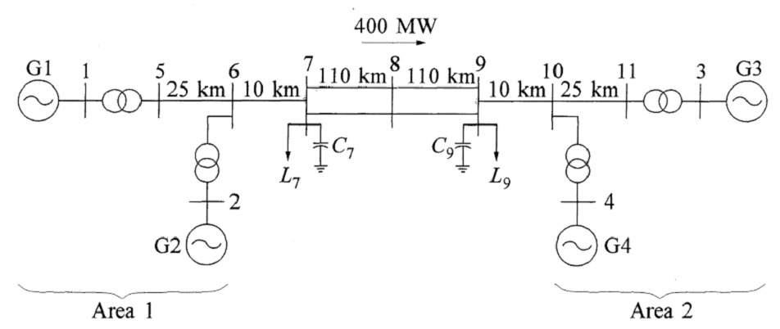

1
SINGLE LINE DIAGRAM OF KUNDUR 2 AREA SYSTEM

Slide 9
1.1
Shaping Dataset for Model Success
Diverse System Configuration: Data collected from a diverse 2-area system with 11 buses, 4 generators, and 4 transformers.
Post-Fault Data Collection: Capturing voltage and current data after fault occurrences for in-depth analysis.
Varied Fault Locations: Inducing faults at 4 unique locations to ensure model robustness.
Time-Stamped Data: Data collected at precise intervals: 2-2.1s, 3-3.1s, and 4-4.1s post-fault.
Comprehensive Fault Types: Covering S-L-G, L-L, L-L-G, L-L-L, and L-L-L-G fault scenarios. Also considered no fault scenario.

Slide 10
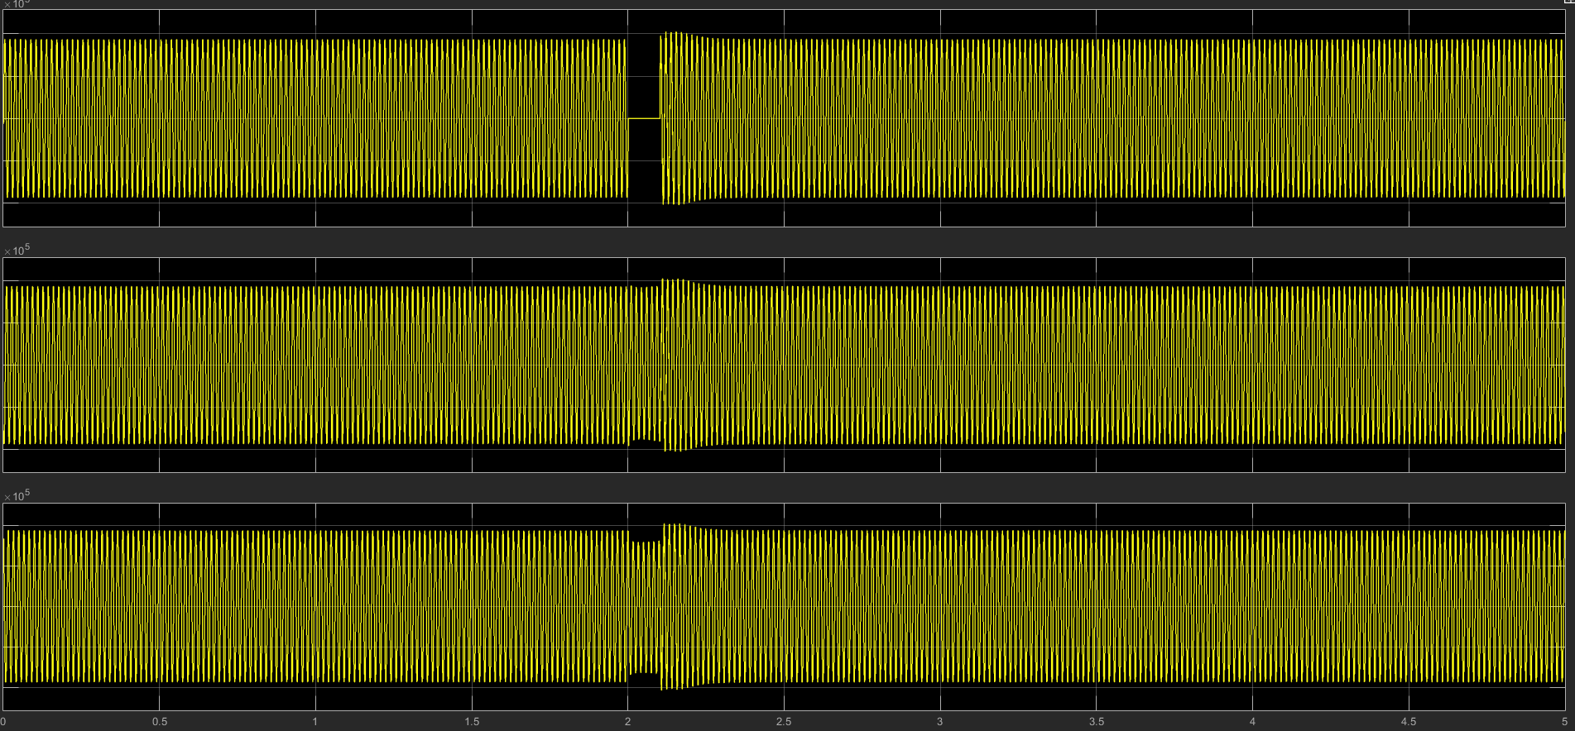
SIMULATION RESULT
S Single Line to ground fault at line A

Slide 11
FUTURE WORK / IMPLEMENTATION
Data Preparation:
Preprocessing
Feature Extraction and Selection
Customized Parameters
Model Exploration:
Implementing Various Algorithms
Model Selection
Training and Validation:
Model Training
Validation
Fault Analysis:
Fault Classification (SVM)
Source Location Detection

Slide 12
REFERENCES
H. A. Tokel, R. A. Halaseh, G. Alirezaei and R. Mathar, "A new approach for machine learning-based fault detection and classification in power systems," 2018 IEEE Power & Energy Society Innovative Smart Grid Technologies Conference (ISGT), Washington, DC, USA, 2018, pp. 1-5, doi: 10.1109/
S. I. Ahmed, M. F. Rahman, S. Kundu, R. M. Chowdhury, A. O. Hussain and M. Ferdoushi, "Deep Neural Network Based Fault Classification and Location Detection in Power Transmission Line," 2022 12th International Conference on Electrical and Computer Engineering (ICECE),2022, pp. 252-255, doi: 10.1109/
V. Malathi and N. S. Marimuthu, "Multi-class Support Vector Machine approach for fault classification in power transmission line," 2008 IEEE International Conference on Sustainable Energy Technologies, Singapore, 2008, pp. 67-71, doi: 10.1109/ICSET.2008.4746974.
S. M. Chopdar and A. K. Koshti, "Fault Detection and Classification in Power System Using Artificial Neural Network," 2022 2nd International Conference on Intelligent Technologies (CONIT), Hubli, India, 2022, pp. 1-6, doi: 10.1109/CONIT55038.2022.9848016.

Slide 13
Thank You!!

