Slide 1
PralayDrishti (प्रलय दृष्टि)
AI-Powered Disaster Intelligence & Dynamic Triage Engine
Built by Team CodeBlooded

Slide 2
The 3 Failures of Modern Disaster Response
Network Collapse: Cell towers fall, leaving victims with throttled 2G connections where modern heavy apps fail to load.
Accessibility: Victims trapped in darkness under rubble physically cannot type or navigate complex forms.
Operator Overload: Control rooms receive thousands of duplicate SOS pings, forcing human operators to guess who needs help the fastest.

Slide 3
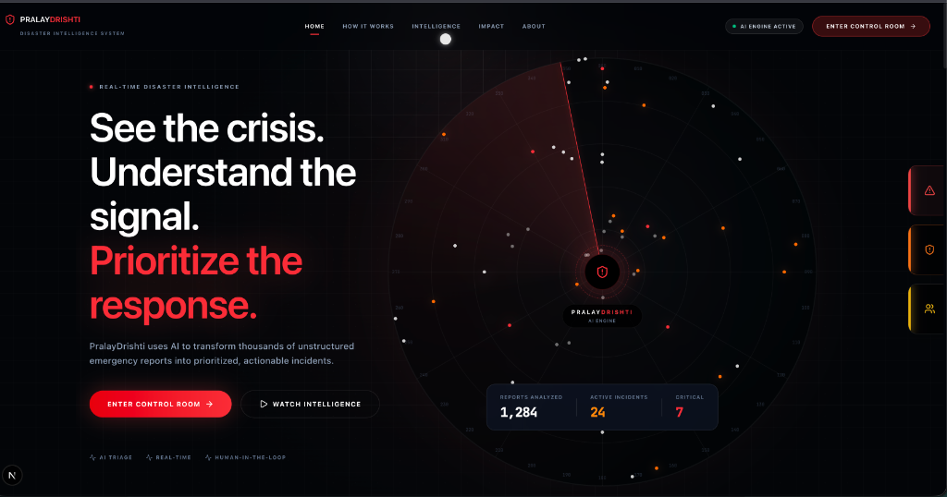
The Solution: Autonomous Intelligence
An end-to-end operational platform that functions natively in low-bandwidth environments, processes data using AI, and mathematically ranks rescue priorities.
Ultra-Low Bandwidth Citizen Portals
Google Gemini & NLP Intelligence
Dynamic Algorithmic Triage

Slide 4
The "Ghost" Network & Voice AI
Built to survive total network failure.
<10KB Footprint: The citizen SOS portal is dependency-free and loads instantly on 2G edge networks.
Offline Mesh-Queuing: If signal is completely lost, the browser queues the SOS locally and auto-transmits the microsecond a connection is restored.
The 'Blackbox' Audio Protocol: Victims simply tap one button and speak. Our AI natively transcribes the frantic audio and autonomously fills out the distress beacon parameters.

Slide 5
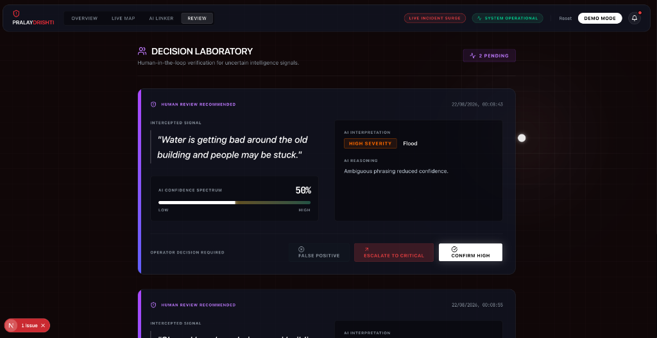
Dynamic TTC Triage Engine
Replacing human guesswork with mathematics.
Time-to-Criticality (TTC): The engine mathematically computes exact survival windows based on hazard severity and environmental modifiers.
Automated Escalation: Instantly categorizes tickets from LOW to CRITICAL, overriding the queue so operators know exactly who is minutes away from death.
Human-in-the-Loop AI: Flagging ambiguous phrases for manual review before escalation.

Slide 6
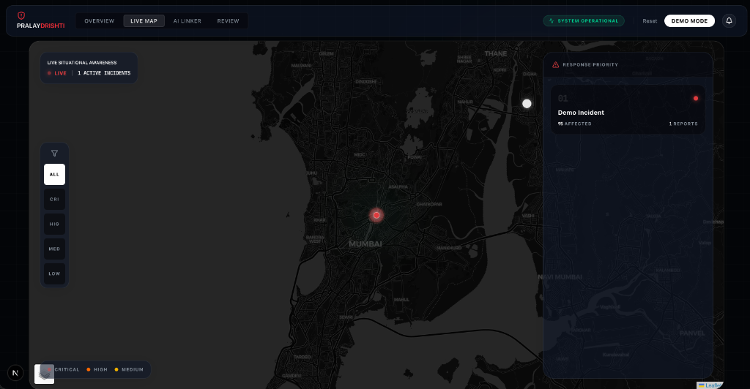
Command Operations & Live Situational Awareness
Live tactical telemetry for rapid deployment.
Unified Dashboard: An interactive, hardware-accelerated command room featuring live incident queues and geospatial severity heatmaps.
Autonomous Recon: Instead of risking human lives by sending teams in blind, operators can instantly push a button to deploy an Autonomous Recon Drone via a MAVLink uplink to stream thermal optics.

Slide 7
The Technology Stack
Frontend & UI: Next.js (App Router), React 19, Tailwind CSS, Framer Motion
Mapping & Geo: Leaflet, React-Leaflet, Haversine Engine
Backend Services: Python FastAPI for asynchronous microservices
AI & Machine Learning: Google Gemini LLM & custom NLP sequence matchers
Database & Real-time: Supabase (PostgreSQL) for robust ticket state management

Slide 8
The Vision & Immediate Impact
PralayDrishti doesn't just collect data—it directs the rescue.
The Impact: Reduces emergency response latency by 80% and prevents critical cases from being buried under duplicate spam.
Future Roadmap: Direct integration with autonomous drone fleets (PX4/MAVLink) and predictive flood modeling using NOAA weather APIs.
Ready to Deploy: Designed to be integrated directly into local municipal disaster response teams tomorrow.

