Slide 1

S A D H Y A

Slide 2

CardioTwin at a glance
A synthetic-data prototype for clinician review of cardiac context and incoming telemetry.
One patient view
from two data streams
Synthetic EHR
patient context
CardioTwin
Risk · rhythm · BP
Simulated
wearable readings
CardioTwin combines a synthetic EHR profile with simulated wearable readings, then presents rule-based cardiac indicators in a clinician dashboard and patient app.
Review support · not diagnosis
SADHYA · CARDIOTWIN
02
Notes:
Introduce the project as a synthetic proof of concept. It is built to demonstrate how EHR context and wearable data could be reviewed together.
Sources:
https://github.com/Aditya725wu/DigitalTwin/blob/main/README.md
https://github.com/Aditya725wu/DigitalTwin/blob/main/docs/architecture.md
Safety: synthetic proof of concept only. Outputs are simplified heuristics, not validated clinical predictions or medical advice.

Slide 3
Two data streams define the patient context
Every seeded record and wearable reading in the repository is synthetic.
01 · Historical context
02 · Incoming telemetry
Demographics
Age · sex · BMI
Risk factors
Smoking · diabetes · hypertension
History & labs
Family history · total / HDL / LDL cholesterol
Vitals
Heart rate · systolic / diastolic BP
Oxygen saturation
Rhythm signal
ECG rhythm label + quality
Context fields
Timestamp · source
A shared patient timeline for the prediction and review flows
SADHYA · CARDIOTWIN
03
Notes:
The repository documents static EHR factors and a dynamic wearable stream. The generator seeds synthetic patient profiles and readings.
Sources:
https://github.com/Aditya725wu/DigitalTwin/blob/main/README.md
https://github.com/Aditya725wu/DigitalTwin/blob/main/docs/api-reference.md
https://github.com/Aditya725wu/DigitalTwin/blob/main/backend/generate_cardiac_data.py
Safety: synthetic proof of concept only. Outputs are simplified heuristics, not validated clinical predictions or medical advice.

Slide 4
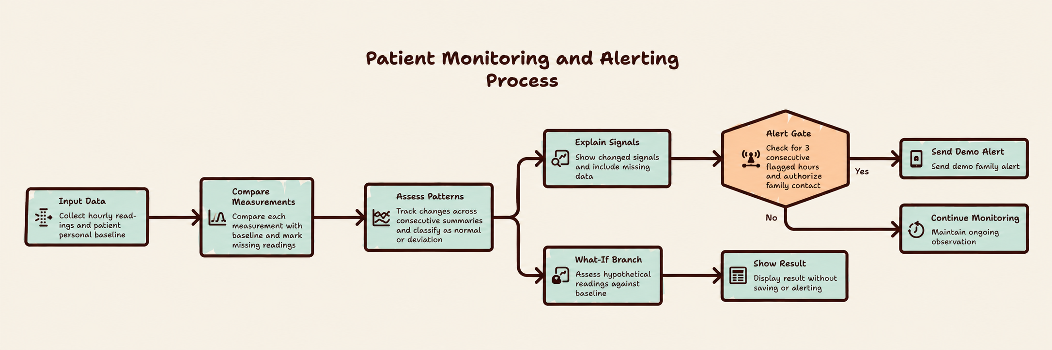
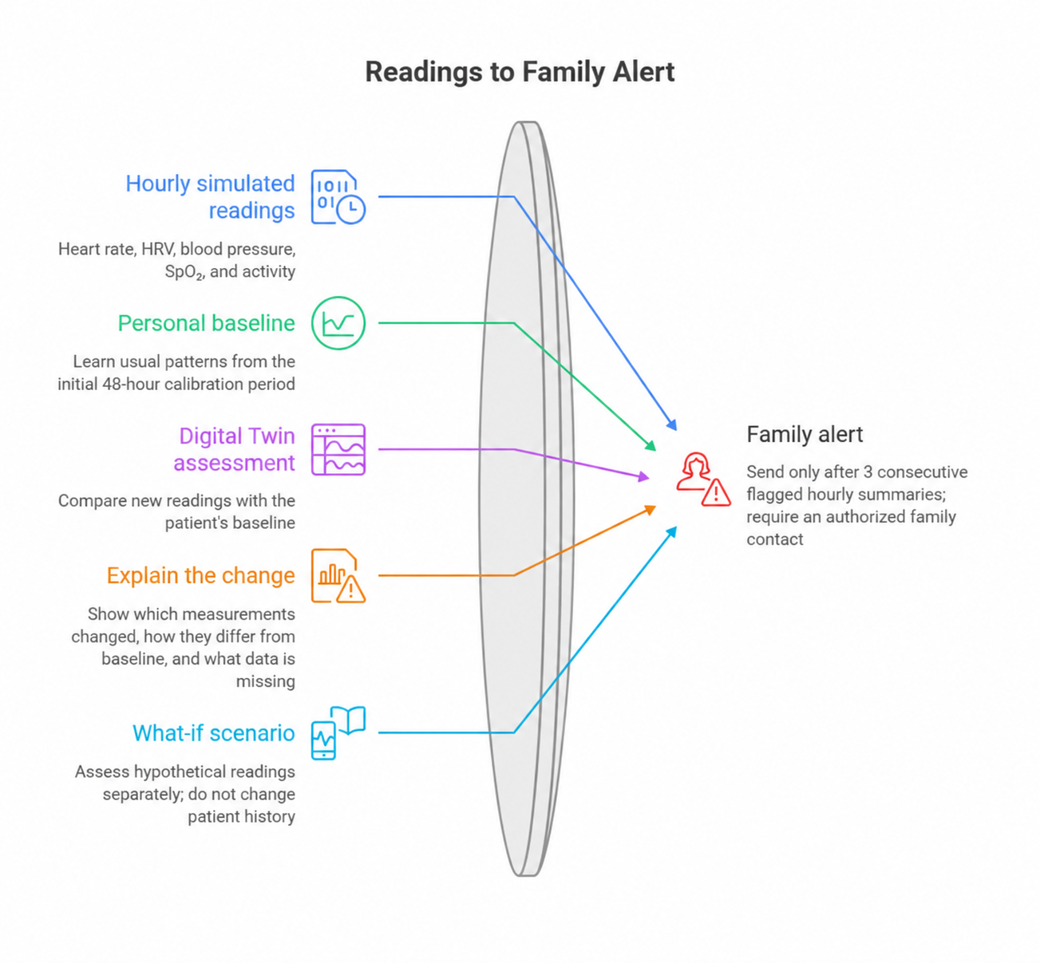
Twin monitoring workflow
Two views of baseline comparison, Twin assessment, scenario review, and family alerting.
ASSESS · EXPLAIN · SIMULATE
FAMILY ALERT
SADHYA · CARDIOTWIN
04
Notes:
Slide 4 embeds both ChatGPT diagram image files provided by the user, without redrawing their contents. The images show the Twin decision and alert workflow. The POC uses synthetic data and flags deviations for attention; it does not diagnose or predict medical events.
Sources:
https://github.com/Aditya725wu/DigitalTwin/blob/main/README.md
Safety: synthetic proof of concept only. Outputs are simplified heuristics, not validated clinical predictions or medical advice.

Slide 5
Backend API surface
The documented contract covers patients, wearable readings, predictions, alerts, analytics, and streaming.
1
PATIENTS
GET /api/patients
List seeded profiles
2
VITALS
POST /api/patients/{id}/vitals
Submit a wearable reading
3
PREDICTION
POST /api/patients/{id}/predict/cardiac
Return score, rhythm, BP trend, actions
4
ALERTS
GET /api/alerts · POST /api/alerts/{id}/acknowledge
Review and acknowledge alerts
5
STREAM
WS /ws/patient/{id}
Receive live telemetry and prediction updates
SADHYA · CARDIOTWIN
05
Notes:
Use Swagger at /docs during a demo. These endpoints are documented in the current repository.
Sources:
https://github.com/Aditya725wu/DigitalTwin/blob/main/docs/api-reference.md
Safety: synthetic proof of concept only. Outputs are simplified heuristics, not validated clinical predictions or medical advice.

Slide 6
The live score is a simplified heuristic
The API calls its output a probability; the implementation is not calibrated against real outcomes.
Inputs used by the active API
Banded
point rules
Score ÷ 45
Risk band
Age · sex · smoking · diabetes
Systolic BP · total cholesterol
HDL cholesterol
→
→
Overall risk also considers rhythm severity and a rule-based blood-pressure trend.
LOW
MODERATE
HIGH
CRITICAL
A rule score is not a clinically validated event probability.
SADHYA · CARDIOTWIN
06
Notes:
The service uses a score assembled from threshold points and divides by 45. Risk classification also considers blood-pressure and rhythm flags. This should not be presented as a validated probability.
Sources:
https://github.com/Aditya725wu/DigitalTwin/blob/main/backend/main.py
https://github.com/Aditya725wu/DigitalTwin/blob/main/backend/heart_disease_models.py
Safety: synthetic proof of concept only. Outputs are simplified heuristics, not validated clinical predictions or medical advice.

Slide 7
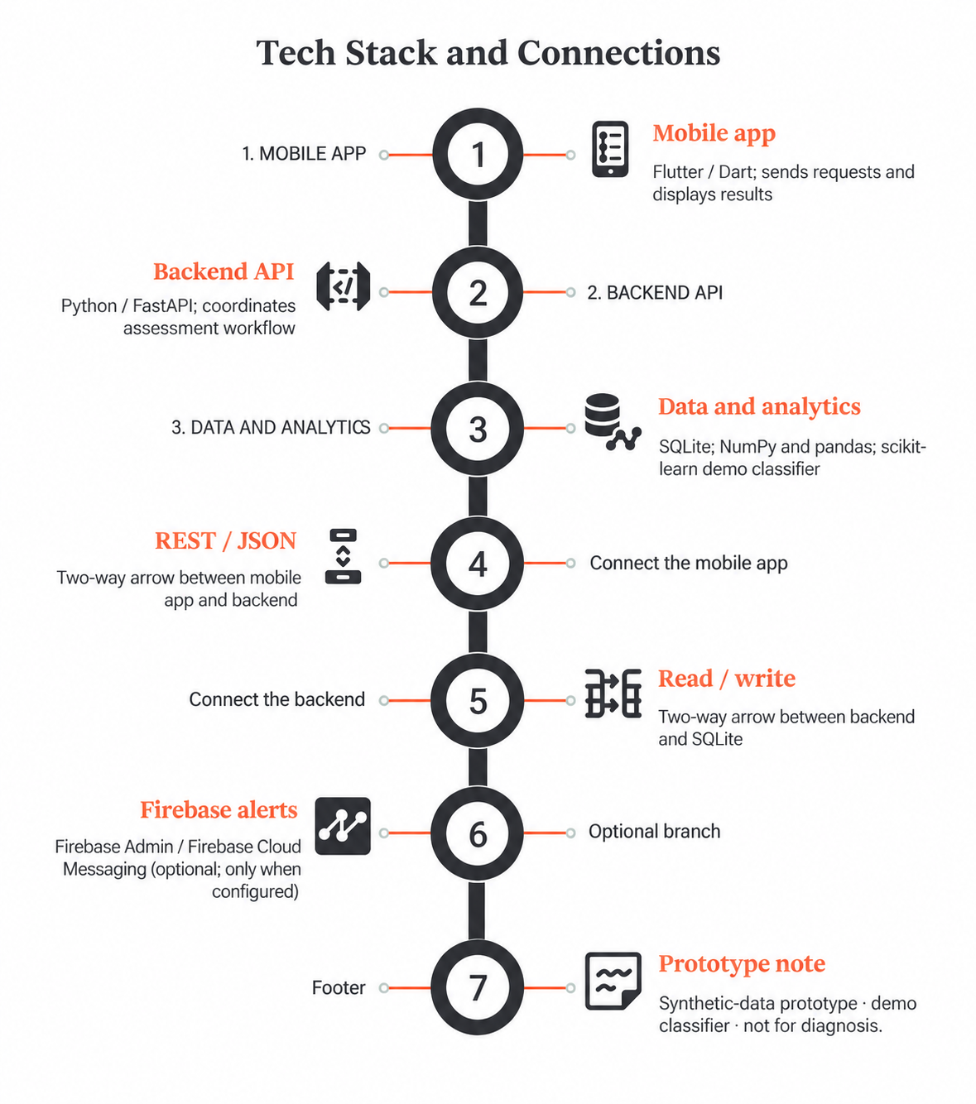

Slide 8
The ML trainer is separate from the live API
This distinction matters when describing model capability and validation.
LIVE API PATH
OPTIONAL TRAINING UTILITIES
Banded risk points
Heart-rate / ECG labels
Blood-pressure trend thresholds
Immediate vital-sign alert rules
Gradient Boosting is trained by a separate utility on generated patient labels. The labels are derived from simplified score / condition rules; the service does not load this model in its active prediction path.
Synthetic labels + no independent clinical validation = demo logic, not medical prediction
SADHYA · CARDIOTWIN
07
Notes:
Do not conflate the optional model-training script with the active API path. The risk labels in the trainer are constructed from the same simplified factors, so its metrics do not establish clinical performance.
Sources:
https://github.com/Aditya725wu/DigitalTwin/blob/main/backend/main.py
https://github.com/Aditya725wu/DigitalTwin/blob/main/backend/heart_disease_models.py
https://github.com/Aditya725wu/DigitalTwin/blob/main/backend/generate_cardiac_data.py
Safety: synthetic proof of concept only. Outputs are simplified heuristics, not validated clinical predictions or medical advice.

Slide 9
Streaming moves readings through one review loop
REST and WebSocket paths both support demo telemetry ingestion.
1
2
3
4
1 · Send
POST vital or WS event
2 · Store
Append to patient history
3 · Evaluate
Risk + threshold checks
4 · Update
Alert + client view
WebSocket event types
subscribe → register interest
vitals → ingest a reading
alert / prediction_update → push results
SADHYA · CARDIOTWIN
08
Notes:
The current backend stores recent readings in memory, capped at 1,000 per patient, and pushes alert or prediction updates over the socket.
Sources:
https://github.com/Aditya725wu/DigitalTwin/blob/main/docs/api-reference.md
https://github.com/Aditya725wu/DigitalTwin/blob/main/backend/main.py
https://github.com/Aditya725wu/DigitalTwin/blob/main/docs/architecture.md
Safety: synthetic proof of concept only. Outputs are simplified heuristics, not validated clinical predictions or medical advice.

Slide 10
Alerts flag threshold events for review
Thresholds are code rules, not a calibrated multi-signal clinical alarm system.
SIGNAL CHECK
EXAMPLE RULE IN CODE
FOLLOW-UP IN APP
Heart rate
>120 or <50 bpm → HIGH; >100 → MEDIUM
Alert queue
Blood pressure
SBP ≥180 or DBP ≥120 → CRITICAL; SBP ≥160 or DBP ≥100 → HIGH; SBP ≥140 or DBP ≥90 → MEDIUM
Alert queue
Oxygen
SpO₂ <90% → HIGH
Alert queue
ECG label
AFib / PVC / ST elevation / T-wave inversion → HIGH
Alert queue
Clinician acknowledgement is supported; alert history is in-memory and resets with the API process.
SADHYA · CARDIOTWIN
09
Notes:
Thresholds are illustrative code behavior only. The action strings returned by the repository are hard-coded and need clinician safety review before any real-world use.
Sources:
https://github.com/Aditya725wu/DigitalTwin/blob/main/backend/main.py
https://github.com/Aditya725wu/DigitalTwin/blob/main/docs/api-reference.md
Safety: synthetic proof of concept only. Outputs are simplified heuristics, not validated clinical predictions or medical advice.

Slide 11
Clinician dashboard
Next.js / React overview for roster, telemetry, prediction watchlist, and alerts.
CARDIOTWIN / CLINICAL COMMAND CENTER
Cardiac overview
Patients monitored
4
Active alerts
2
High-risk patients
2
Average heart rate
100 bpm
HEART RATE + BP TREND
PATIENT RISK MIX
LOW
1
MEDIUM
1
HIGH
1
CRITICAL
1
PREDICTION WATCHLIST
RECENT ALERTS · ACKNOWLEDGE
Illustrative interface and trend line · seeded records are synthetic
SADHYA · CARDIOTWIN
10
Notes:
This is an editable schematic based on the React dashboard sections in the repo, not a captured screenshot. The plotted trend line is illustrative rather than patient data. The code refreshes dashboard data every 30 seconds and supports alert acknowledgement.
Sources:
https://github.com/Aditya725wu/DigitalTwin/blob/main/web-dashboard/src/app/dashboard/page.tsx
https://github.com/Aditya725wu/DigitalTwin/blob/main/README.md
Safety: synthetic proof of concept only. Outputs are simplified heuristics, not validated clinical predictions or medical advice.

Slide 12
Patient app
Expo / React Native screens bring cardiac status and telemetry to mobile.
Four-tab Expo app
CARDIOTWIN PATIENT VIEW
Synthetic patient
Home · Cardiac · Alerts · Profile
Personal status from EHR + telemetry
The Home screen shows the current synthetic patient status, selected vital readings, and a rule-based risk summary. Cardiac view lists recent telemetry; alerts and profile live in their own tabs.
Heart rate
72 bpm
Blood pressure
118/78
Oxygen
98.5%
Twin risk
LOW
Cardiac event score
13%
Illustrative screen · values from a seeded synthetic profile
SADHYA · CARDIOTWIN
11
Notes:
This slide is an editable schematic based on the Expo screen code. The example value is from a seeded synthetic patient and is not clinical evidence.
Sources:
https://github.com/Aditya725wu/DigitalTwin/blob/main/mobile-app/App.js
https://github.com/Aditya725wu/DigitalTwin/blob/main/mobile-app/src/screens/HomeScreen.js
https://github.com/Aditya725wu/DigitalTwin/blob/main/mobile-app/src/screens/CardiacScreen.js
https://github.com/Aditya725wu/DigitalTwin/blob/main/mobile-app/src/screens/AlertsScreen.js
https://github.com/Aditya725wu/DigitalTwin/blob/main/mobile-app/src/screens/ProfileScreen.js
Safety: synthetic proof of concept only. Outputs are simplified heuristics, not validated clinical predictions or medical advice.

Slide 13
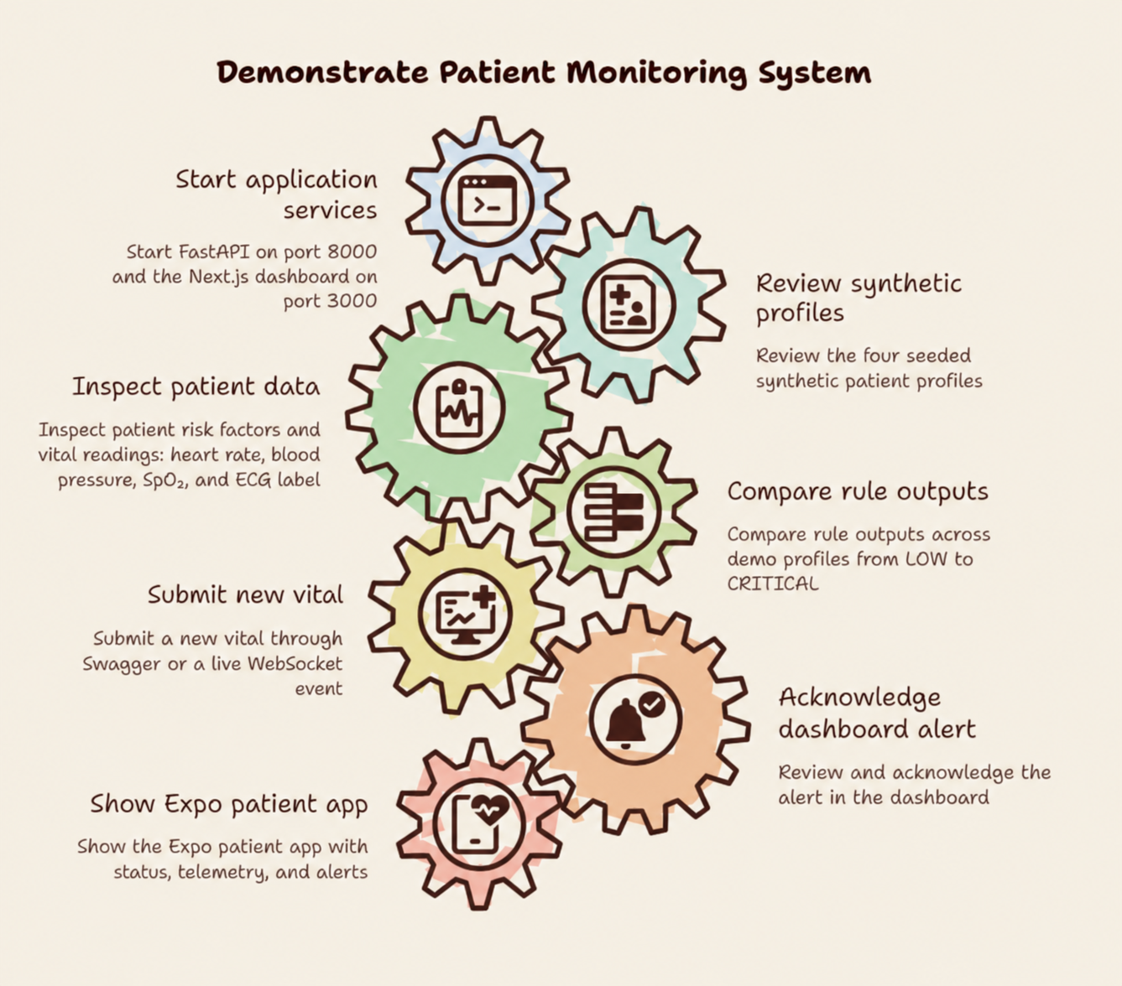
Judge demo flow
A short walkthrough shows ingestion, review, alerting, and the mobile companion.
01
Start API + dashboard
FastAPI on :8000; Next.js on :3000
02
Review synthetic roster
Four seeded patient profiles
03
Inspect EHR + vitals
Risk factors, HR, BP, SpO₂, ECG label
04
Compare rule outputs
LOW through CRITICAL demo profiles
05
Submit a vital
Swagger or live WebSocket event
06
Review + acknowledge
Alert queue updates in the dashboard
07
Show patient app
Expo screens for status, telemetry, alerts
SADHYA · CARDIOTWIN
12
Notes:
Follow the repository demo sequence. Show that a new vital can be submitted through Swagger and then reviewed as an alert.
Sources:
https://github.com/Aditya725wu/DigitalTwin/blob/main/README.md
https://github.com/Aditya725wu/DigitalTwin/blob/main/docs/hackathon-submission.md
https://github.com/Aditya725wu/DigitalTwin/blob/main/docs/api-reference.md
Safety: synthetic proof of concept only. Outputs are simplified heuristics, not validated clinical predictions or medical advice.

Slide 14
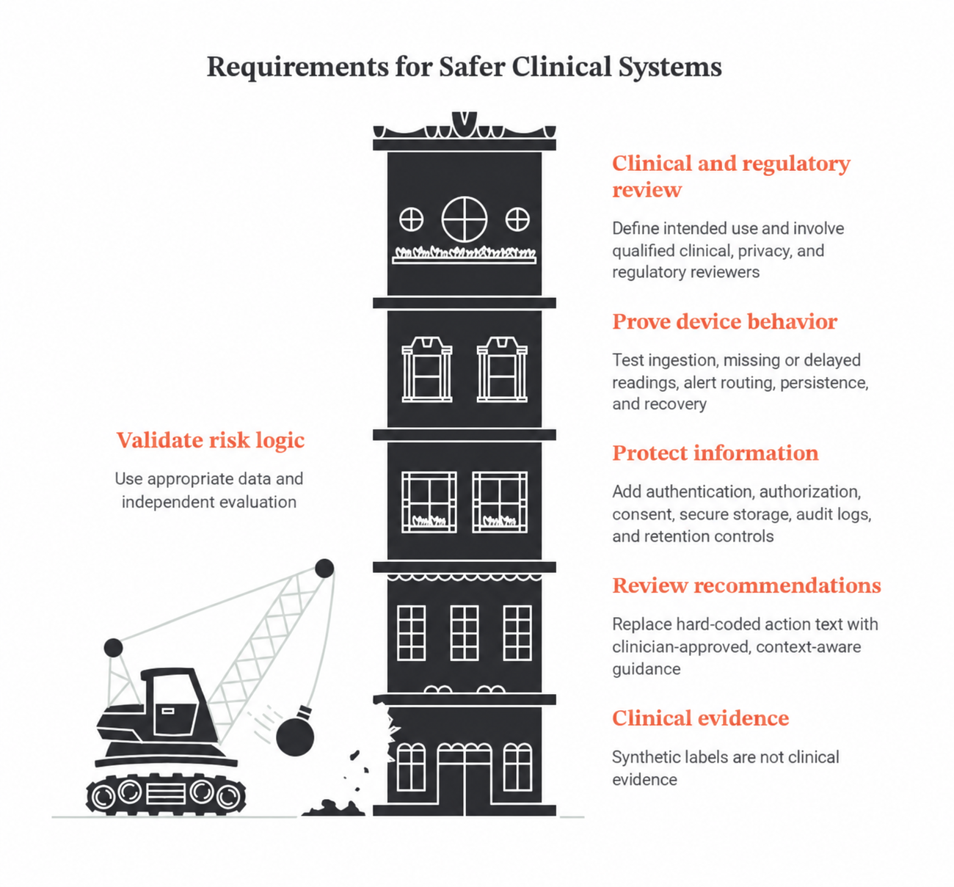
Before real-world use
The path forward is validation, safety review, and production-grade data handling.
01
Validate the risk logic
Use appropriate data and independent evaluation; do not treat synthetic labels as clinical evidence.
02
Review every recommendation
Replace hard-coded action text with clinician-approved, context-aware guidance.
03
Protect patient information
Add authentication, authorization, consent, secure storage, audit logs, and retention controls.
04
Prove device and service behavior
Test ingestion, missing / delayed readings, alert routing, persistence, and recovery.
05
Complete clinical and regulatory review
Set intended use and involve qualified clinical, privacy, and regulatory reviewers.
Prototype only · no diagnosis · no validated event prediction
SADHYA · CARDIOTWIN
14
Notes:
Close with the boundary: all data are synthetic, persistence is in memory, risk scoring is simplified, and the repository is not a medical device.
Sources:
https://github.com/Aditya725wu/DigitalTwin/blob/main/README.md
https://github.com/Aditya725wu/DigitalTwin/blob/main/docs/hackathon-submission.md
https://github.com/Aditya725wu/DigitalTwin/blob/main/backend/main.py
https://github.com/Aditya725wu/DigitalTwin/blob/main/backend/heart_disease_models.py
Safety: synthetic proof of concept only. Outputs are simplified heuristics, not validated clinical predictions or medical advice.

Slide 15
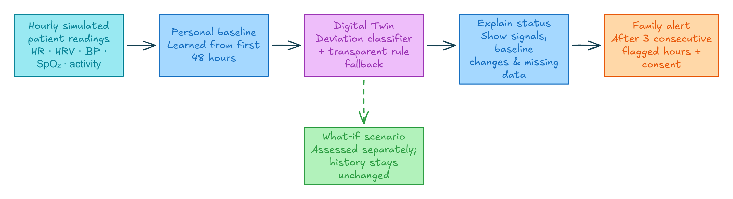
Digital Twin workflow · Excalidraw
Editable source diagram created for the simulated monitoring flow.
What-if readings are assessed separately and do not change patient history. Alerts require authorization and three consecutive flagged hourly summaries.
SADHYA · CARDIOTWIN
13
Notes:
This slide uses the editable Excalidraw source diagram digital_twin_flow.excalidraw created for the project. It complements the Napkin.ai diagram on slide 4.
Sources:
https://github.com/Aditya725wu/DigitalTwin/blob/main/README.md
Safety: synthetic proof of concept only. Outputs are simplified heuristics, not validated clinical predictions or medical advice.

Slide 16
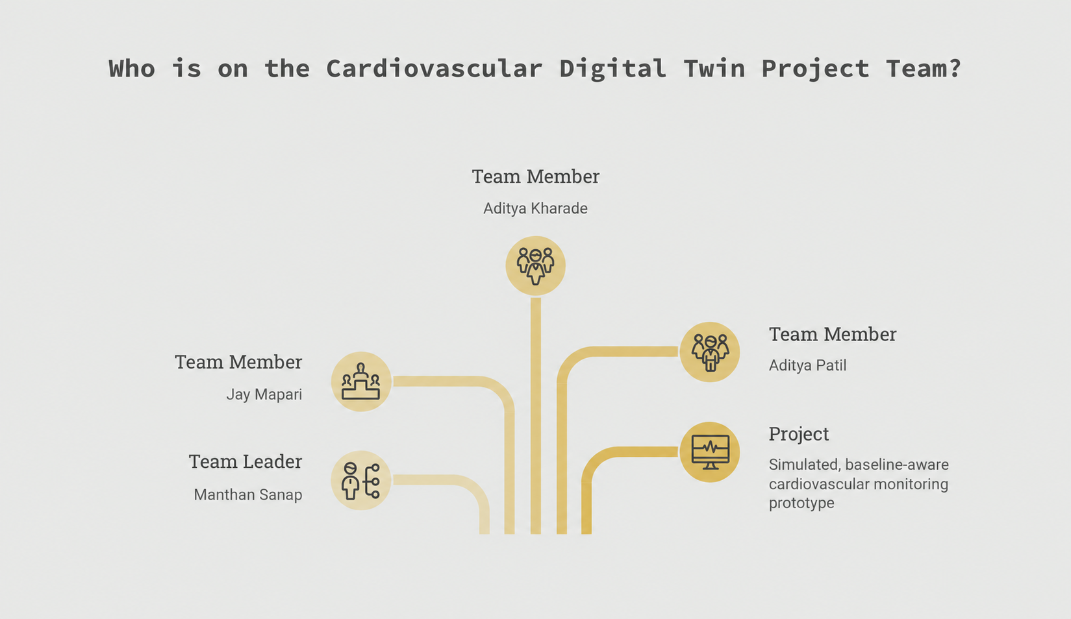
Meet the team
Cardiovascular Digital Twin · project team
TEAM LEADER
Manthan Sanap
TEAM MEMBER
TEAM MEMBER
TEAM MEMBER
Jay Mapari
Aditya Kharade
Aditya Patil
Building a simulated, baseline-aware monitoring prototype
SADHYA · CARDIOTWIN
16
Notes:
Introduce the project team. Team leader: Manthan Sanap. Members: Jay Mapari, Aditya Kharade, and Aditya Patil.
Sources:
https://github.com/Aditya725wu/DigitalTwin/blob/main/README.md
Safety: synthetic proof of concept only. Outputs are simplified heuristics, not validated clinical predictions or medical advice.

Slide 17

CARDIOVASCULAR DIGITAL TWIN
The End
Thank you for exploring CardioTwin.
A baseline-aware monitoring prototype
SADHYA · CARDIOTWIN
17

