Slide 2
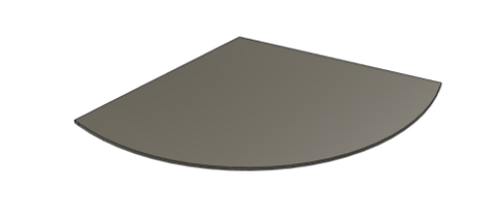
Materials Used:
Processes used:
Mild Steel Discs
Cutting
Cleaning treatments

Slide 3
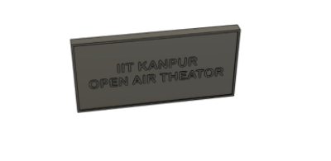
Materials Used:
Processes used:
Thermocol
Celo Tape
Cutting
Adhesive joining

Slide 4
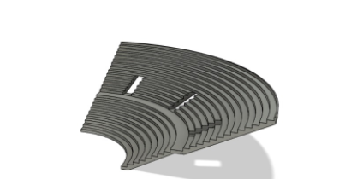
Materials Used:
Processes used:
Mild Steel Flat
Metal forming
Soldering
Cutting
Brazing

Slide 5
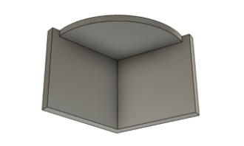
Material used:
Processes Used:
Mild Steel Flat
Mild Steel Discs
Cutting
Brazing
Cleaning treatments

Slide 6
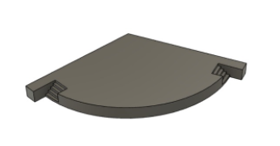
Material used:
Processes Used:
Mild Steel Flat
Mild Steel Discs
Cutting
Brazing
Cleaning treatments
Material removal

