Slide 1
Distillation Column Design
Department of Chemical Engineering Indian Institute of Technology, Kanpur
DISTILLATION COLUMN DESIGN PROJECT -By
HARJAP SINGH
ADITYA SINGH KAURAV

Slide 2
DISTILLATION
Department of Chemical Engineering Indian Institute of Technology, Kanpur
DISTILLATION
Distillation refers to the selective boiling and subsequent condensation of a component in a liquid mixture. The process of distillation exploits the difference in the boiling points of the components in the liquid mixture by forcing one of them into a gaseous state.
It is an energy intensive process but high purity can be obtained by it
Applications in Industry
A wide range of Petroleum Products can be obtained like:
Gasoline , Diesel fuel , Lubricating oil , Fuel oil , paraffin wax , petrochemicals

Slide 3

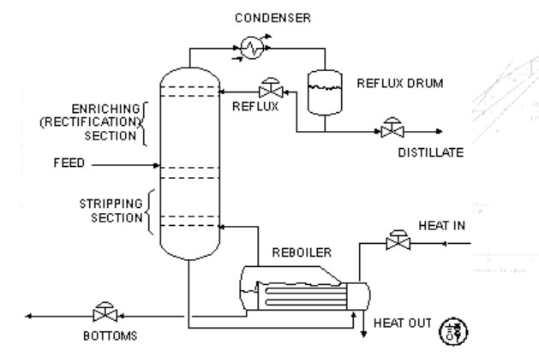

BINARY DISTILLATION COLUMN
Department of Chemical Engineering Indian Institute of Technology, Kanpur
The main components are –
a vertical shell where the separation of liquid components is carried
column internals such as trays/plates and/or packings which are used to enhance component separations
▪
▪
a reboiler to provide the necessary vaporization for the distillation
a condenser to cool and condense the vapor leaving the top of the
column
a reflux drum to hold the condensed vapor from the top of the column so that liquid (reflux) can be recycled back to the column
The liquid mixture that is to be processed is known as the feed and this is introduced usually somewhere near the middle of the column to a tray known as the feed tray. The feed tray divides the column into a top (enriching or rectification) section and a bottom (stripping) section.
The liquid removed from the reboiler is known as the bottoms product or simply, bottoms.
The condensed liquid that is removed from the system is known as the distillate or top product.

Slide 4
SYSTEM CHOSEN – (ACETONE & CHOLOFORM)
Department of Chemical Engineering Indian Institute of Technology, Kanpur
The system chosen is Acetone-Chloroform because it is non-ideal and Azeotropic.
System shows the positive deviation from Rault’s law and form maximum Boiling Point Azeotrope.
There is a small difference in the boiling point of both compounds (Acetone – 56 deg Celsius and Chloroform – 61 deg Celsius).
The acetone is the light key component as it is more volatile and chloroform is heavy key component
Techniques like Extraction Distillation and Pressure Distillation are used in later stages during this project to separate acetone from chloroform.

Slide 5

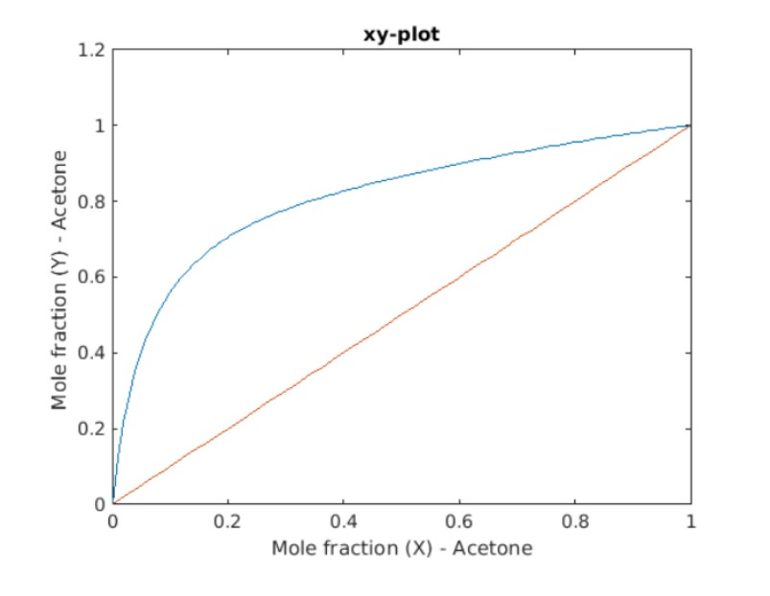
VAPOUR LIQUID EQUILIBRIUM OF ACETONE-BUTANOL
Department of Chemical Engineering Indian Institute of Technology, Kanpur
The xy equilibrium plot for the acetone butanol mixture was obtained by solving the modified Raoult’s Law by using WILSON for obtaining the activity coefficients and Van Der Waal equation of state for calculating the fugacity coefficient and ANTOINE’S parameters for calculating the saturation vapor pressure for each component.
The entire analysis was done at T=380 K in MATLAB. About 100
Points were considered between 0 and 1 to get accurate results.
At each point the activity and fugacity coefficients were calculated and applied in the modified Raoult’s law equation to get the mole fraction in vapor phase for acetone and plot the curve.
By Gibbs Phase rule F=C-P+2 . Here C=2 , P=2 thus we need to define only two independent intensive variables to define the whole system.

Slide 6

MCCABE THIELE PROCESS SIMULATION
Department of Chemical Engineering Indian Institute of Technology, Kanpur
The values of feed composition (xf), distillate composition (xd) , bottoms composition (x_bottom) and (q) value of the feed were taken from the user. All these are the compositions for acetone (more volatile component)
Then , draw the q line using the equation
To get the reflux ratio , we found the minimum reflux ratio first. Reflux ratio is minimum when top section line intersects the equilibrium curve
We found the intersection of q line with equilibrium curve and passed a line from that intersection
point and (xd , xd). The y intercept of line is xd/(Rmin+1)
By getting R min we got reflux ratio as R=1.4 * Rmin

Slide 7

MCCABE THIELE PROCESS SIMULATION
Department of Chemical Engineering Indian Institute of Technology, Kanpur
After getting Reflux ratio , plot the top section line using the equation
Then find the intersection point of the top line and the q-line and name it as
(x_intersect , y_intersect)
After that to calculate the top section stages , run a for loop till x coordinate is greater than the x_intersect as at x_intersect , the feed tray will be inserted . Keep on drawing horizontal lines and look for intersection point with curve and then drop a vertical line and so on. This gives us the number of trays required for top section
Similarly to draw the bottom line use two points (xv , xv) and (x_intersect , y_intersect) and find the
number of stages for bottom section as well
Actual Number of Stages = Top Section Stages + Bottom Section Stages

Slide 8
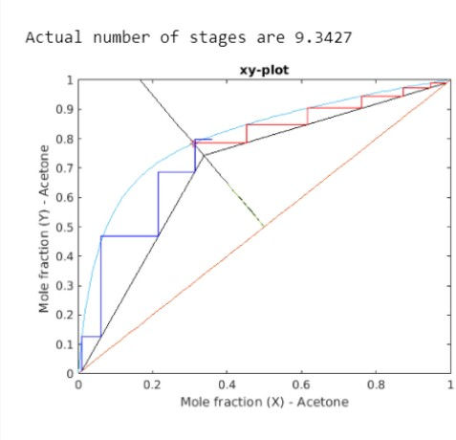
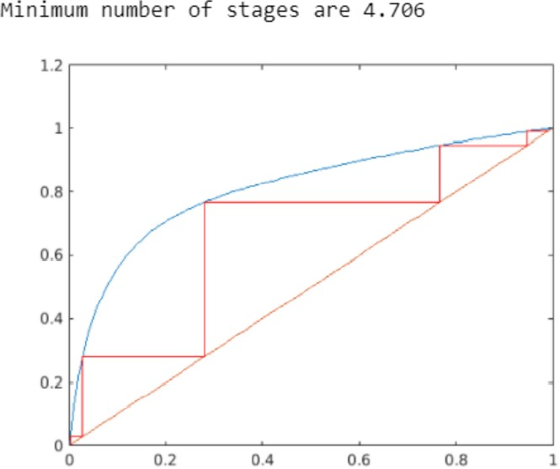
Distillation Column Design
Department of Chemical Engineering Indian Institute of Technology, Kanpur
ACTUAL NUMBER OF STAGES & MINIMUM NUMBER OF STAGES
Minimum stages are calculated by intersecting the horizontal and vertical lines with y=x line as at minimum
stages Reflux ratio is infinite so operating lines coincide with the y=x line

Slide 9
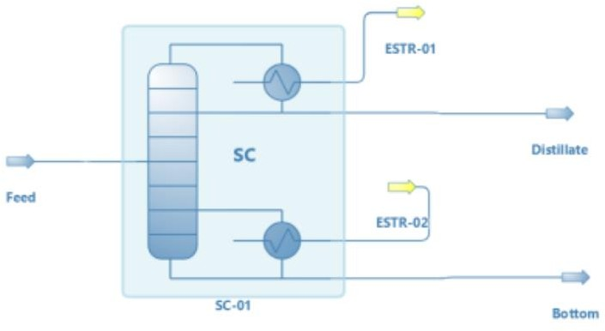
DWSIM SIMULATIONS TO VALIDATE THE RESULTS
Department of Chemical Engineering Indian Institute of Technology, Kanpur
By performing the simulations on DWSIM software using Shortcut Column , the results matched with MATLAB code results which proves the accuracy of the code and method
MATLAB CODE RESULTS | DWSIM RESULTS | ERROR
The actual number of stages - 9.3472 | 9.89 | 5%
The minimum number of stages - 4.706 | 5.01 | 6.4%
Minimum Reflux Ratio - 0.43575 | 0.411 | 5.67%
In all 3 cases the error is around 5-6% which is acceptable

Slide 10
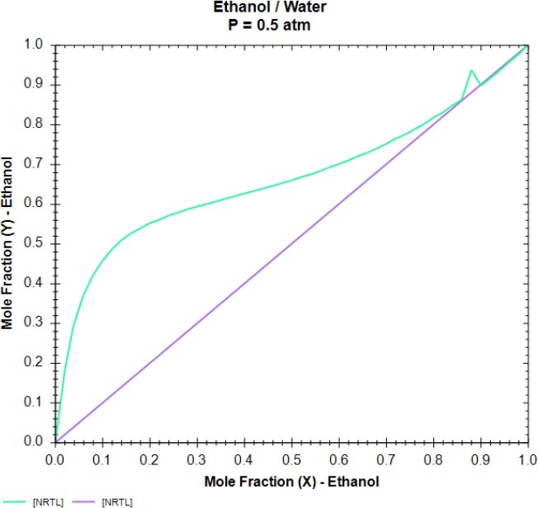
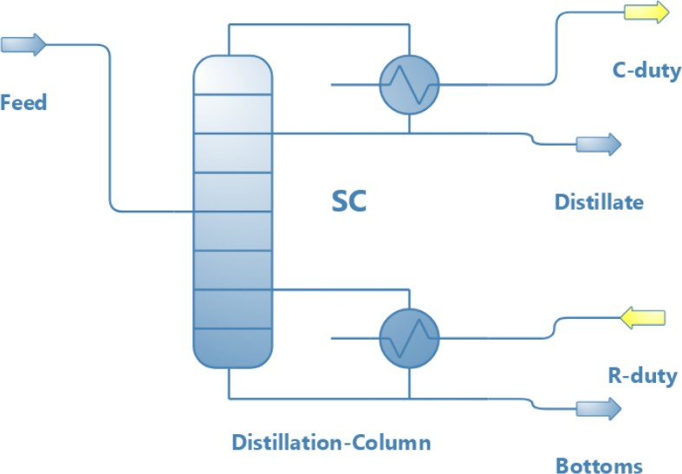
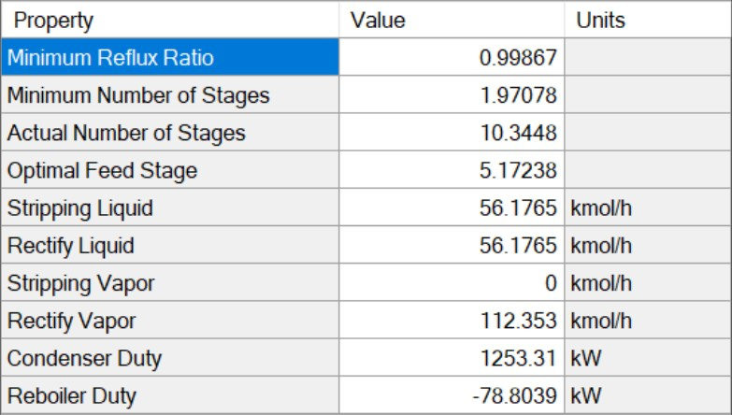
DWSIM DISTILLATION OF AZEOTROPIC MIXTURES
Department of Chemical Engineering Indian Institute of Technology, Kanpur
Ethanol & Water
The azeotropic composition is found when the
mole fraction (X)-Ethanol = mole fraction (Y)-Ethanol
This happens at x=0.86 for Ethanol & Water mixture
Shortcut Column
By simulating a shortcut column , the necessary parameters like
actual number of stages , feed tray optimal position , reflux ratio gets known.

Slide 11
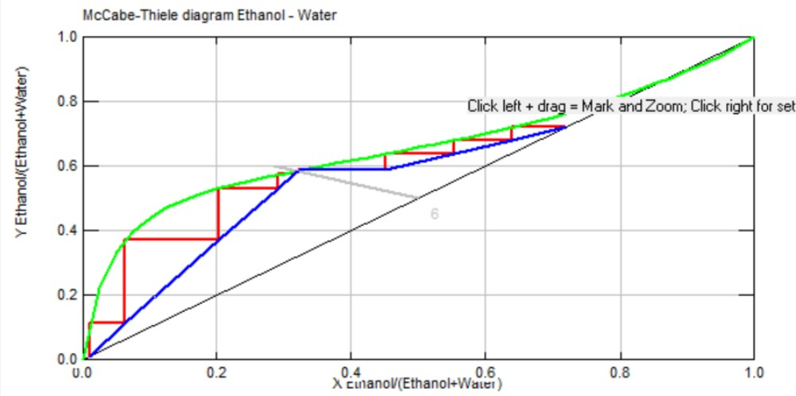
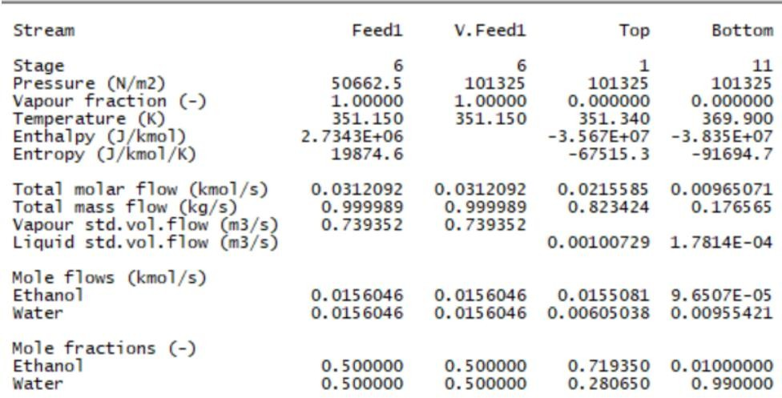
DWSIM DISTILLATION OF AZEOTROPIC MIXTURES
Department of Chemical Engineering Indian Institute of Technology, Kanpur
Ethanol & Water
By putting the same parameters in Chem-Sep column as obtained from Shortcut column simulation one can achieve separation of Ethanol and Water with Ethanol being obtained as a top product (72%) and water as the bottom product (99%)
McCabe-Thiele Diagram
Stream Results

Slide 12
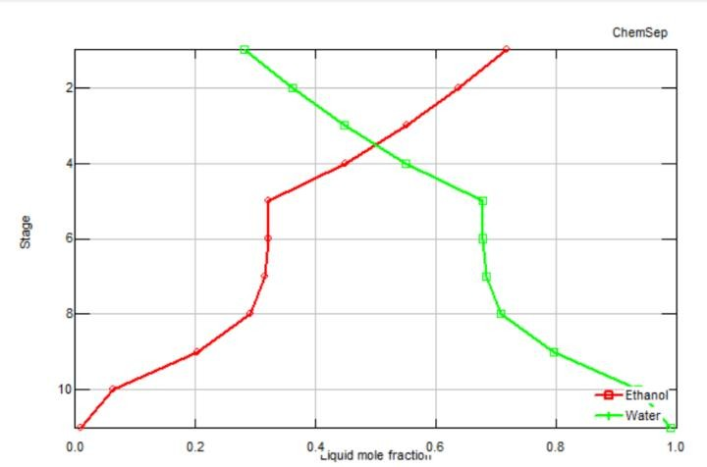
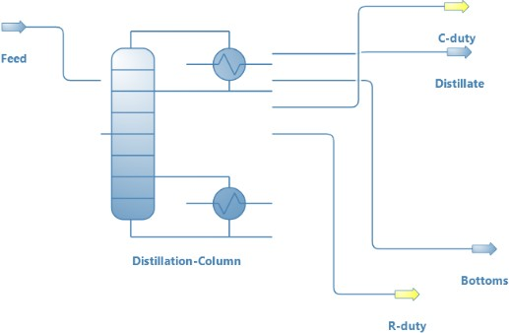
DWSIM DISTILLATION OF AZEOTROPIC MIXTURES
Department of Chemical Engineering Indian Institute of Technology, Kanpur
Composition of Ethanol & Water at each stage in
Chem-Sep Column
Chem-Sep Column Design

Slide 13
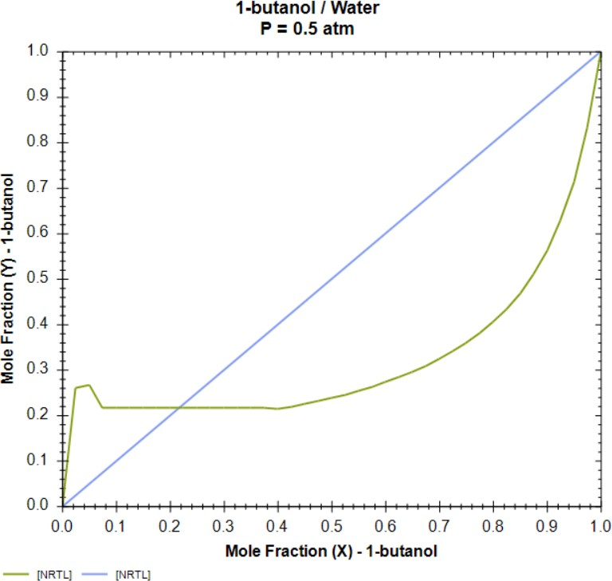
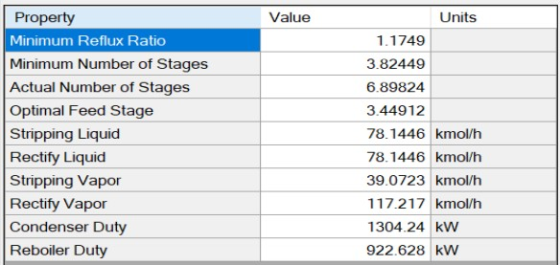
DWSIM DISTILLATION OF AZEOTROPIC MIXTURES
Department of Chemical Engineering Indian Institute of Technology, Kanpur
Butanol & Water
The azeotropic composition is found when the
mole fraction (X)-Butanol = mole fraction (Y)-Butanol
This happens at x=0.21618 for Butanol & Water mixture
Shortcut Column
By simulating a shortcut column , the necessary parameters like
actual number of stages , feed tray optimal position , reflux ratio gets known.

Slide 14
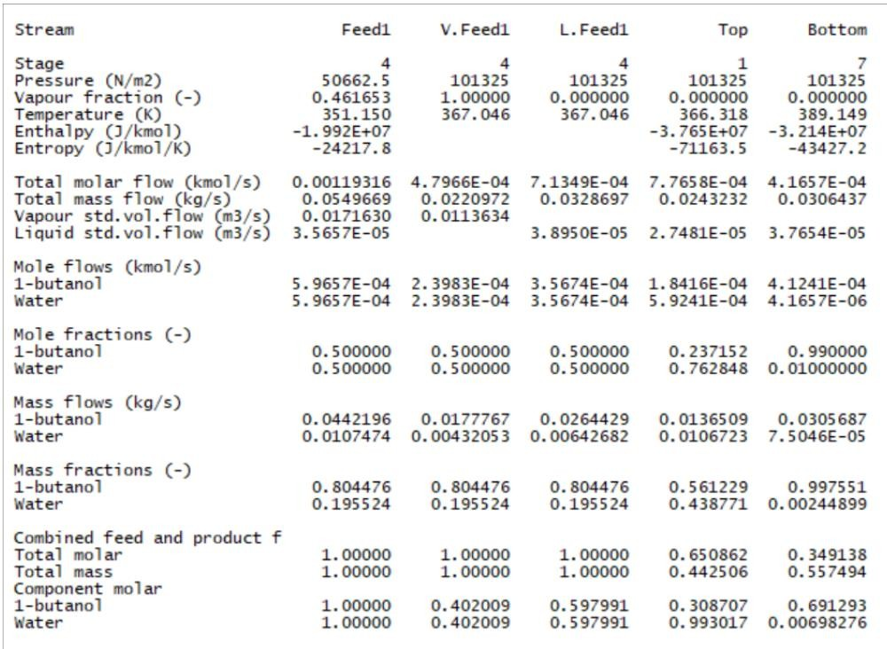
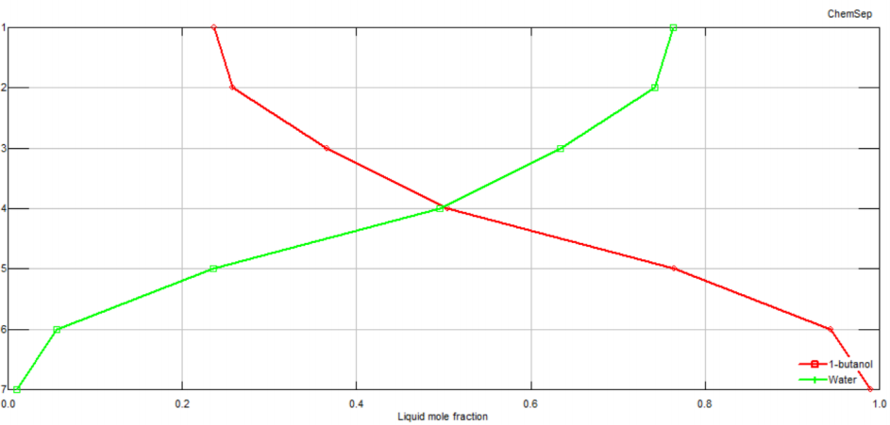
DWSIM DISTILLATION OF AZEOTROPIC MIXTURES
Department of Chemical Engineering Indian Institute of Technology, Kanpur
Butanol & Water
By putting the same parameters in Chem-Sep column as obtained from Shortcut column simulation one can achieve separation of Butanol and Water with Water being obtained as a top product (76%) and butanol as the bottom product (99%)
Composition at each tray
Stream Results

Slide 15
WORK CONTRIBUTION OF GROUP MEMBERS
Department of Chemical Engineering Indian Institute of Technology, Kanpur
DIYA SINGHAL (190320) | DHANANJAY GUPTA (190280)
Wrote the MATLAB code for plotting vapor – liquid equilibrium curve of Acetone-Butanol mixture | Looked out for videos and resources for McCabe Thiele process simulation in MATLAB
Wrote the MATLAB code for getting the actual number of stages , Reflux ratio , Minimum Reflux Ratio | Wrote the MATLAB code for getting the minimum number of stages
Simulated the Shortcut column in DWSIM for acetone-butanol mixture and compiled all the results in a report | Simulated the xy - Equilibrium plot for azeotropic mixtures in DWSIM for Ethanol-Water and Butanol-Water mixture
Simulated the azeotropic mixtures in DWSIM using both Chemsep and Shortcut column for Ethanol- Water and Butanol-Water mixture | Simulated the azeotropic mixtures in DWSIM using only Shortcut column for Ethanol-Water and Butanol-Water mixture

