Slide 1



Trees Species Classification

Slide 2

Learning Objectives
Understanding Transfer Learning in Deep Learning: demonstrates how to use the DenseNet121 architecture with transfer learning
Developing End-to-End Image Classification Applications: It guides users through building a complete workflow, from setting up data preprocessing (resizing images to 320x320) to training and deploying a deep learning model.
Building User Interfaces for ML Models: By using Streamlit to build an interactive frontend, users learn about deploying machine learning models as accessible web applications.
Interpreting Model Outputs: Testing Model and using the best model prediction the trees species.
Promoting Real-World Applications in Botany: The system is positioned as a tool for botanists, students, researchers, and nature enthusiasts, illustrating how AI can be applied to support biodiversity research and environmental monitoring.
Basic User Authentication Integration: With a login sidebar for user credentials, it touches on adding simple authentication layers to machine learning web apps.
GOAL
Source :
www.freepik.com/

Slide 3
Tools and Technology used
Model Architecture: DenseNet121, a convolutional neural network (CNN) architecture known for efficient feature reuse and deep network construction.
Programming Language: Python (commonly used for deep learning and data science pipelines).
Libraries/Frameworks:
PyTorch or TensorFlow (for model development and training—DenseNet is implemented in both, with project-dependent choice).
Streamlit (for building the interactive web-based user interface for model deployment and visualization).
OpenCV and Pillow (PIL) (for image preprocessing such as resizing and augmentation).
NumPy and Pandas (for numerical computations and data handling).
Transfer Learning: Utilizes pretrained weights from DenseNet121, further fine-tuned on a dataset of 29 Indian tree species.
User Authentication: Streamlit's sidebar capabilities are used to implement basic login functionality.
Visualization: Bar charts visualize model confidence for predictions, promoting model transparency.
Deployment: The model is integrated into a web app, likely hosted on Streamlit Cloud, Heroku, or similar platforms.

Slide 4
Tools and Technology used
Transformer Libraries:
Hugging Face Transformers (provides pre-trained Vision Transformer models and utilities commonly used for such tasks)
Vision Transformer (ViT): The most commonly used transformer model for image classification. Leveraged via Hugging Face Transformers or native frameworks like PyTorch or TensorFlow

Slide 5
Methodology
Data Acquisition and Preprocessing
Collection of labeled tree species images.
Image preprocessing: resizing images, normalization, and potential augmentation (rotation, cropping, flipping) to increase dataset diversity.
2. Dataset Splitting
Division of data into training, validation, and test sets—often using stratified sampling to preserve class proportions.
Data loaders or generators are set up for efficient batch data feeding into the model.
3. Model Selection and Initialization
Implementation or import of a Vision Transformer (ViT) model architecture, likely using Hugging Face Transformers, PyTorch, or TensorFlow.
Model is initialized with pre-trained weights (such as from ImageNet) and adapted for the number of output classes corresponding to the tree species dataset.

Slide 6
Methodology
4. Transfer Learning and Fine-tuning
The pre-trained backbone is fine-tuned on the specific dataset.
Some layers (often the early vision transformer encoder blocks) may be frozen initially to retain general image understanding, while deeper layers and the classifier head are trained on the tree species data.
5. Training the Model
Definition of loss function (e.g., Cross-Entropy Loss for classification), optimizer (such as Adam or SGD), and learning rate scheduling.
The model is trained for a set number of epochs, with validation performance monitored after each epoch to prevent overfitting (early stopping or model checkpointing may be used)
6. Evaluation
After training, the best model is evaluated on the hold-out test set.
Performance metrics such as accuracy, precision, recall, F1 score, and confusion matrix are calculated.
Model predictions might be visualized (e.g., actual vs predicted class, probability/confidence bar plots).

Slide 7
Methodology
7. Visualization and Interpretation
Visualization of sample predictions for qualitative assessment.
Visualization of attention maps (optional, for transformer models) to interpret which parts of the image contributed most to the decision.
Performance charts such as learning curves.
8. Inference and Deployment
The trained model can be saved and loaded for inference on new, unseen images.
The workflow can be integrated into a Streamlit app for user-friendly interaction (as in the main repository workflow).

Slide 8
Problem Statement:
Develop an accurate, image-based classifier using advanced deep learning (DenseNet121, Vision Transformers) to automate identification of Indian tree species. The solution is practical for botanists and nature enthusiasts, showcasing modern ML methods and facilitating biodiversity research through a user-friendly web app.
Provide an accessible and practical solution for botanists, students, researchers, and nature enthusiasts to assist with tree species identification, thereby supporting biodiversity research and environmental monitoring.
Showcase modern machine-learning practices such as transfer learning, fine-tuning on custom datasets, and deployment via interactive web apps.
In summary, the project addresses the real-world problem of automating tree species recognition from images, enhancing both research capabilities and public engagement in biodiversity efforts.

Slide 9
Solution:
The solution leverages a Vision Transformer (ViT) model, fine-tuned on labeled images of Indian tree species. Images are preprocessed and split into training, validation, and test sets. The ViT—initialized with pre-trained weights—learns to classify tree species through transfer learning and is trained using modern deep learning techniques. Model outputs are evaluated for accuracy and served via a user-friendly web app, enabling instant, automated tree identification from images with transformer-driven interpretability.

Slide 10
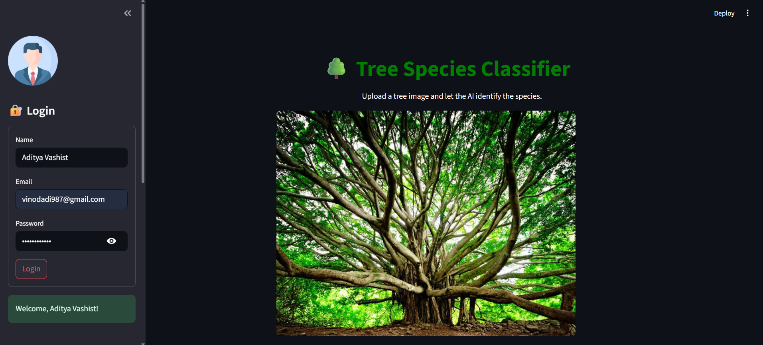
Screenshot of Output:

Slide 11
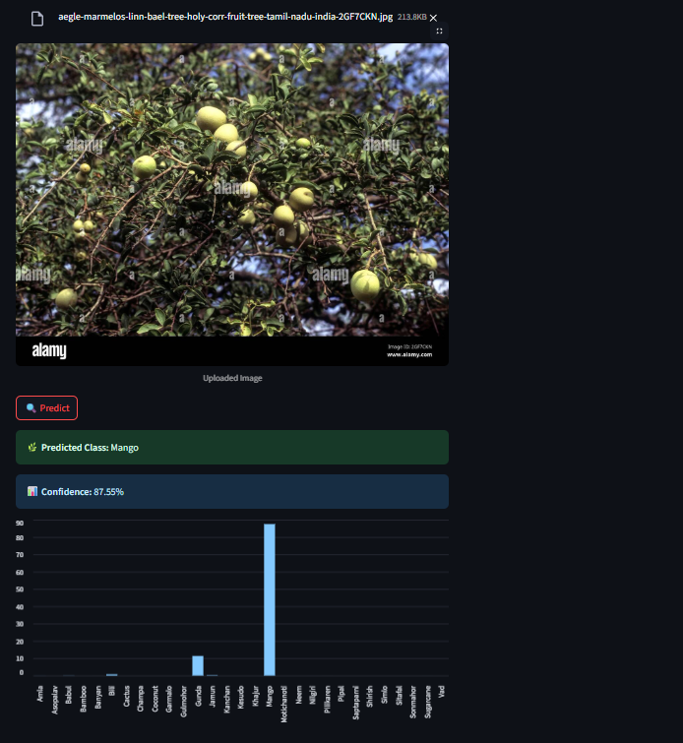
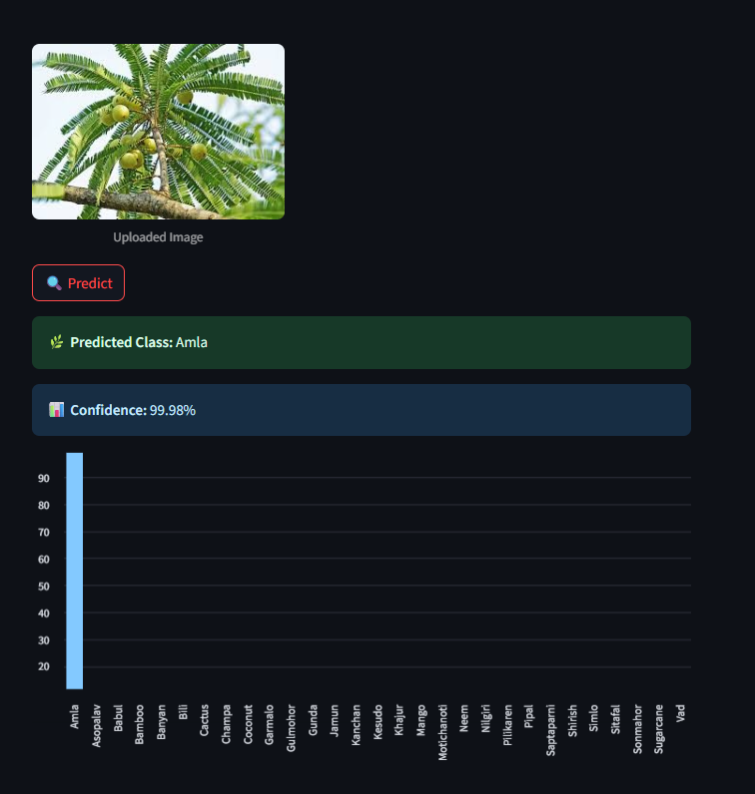
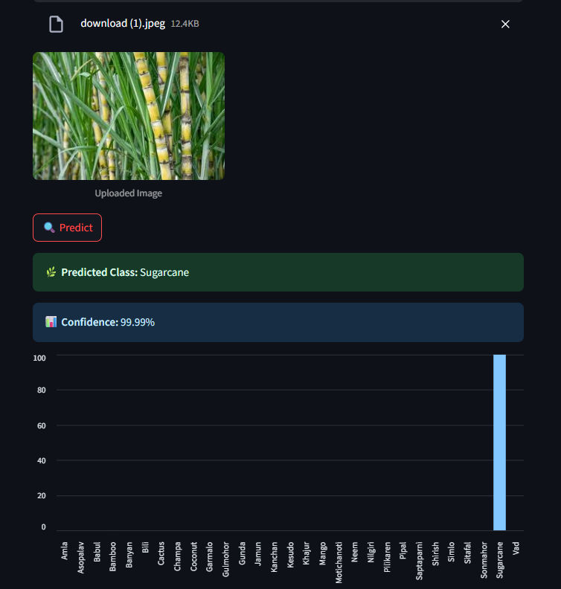
Screenshot of Output:

Slide 12
Conclusion:
The "Trees_Species_classification" project successfully demonstrates the application of advanced deep learning techniques—specifically DenseNet121 and Vision Transformers—to automate the classification of Indian tree species from images. By leveraging transfer learning with pre-trained models like Vision Transformer (ViT), the solution achieves robust and accurate multi-class classification while handling diverse, real-world image data.
The integration of effective preprocessing, fine-tuning, and evaluation methodologies ensures strong model performance. Furthermore, deploying the model through an intuitive Streamlit web app makes this technology accessible to botanists, researchers, and nature enthusiasts, facilitating biodiversity research and environmental monitoring. Overall, this project bridges cutting-edge AI with practical conservation efforts, showcasing how modern vision transformers can enhance fine-grained botanical identification tasks.

