Slide 1
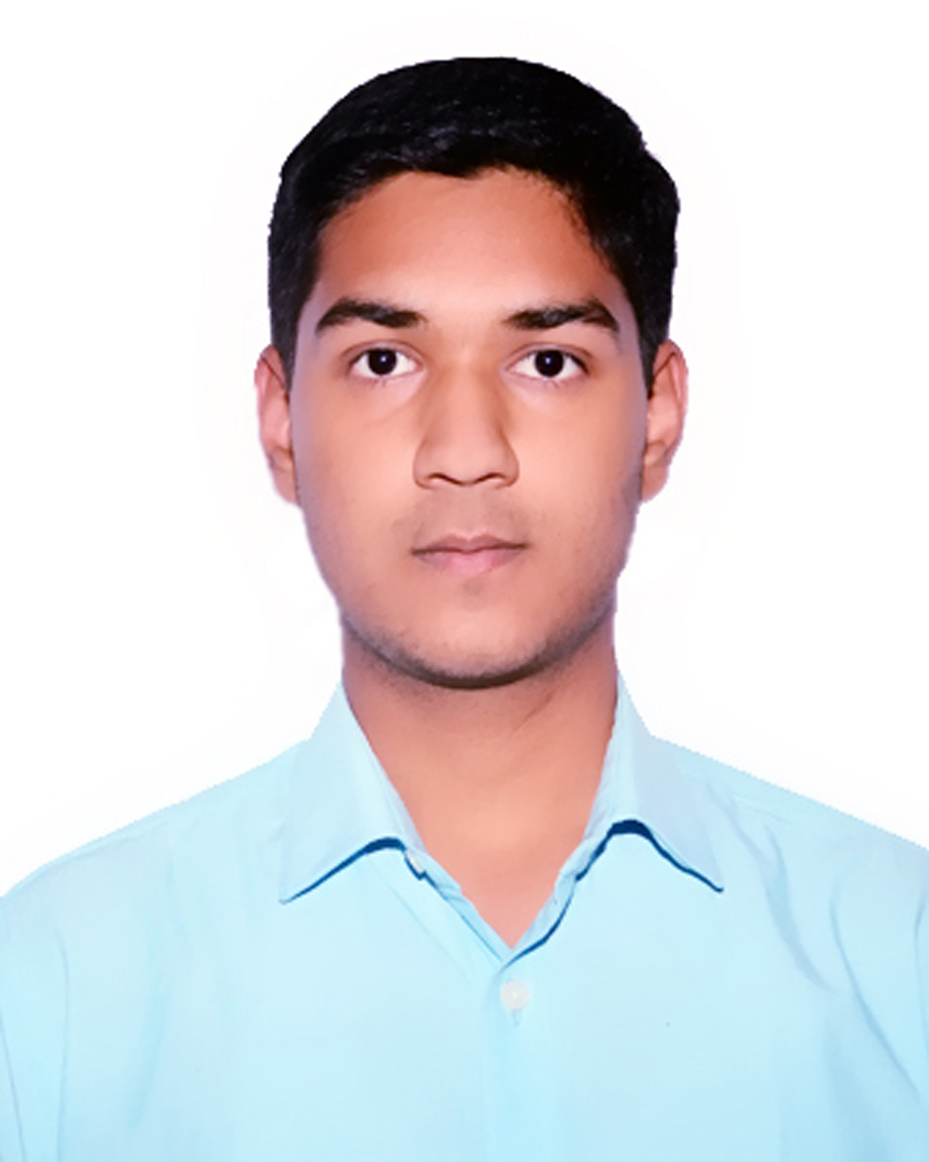

Student details
Name : Aditya Punia
Course : B. Tech ( CSE AI & ML )
Student ID : STU63fccbe625e471677511654
Internship ID : INTERNSHIP_168198413964410a8b547b1
SkillsBuild Email id : adityapunia4@gmail.com
SkillsBuild Organisation : DGT
College Name : Dronacharya College of Engineering, Gurgaon
Internship Domain : Artificial Intelligence
Internship Start and End Date : 12 June 2023 – 24 July 2023

Slide 2
PROJECT TITLE
AI Mental Fitness Tracker Model
Problem Statement
This project focuses on addressing the problem of measuring mental fitness by developing a mental fitness tracker.
Lack of accessible and personalized mental fitness tracking tools.
Difficulty in monitoring and improving mental well-being.
The primary objective is to calculate Disability-Adjusted Life Years (DALYs), which serve as a comprehensive indicator of mental well-being. By incorporating various features, of the prevalence of various mental disorder, we aim to derive accurate estimates of DALYs and provide valuable insights into mental fitness across different countries.

Slide 3
Agenda
Introduction and Problem Statement - Introduce the problem statement and project topic.
Project Overview - Provide a brief overview of the project's purpose, scope, and objectives.
End Users of the Project - Identify and describe the target audience and their needs.
Solution and Value Proposition - Present the solution and how it addresses the end users' needs.
Customization and Uniqueness - Highlight the unique aspects of the solution.
Modelling Approach - Showcase the modeling techniques and technologies utilized.
Results - Share the outcomes and success metrics of the project.
Links - Provide relevant resources associated with the project.

Slide 4
Project overview
Develop a Mental Fitness Tracker AI Model.
The project aims to build a mental fitness tracker that calculates Disability-Adjusted Life Years (DALYs) for various mental disorders across different countries.
The purpose of the project is to provide a comprehensive measure of mental fitness by analyzing the prevalence of mental disorders.
The scope of the project includes leveraging a dataset that encompasses information on different mental disorders and their prevalence across countries. By utilizing this data, the project focuses on developing a regression model to accurately calculate DALYs, which serve as an important indicator of mental well-being.
The main objective of the project is to create a tool that enables a deeper understanding of mental health and assists in monitoring and addressing mental disorders effectively.

Slide 5
Who are the end users of this project
The mental fitness tracker caters to a variety of end users in the field of mental health, including researchers, mental health professionals, Educational Institutions and individuals seeking to understand and improve their mental well-being.
Mental health professionals and therapists : Mental health professionals can utilize the tracker as an evidence-based tool for assessing the impact of mental disorders, planning treatment strategies, monitoring progress, and evaluating intervention effectiveness.
Researchers : Researchers can benefit from the mental fitness tracker by gaining access to comprehensive and accurate data, facilitating their research efforts and contributing to the body of knowledge in mental health research.
Corporate wellness programs.
Educational institutions (students and teachers).

Slide 6
Your solution and its value proposition
My solution to the mental fitness tracking problem involves employing machine learning modeling techniques to create a high-accuracy model across a large dataset.
By using the power of AI models, I aim to provide precise measurements of Disability-Adjusted Life Years (DALYs) for various mental disorders.
Integration of diverse mental health metrics and indicators.
This comprehensive understanding of mental fitness enables researchers, mental health professionals, and other end users to make data-driven decisions and develop targeted interventions, leading to improved mental health outcomes.

Slide 7
How did you customize the project and make it your own
One of the distinguishing aspects of my mental fitness tracker is the utilization of Random Forest Regressor algorithm to build the model. It is different and better than traditional Linear Regression algorithm. Using Random Forest Regressor the model gives better accuracy and results than traditional Linear Regression algorithm.
Using Random Forest Regressor algorithm leads to the following benefits :
Ability to capture complex patterns and relationships within the data.
Effective handling of large and high-dimensional datasets.
Robustness to missing or noisy data.

Slide 8
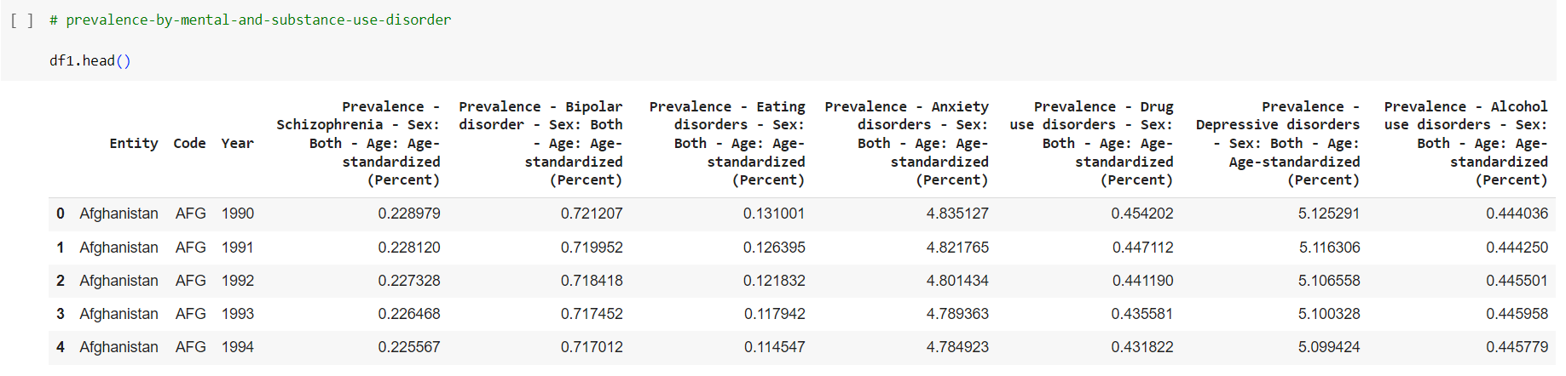
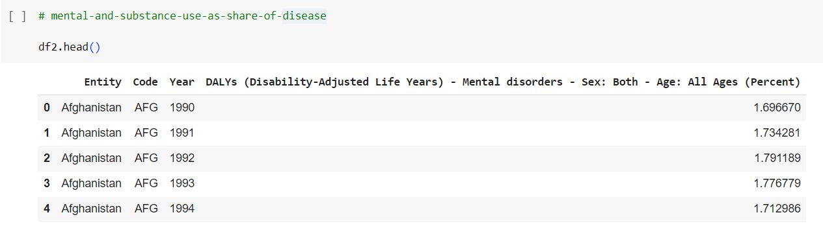
Dataset
We have two datasets on which we will be working upon :
1st – Prevalence by mental and substance use disorder
2nd – Mental and substance use as share of disease

Slide 9
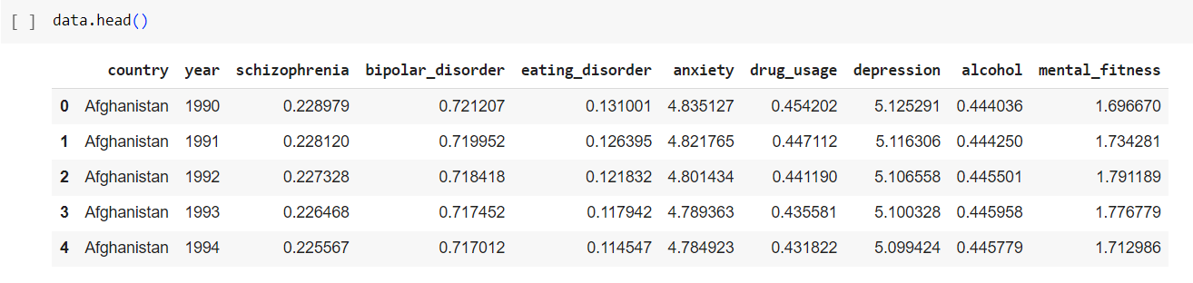
Data Preprocessing and Feature Engineering
On the dataset I performed some preprocessing and feature engineering steps to make the final clean dataset that will be used for final model building.
This dataset have shape of (6840,10) i.e., Rows = 6840 and Columns = 10
Here, the target column that is to be predicted by the model is “mental_fitness”, it’s name is changed from DALY to “mental_fitness” during preprocessing to provide better understandable naming conventions.

Slide 10
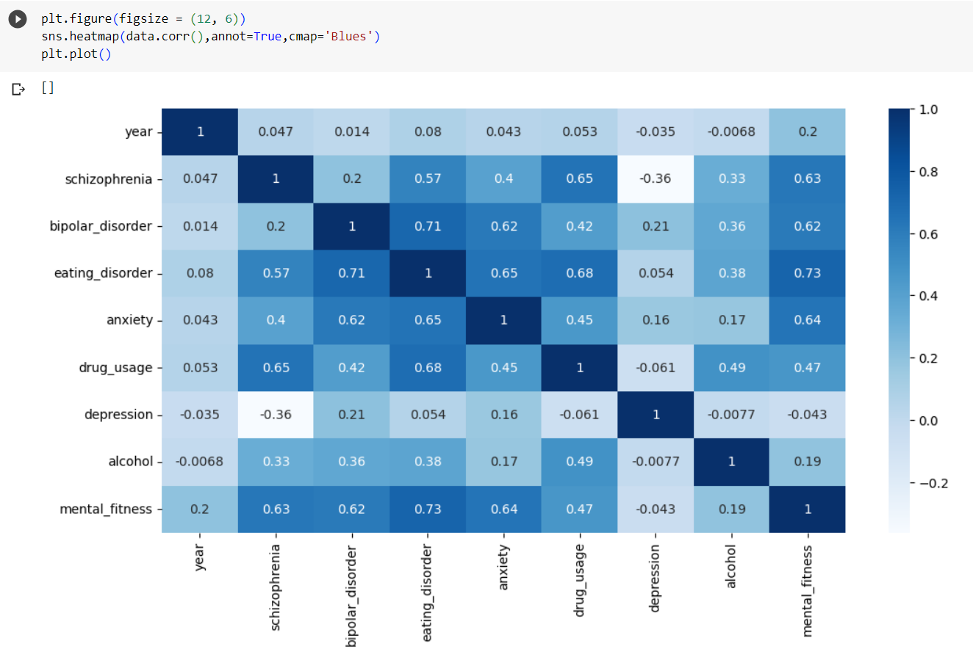
Data Visualization
Plotting a heat map to find correlation between different features of the dataset.
We see that, “Eating_Disorder” is positively correlated to “mental_fitness”, and vice-versa as our eating choice affect our mental health.

Slide 11
Modelling
In the Modelling part of the project we have mainly three steps, which are :
Splitting the data into “Training” and “Testing” data.
Training the model using labeled mental health data and Random Forest Regressor Algorithm.
Evaluation of model performance and metrics.

Slide 12
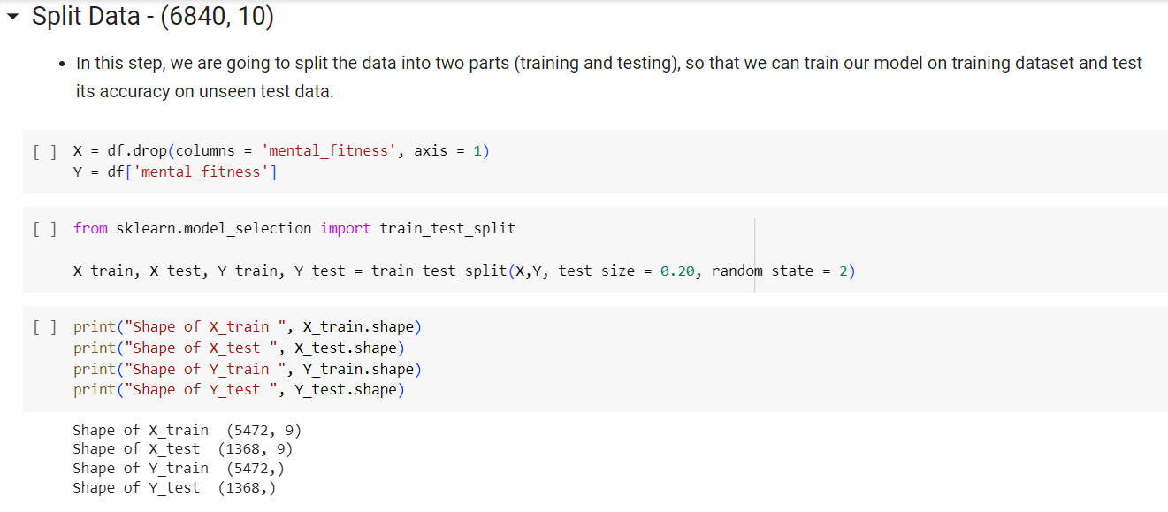
Split data
We will split the pre-processed clean data into two parts : “Training set” and “Testing set”. This is done with the help of scikit-learn library’s “train_test_split” function.
Training set : This labelled data will be used to build the model using “Random Forest Regressor Algorithm”.
Testing set : This part of data will be used to evaluate the accuracy and performance of the model.

Slide 13
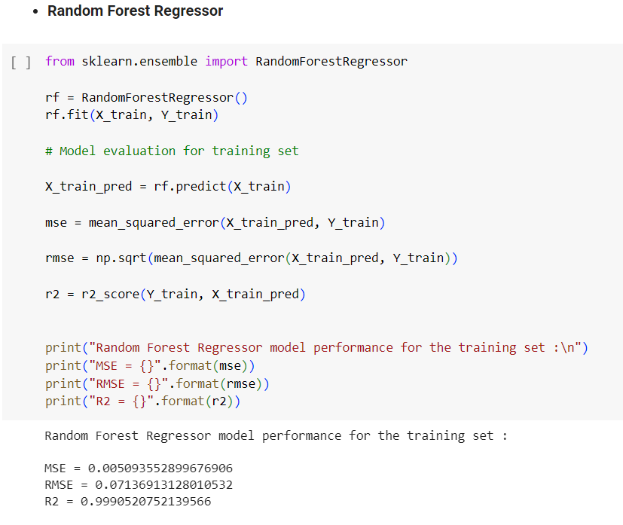
Model training
We will use Random Forest Regressor algorithm for model building.
For building the model we have used “sklearn.ensemble” from which we imported the “RandomForestRegressor”
Also, we have evaluated the performance of the model for
Training dataset on which it was trained.
And we see that it has performed really well with :
MSE = 0.005
RMSE = 0.071
R2 = 0.999
Here, the error is very less and also R2 score is high as
preferred. So we can say that our model is performing
really good.

Slide 14
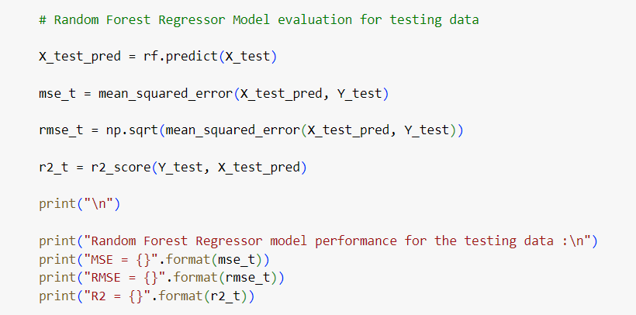
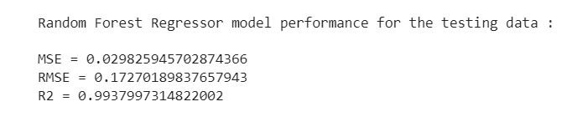
Evaluation
Evaluating the performance of the model that we built now we will use some evaluation metrics that will tell us how good our model is performing and we will use the “Testing Dataset” for evaluation.
The Evaluation metrics that will be used are :
MSE : MSE is the average of the square of the difference between the observed and predicted values of a variable.
RMSE : RMSE measures the average difference between the values predicted by the model and the actual values.
R2_Score : R2 or Coefficient of determination is a measure that provides information about the goodness of fit of a model.

Slide 15
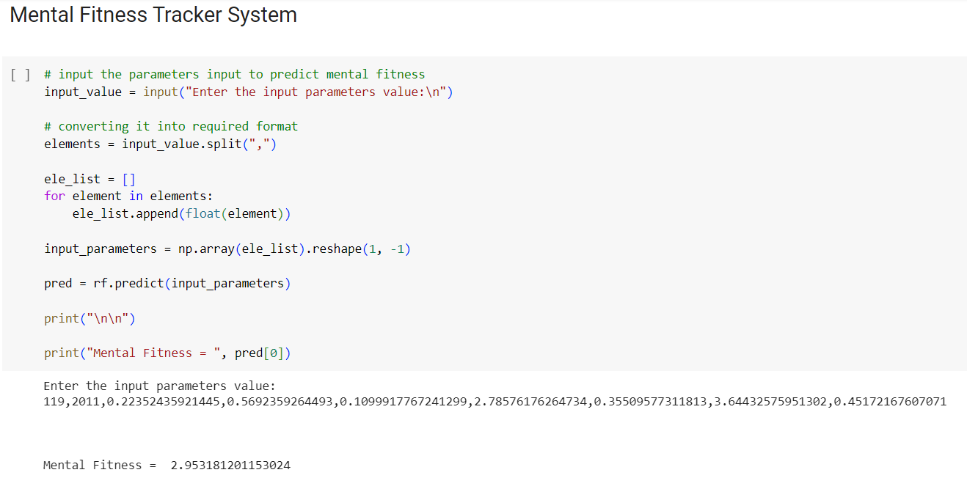
Results
Random Forest Regressor model performs well on both training and testing data.
Our model gives really good R2_score on both training and testing data. Also, the MSE and RMSE value is very less that is preferrable for a good model.
Finally we get a prediction system that can be used to predict the “mental_fitness” according to the input values.
Prediction
System –

Slide 16
Links
Colab Notebook ( Project Code) - https://colab.research.google.com/drive/1hsqexbHgdbL1tiLhXbN-fimey38VzzKU
Learning Plan Completion Certificate - http://bit.ly/3Di3cAc
GitHub Repository Link of Project Code - https://github.com/Aditya8404/Mental-Fitness-Tracker_IBM-SkillsBuild
References
Scikit-Learn Documentation – https://devdocs.io/scikit_learn/

Slide 17
Thank you

