Slide 1
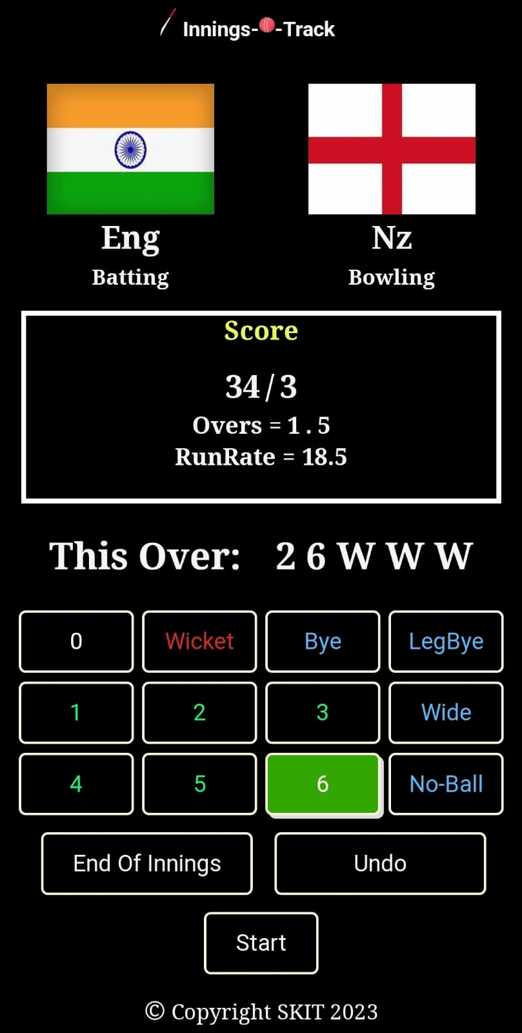
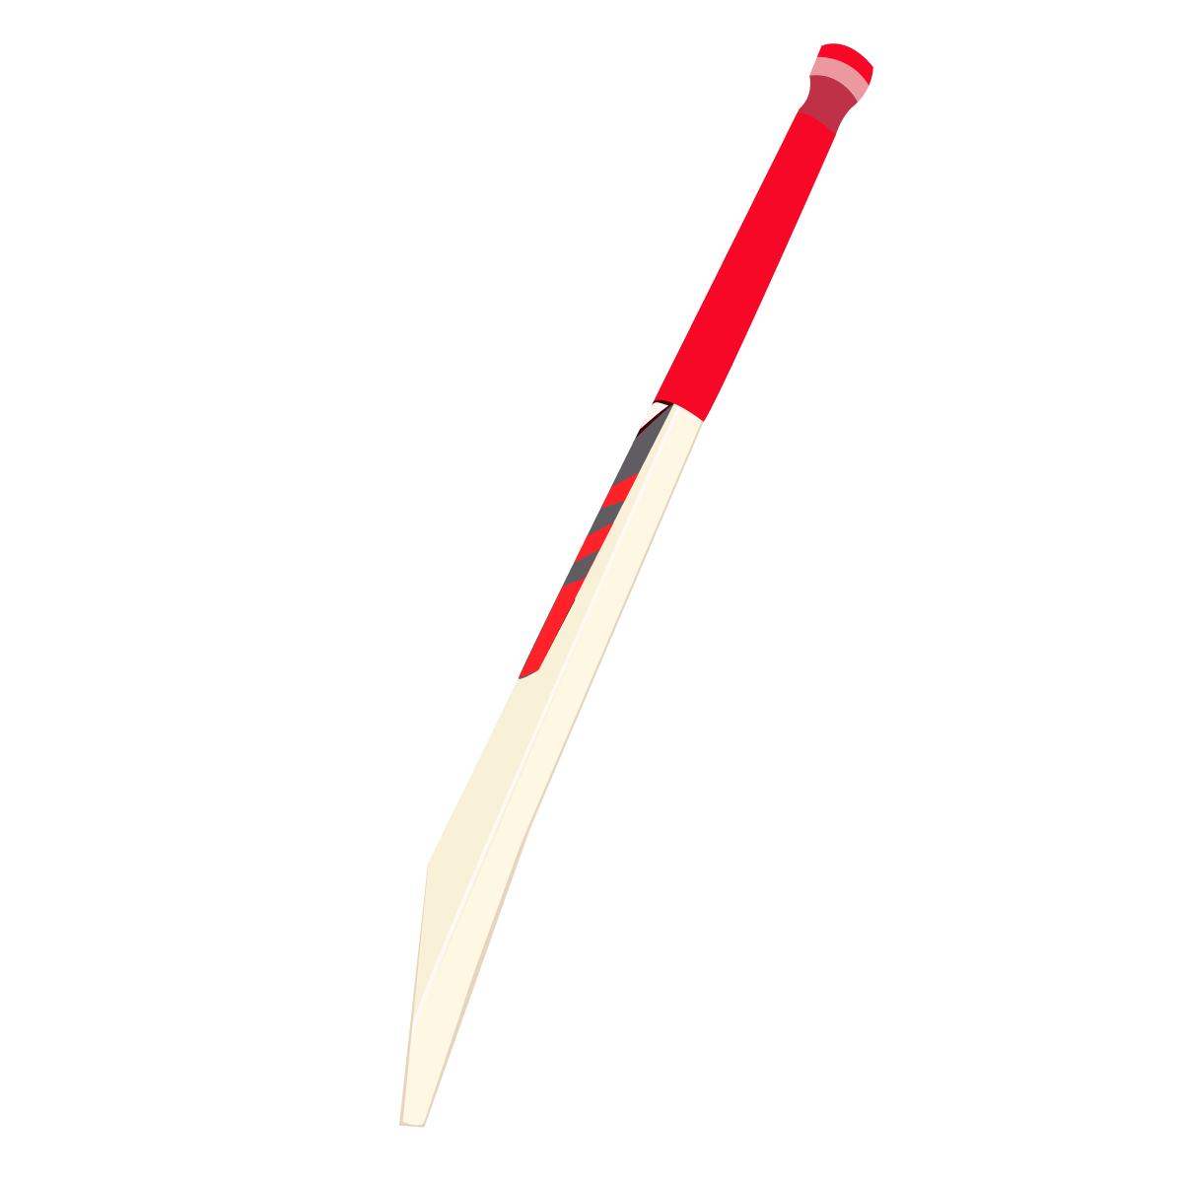

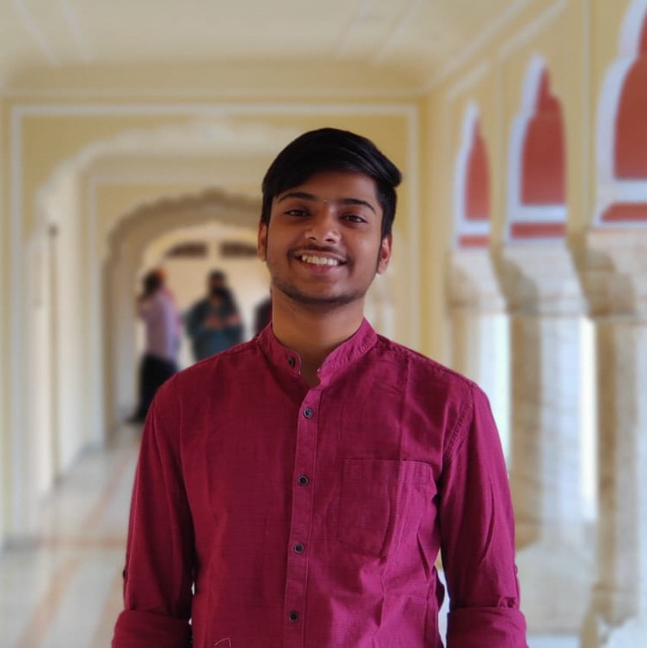
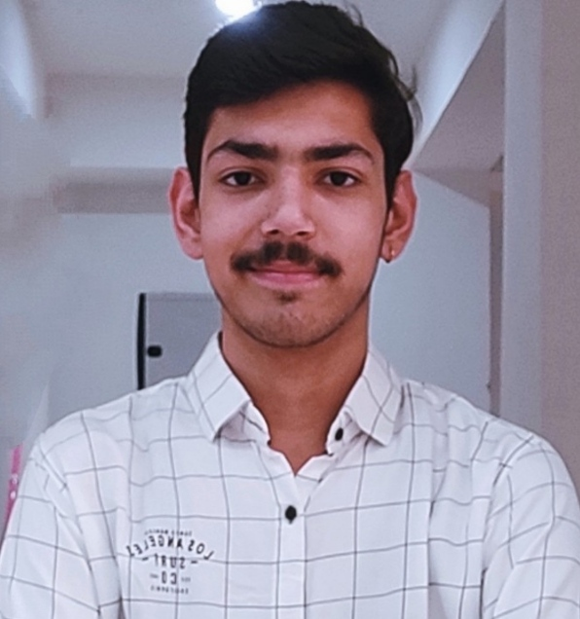
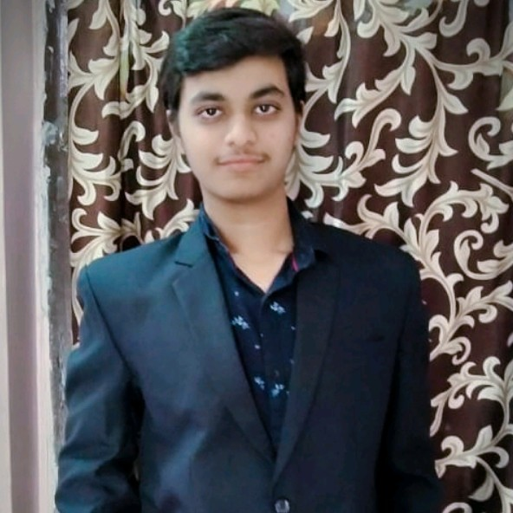
Sarthak Maheshwari
Aditya Parashar
Danish Khan
Task: Create a Welcome Page
Apply CSS to the entire Project
Task: Create a Scorecard Page and Apply JavaScript
Task: Create a Toss Page and Apply JavaScript

