Slide 1

European Soccer Analysis
Aditya Kalyan Jayanti

Slide 2
Making an Informed Decision
Which players to choose to build a team?
Most upcoming player?
To build the most efficient team?
Increasing your probability to win?

Slide 3
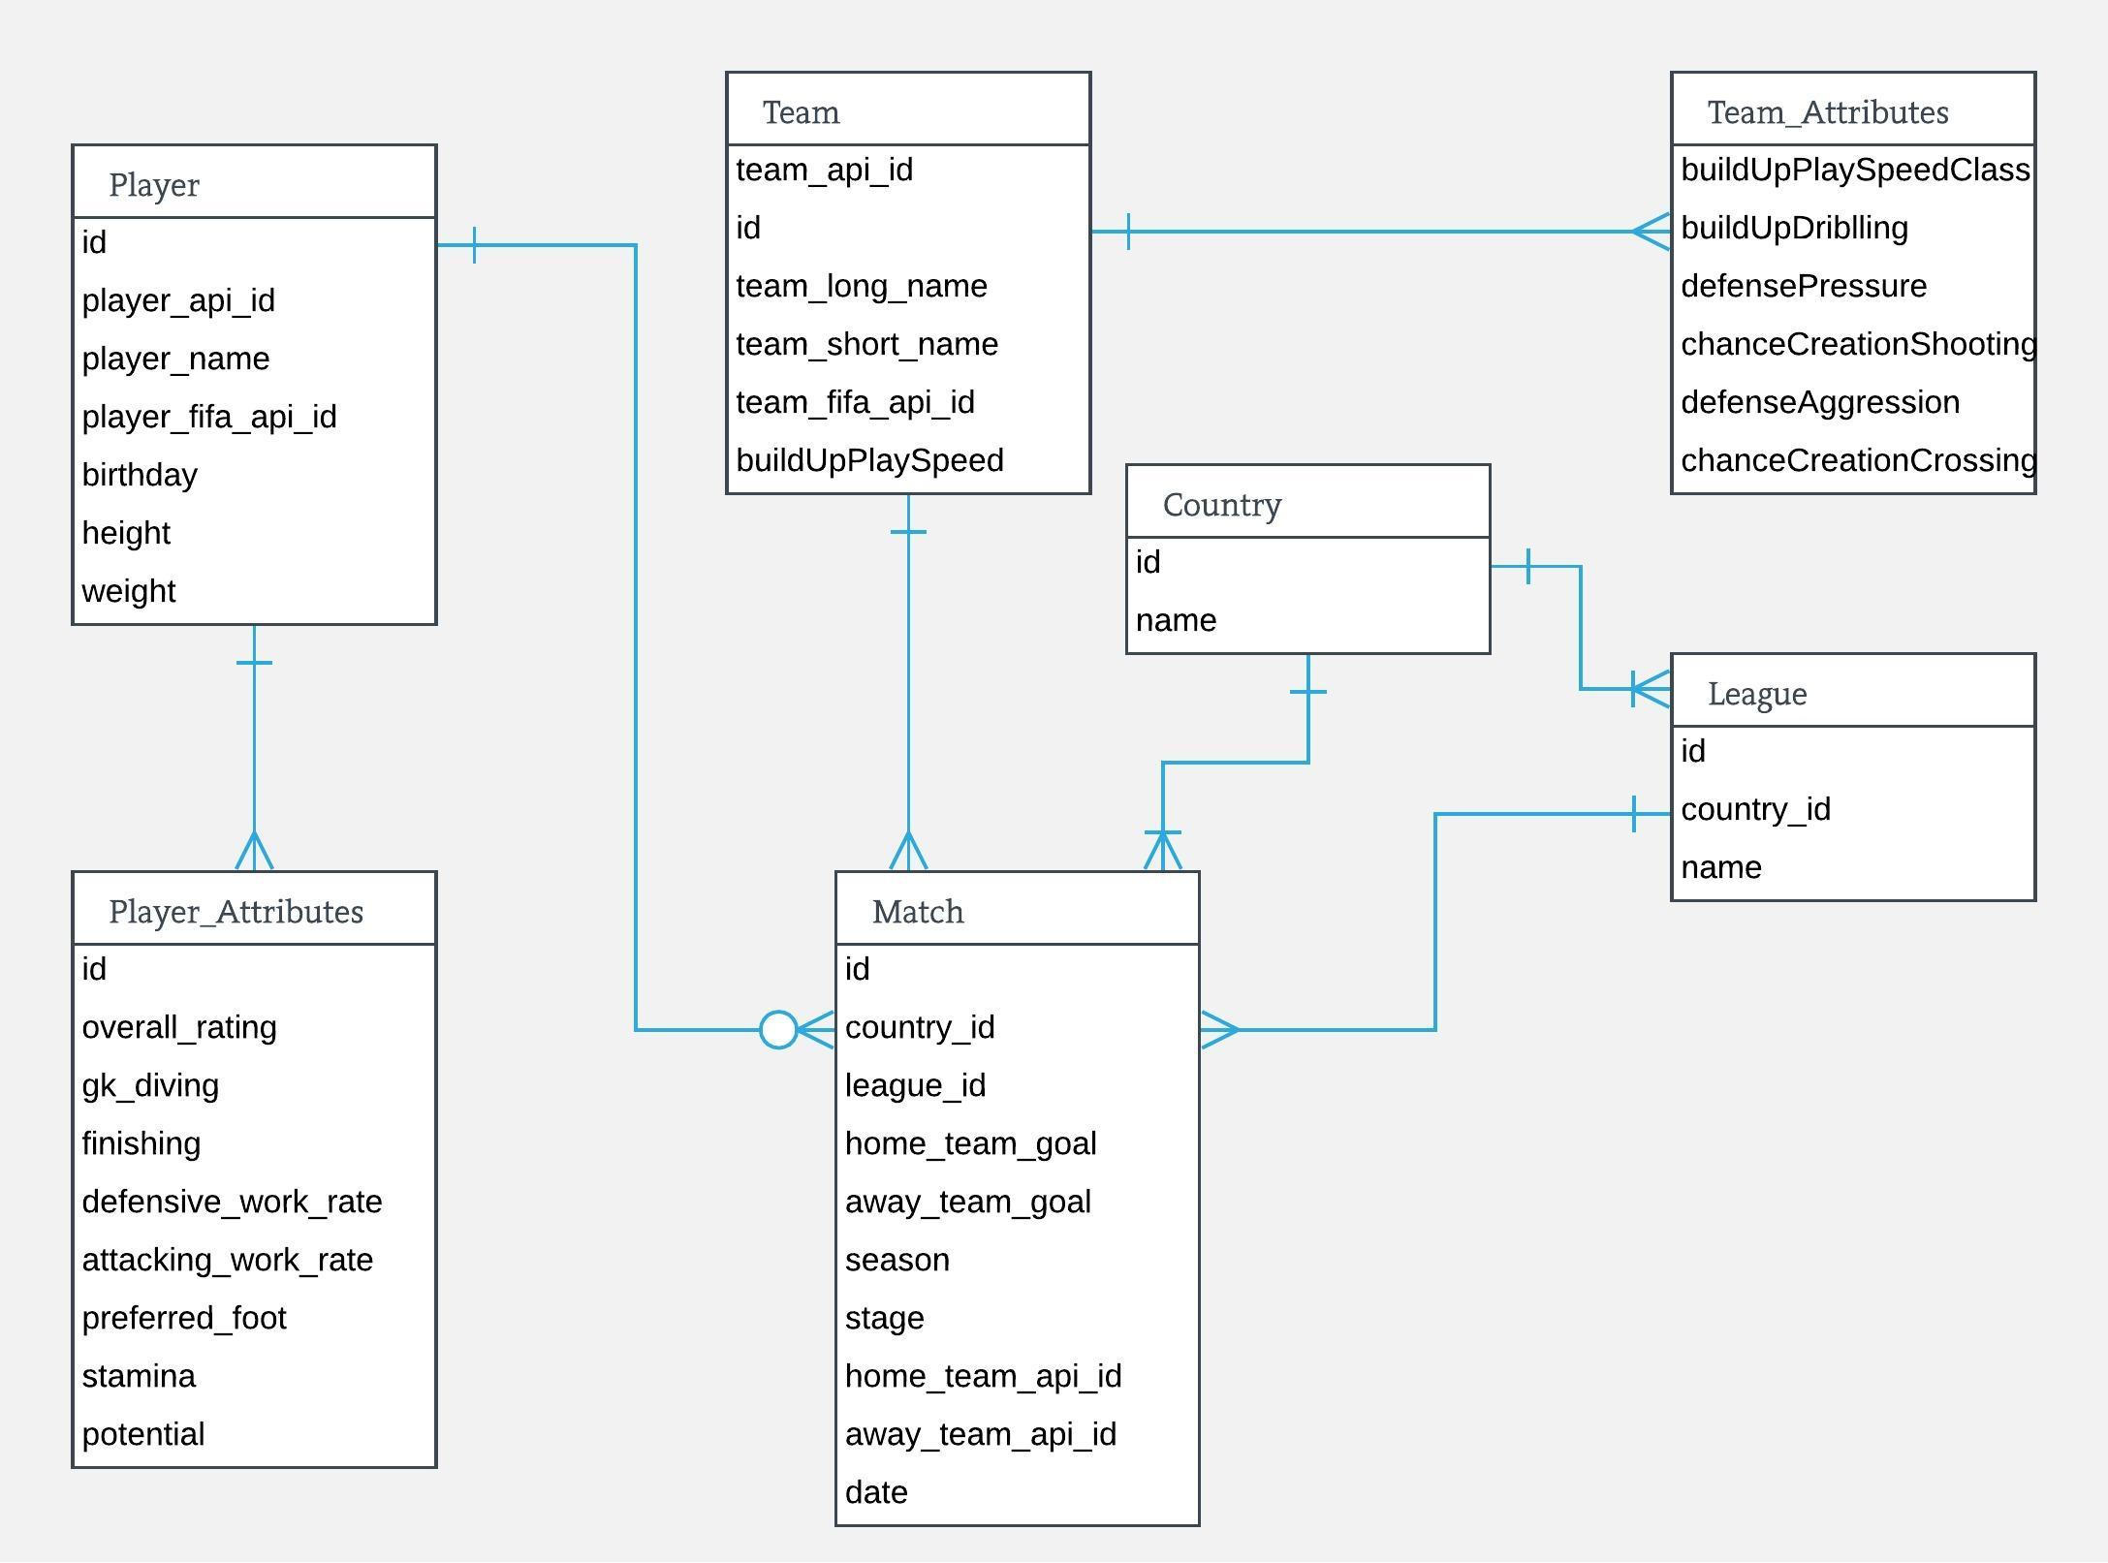
ER Diagram

Slide 4

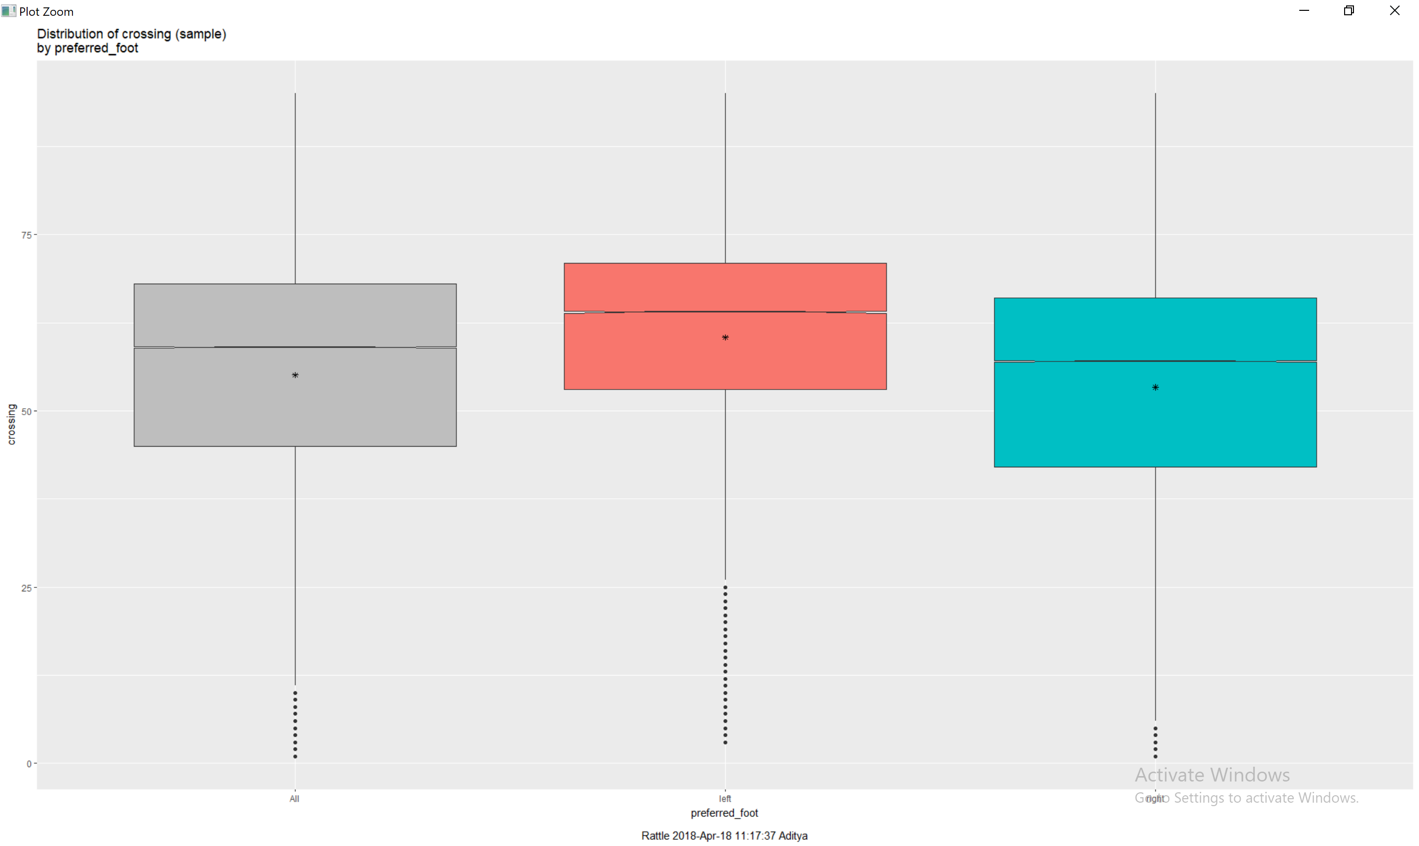
Which foot do you use to cross the ball?

Slide 5

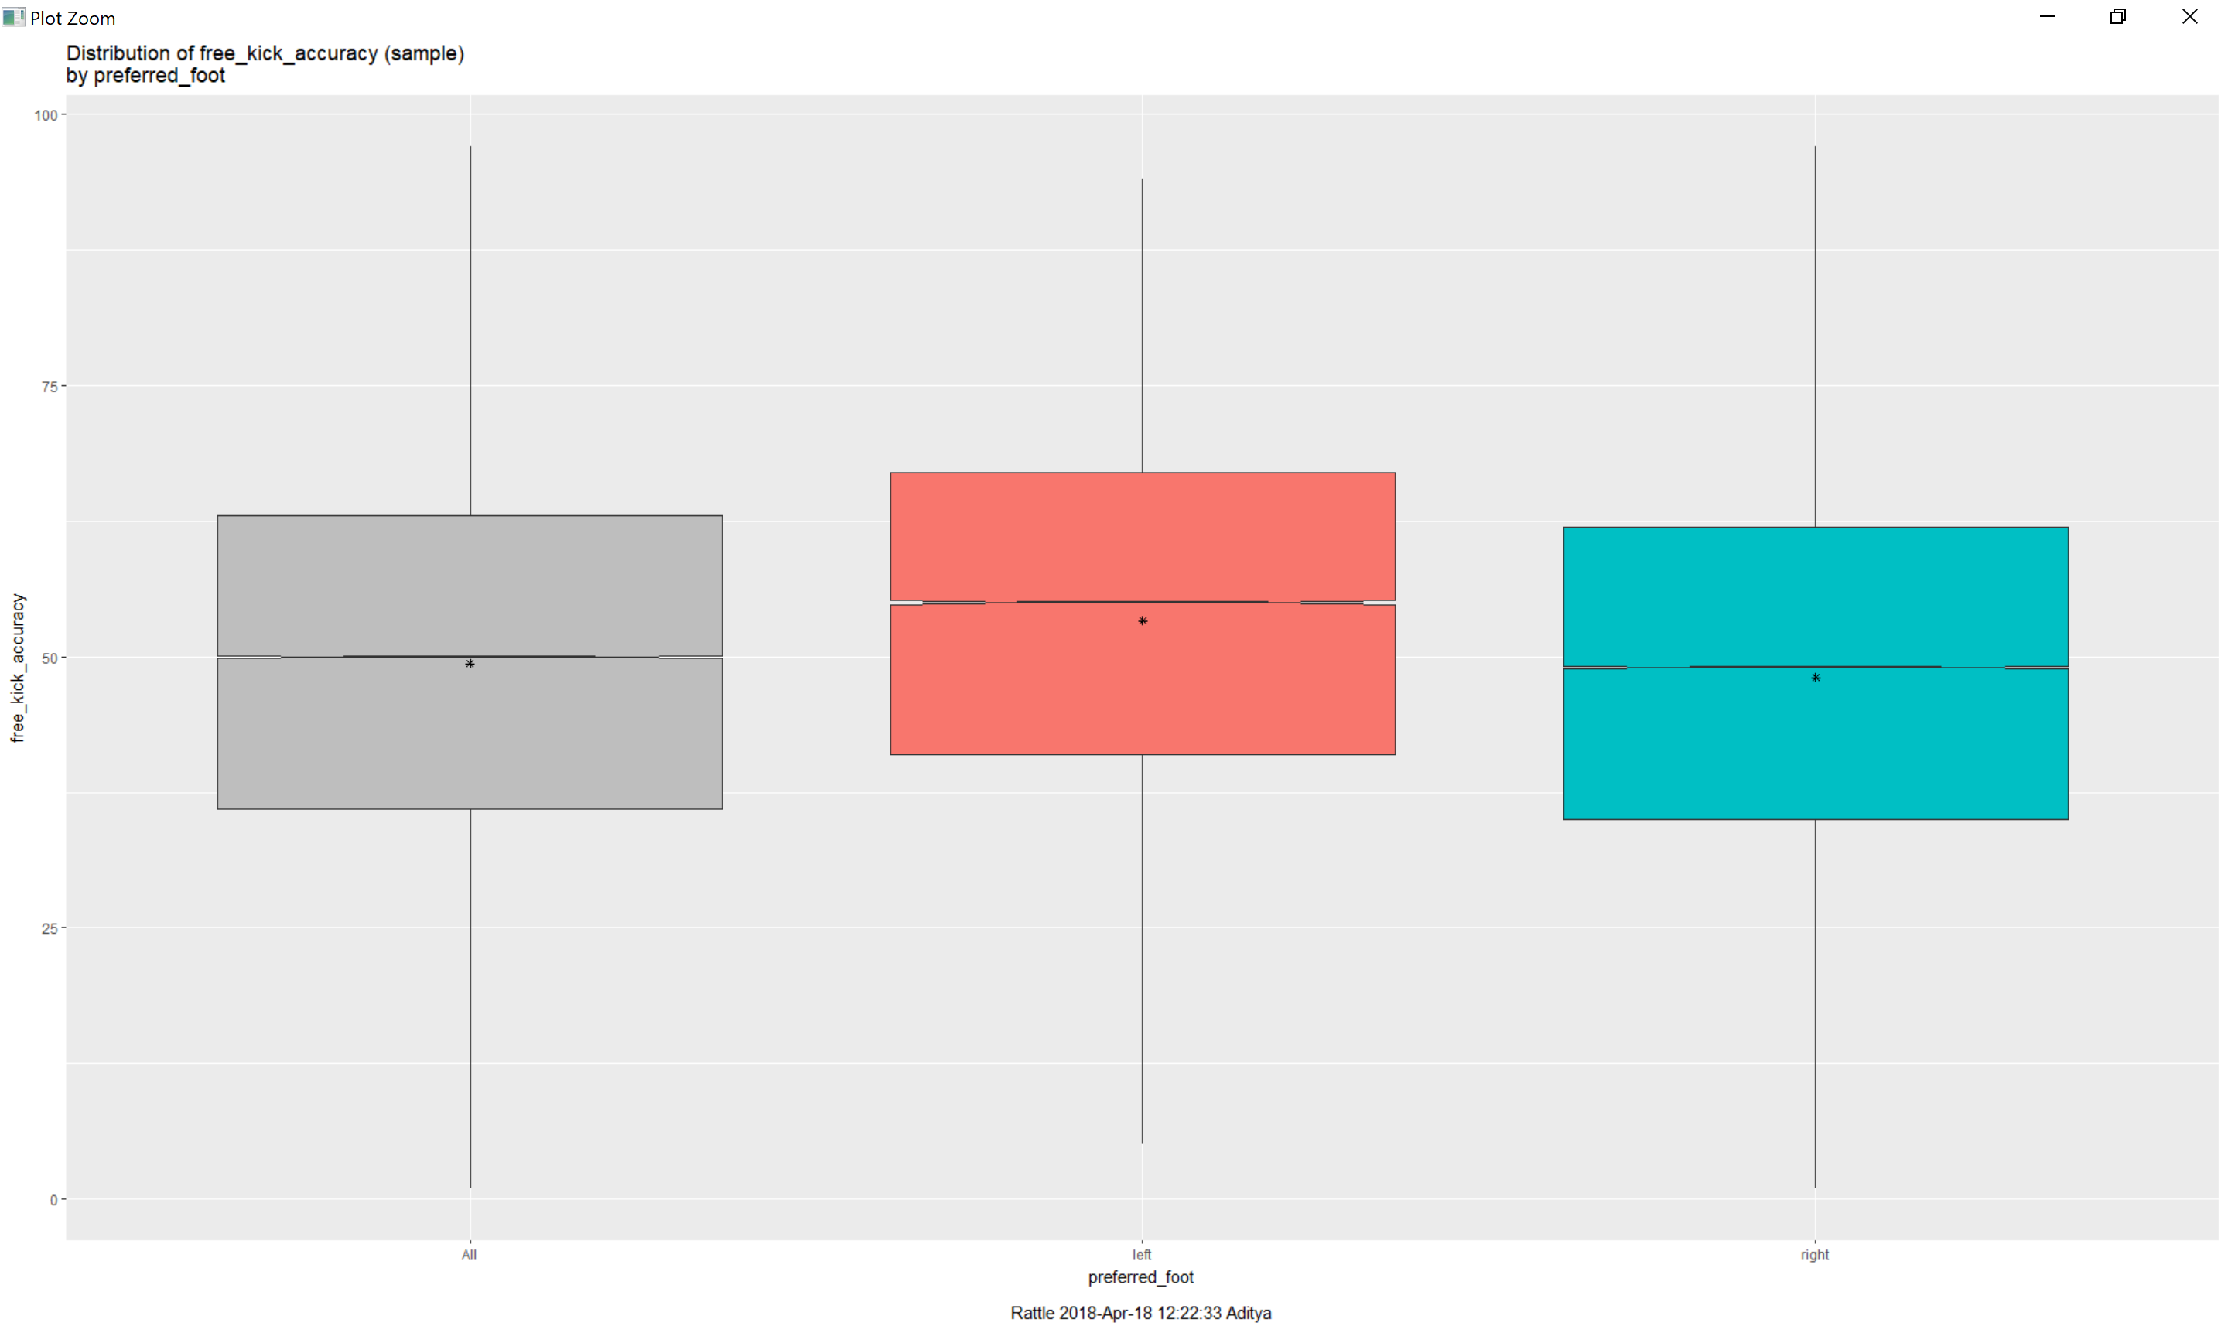
Better Accuracy? Go Left!

Slide 6
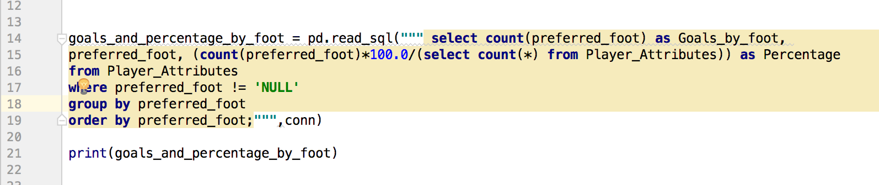
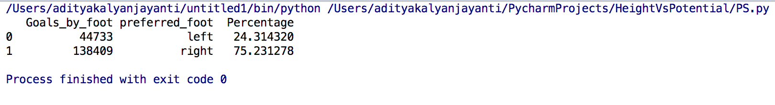
Percentage of Goals by Foot

Slide 7
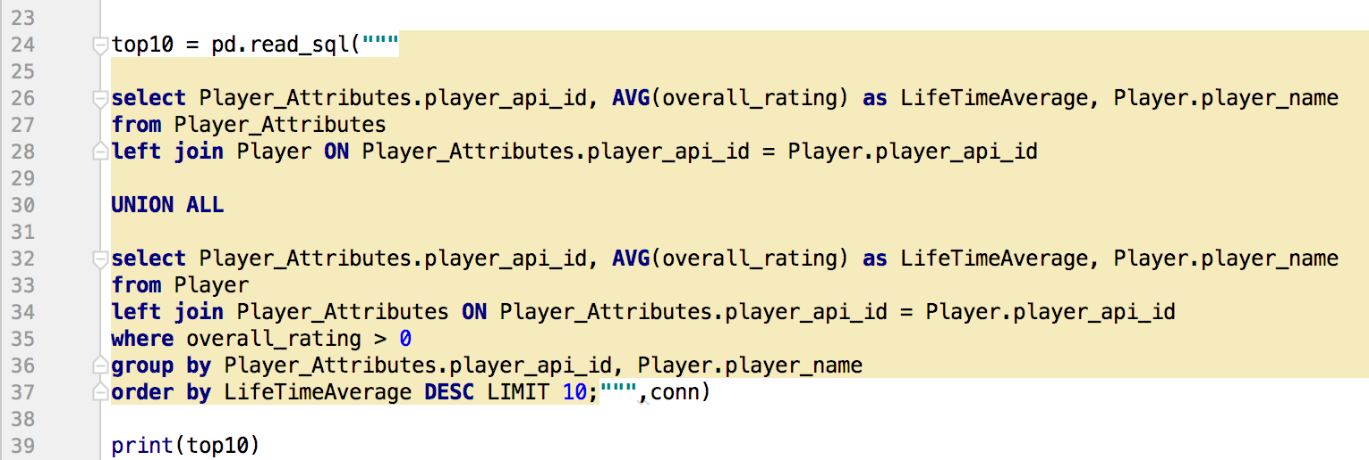
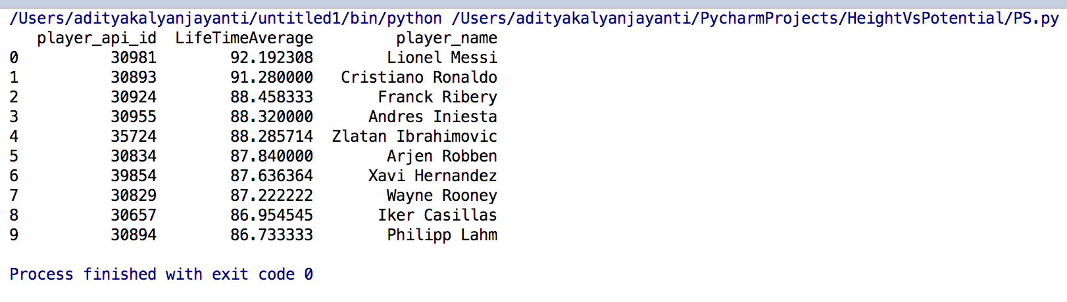
Top 10 Players

Slide 8
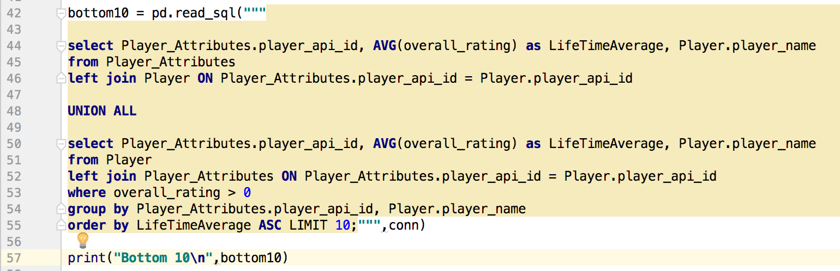
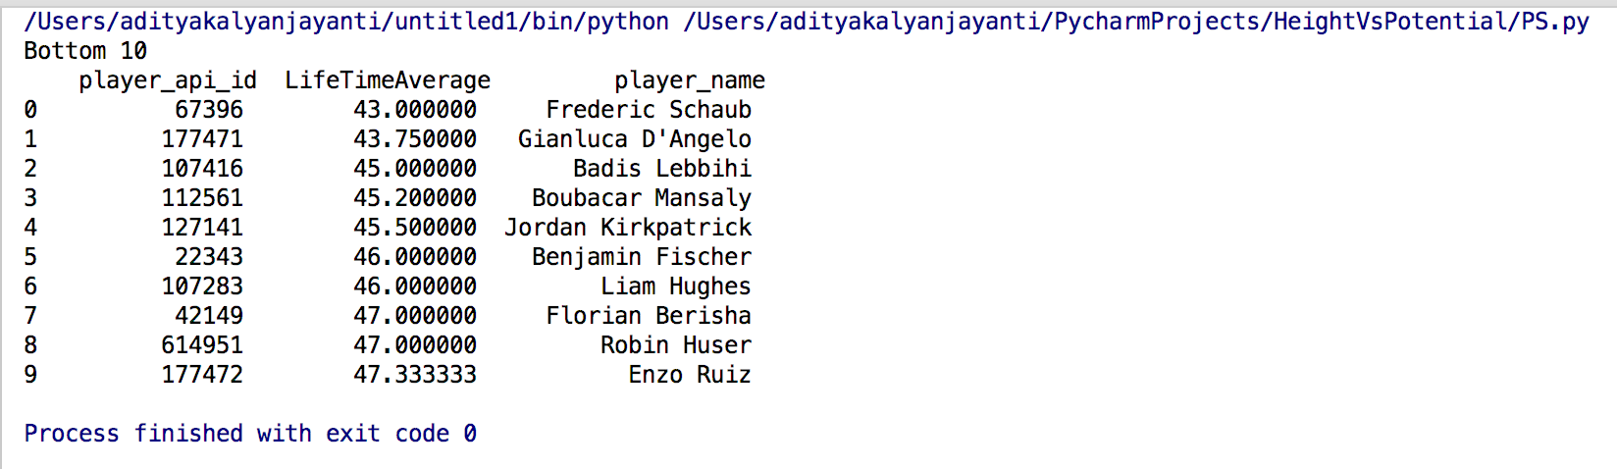
Bottom 10 Players

Slide 9
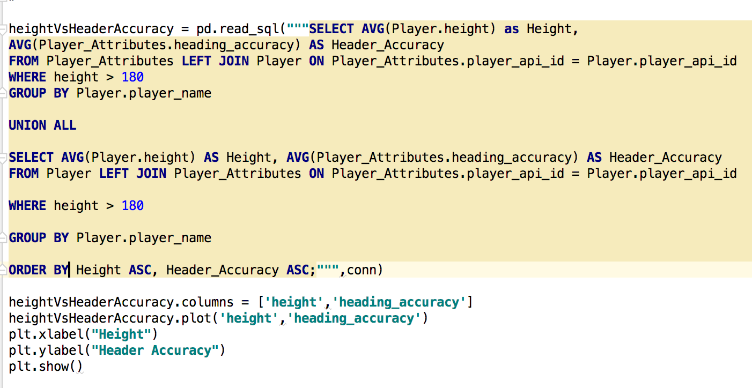
Height v/s Header Accuracy

Slide 10
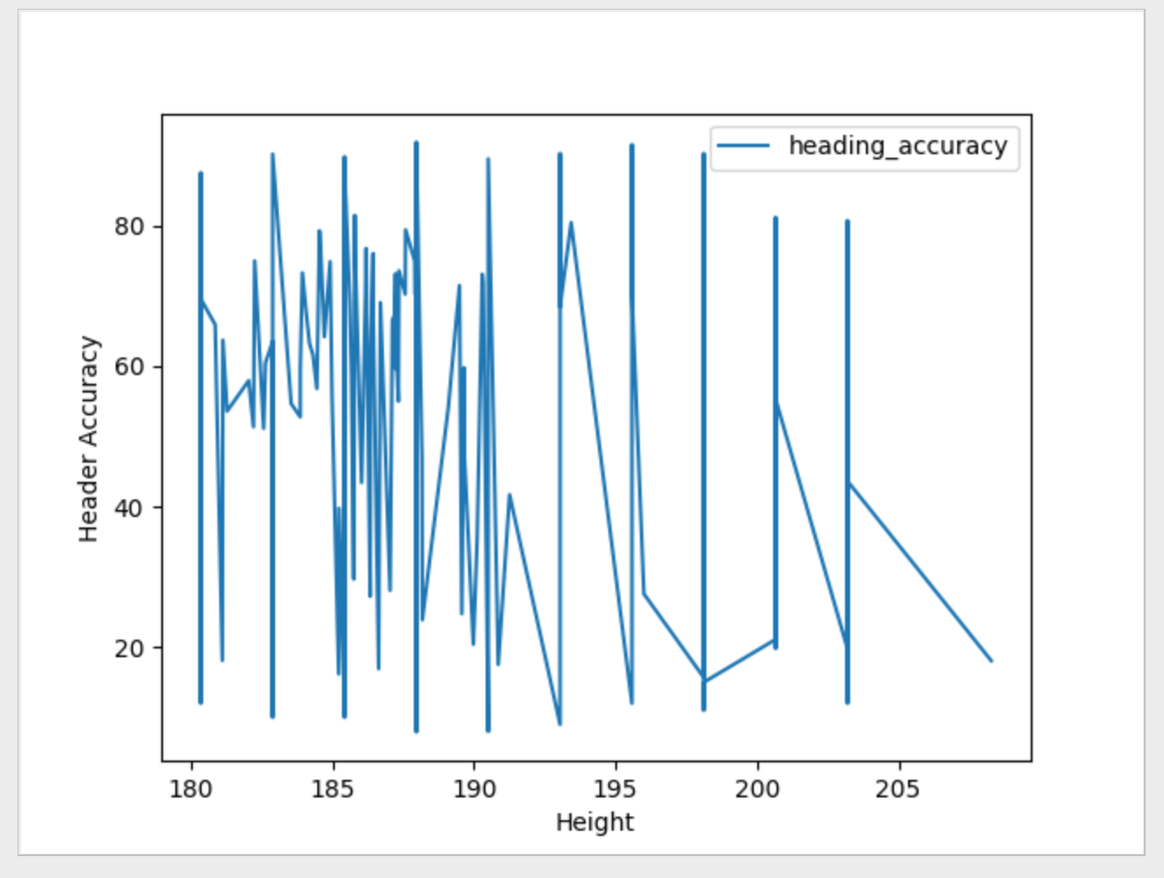

Slide 11
CONCLUSION
Win-Win situation for Players & Team Mangers
Analysis is useful when bidding a player

