Slide 1

Healthcare Expert Advisor
Idea for MPGI Hacks 2023

Slide 2

Table of Content
Introduction
Problem Statement
Idea Explanation
Basic Design
Explanation
Future Ideas

Slide 3
Team
Ayush Gupta
Ayush1Pal
Durgesh Mishra
Aditya Gupta

Slide 4
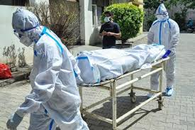

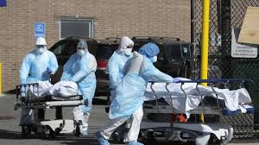
Pitch Deck Presentation
Problem Statement
Recent surveys have indicated that now days whenever there is a emergency situation , the survival rate of the patient depends on whether the hospital he is admitted to have enough facilities or specialists for the treatment.
In some cases even the hospitals decline to administer to the patient , as they don’t have sufficient equipment to administer the problem.

Slide 5


Basic Idea
Our Site is an online platform designed to provide customers with the best advice and resources on healthcare. We understand that choosing the right hospital can be a difficult decision, so we strive to provide you with the most up-to-date information on hospital performance to increase a patient’s survival rate. Additionally, our team of experts provide quick health tips to help you stay healthy and informed.

Slide 6


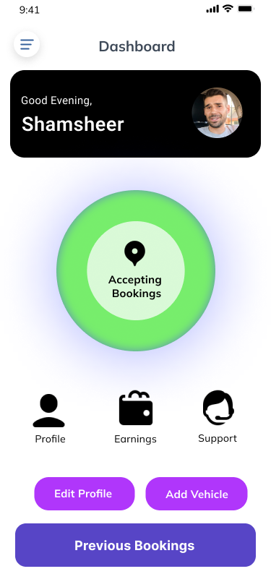
COMPANY GROUP
Hexa to save lives
Basic Design
Connecting Cargo to Transporters
This is the basic design of our interface

Slide 7

About us
This page tells about the basic services and motto we follow to provide those services

Slide 8
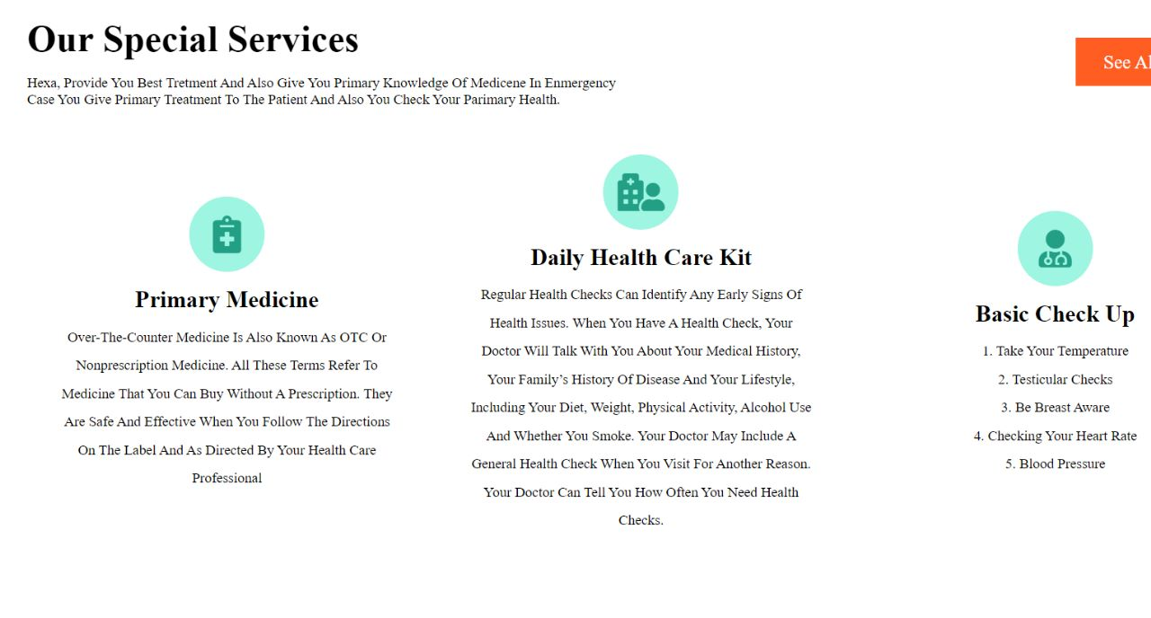
This page explains the other services we provide like primary OTT medicines (medicines that can taken without any prescription) , daily healthcare equipment like(heart monitor, BP monitor , Sugar monitor and so on ) , and monthly health checkups to monitor one’s health index while sitting at home.

Slide 9
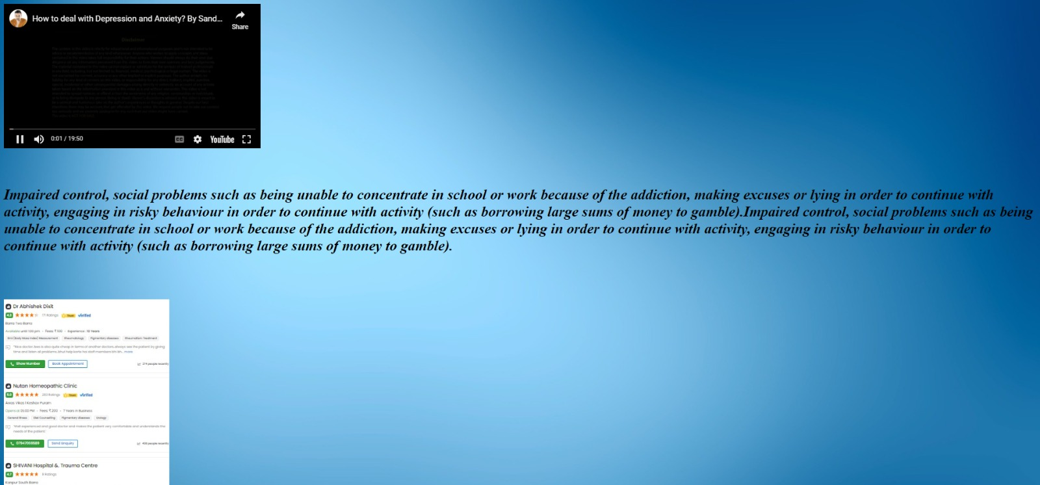
This panel is the response towards the patients ‘ emergency situation where a video shows the procedure to follow to helps treat the patient while waiting for ambulance and contact information of specialists in that area.

Slide 10
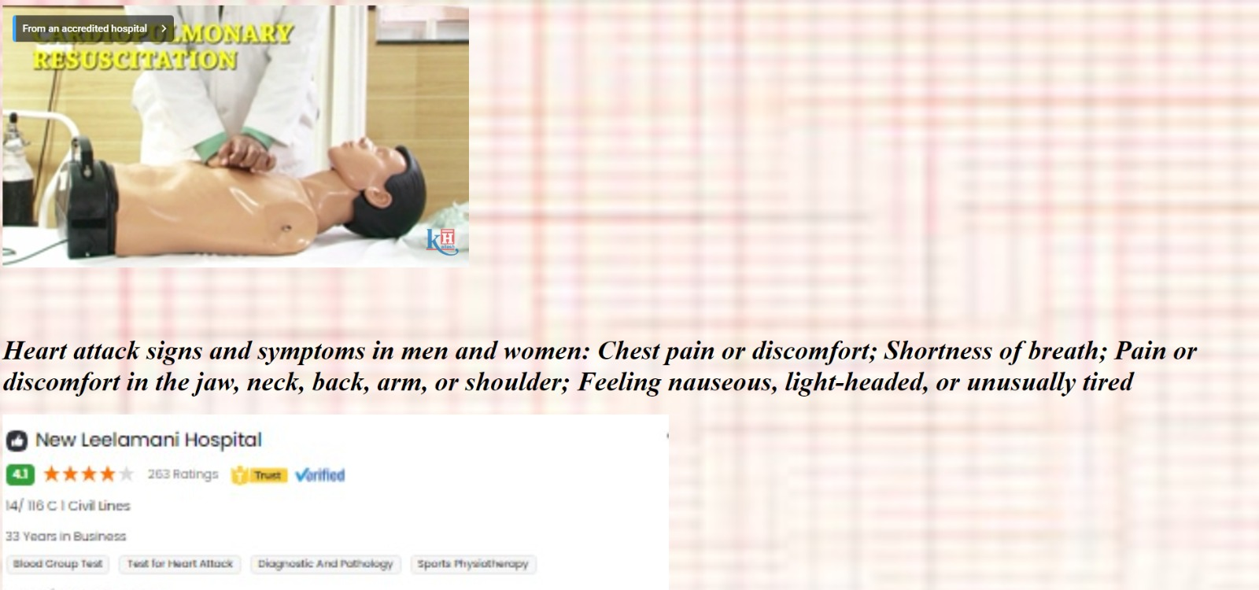
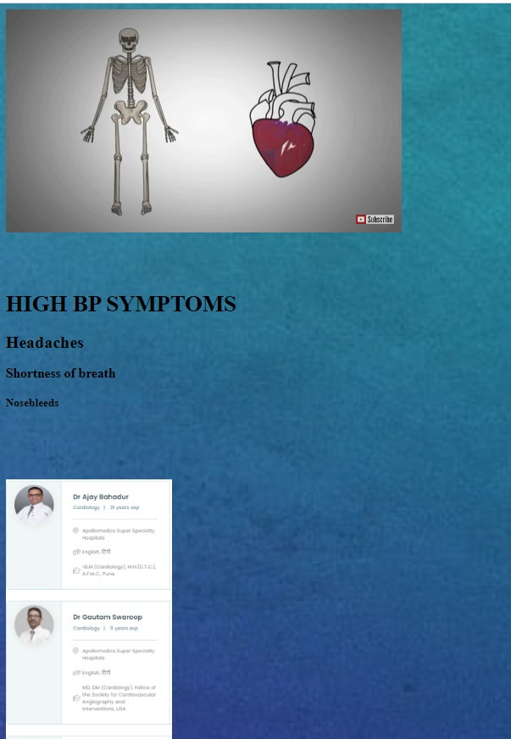
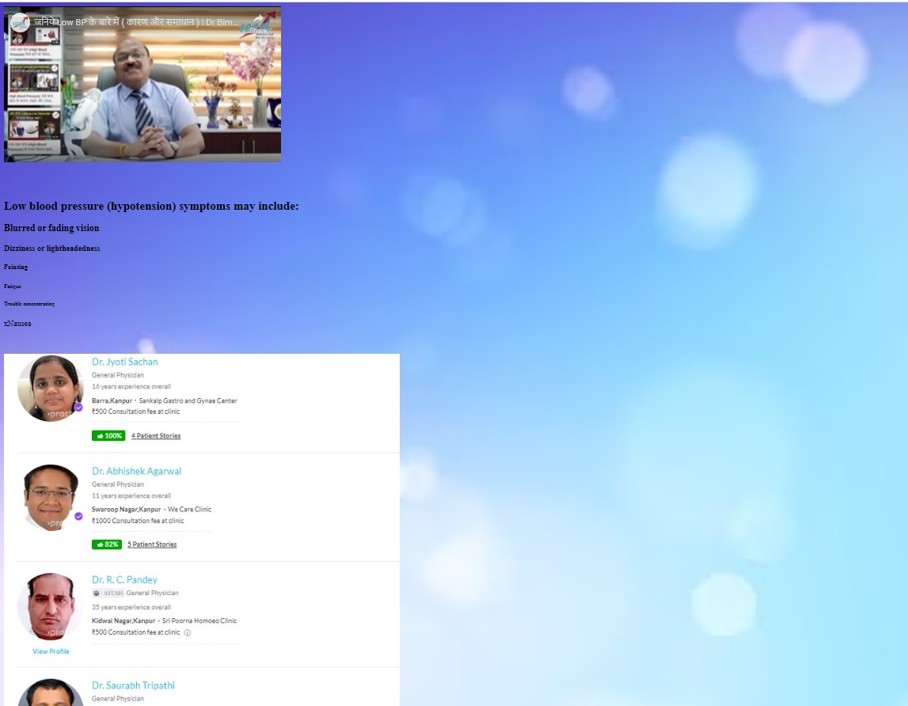
Currently there are 4 such pages

Slide 11

customers will be able to store previous hospital records and reports. That will lead to doctors having previous records of their patients using ai(artificial intelligence) Constructing perfomance index and charts of hospitals using the data provided by the patients.
FUTURE IDEAS

Slide 12
Thank You

