Slide 1

Project Title –Credit Card Transaction and Customer Dashboard
[Aditya Adak]

Slide 2

PROBLEM STATEMENT
To develop a comprehensive credit card weekly dashboard that provide real-time insights into key performance metrics and trends, enabling stakeholders to monitor and analyze credit card operations effectively.

Slide 3
Project Description
This project aims to develop a comprehensive weekly dashboard using Power BI
that provides real-time insights into key performance metrics and trends
related to credit card transactions. The dashboard will help stakeholders
monitor, analyze, and make informed decisions regarding credit card operations,
revenue, customer behavior, and financial performance.

Slide 4

WHO ARE THE END USERS?
Executives and Senior Management:
Purpose: To gain a high-level overview of the financial performance, revenue trends, and key
operational metrics. They use this information to make strategic decisions and set organizational goals.
Financial Analysts:
Purpose: To perform detailed financial analysis, identify trends, and generate reports.
They use the dashboard to drill down into specific data points and understand the
underlying factors affecting financial performance.
Marketing and Sales Teams:
Purpose: To analyze customer behavior and spending patterns. They use the dashboard
to develop targeted marketing campaigns and identify opportunities for upselling and
cross-selling credit card products.
Customer Service Teams:
Purpose: To monitor customer satisfaction and identify issues related to transactions
and payments. They use the dashboard to respond promptly to customer inquiries and
improve service quality.

Slide 5
Technology Used
Data Visualization and Dashboard Development:
Tools: Power BI, Tableau
Purpose: To create interactive and user-friendly visualizations and dashboards for monitoring key performance metrics and trends.

Slide 6
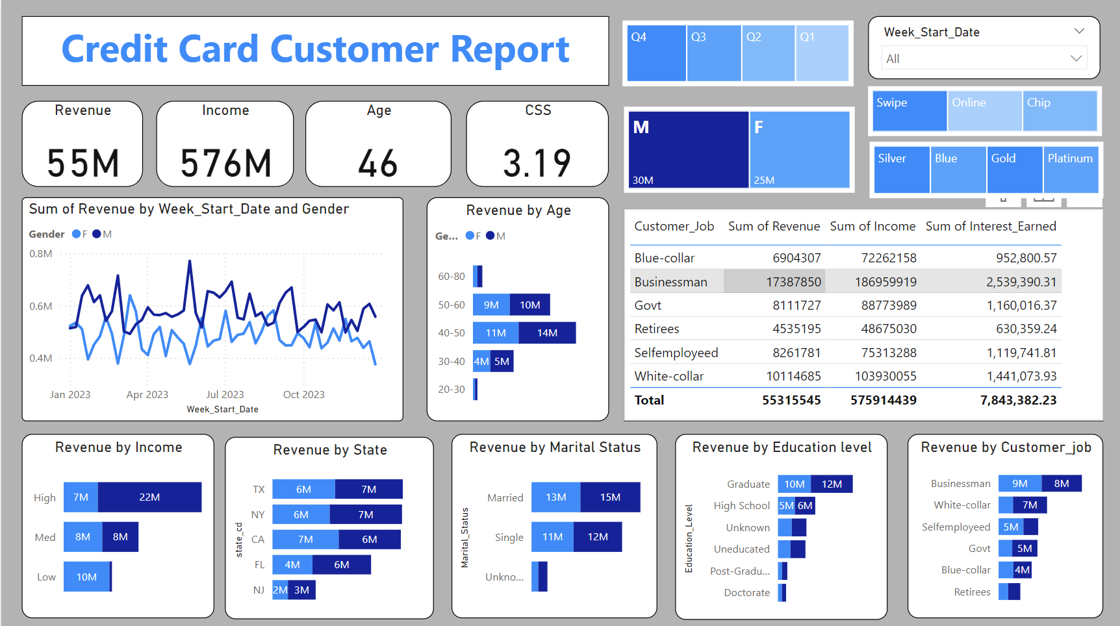
RESULTS

Slide 7
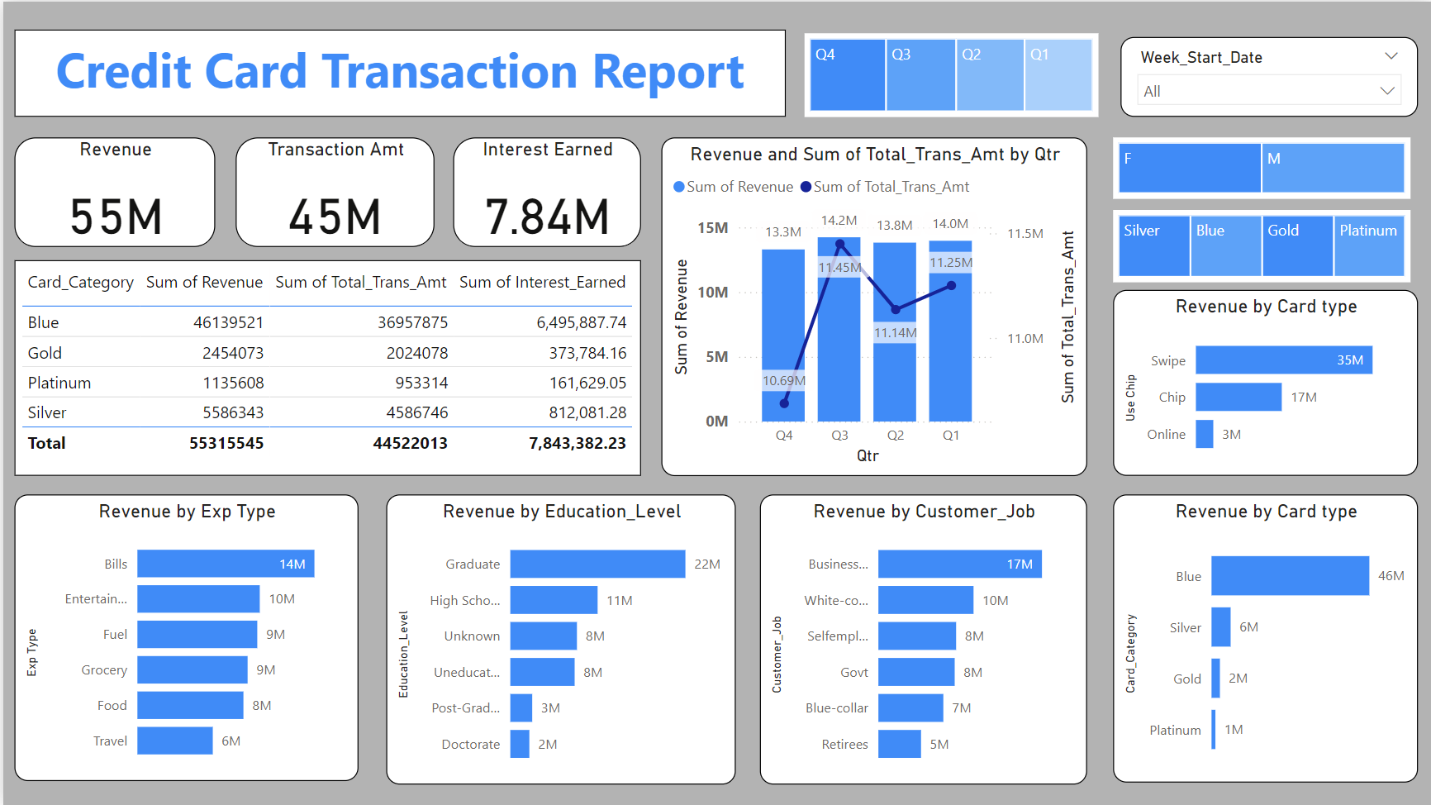
RESULTS

Slide 8
Key Insight
1)Last Week sale decrease by 12%.
2)Male Contribute maximum to generate revenue.
3)Total Revenue generated is 55M.
4)Most used chip is swipe.
5)Blue card generate maximum revenue.
6)Total interest earned is 7.84M.
7)40-50 age group contribute maximum to revenue.

Slide 9
RESULTS
Real-Time Dashboard:
A dynamic, real-time dashboard that provides up-to-date insights into
key performancemetrics and trends in credit card operations.
Enhanced Monitoring:
Improved ability for stakeholders to monitor transaction volumes,
transaction values, and revenue trends on a weekly basis.
Informed Decision-Making:
Enhanced decision-making capabilities for executives and senior
management based on comprehensive data visualizations and trend analysis.
Detailed Financial Analysis:
Detailed financial analysis and reporting capabilities for financial
analysts, including breakdowns by expenditure type, customer education
level, job category, and transaction method.
Demo Link
https://github.com/AdityaAdak8085/Credit-Card-Transaction-and-Customer-Dashboard.git

Slide 10
Thank you
I am deeply thankful to VOIS and the whole team for the exceptional data analysis
project opportunity, which has significantly elevated my skills and prepared me for
substantial accomplishments in this field.
.
.

