Slide 1
Food Recommendation System
Name: Aditya Adke UFID: 84825619

Slide 2
Project Overview & Objectives
Objective: The objective of this project is to build a machine learning model that recommends best food to user according to user’s nutritional requirements . For example, a list recipe is high in protein based only on the keywords of the recipe requirement.
Data Sources
Recipes Dataset: https://www.kaggle.com/datasets/irkaal/foodcom-recipes-and-reviews
Reviews Dataset:
https://www.kaggle.com/datasets/irkaal/foodcom-recipes-and-reviews
Recipe and Ingredient Data:
https://www.kaggle.com/datasets/shuyangli94/foodcom-recipes-with-search-terms-and-tags

Slide 3
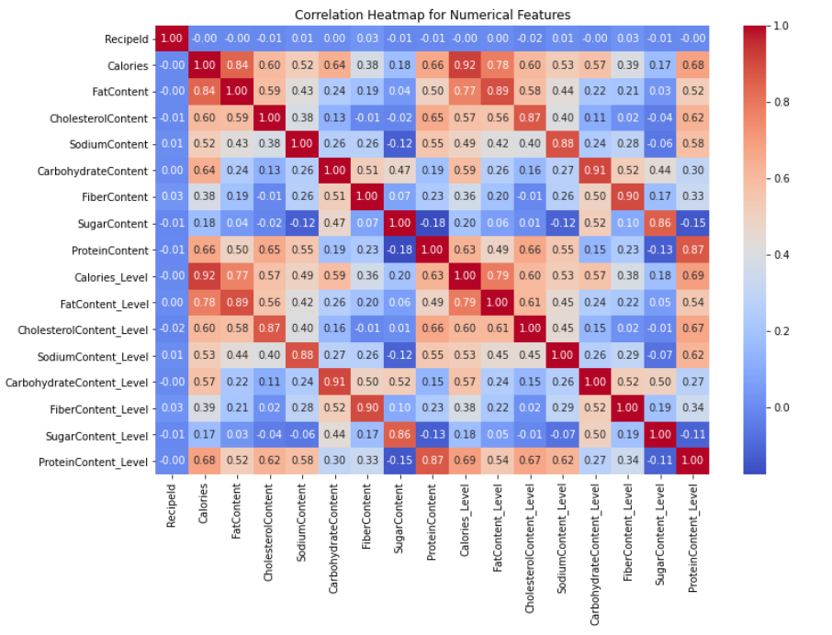
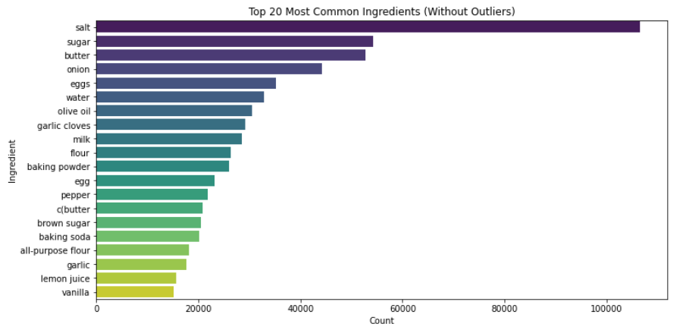
Exploratory Data Analysis
(EDA Results)
The heatmap shows the relationship strong between the nutrients and their nutrient_level. Indicating we have correctly generated new variables, keeping proportionality similar.
Calories and FatContent are highly correlated
Calories and ProteinContent also show strong correlation
Calories and CarbohydrateContent show moderate correlation
Most common ingredients for dishes are raw items used for cooking

Slide 4
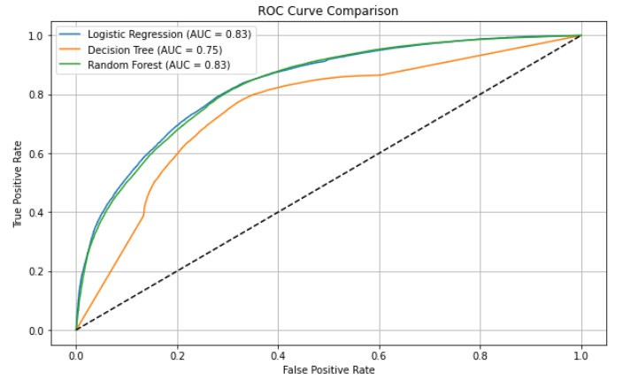
Model Selection & Evaluation
Approaches Implemented:
Models Evaluated: - Decision Tree →Slightly Overfits - Random Forest Regression → good result - Logistic Regression → best results Best Model: Logistic Regression
- AUC ROC: 0.83 - Accuracy : 0.78
- F1- Score: 0.85 - Recall: 0.93 Features Used: • Keywords Column • Nutrients_level (Protein (here), Carbs, Fats, Calorie, Cholestrol, Sodium, Sugar)
Process of using Keywords: • TF-IDF Vectorizer

Slide 5
Key Takeaways and Future Work
Key Takeaways
Future Work
As Scientifically proven nutrients have correct correlation as expected
Logistic Regression delivers more accurate results
Feature engineering (Heatmap) proved crucial for understanding relations
Implement the Streamlit dashboard with interactive filters
Expand analysis to other nutrients
Explore Deep Learning models to more advanced recommendation
Add sentiment analysis of review content

