Slide 1
Major Project: Student Dropout Analysis

Slide 2
DESCRIPTION OF THE TOPIC
While college dropouts are frequently portrayed in popular culture as the rebels who changed the world, dropping out usually results in emotional distress and a loss of investment. It also negatively impacts the universities' performance records and expected outcomes. Nevertheless, if we could identify the students who are most likely to drop out, the universities could provide support to those who are at risk, and the students themselves could be better equipped to make decisions about their own futures.

Slide 3
FEASIBILITY STUDY
Data Availability: Check if there's enough reliable data on student demographics, academic performance, etc.
Model Suitability: Assess if machine learning models like logistic regression or decision trees are appropriate for predicting dropout rates.
Feature Importance: Determine which variables are most predictive of dropout rates and if any feature engineering is needed.
Data Preprocessing: Plan for handling missing data, encoding categorical variables, and scaling features.
Model Training: Estimate the computational resources required for training models and validate them using techniques like cross-validation.
Interpretability: Consider if stakeholders can understand and trust the model's predictions, and if there are methods to explain its decisions.
Impact Assessment: Evaluate the potential short-term and long-term benefits of the project in reducing dropout rates and improving educational outcomes.

Slide 4
EXISTING SOLUTIONS
Predictive Modeling: Use machine learning algorithms to forecast dropout rates based on historical student data.
Early Warning Systems: Implement systems that use real-time data to identify at-risk students and provide timely interventions.
Predictive Analytics Platforms: Utilize platforms with pre-built models and visualization tools for tracking and addressing student attrition.
Research Papers and Studies: Refer to academic research for novel machine learning approaches to analyzing dropout rates.
Open-Source Projects: Explore open-source libraries and projects focused on educational data analysis.
Collaborative Initiatives: Engage in collaborative efforts between institutions, researchers, and technology companies to develop innovative solutions.

Slide 5
GAPS IN EXISTING SOLUTION
Data Accessibility: Limited or incomplete datasets hinder accurate predictions.
Interpretability: Models often lack interpretability, hindering trust and understanding.
Integration Issues: Integration with existing systems may be complex and require significant resources.
Effectiveness Assessment: Limited evaluation of intervention effectiveness hampers improvement efforts.
Long-Term Impact: Little research exists on the long-term effects of machine learning interventions on student success.
Generalizability: Models may not generalize well across different contexts and demographics.

Slide 6
PROBLEM STATEMENT
Creating a machine learning system to forecast student dropout rates by analyzing historical data on various factors such as demographics, academic performance, and socio-economic backgrounds. The system aims to identify students at risk of dropping out and intervene promptly with targeted support strategies. Through accurate predictions and timely interventions, the goal is to improve student retention rates and enhance overall educational outcomes.

Slide 7
OBJECTIVE
To develop a comprehensive analysis of student dropout rates leveraging advanced machine learning models to identify key predictors and patterns, aiming to provide actionable insights for intervention strategies and policy enhancements in education systems.

Slide 8




TOOLS/PLATFORM USED
Jupyter Python
Streamlit
Power BI
Kaggle

Slide 9
DESIGN METHODOLOGY
Objective Definition: Clearly define objectives and scope.
Data Collection and Preprocessing: Gather and clean relevant data.
Exploratory Data Analysis (EDA): Gain insights and visualize key metrics.
Feature Selection: Select relevant features.
Model Selection and Training: Choose models, train, and optimize.
Model Evaluation: Assess performance using appropriate metrics.
Interpretation and Insights: Extract actionable insights.
Deployment and Monitoring: Deploy and monitor model performance.
Documentation and Reporting: Summarize findings and recommendations.

Slide 10
CHALLENGES AND ISSUES IDENTIFIED
Data Quality: Ensuring completeness and consistency.
Imbalanced Data: Addressing bias from unequal dropout and non-dropout samples.
Feature Selection: Identifying relevant predictors amidst numerous variables.
Model Complexity: Balancing accuracy with interpretability.
Overfitting: Preventing models from capturing noise instead of patterns.
Deployment: Integrating models into existing systems effectively.
Resource Constraints: Managing limited computational resources.
Evaluation Metrics: Choosing metrics reflecting real-world impact accurately.

Slide 11
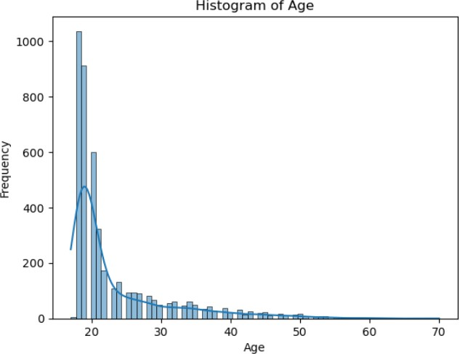
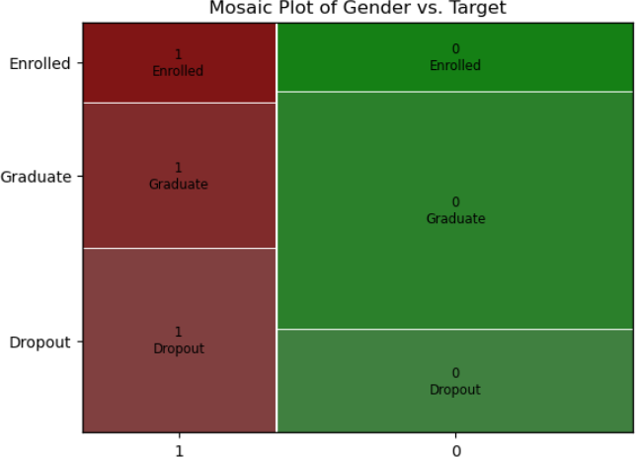
Methodology &Implementation/ Interface and Design Implementation
EXPLORATORY DATA ANALYSIS
This diagram shows the histogram of Age plotted against the Frequency of its appearance
This diagram shows the mosaic plot for Gender vs Target

Slide 12
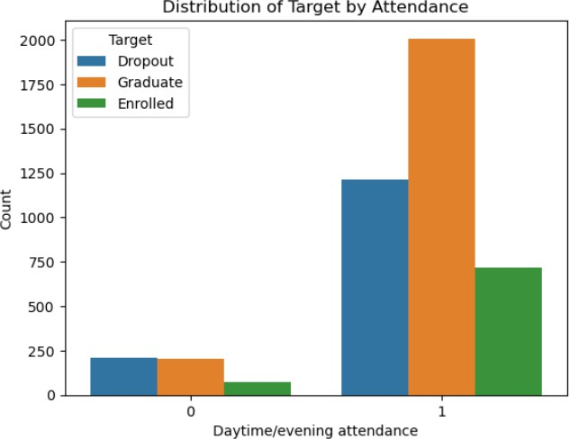
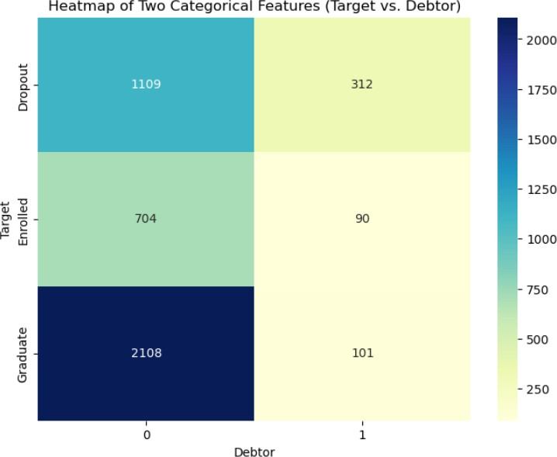
This diagram shows the Distribution of Target by the Attendance for each category
This heat map shows two categorical features Target vs. Debtor

Slide 13
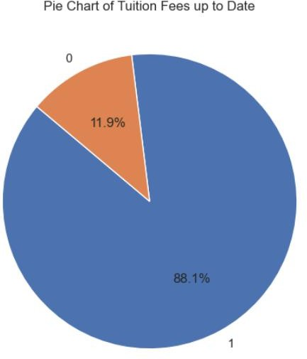
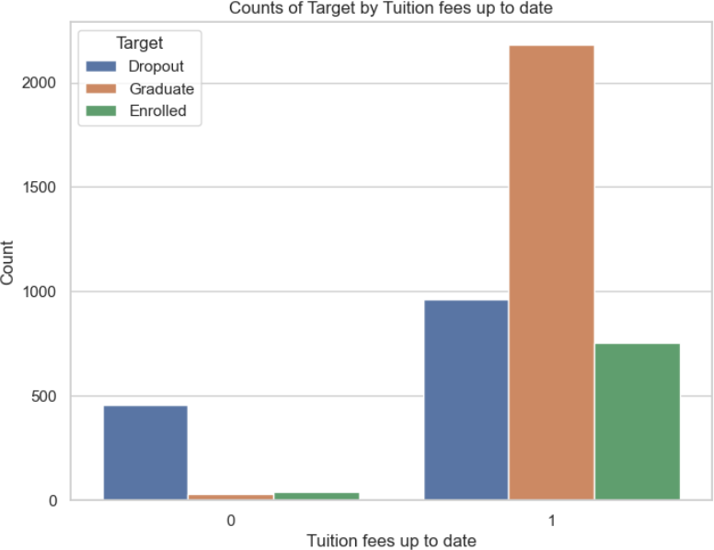
This pie chart shows the percentage of students who have paid their tuition fees
This count plot shows the count of the number of students who have paid their tuition fees up to date.

Slide 14
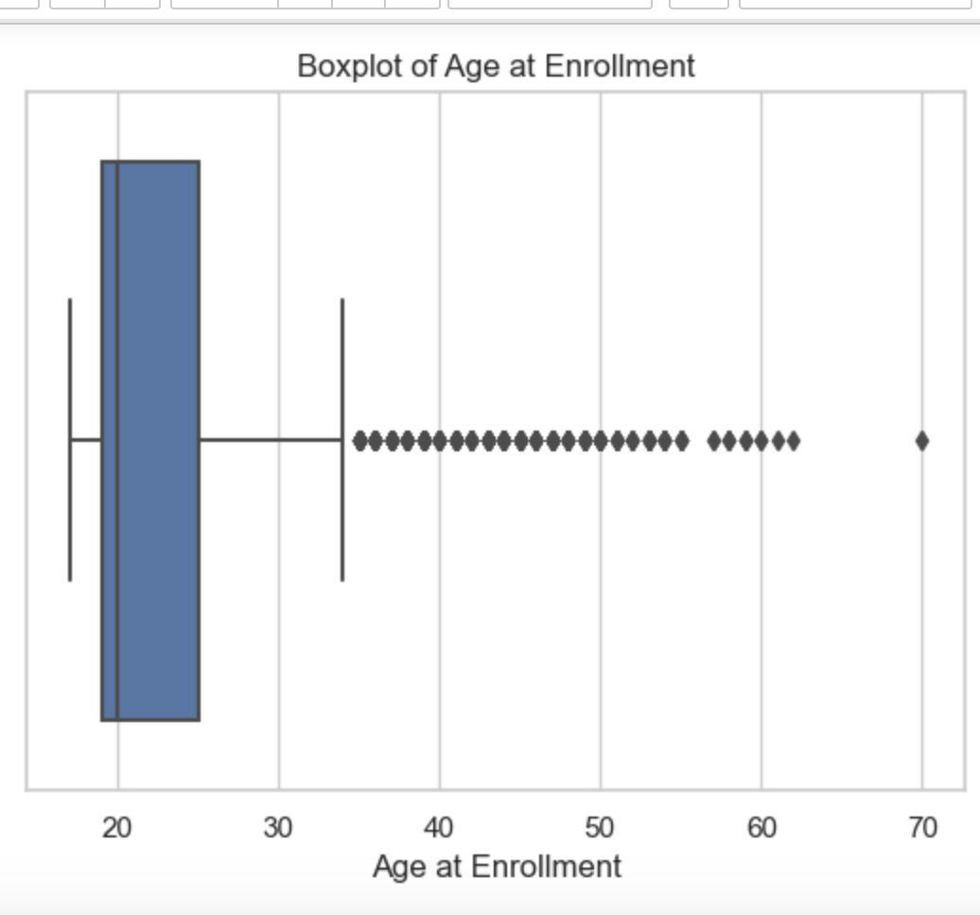
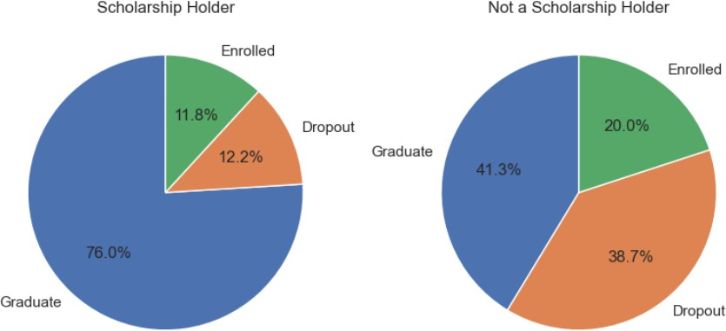
This pie chart shows the percentage of students who have received scholarship and those who haven’t.
This Box Plot shows the Age wise Distribution of the dataset along with outlier at Age 70

Slide 15
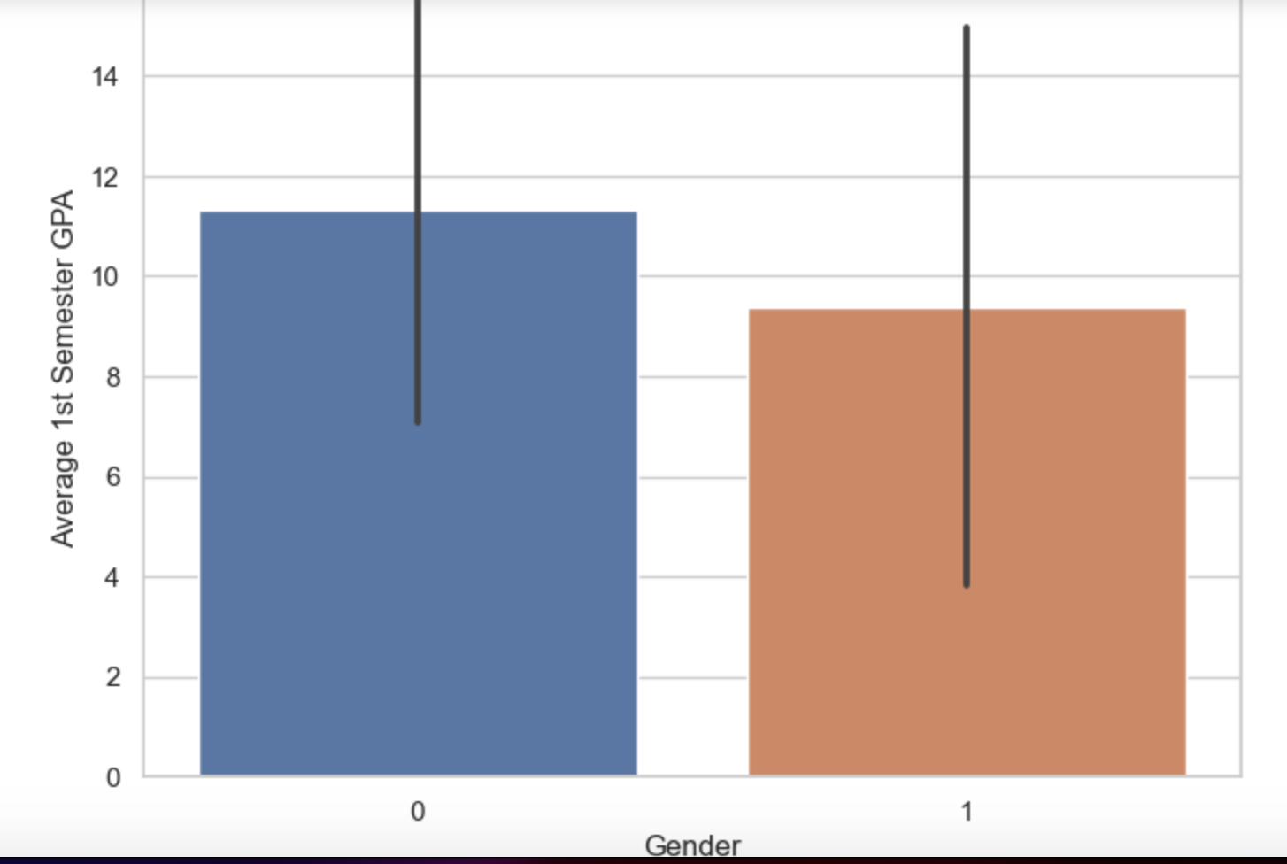
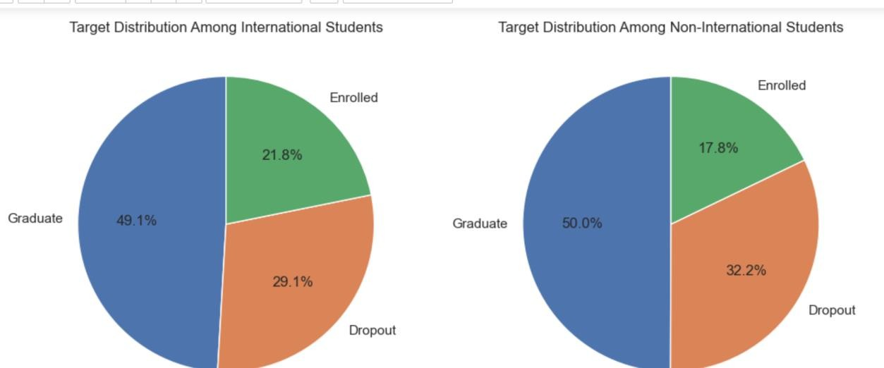
This pie chart shows the target distribution among International and Non International Students
The plot shows Avg. GPA by Gender

Slide 16
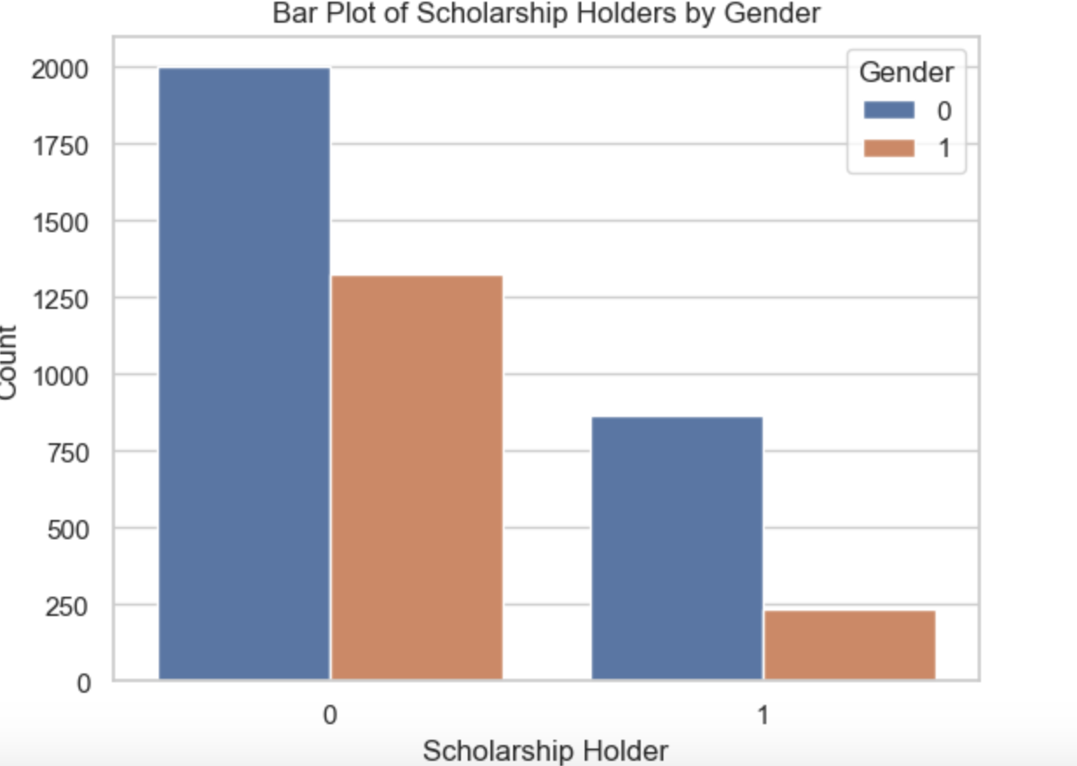
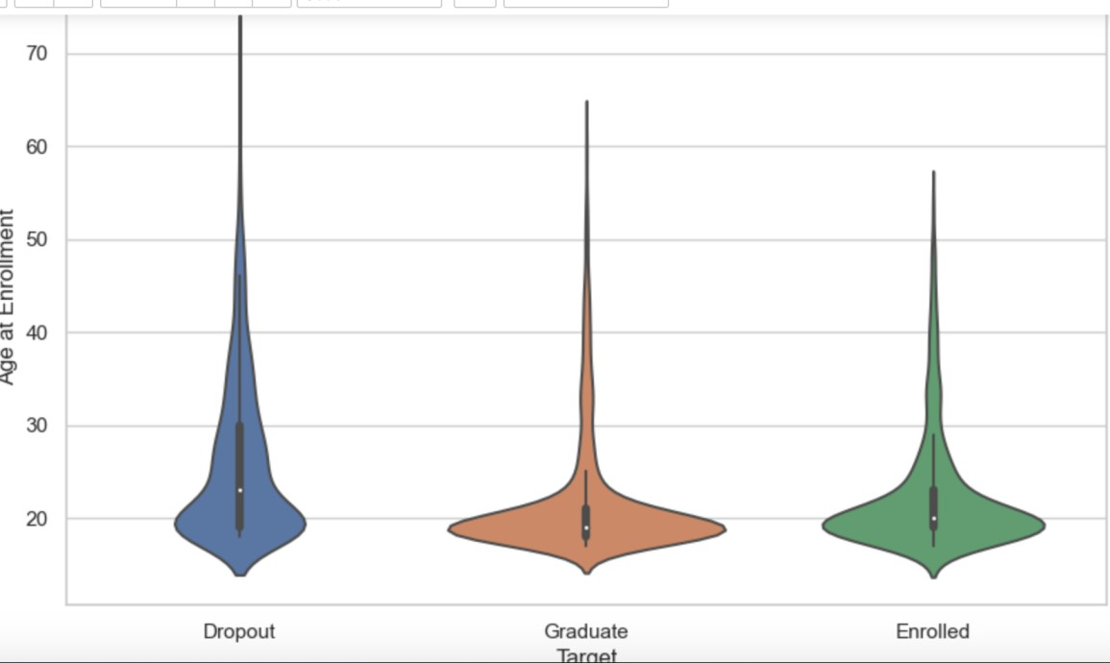
This Bar chart shows scholarship holders by Gender
This Violin plot shows Age at enrollment by target category

Slide 17
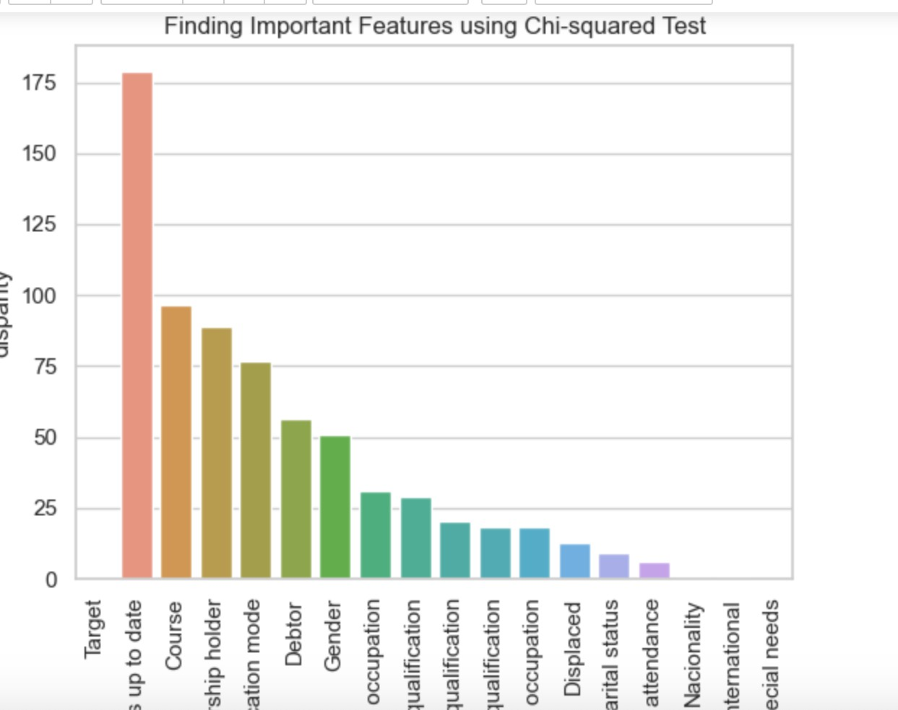
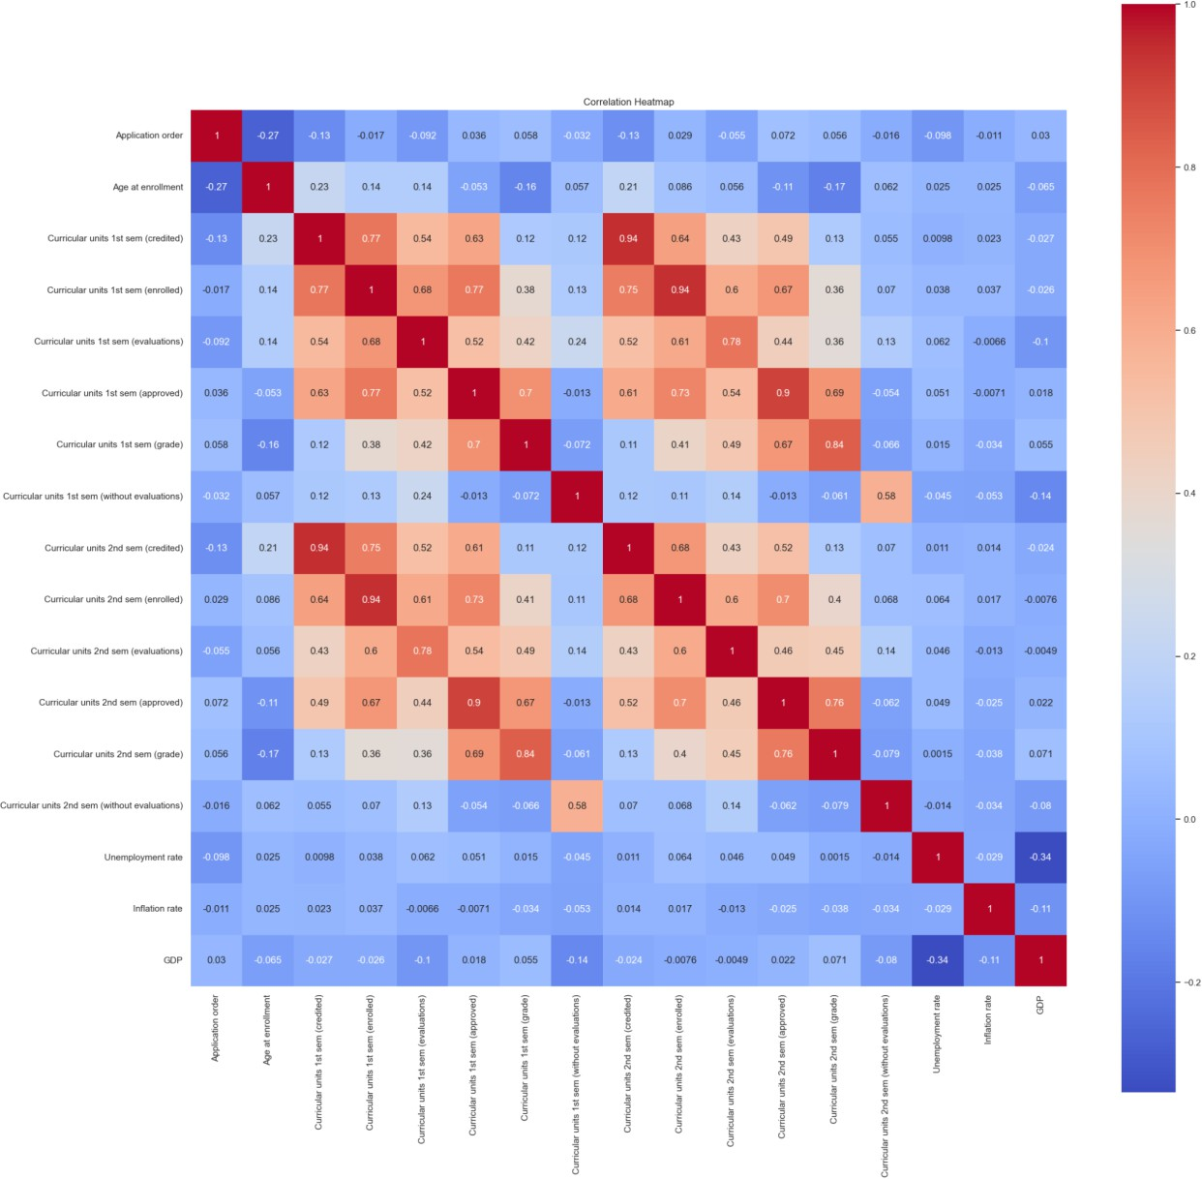
This test shows the important features in the dataset
This map shows the correlation between the features and we find curricular units 1st semester (credited) is correlated with 2nd semester(credited)

Slide 18
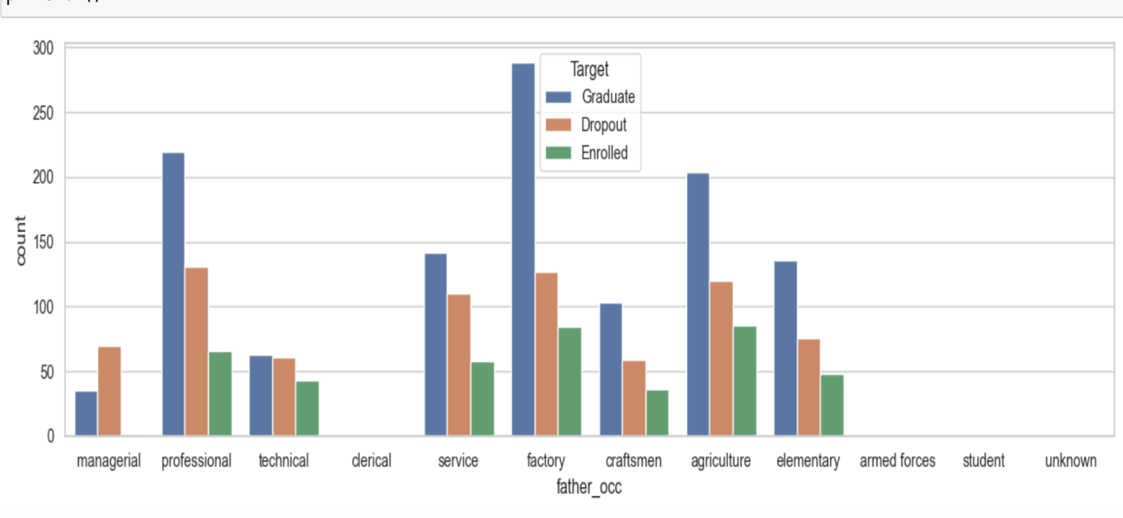
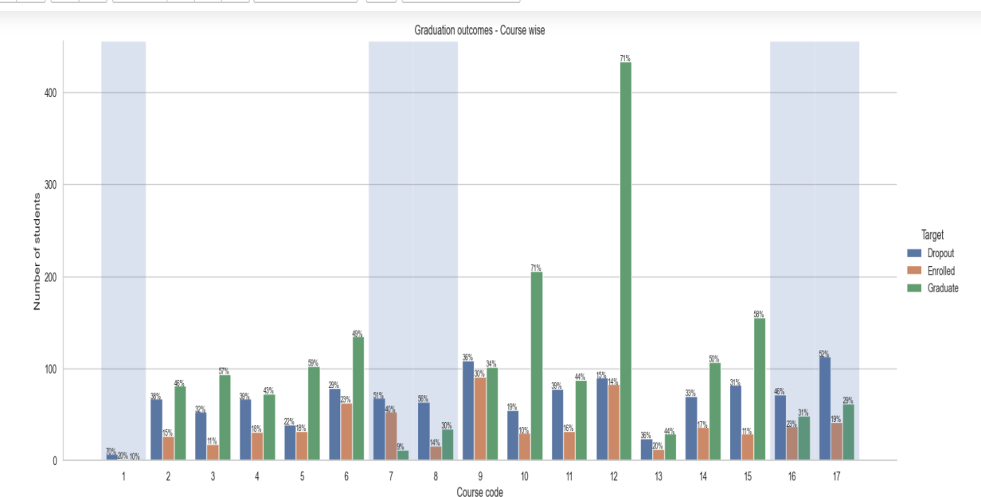
This Count Plot shows the Father’s Qualification by target category
This Count Plot shows the Graduation outcome by number of students

Slide 19
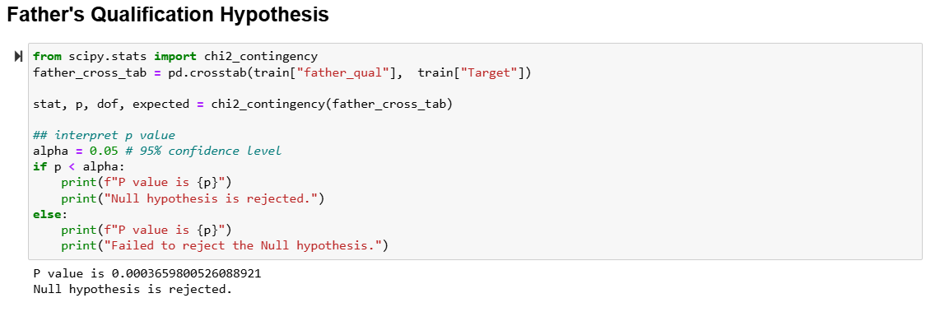
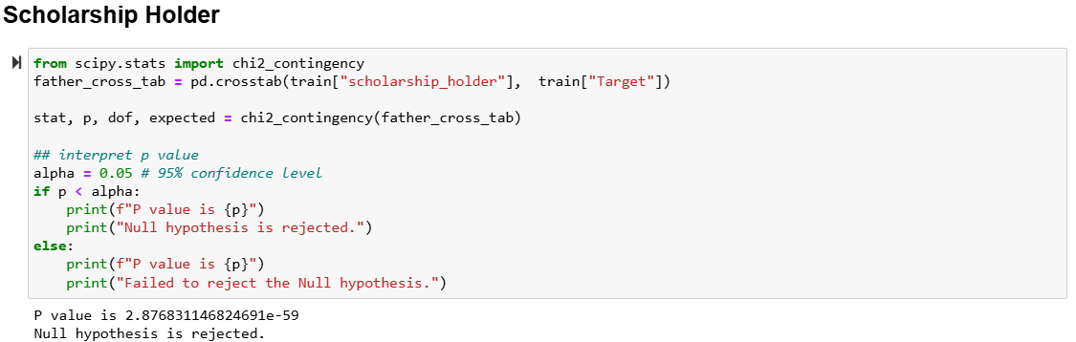

Slide 20
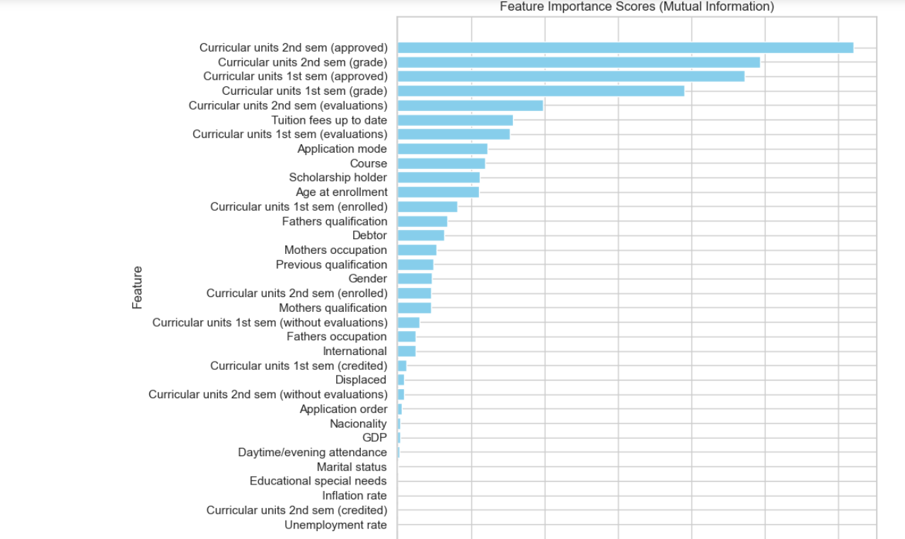
FEATURE SELECTION

Slide 21
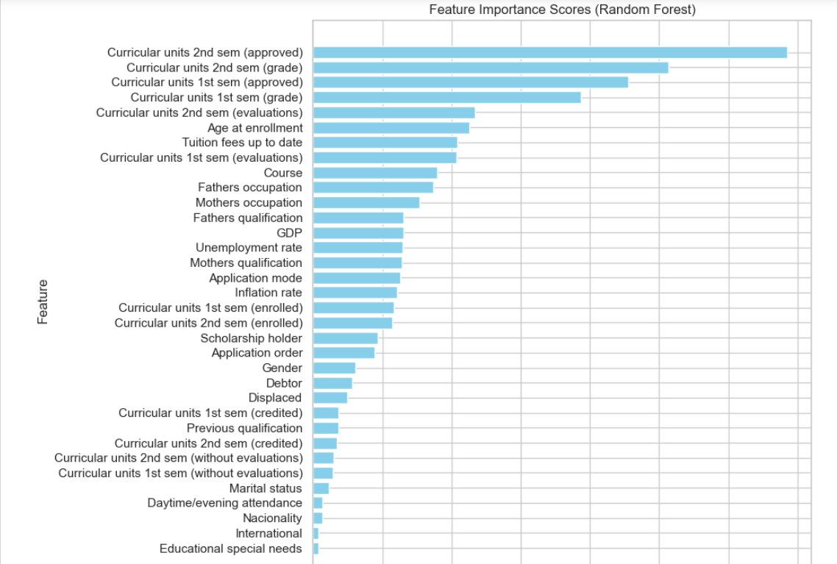

Slide 22
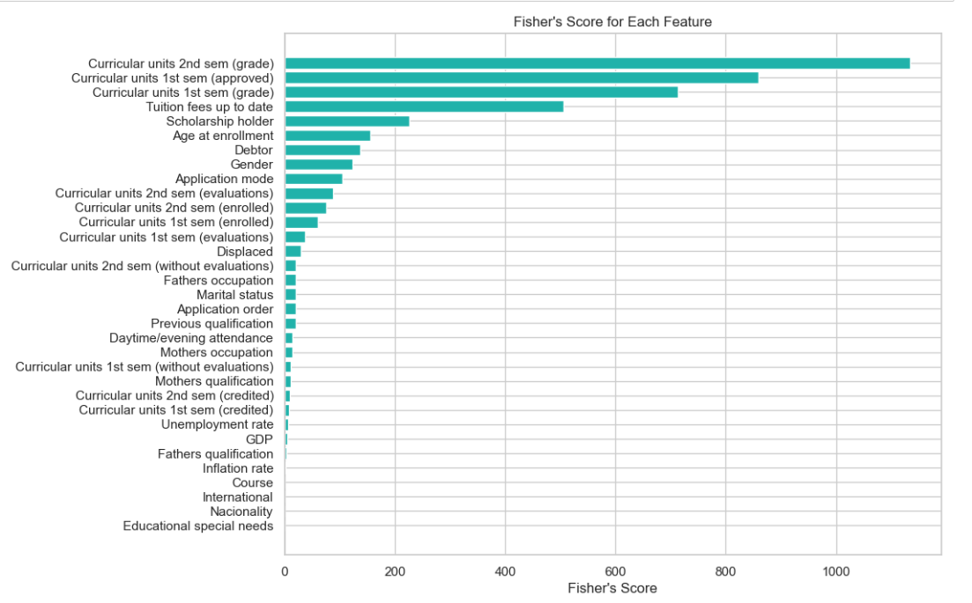

Slide 23
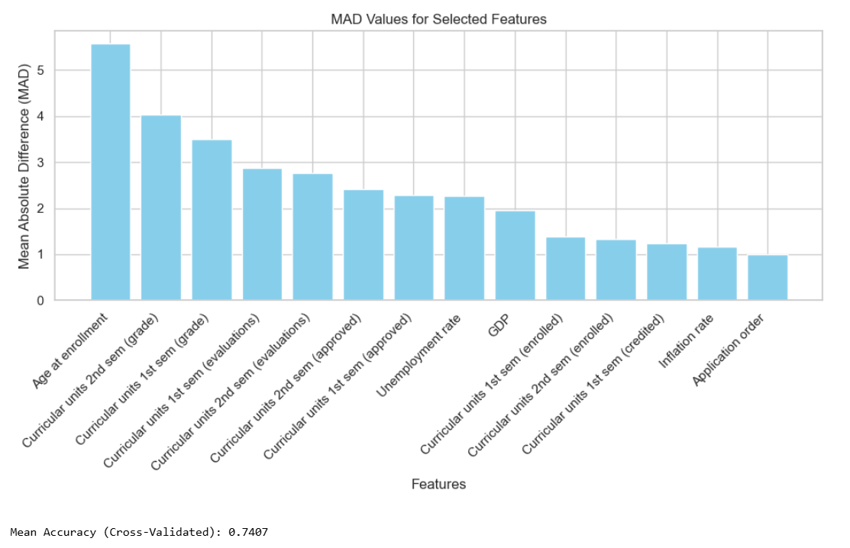

Slide 24
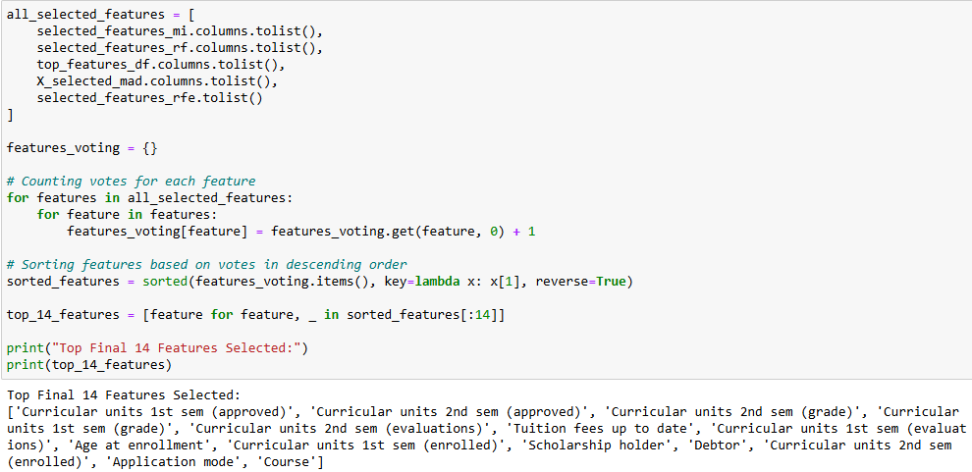

Slide 25
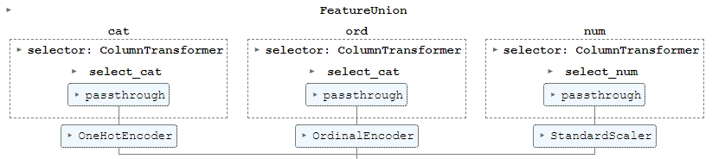
PIPELINE

Slide 26
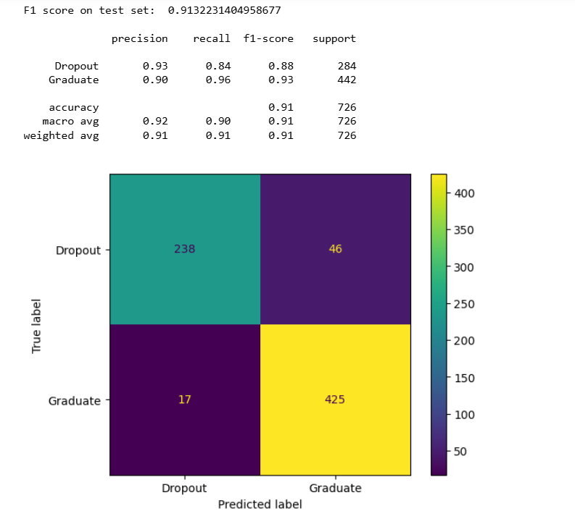
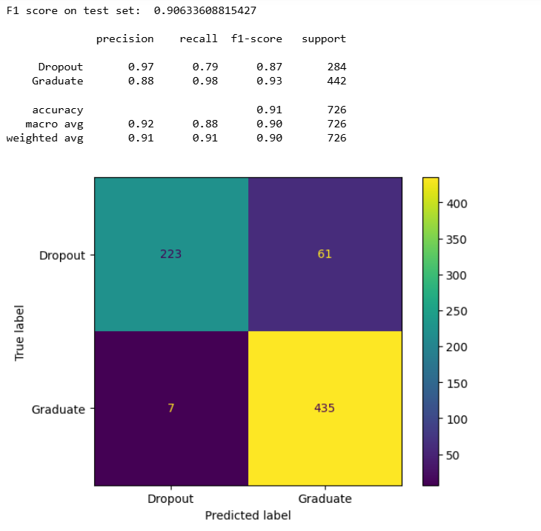
Testing and Performance Evaluation
Logistic Classification Model
Ridge Classification Model

Slide 27
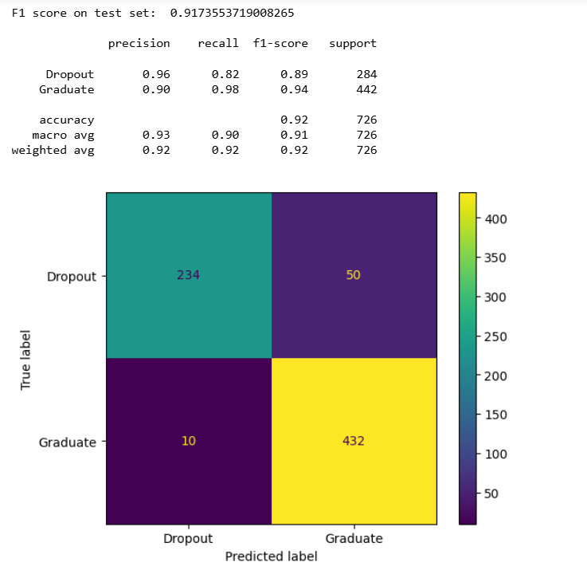
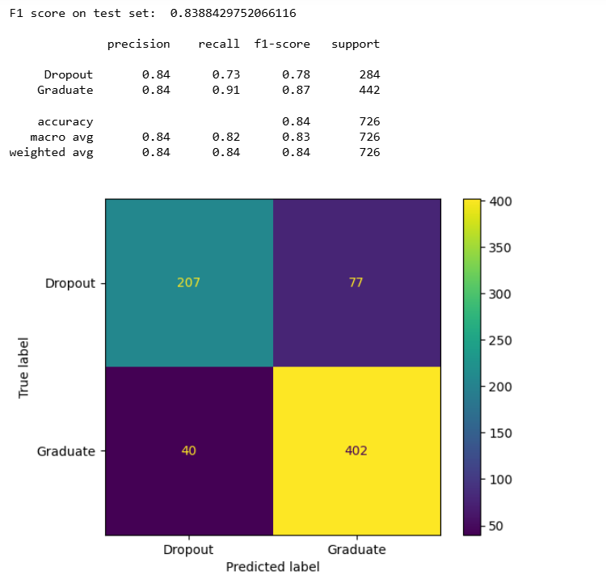
Support Vector Machine Model
Tree Classifier Model

Slide 28
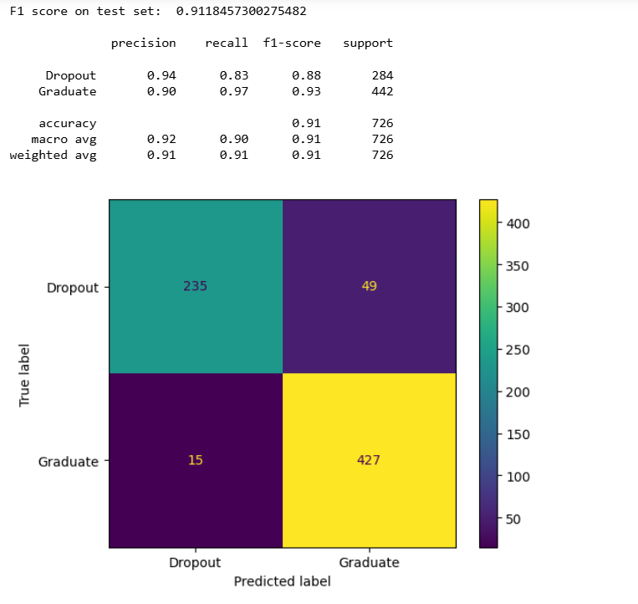
Random Forest Classifier

Slide 29
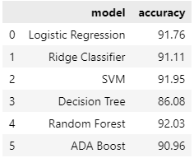

Slide 30
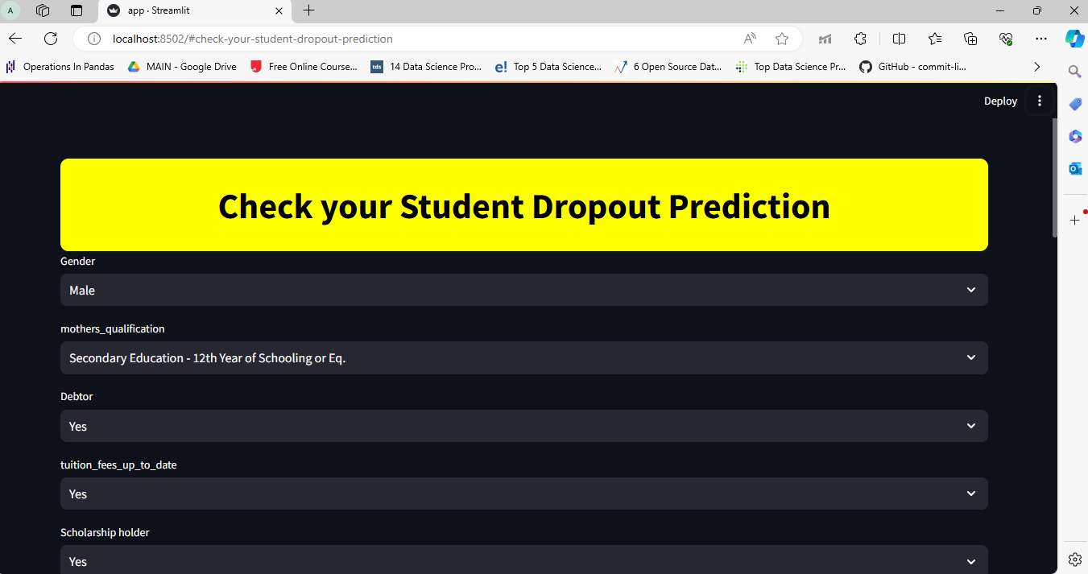
Final Demonstration Screen shot with Explanation/Research Conclusion

Slide 31
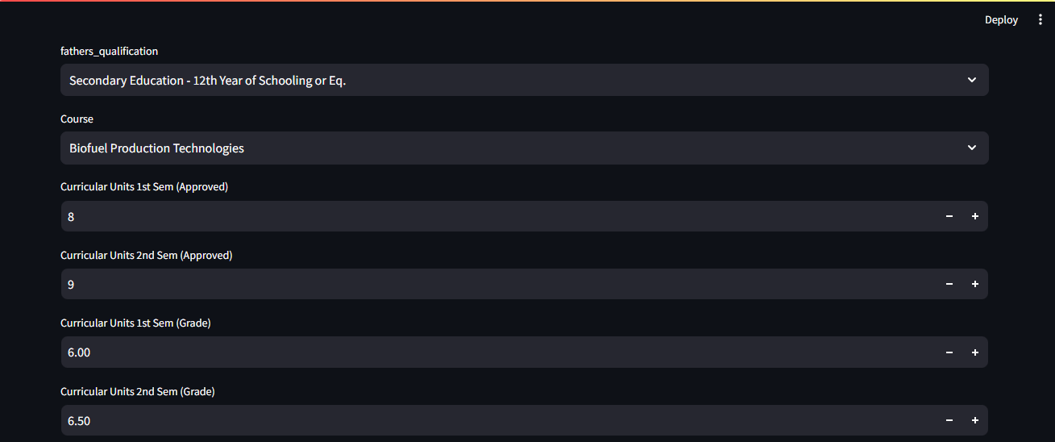

Slide 32


Slide 33


Slide 34
EXPECTED OUTCOME OF PROJECT
Accurate prediction of at-risk students: Machine learning models identify students likely to drop out based on academic performance, attendance, and socio-economic factors.
Early intervention: Prompt support interventions, such as mentoring and tutoring, are provided to at-risk students to improve retention.
Efficient resource allocation: Analysis guides better allocation of resources to areas and students most in need.
Informed policies: Analysis informs evidence-based policies for government aimed at reducing dropout rates and promoting equity.
Improved success rates: Targeted interventions lead to higher retention and graduation rates.
Long-term benefits: Lower dropout rates lead to a more skilled workforce and reduced social inequalities, fostering economic growth.

Slide 35
CONCLUSION AND FUTURE SCOPE
Predicting dropout rates enables early identification of at-risk students, leading to targeted interventions and improved academic success through optimized resource allocation and continuous model refinement.
Personalized interventions: Tailor support strategies for individual students.
Longitudinal studies: Analyze trends over time to assess intervention effectiveness.
Diverse data integration: Incorporate additional factors for more accurate predictions.
Scaling up: Expand project to larger educational systems.
Exploring causality: Investigate underlying factors contributing to dropout rates.
Self-Evaluation: Helps the student to self analyze the current scenario.

Slide 36
REFERENCES
Altonji, J.G. 1993. "The Demand for and Return to Education when Education Outcomes are Uncertain." Journal of Labour Economics, vol. 11, Part I, 48-83.
Chuang, H.L. 1997. "High School Youths' Dropout and Re-Enrollment Behavior." Economics of Education Review, vol. 16, no. 2, 171-186.
Chaplin, D.D., M.D. Turner and A.D. Pape. 2003. "Minimum Wages and School enrolment of Teenagers: A Look at the 1990's." Economics of Education Review, vol. 22, 11- 21.
Eckstein, Z. and K.I. Wolpin. 1999. "Why Youths Drop Out of High School: The Impact of Preferences, Opportunities, and Abilities." Econometrica, vol. 67, no. 6, 1295-1339.
Ferrer, A. and D. Lauzon. 2005. The Role of Employment Opportunities and Earnings in the Decline of the High School Dropout Rate Over the 1990s. Manuscript. UBC.
Doll, J.J., Eslami, Z., & Walters, L. (2013). Understanding why students drop out of high school, according to their own reports. SAGE Open, 3 (4), 1-15. doi: 10.1177/2158244013503834
BAYER, A. The college drop-out: factors affecting senior college completion. Sociology of Education, 1968,41, 305–316.
BROWN, F. G. Identifying college drop-outs with Minnesota Counselling Inventory.Personnel and Guidance Journal, 1960,39, 280–282.
DANIEL, K. L. B.A study of dropouts at the University of Alabama with respect to certain academic and personality variables. (Doctoral dissertation, University of Alabama) Ann Arbor, Mich.: University Microfilms, 1963. No. 64-9118.

