Slide 1

TEAM NAME:
Ctrl + Alt + Dev
TEAM MEMBERS:
ADITYA A
DUMPA REVANTH VENKATA SAI
G A ROHAN
HARSHITHA SANJANA R
THEME:
HEALTH AND WELLNESS

Slide 2
BRIDGING THE GAP
Enhancing Access To Patient Health Proﬁles In Medical Emergencies

Slide 3
PROBLEM STATEMENT
In medical emergencies, bystanders and first responders often lack immediate access to critical patient health information, such as allergies, chronic conditions, and medications. This information gap delays appropriate interventions, increases the risk of incorrect actions, and reduces the chances of positive outcomes before professional medical help arrives. A solution is required to provide real-time access to health profiles and actionable guidance, empowering first responders and bystanders to deliver timely and accurate care.

Slide 4
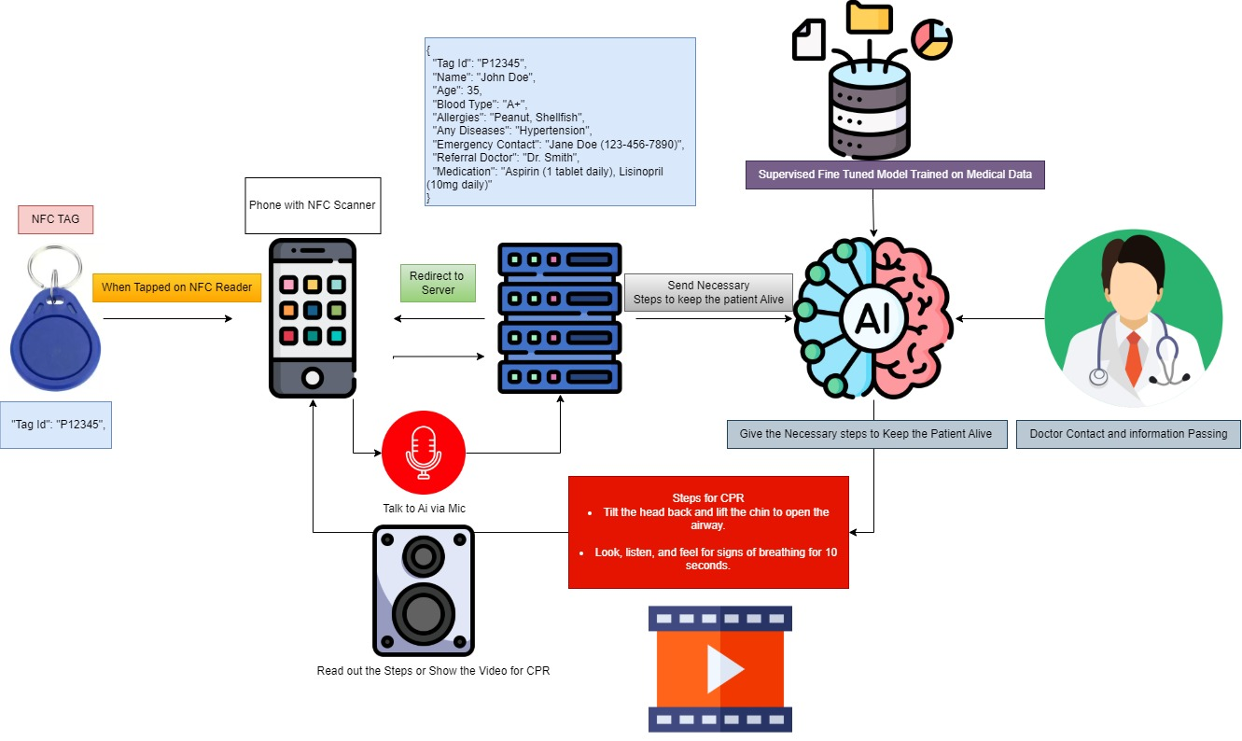
FLOWCHART

Slide 5
SOLUTION OVERVIEW
Comprehensive Digital Health Profile:
Stores essential patient details:
Name, Age, Gender
Blood Type, Allergies, Chronic Diseases
Ongoing Medications, Recent Health Metrics
Emergency Contact and Referral Doctor Information
Profile updated and maintained by the user or authorized healthcare providers
Web Application:
Accessible for both users and emergency responders.
Scanning tags to retrieve health profiles instantly
AI-driven recommendations for first aid based on the patient’s data
Notifications to emergency contacts and healthcare providers
Emergency responders can log in to retrieve patient data during critical scenarios.
AI-Powered Diagnostics:
Real-time analysis of health profile data to recommend appropriate first aid actions.
A symptom-checker AI that asks the patient a series of questions and provides a preliminary diagnosis, suggesting possible next steps
Visual and voice-assisted step-by-step guidance for bystanders.
Smart Health Profile Tags:
NFC-enabled or QR-coded wearable tags (wristbands, necklaces) for easy scanning.
Unique Tag ID linked to a secure cloud-based health database.
DEMO
Emergency Response Integration:
In case of urgent medical conditions, the platform connects the patient directly with emergency services in their location.

Slide 6
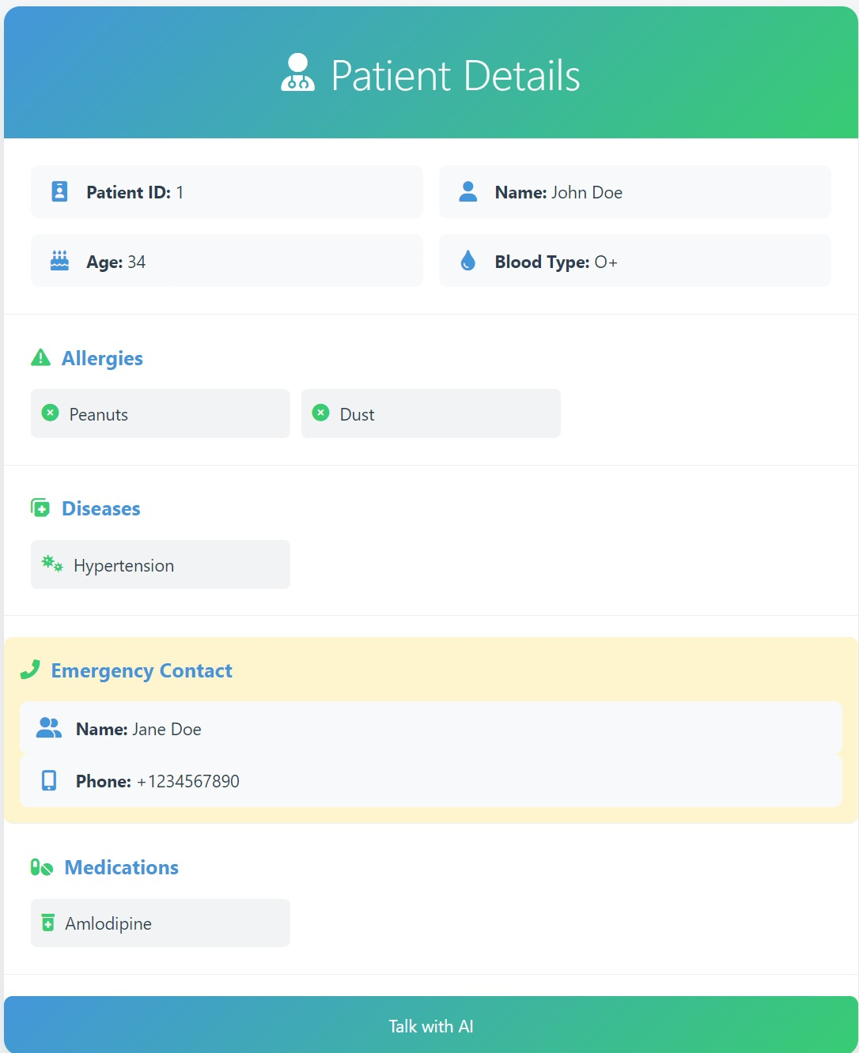
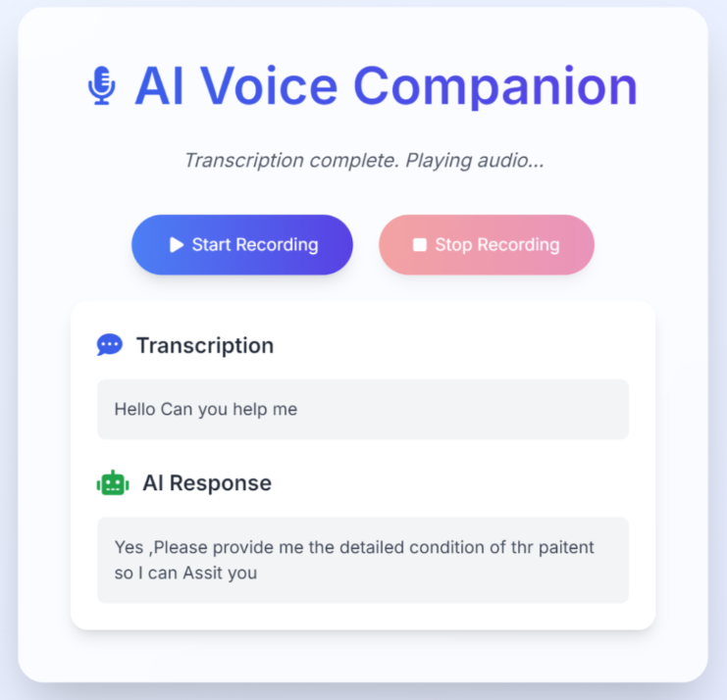
LIVE IMPLEMENTATION

Slide 7
FUTURE IMPLEMENTATION
Advanced AI Features
Personalized Health Recommendations: Use AI to provide tailored lifestyle and health tips based on a patient's medical history and health data.
Predictive Analytics: Implement algorithms to predict potential health risks based on patient data and demographics, allowing preventive care.
Comprehensive Medication Management
Smart Reminders: Notify patients of upcoming medication schedules, refills, or dosage changes.
Drug Interaction Alerts: AI-powered tools to warn users about potential drug interactions or side effects.
Prescription Delivery Services: Partner with pharmacies to enable doorstep delivery of prescribed medicines.
Integration with Wearables and IoT Devices
Collect real-time health data (e.g., heart rate, blood pressure, glucose levels) from wearable devices to monitor chronic conditions and alert healthcare providers in case of anomalies.
Emergency Response Optimization
Integrate GPS-enabled real-time ambulance tracking and prioritized routing for faster emergency responses.
Partnerships with Local Healthcare Providers
Collaborate with hospitals, clinics, and pharmacies for seamless referral systems, discounted medication plans, and localized care delivery.
Partner with insurance companies to enable seamless claims processing directly from the platform.
Blockchain for Data Security
Use blockchain technology for immutable and transparent medical record storage to enhance security, prevent fraud, and simplify data sharing.
Advanced Analytics Dashboard for Providers
Provide healthcare professionals with dashboards that offer insights into patient trends, treatment efficacy, and population health statistics.

Slide 8
THANK YOU!

