Slide 1

Teach-Assist
V.E.S. INSTITUTE OF TECHNOLOGY, CHEMBUR, MUMBAI-74
(An Autonomous College Affiliated to University of Mumbai, Approved by
AICTE & Recognized by Govt. of Maharashtra)
Department of Electronics and Computer Science
Harness the power of AI to automatically convert your PDF documents into beautiful, ready-to-present PowerPoint slides.

Slide 2
Huffman Coding: Data Compression Through Efficient Encoding

Slide 3
Index
1: How Huffman Coding Works: A Conceptual Overview2: Building the Huffman Tree: A Step-by-Step Example3: Huffman Coding: Encoding and Decoding4: Huffman Coding Algorithm Implementation (C example)5: Advantages and Limitations of Huffman Coding6: Applications of Huffman Coding7: Conclusion: Huffman Coding – A Powerful Compression TechniqueConclusion

Slide 4
How Huffman Coding Works: A Conceptual Overview
The process begins by calculating the frequency of each unique character in the input data.A binary tree is constructed, where each leaf node represents a character, and its weight is the character's frequency.Nodes with the lowest frequencies are paired and combined into a parent node, whose weight is the sum of its children's weights.This process is repeated until only one node (the root) remains.Codes are assigned to each character by traversing the tree from the root to the leaf node, assigning '0' to left branches and '1' to right branches.More frequent characters end up with shorter codes, leading to compression.The resulting Huffman tree and codes are used for both encoding and decoding.

Slide 5

Illustrations from Page 1

Slide 6
Building the Huffman Tree: A Step-by-Step Example
**Step 1: Frequency Calculation:** Determine the frequency of each character in the input string (e.g., **Step 2: Priority Queue:** Create a priority queue (min-heap) to store characters and their frequencies, sorted by frequency (ascending order).**Step 3: Tree Construction:** Repeatedly extract the two lowest-frequency nodes from the queue, create a new parent node with their combined frequency, and insert this new node back into the queue.**Step 4: Iteration:** Continue this process until only one node (the root) remains in the queue. This completes the Huffman tree.**Step 5: Code Assignment:** Assign '0' to the left branch and '1' to the right branch of each node. Traverse the tree from the root to each leaf node to find the code for each character.Illustrative diagram showing the tree construction process would be beneficial here.

Slide 7
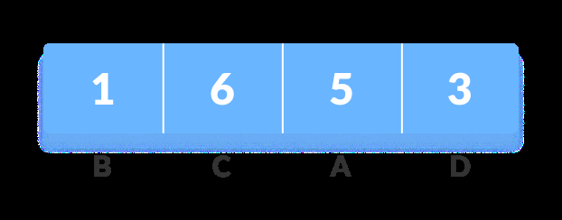
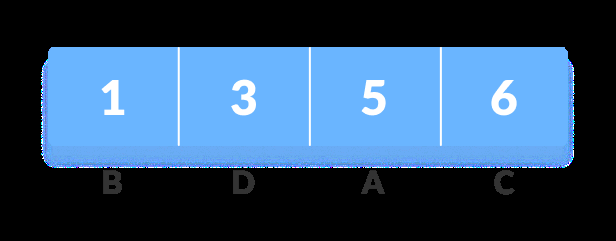
Illustrations from Page 2

Slide 8
Huffman Coding: Encoding and Decoding
**Encoding:** Replace each character in the input string with its corresponding Huffman code. This creates the compressed data.**Decoding:** Use the Huffman tree to decode the compressed data. Start at the root and traverse the tree based on the bits in the code. When you reach a leaf node, you've found the corresponding character.Example: Show a simple string, its Huffman codes, the encoded string, and the decoding process.Emphasis on the prefix-free property of Huffman codes: no code is a prefix of another, preventing ambiguity during decoding.Illustrative diagram showing the decoding process using the tree.

Slide 9
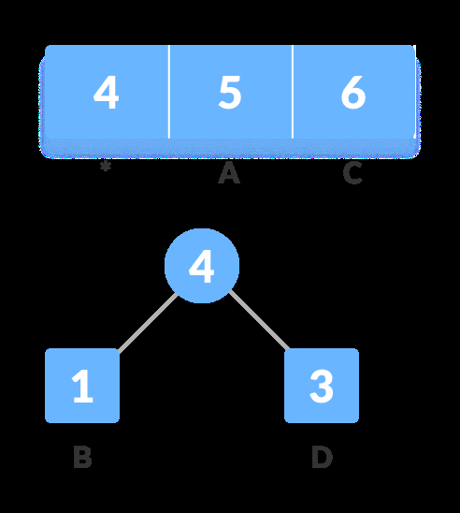
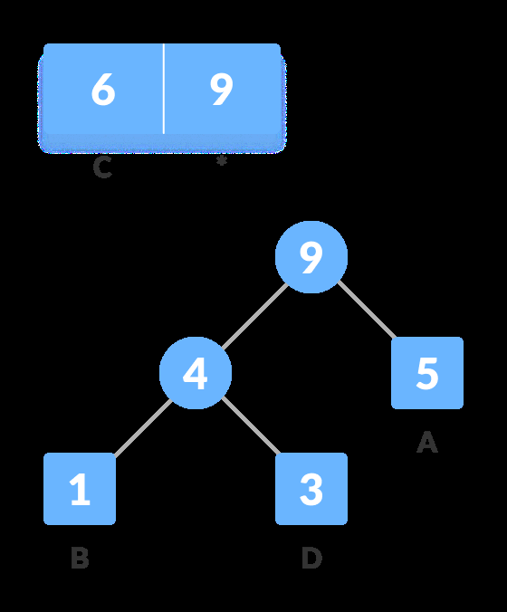
Illustrations from Page 3

Slide 10
Huffman Coding Algorithm Implementation (C example)
Show snippets of code explaining key functions: `createAndBuildMinHeap`, `buildHuffmanTree`, `printHCodes`.Briefly explain the data structures used (MinHeap, MinHNode).Highlight the core logic of building the tree and assigning codes.Mention the time and space complexity of the algorithm.Focus on the clarity and readability of the code snippets. (Avoid overwhelming the audience with extensive code.)

Slide 11
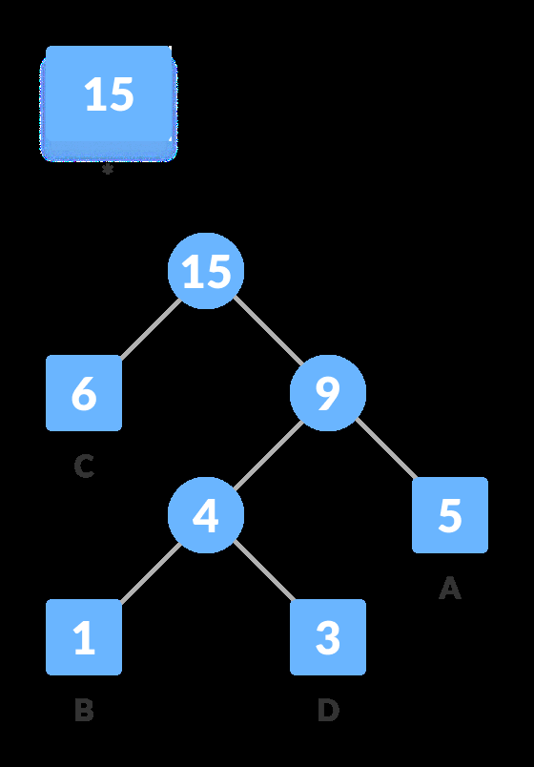
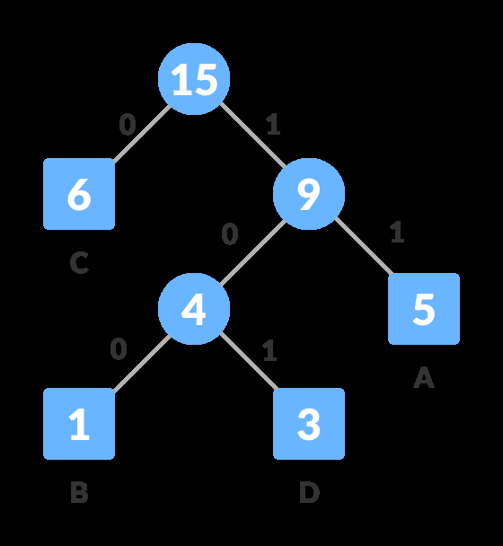
Illustrations from Page 4

Slide 12
Advantages and Limitations of Huffman Coding
**Advantages:** Lossless compression, relatively simple to implement, effective for data with skewed character distributions.**Limitations:** Not optimal for all types of data (e.g., already highly compressed data), requires storing the Huffman tree alongside the encoded data, computational overhead for large datasets.Comparison with other compression techniques (e.g., Lempel-Ziv) can be mentioned briefly.Discuss scenarios where Huffman coding excels and where it might not be the best choice.

Slide 13

Illustrations from Page 5

Slide 14
Applications of Huffman Coding
Data compression in file archiving (e.g., .zip, .rar).Text compression in document processing.Image compression (although less common than other techniques).Data transmission in communication systems to reduce bandwidth usage.Mention specific real-world examples where Huffman coding is used.

Slide 15
Conclusion: Huffman Coding – A Powerful Compression Technique
Huffman Coding provides an efficient way to compress data by exploiting the frequency distribution of characters.Its simplicity and effectiveness make it a valuable tool in various applications.While not universally optimal, it remains a fundamental algorithm in the field of data compression.Further research into more advanced compression algorithms can build upon the foundational principles of Huffman coding.Open the floor for questions and discussions.

