Slide 1

Teach-Assist
V.E.S. INSTITUTE OF TECHNOLOGY, CHEMBUR, MUMBAI-74
(An Autonomous College Affiliated to University of Mumbai, Approved by
AICTE & Recognized by Govt. of Maharashtra)
Department of Electronics and Computer Science
Harness the power of AI to automatically convert your PDF documents into beautiful, ready-to-present PowerPoint slides.

Slide 2
Polymer Chemistry: Types, Properties, and Biomedical Applications
Created by: shreyash katole

Slide 3
Index
1.Condensation Polymerization: Step-Growth Reaction2.Polymer Applications: Examples in Daily Life3.Conducting Polymers: Electrical Conductivity in Polymers4.Types of Conducting Polymers and Doping5.Polymers in Medicine and Surgery: Biomaterials6.Conclusion: The Versatile World of PolymersConclusion

Slide 4
Condensation Polymerization: Step-Growth Reaction
Condensation polymerization requires monomers with at least two functional groups capable of reacting with each other.These functional groups react, forming a bond between monomers and releasing a small molecule as a byproduct (e.g., water, ammonia, hydrogen chloride).Mineral acids or bases commonly serve as catalysts in condensation polymerization.Unlike addition polymerization, this process is endothermic, absorbing heat.It is generally a slower process than addition polymerization.Condensation polymers typically have higher molecular weights than addition polymers.This method often results in three-dimensional, cross-linked, thermosetting polymers.

Slide 5
Polymer Applications: Examples in Daily Life
Polyethylene is widely used in disposable syringes due to its flexibility and low cost.Polypropylene's strength and biocompatibility make it suitable for heart walls and blood filters.Polyvinyl chloride (PVC) also finds application in disposable syringes.Acrylic hydrogels are employed in grafting procedures due to their biocompatibility and water-absorbing properties.Polymethyl methacrylate (PMMA) is a common material for contact lenses owing to its transparency and biocompatibility.Poly(alkyl sulfone) membranes are used in oxygenators for their gas permeability and biocompatibility.

Slide 6
Conducting Polymers: Electrical Conductivity in Polymers
Most polymers are electrical insulators because their electrons are tightly bound in sigma bonds, limiting mobility.Conductivity is achieved in polymers through the presence of conjugated (alternating) double bonds, creating delocalized pi electrons.These delocalized pi electrons can move relatively freely along the polymer chain under an electric field, enabling electrical conduction.This creates a system of valence and conduction bands, similar to those in metals. Examples include polyacetylene, polyanilines, and polythiophene.The conductivity of these polymers can be further enhanced through doping.

Slide 7
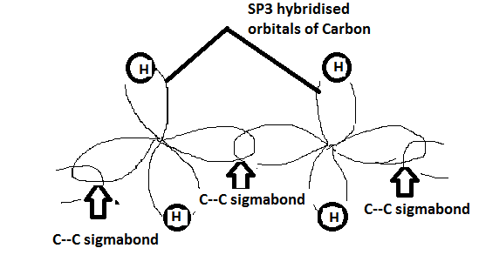
Figures from Section 3

Slide 8
Types of Conducting Polymers and Doping
Intrinsically conducting polymers (ICPs) possess delocalized electrons within their backbone structure (e.g., polyacetylene, polypyrrole, polythiophene).Extrinsically conducting polymers achieve conductivity through added components: filled polymers (conducting elements like carbon black dispersed in a polymer matrix) and blended polymers (blending conventional and conducting polymers).Doping increases conductivity by introducing charge carriers: p-doping (oxidation using Lewis acids, creating positive charges) and n-doping (reduction using Lewis bases, creating negative charges).P-doping examples include treatment with iodine or iron(III) chloride.N-doping examples include treatment with lithium or sodium.Coordination conducting polymers are formed by combining a metal atom with a polydentate ligand.

Slide 9
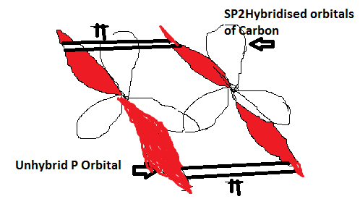
Figures from Section 4

Slide 10
Polymers in Medicine and Surgery: Biomaterials
Biomaterials are materials used in medical applications without causing adverse effects. Polymer biomaterials are increasingly important.Key characteristics of biomedical polymers include biocompatibility (lack of harmful reactions with body tissues), purity and reproducibility, and sterilizability without property alteration.They must possess optimal physical and chemical properties for their intended use.Biomedical polymers must not destroy blood cellular elements or enzymes, nor cause toxic or allergic reactions.They should also maintain electrolyte balance in the body.

Slide 11
Conclusion: The Versatile World of Polymers
Polymers exhibit a wide range of properties and applications, from everyday plastics to advanced biomaterials and conducting polymers.Understanding the different types of polymerization and the factors influencing polymer properties is crucial for designing materials with specific functionalities.Continued research and development in polymer chemistry will lead to further innovations in various fields, including medicine, electronics, and materials science.The versatility of polymers makes them essential materials for modern technology and improving the quality of life.

