Slide 1

Teach-Assist
V.E.S. INSTITUTE OF TECHNOLOGY, CHEMBUR, MUMBAI-74
(An Autonomous College Affiliated to University of Mumbai, Approved by
AICTE & Recognized by Govt. of Maharashtra)
Department of Electronics and Computer Science
Harness the power of AI to automatically convert your PDF documents into beautiful, ready-to-present PowerPoint slides.

Slide 2
Huffman Coding: Data Compression Technique
Created by:

Slide 3
Index
1.Introduction to Huffman Coding2.How Huffman Coding Works: An Example3.Building the Huffman Tree4.Huffman Coding Algorithm & Code Implementation (Snippet)5.Prefix Codes and Ambiguity Prevention6.Encoding and Decoding Example7.Conclusion: Advantages & Disadvantages of Huffman CodingConclusion

Slide 4
Introduction to Huffman Coding
Developed by David Huffman.A lossless data compression technique.Reduces data size without losing information.Most effective for data with frequently occurring characters.Uses variable-length codes based on character frequency.Creates a binary tree to represent character codes.Achieves compression by assigning shorter codes to more frequent characters.

Slide 5

Huffman Coding
Figure 1

Slide 6
How Huffman Coding Works: An Example
Consider a string needing transmission (e.g., Each character typically uses 8 bits (1 byte).Calculating total bits for the initial string (15 characters * 8 bits/character = 120 bits).Huffman coding aims to reduce this bit count.It achieves this by assigning shorter codes to frequent characters and longer codes to less frequent characters.This leads to a smaller overall size for the encoded data.

Slide 7
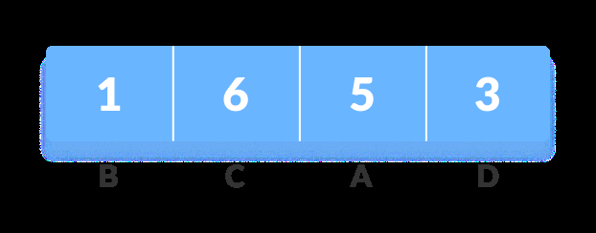
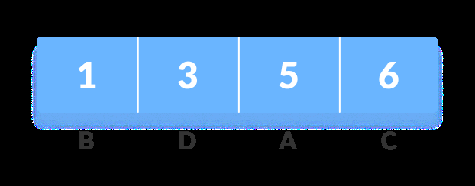
Huffman Coding prevents any ambiguity in the decoding process using the
Figure 1
Figure 2

Slide 8
Building the Huffman Tree
Calculate the frequency of each character in the input string.Sort characters in ascending order of frequency (using a priority queue).Create a leaf node for each character, with its frequency as a value.Repeatedly combine the two nodes with the lowest frequencies:Create a new parent node.Assign the sum of the children's frequencies to the parent.Assign '0' to the left branch and '1' to the right branch.Continue until only one node (the root) remains.

Slide 9
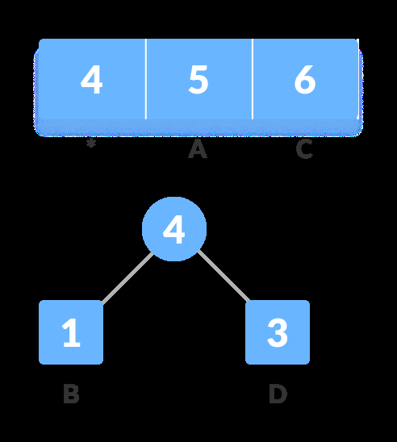
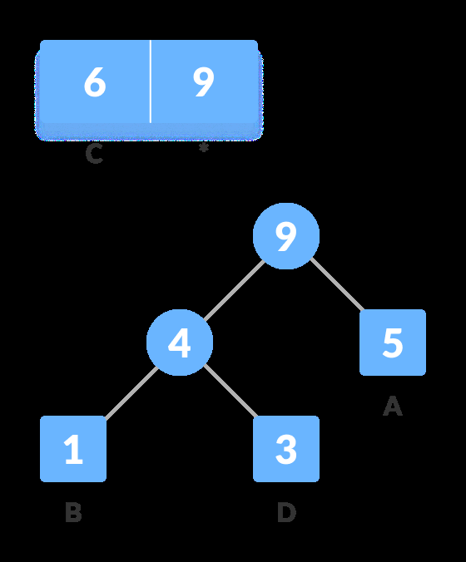
of the z as the sum of the above two minimum frequencies.
Figure 1
Figure 2

Slide 10
Huffman Coding Algorithm & Code Implementation (Snippet)
Priority Queue: Use a Min-Heap data structure to efficiently manage character frequencies.Tree Construction: Iteratively build the Huffman tree by merging nodes with the smallest frequencies.Code Generation: Traverse the tree to assign binary codes to each character (0 for left, 1 for right).Code Example (C/C++): Show snippets of functions like `buildHuffmanTree`, `printHCodes`, etc.(Include relevant data ...Illustrate the key steps of the algorithm within the code.

Slide 11
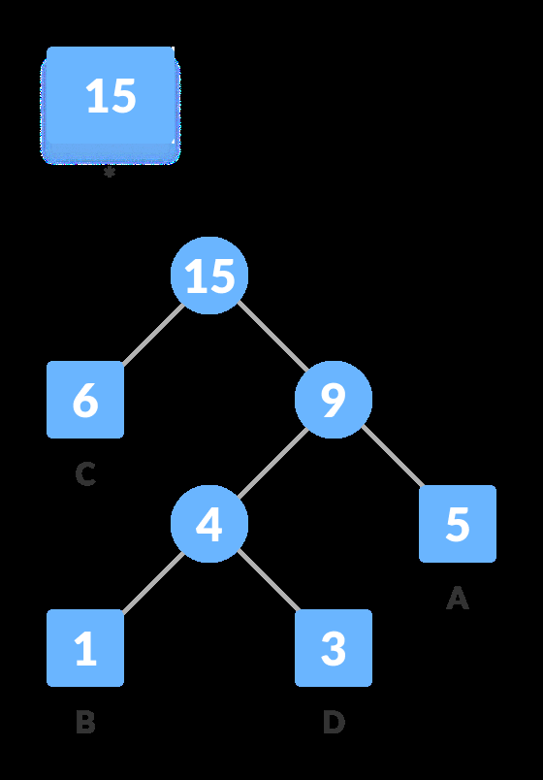
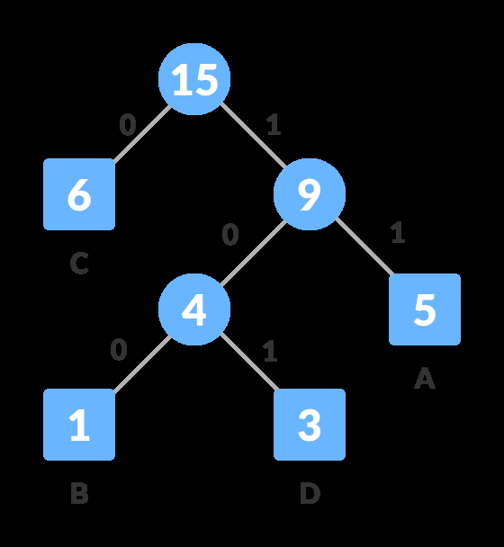
8. For each non-leaf node, assign 0 to the left edge and 1 to the right edge.
Figure 1
Figure 2

Slide 12
Prefix Codes and Ambiguity Prevention
Huffman codes are prefix codes.No code is a prefix of another code.This prevents ambiguity during decoding.The tree structure ensures this prefix property.Decoding is unambiguous because you can uniquely traverse the tree based on the binary code.

Slide 13

Character Frequency Code Size
Figure 1

Slide 14
Encoding and Decoding Example
Show a table with characters, their frequencies, and assigned Huffman codes.Demonstrate the encoding process: replace each character in the input string with its Huffman code.Calculate the size of the encoded string.Show how to decode the encoded string using the Huffman tree.Illustrate the decoding process step-by-step, using an example code.

Slide 15
Conclusion: Advantages & Disadvantages of Huffman Coding
Advantages: Lossless compression, efficient for data with repetitive characters, relatively simple algorithm.Disadvantages: Overhead of transmitting the Huffman tree, not optimal for all types of data, can be less efficient t...Applications: Data compression in various fields, text compression, image compression (in conjunction with other tech...Future improvements and related algorithms could be mentioned briefly.

