Slide 1

Teach-Assist
V.E.S. INSTITUTE OF TECHNOLOGY, CHEMBUR, MUMBAI-74
(An Autonomous College Affiliated to University of Mumbai, Approved by
AICTE & Recognized by Govt. of Maharashtra)
Department of Electronics and Computer Science
Harness the power of AI to automatically convert your PDF documents into beautiful, ready-to-present PowerPoint slides.

Slide 2
Polymer Chemistry: Types, Properties, and Biomedical Applications

Slide 3
Index
1.Condensation Polymerization: Step-Growth2.Polymer Applications: Examples of Common Polymers3.Conducting Polymers: Enhancing Electrical Conductivity4.Types of Conducting Polymers and Doping5.Polymers in Medicine and Surgery: Biomaterials6.Conclusion: The Versatility of PolymersConclusion

Slide 4
Condensation Polymerization: Step-Growth
Condensation polymerization involves monomers with at least two functional groups that react to form a polymer chain, releasing a small molecule (e.g., water, ammonia, HCl) as a byproduct.Mineral acids or bases often catalyze the reaction, increasing its rate.Unlike addition polymerization, it's an endothermic process, requiring energy input.The reaction proceeds relatively slowly compared to addition polymerization, with a stepwise growth of the polymer chain.Condensation polymers typically exhibit higher molecular weights than addition polymers.Three-dimensional network structures are common, often resulting in thermosetting polymers.

Slide 5
Polymer Applications: Examples of Common Polymers
Polyethylene: Used in disposable syringes due to its flexibility and low cost.Polypropylene: Employed in heart walls and blood filters due to its biocompatibility and strength.Polyvinyl chloride (PVC): Used in disposable syringes and medical tubing for its durability and chemical resistance.Acrylic hydrogels: Utilized in grafting applications due to their water-absorbing properties and biocompatibility.Polymethyl methacrylate (PMMA): A common material for contact lenses due to its optical clarity and biocompatibility.Poly(alkyl sulfone): Used in membrane oxygenators due to its high gas permeability and biocompatibility.

Slide 6
Conducting Polymers: Enhancing Electrical Conductivity
Most polymers are electrical insulators due to the lack of freely mobile electrons.Conductivity can be achieved by introducing a system of conjugated (alternating) double bonds within the polymer backbone.These conjugated pi electrons can be excited and transported through the polymer in an electric field, enabling electrical conduction.This leads to the formation of valence and conduction bands, similar to those found in metals and semiconductors.Examples of intrinsically conducting polymers include polyacetylene, polyaniline, and polythiophene.

Slide 7
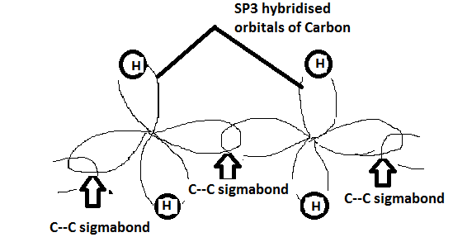
Figures from Section 3

Slide 8
Types of Conducting Polymers and Doping
Intrinsically conducting polymers (ICPs) possess delocalized electrons within their backbone or associated groups.Extrinsically conducting polymers gain conductivity through added ingredients: filled polymers (with carbon black or metal oxides) and blended polymers (mixing with conducting polymers).Doping enhances ICP conductivity by introducing charge carriers: p-doping (oxidation) using Lewis acids like iodine or iron chloride, and n-doping (reduction) using Lewis bases like lithium or sodium.P-doping creates positive charges on the polymer backbone, while n-doping creates negative charges.Coordination conducting polymers are charge-transfer complexes formed by combining metal atoms with polydentate ligands.

Slide 9
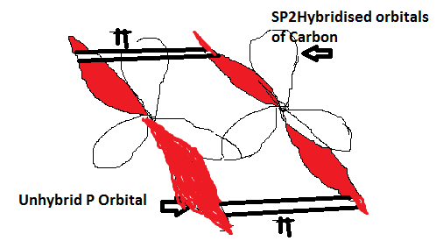
Figures from Section 4

Slide 10
Polymers in Medicine and Surgery: Biomaterials
Biomaterials are materials used in the body without causing adverse effects.Polymer biomaterials are increasingly important in diagnostic, surgical, and therapeutic applications.Key characteristics of biomedical polymers include biocompatibility (lack of harmful reactions), purity, reproducibility, sterilizability without property alteration, and optimal physical and chemical properties.The choice of polymer depends heavily on the specific application and required properties (e.g., strength, flexibility, biodegradability).Ongoing research focuses on developing new biocompatible polymers with improved properties for various medical uses.

Slide 11
Conclusion: The Versatility of Polymers
Polymers are versatile materials with a wide range of applications, from everyday plastics to advanced biomedical devices.Understanding the different types of polymerization, their properties, and the factors influencing conductivity is crucial for designing new materials.The development of biocompatible polymers is driving innovation in medicine and surgery, offering improved treatments and therapies.Continued research in polymer chemistry will undoubtedly lead to further advancements in various fields.

