Slide 1

Teach-Assist
V.E.S. INSTITUTE OF TECHNOLOGY, CHEMBUR, MUMBAI-74
(An Autonomous College Affiliated to University of Mumbai, Approved by
AICTE & Recognized by Govt. of Maharashtra)
Department of Electronics and Computer Science
Harness the power of AI to automatically convert your PDF documents into beautiful, ready-to-present PowerPoint slides.

Slide 2
Huffman Coding: Data Compression Through Efficient Encoding
Created by: guppi

Slide 3
Index
1.Introduction to Huffman Coding2.How Huffman Coding Works: An Example3.Building the Huffman Tree4.Huffman Coding Algorithm: A Step-by-Step Guide5.Prefix Codes and Ambiguity Prevention6.Encoding and Decoding Example & Code Implementation Overview7.Conclusion: Efficiency and Applications of Huffman CodingConclusion

Slide 4
Introduction to Huffman Coding
Huffman coding is a lossless data compression algorithm that reduces file size by assigning shorter codes to more frequent characters.It was developed by David A. Huffman and published in 1952.The algorithm is based on the frequency of characters in the input data. More frequent characters receive shorter codes, and less frequent characters receive longer codes.This variable-length coding scheme leads to significant compression, especially for text with repetitive characters.Huffman coding is widely used in various applications, including data archiving, file compression (e.g., .zip, .rar), and fax transmission.It forms the basis for many more advanced compression techniques.Unlike fixed-length coding (e.g., ASCII), Huffman coding dynamically adjusts code lengths based on character frequency.

Slide 5

Figures from Section 1

Slide 6
How Huffman Coding Works: An Example
Consider a string: Huffman coding aims to represent this string using fewer bits.We first count the frequency of each character: A (5), B (2), C (3), D (2).The algorithm then constructs a binary tree based on these frequencies, assigning shorter codes to more frequent characters.The final encoded string will be significantly shorter than the original 120 bits.

Slide 7
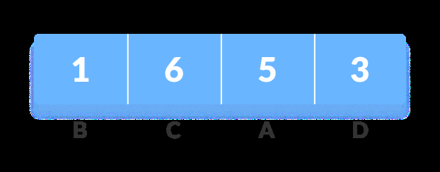
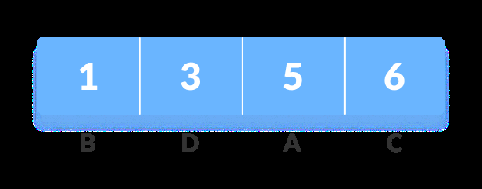
Figures from Section 2

Slide 8
Building the Huffman Tree
The process begins by creating a min-heap data structure, containing nodes representing each character and its frequency.Repeatedly, the two nodes with the lowest frequencies are extracted from the heap.A new node is created, its frequency being the sum of the frequencies of the extracted nodes. The extracted nodes become the left and right children of this new node.This new node is inserted back into the heap.This process continues until only one node remains – the root of the Huffman tree.Each leaf node represents a character, and the path from the root to a leaf node defines the code for that character (0 for left, 1 for right).

Slide 9
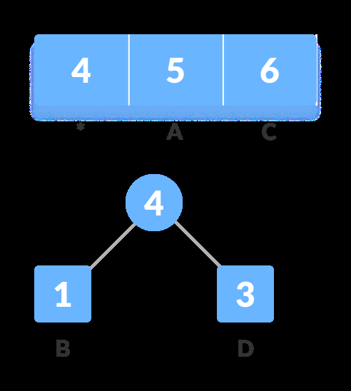
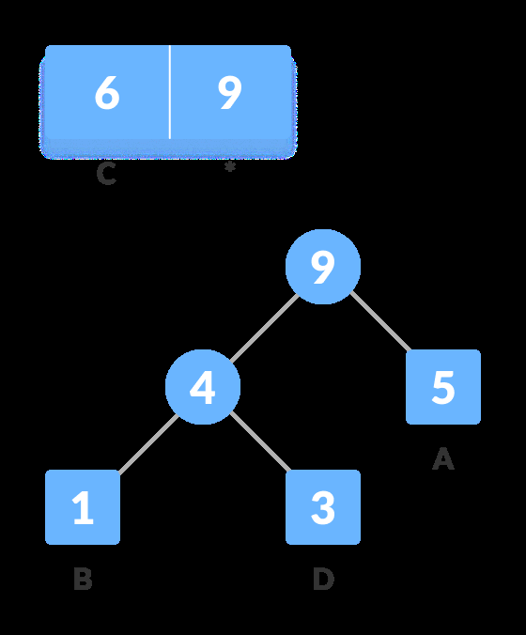
Figures from Section 3

Slide 10
Huffman Coding Algorithm: A Step-by-Step Guide
**Step 1:** Calculate the frequency of each unique character in the input string.**Step 2:** Create a min-heap data structure to store characters and their frequencies.**Step 3:** Repeatedly extract the two nodes with the smallest frequencies from the heap.**Step 4:** Create a new node with these two nodes as children, the frequency of the new node being the sum of the children's frequencies. Insert the new node back into the heap.**Step 5:** Repeat Step 3 and 4 until only one node remains (the root of the Huffman tree).**Step 6:** Assign '0' to the left branch and '1' to the right branch of each node.**Step 7:** Traverse the tree to generate the Huffman code for each character.

Slide 11
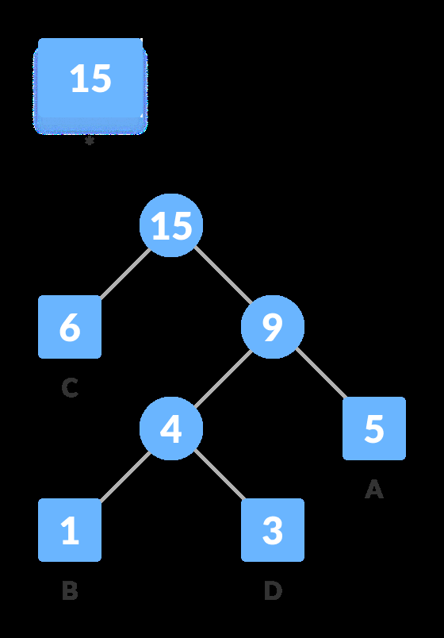
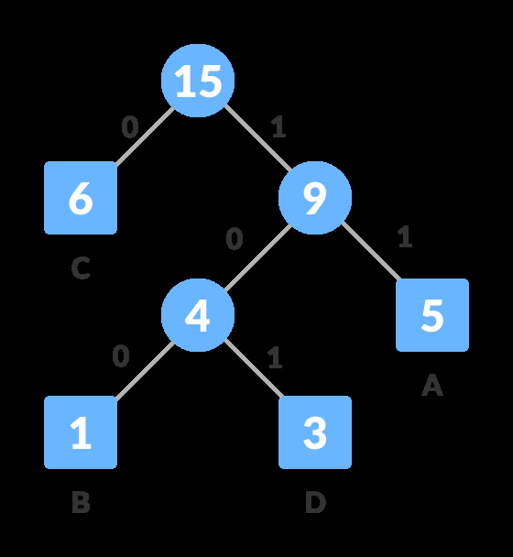
Figures from Section 4

Slide 12
Prefix Codes and Ambiguity Prevention
Huffman codes are prefix codes, meaning no code is a prefix of another. This prevents ambiguity during decoding.The tree structure ensures that no code can be confused with another. For example, if 'A' is encoded as '0' and 'B' is encoded as '01', there's no ambiguity.This prefix property is crucial for efficient and unambiguous decoding.The tree structure itself needs to be transmitted along with the encoded data for proper decoding. However, efficient methods exist to represent the tree concisely.The overhead of transmitting the tree is usually small compared to the compression achieved.

Slide 13

Figures from Section 5

Slide 14
Encoding and Decoding Example & Code Implementation Overview
Illustrate an encoding and decoding example using a sample string and its Huffman tree. Show the original string, frequency table, Huffman tree, generated codes, encoded string, and the decoding process.Briefly show a high-level overview of the code (C/C++ or Python) used to implement the Huffman coding algorithm, highlighting key functions like building the tree, encoding, and decoding. Focus on the data structures used (min-heap, tree nodes). Avoid showing extensive code snippets.

Slide 15
Conclusion: Efficiency and Applications of Huffman Coding
Huffman coding provides a highly efficient way to compress data, especially for text and other data with frequently occurring symbols.The compression ratio depends on the distribution of character frequencies in the input data.It's a lossless compression method; no information is lost during compression or decompression.Huffman coding is widely applied in various fields, including data compression utilities, image and audio compression, and network communication.While it's not the most advanced compression algorithm, it provides a solid foundation for understanding more sophisticated techniques. It's often used as a building block in more complex compression methods.

