Slide 1

Teach-Assist
V.E.S. INSTITUTE OF TECHNOLOGY, CHEMBUR, MUMBAI-74
(An Autonomous College Affiliated to University of Mumbai, Approved by
AICTE & Recognized by Govt. of Maharashtra)
Department of Electronics and Computer Science
Harness the power of AI to automatically convert your PDF documents into beautiful, ready-to-present PowerPoint slides.

Slide 2
Huffman Coding: Data Compression Technique
Created by: Aditya Bhogil

Slide 3
Index
1.Introduction to Huffman Coding2.How Huffman Coding Works: Encoding3.Huffman Tree Construction4.Huffman Coding Algorithm & Example5.Prefix Codes and Ambiguity Prevention6.Decoding Huffman Codes & Size Comparison7.ConclusionConclusion

Slide 4
Introduction to Huffman Coding
Developed by David Huffman.Data compression technique reducing file size without data loss.Most effective for data with frequently occurring characters.Achieves compression by assigning shorter codes to more frequent characters.Uses a binary tree structure for encoding and decoding.Widely used in file compression (e.g., gzip, PNG).Improves data transmission efficiency.

Slide 5

Huffman Coding
Figure 1

Slide 6
How Huffman Coding Works: Encoding
Example: Consider a string needing network transmission.Each character initially occupies 8 bits (e.g., ASCII).Total initial bit count calculation (number of characters * 8 bits/character).Huffman coding reduces this bit count significantly.Encoding involves creating a Huffman tree based on character frequencies.Assigning unique binary codes (0s and 1s) to each character based on tree structure.Concatenating these codes to represent the entire string.

Slide 7
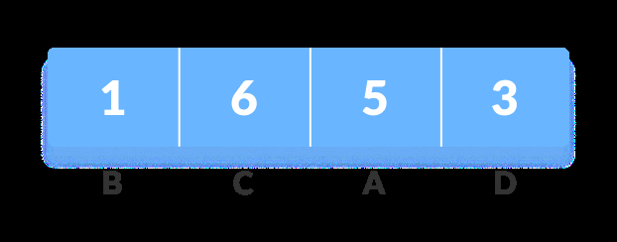
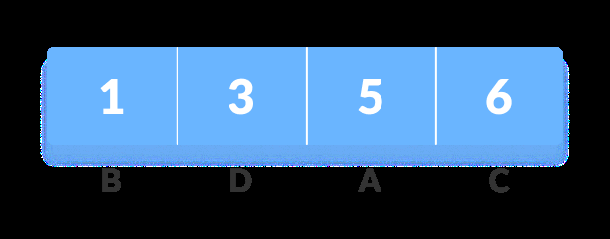
Huffman Coding prevents any ambiguity in the decoding process using the
Figure 1
Figure 2

Slide 8
Huffman Tree Construction
Calculate the frequency of each character in the input string.Sort characters in ascending order of frequency (priority queue).Create a leaf node for each unique character.Iteratively combine the two nodes with the lowest frequencies:Create a new parent node.Assign the left child the lower frequency node.Assign the right child the higher frequency node.The parent node's frequency is the sum of its children's frequencies.Repeat until only one node (the root) remains.

Slide 9
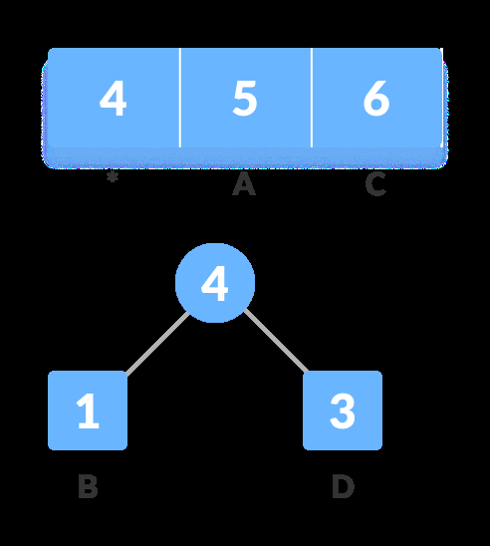
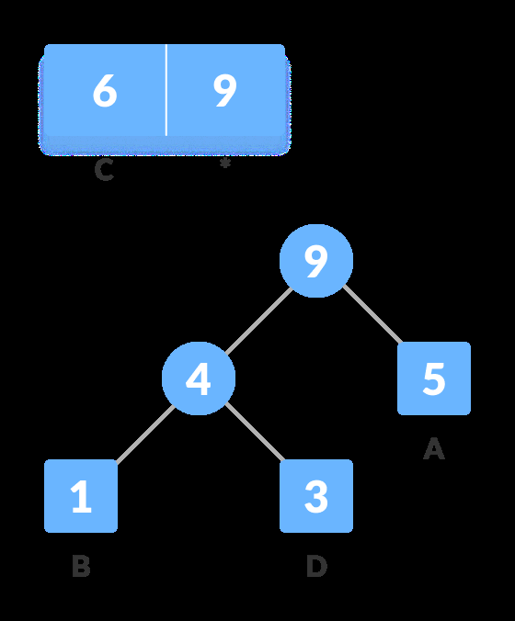
of the z as the sum of the above two minimum frequencies.
Figure 1
Figure 2

Slide 10
Huffman Coding Algorithm & Example
`createAndBuildMinHeap`: Creates a min-heap from character frequencies.`buildHuffmanTree`: Builds the Huffman tree using the min-heap.`printHCodes`: Traverses the tree and assigns codes to characters (0 for left, 1 for right).Example: Illustrate with a simple character set (e.g., A, B, C, D) and their frequencies.Show the step-by-step creation of the Huffman tree.Show the resulting Huffman codes for each character.

Slide 11
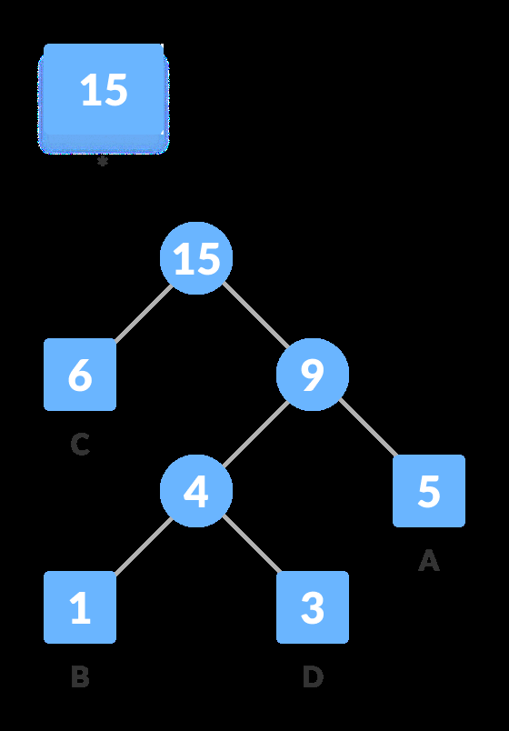
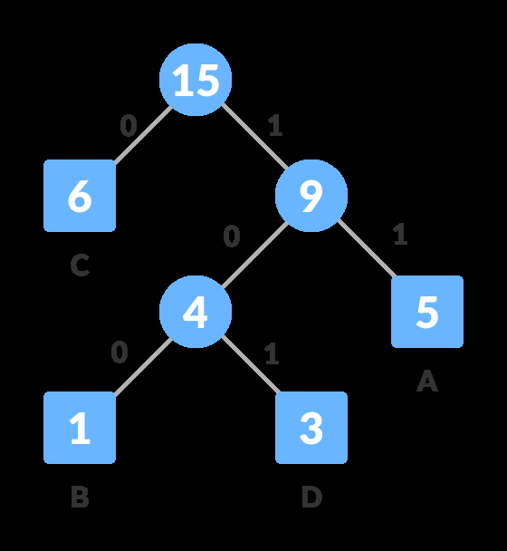
8. For each non-leaf node, assign 0 to the left edge and 1 to the right edge.
Figure 1
Figure 2

Slide 12
Prefix Codes and Ambiguity Prevention
Huffman codes are prefix-free (no code is a prefix of another).This prevents ambiguity during decoding.The tree structure inherently ensures the prefix-free property.Any sequence of codes can be uniquely decoded by traversing the tree.Illustrate with examples of valid and invalid prefix codes.

Slide 13

Character Frequency Code Size
Figure 1

Slide 14
Decoding Huffman Codes & Size Comparison
Decoding involves traversing the Huffman tree using the encoded bitstream.Each bit (0 or 1) directs the traversal (left or right).When a leaf node is reached, the corresponding character is output.Compare the size of the original string (in bits) to the size of the encoded string.Show the reduction in size achieved by Huffman coding.Include a table comparing original size vs. encoded size (including tree representation overhead).

Slide 15
Conclusion
Huffman coding is an efficient lossless data compression technique.It leverages character frequencies to minimize the encoded string size.The prefix-free property ensures unambiguous decoding.Widely applicable in various data compression scenarios.Further improvements can be achieved by combining Huffman coding with other techniques.

