Slide 1
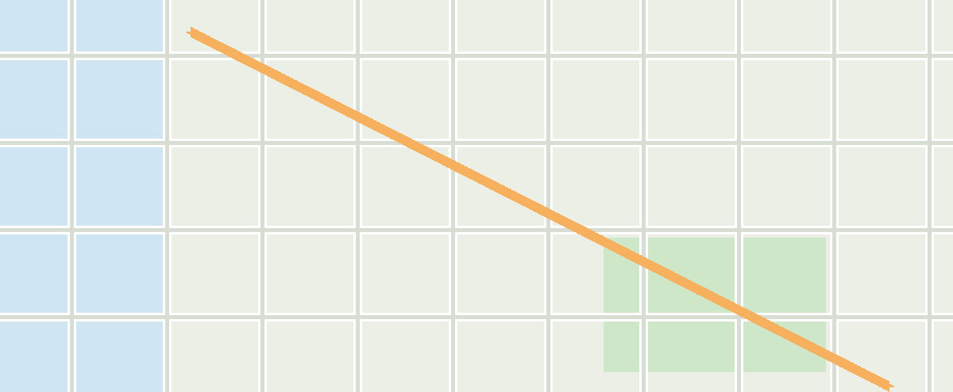
PROPERTY LOCATION & ACCESS
KEY DISTANCES
 | Downtown Core | 4.2 km | 9 min
 | Intl. Airport | 18.1 km | 22 min
 | Regional Park | 2.6 km | 6 min
I-95 & Route 1
THE PROPERTY
10 min drive
A
Smith & Sons Depot
O'Hare Terminal

