Slide 1
🎮 Enhancing Game Success Prediction using Streamlit
Specialized ML Framework Demonstration
Name: Aditya Bahira
Course: Machine Learning
Task: Explore & Present – Specialized ML Frameworks

Slide 2
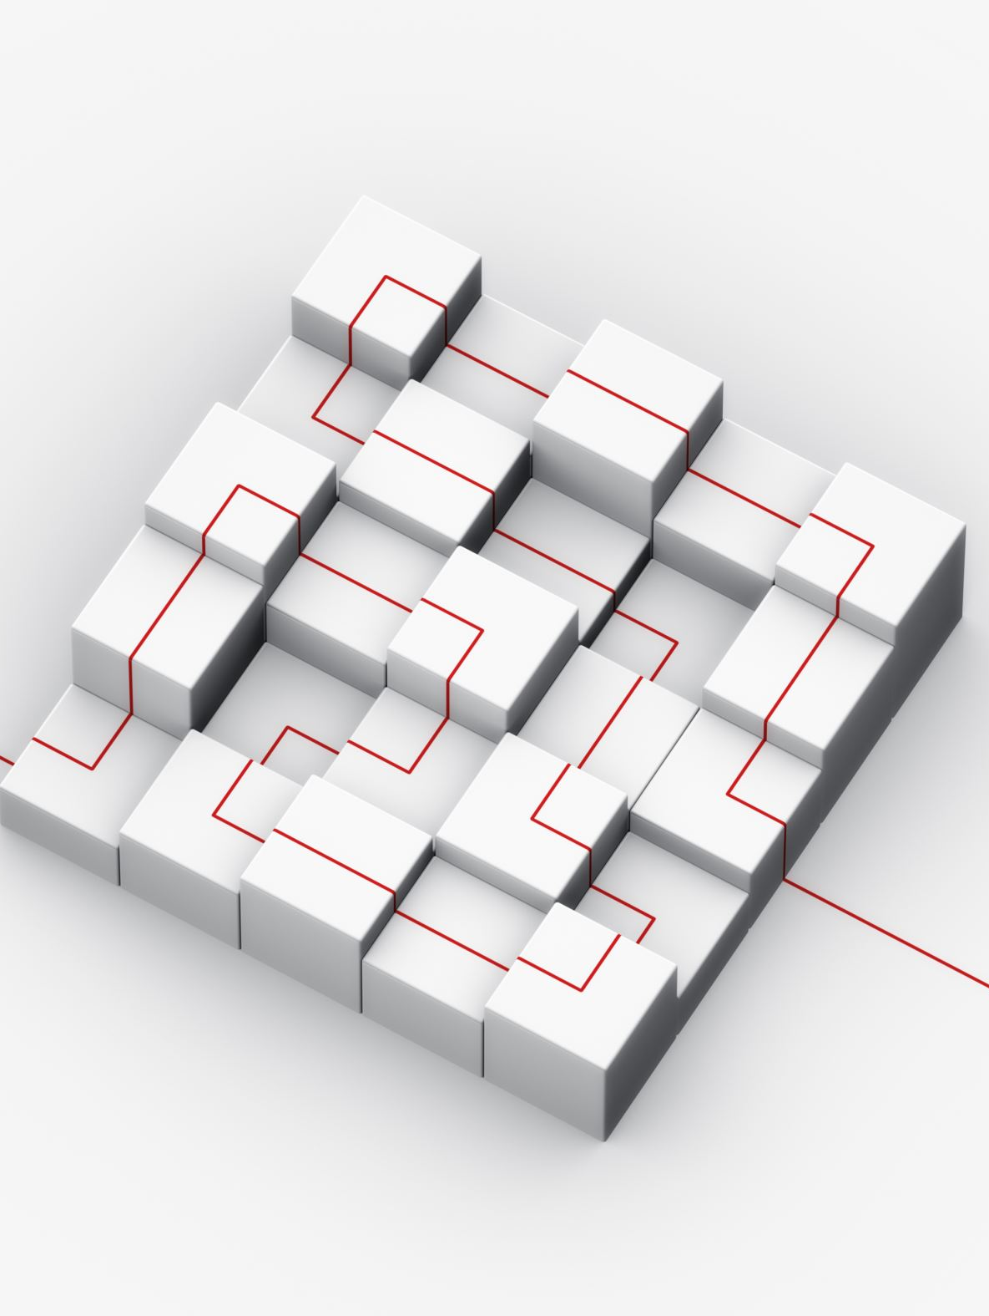
What are Specialized ML Tools?
Specialized Machine Learning tools help improve different stages of the ML workflow such as:
Model development
Data visualization
Model deployment
Examples include:
PyCaret (AutoML)
Plotly/Bokeh (Interactive visualization)
Streamlit (Model deployment)
For this project, Streamlit was selected.

Slide 3

What is Streamlit?
Streamlit is an open-source Python framework used to build interactive web applications for machine learning models.
Key features:
Simple Python-based interface
Real-time interaction
Fast deployment of ML models
No web development knowledge required
Streamlit allows ML models to be converted into usable applications.

Slide 4

How Streamlit Enhances the Notebook
The original notebook performs:
Data preprocessing
Exploratory data analysis
Model training
Using Streamlit, this analysis can be transformed into an interactive prediction tool.
Users can now:
Enter critic score
Enter user score
Select genre and platform
Predict whether a game will be successful

Slide 5
Implementation
Steps followed:
1) Installed Streamlit using pip
2) Created a Python application (app.py)
3) Loaded the dataset games(1).csv
4) Trained a Random Forest model
5) Built an interactive UI with sliders and dropdown menus
6) Generated predictions based on user input
The application predicts game success based on historical data.

Slide 6
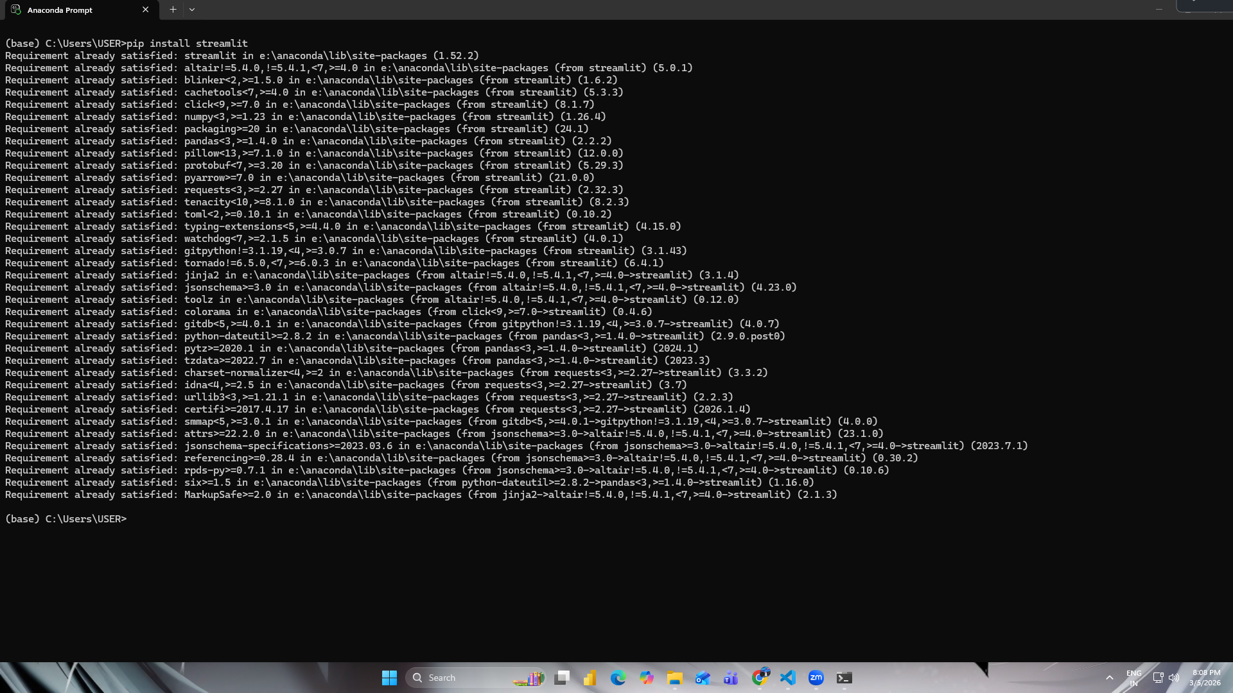
Demonstration

Slide 7
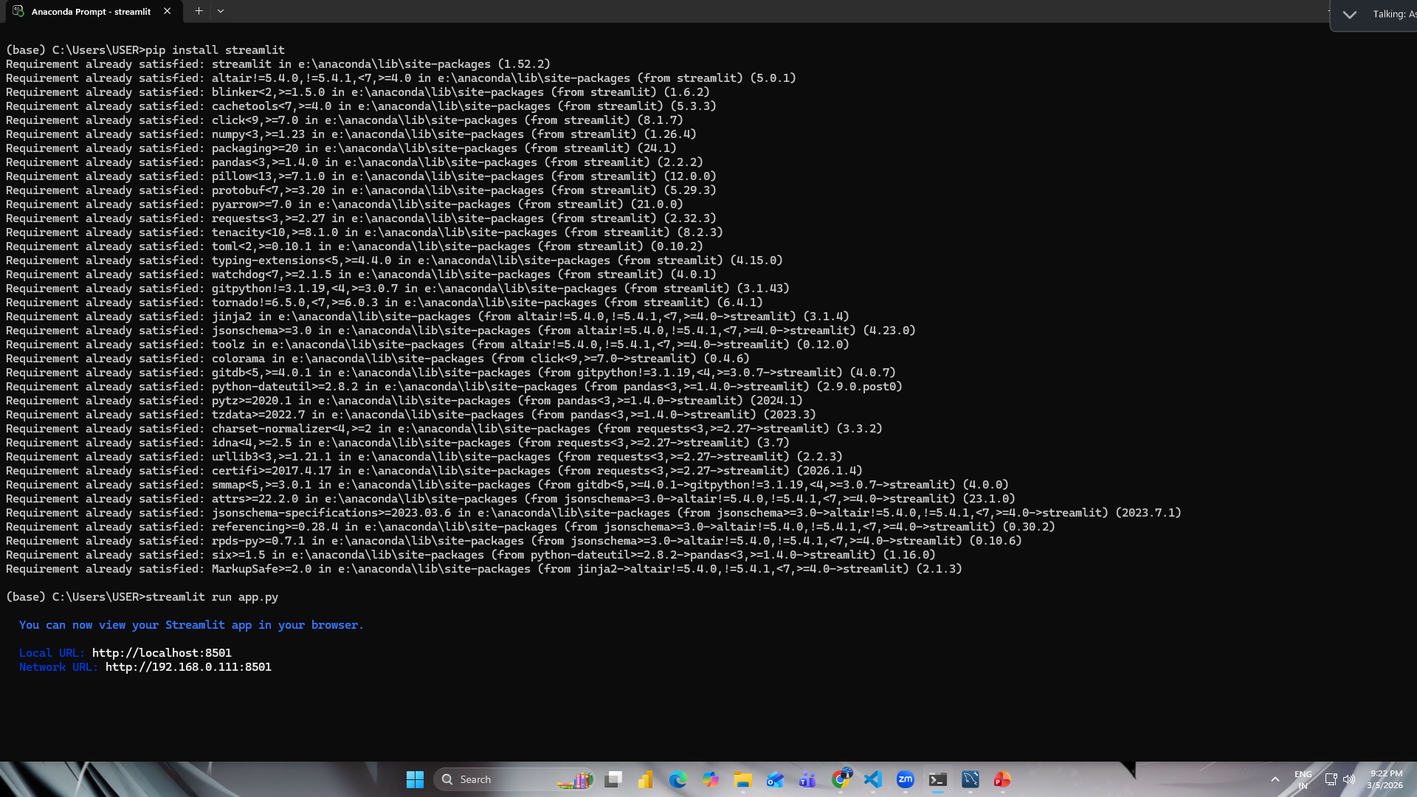

Slide 8
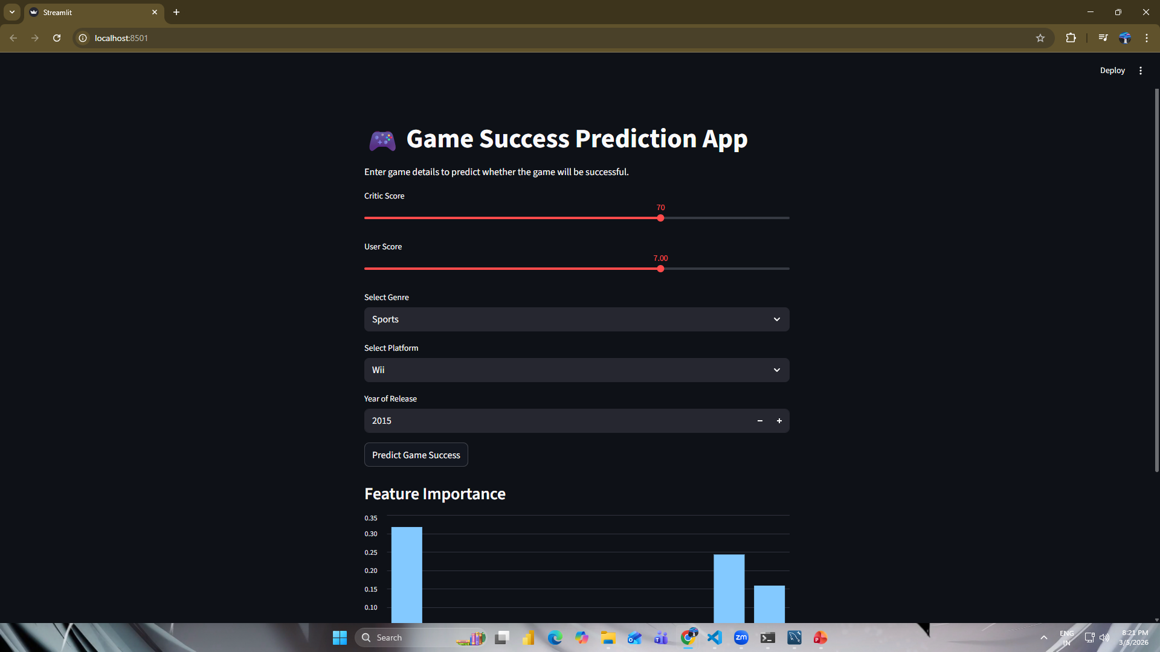

Slide 9
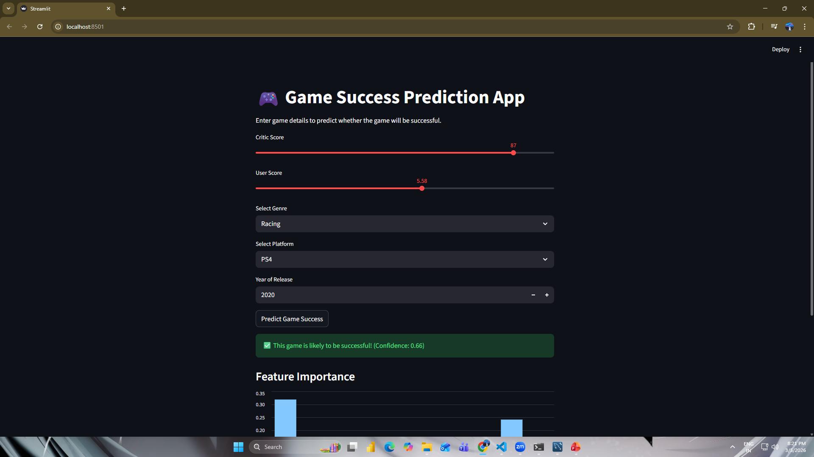

Slide 10
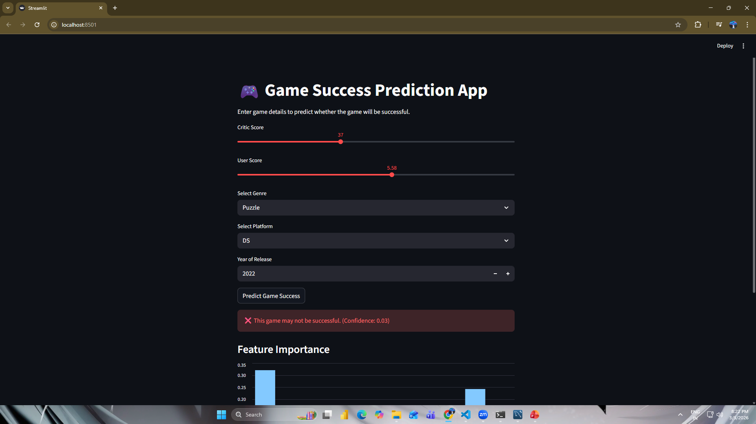

Slide 11

Conclusion
Streamlit significantly enhances machine learning projects by allowing models to be deployed as interactive applications.
Benefits:
Makes ML results accessible to non-technical users
Enables real-time predictions
Improves usability of data analysis
This tool demonstrates how machine learning models can be converted into practical applications.

