Slide 1

Online Live Courier Tracking and Delivery System
Aditya Bahl
2016580​
Mentor : Mr. Pankaj Kumar

Slide 2

Introduction
This presentation discusses the Online Courier Tracking and Delivery System and how it leverages React, Firebase, HTML, CSS, and JavaScript for efficient courier management and tracking.
The system aims to automate and streamline the process of managing courier services, providing a centralized platform for users to track their shipments, schedule deliveries, and manage logistics. By utilizing these modern web technologies, courier companies can enhance efficiency, improve customer experience, and optimize their delivery operations.

Slide 3
Key features
Shipment Creation
Shipment Tracking
User Management, Registration and Authentication
Customer Support
Dynamic Website
benefits
Automation of courier management processes.
Streamlined tracking and delivery operations.
Enhanced efficiency and reduced manual errors.
Improved customer experience and satisfaction.
Real-time tracking and notifications.

Slide 4
METHODOLOGY
Functional Requirements
Functional requirements define what a product must do, what its features and functions are.
User Authentication
Shipment Creation
Shipment Tracking
Contact us, Report and About Me
Non-Functional Requirements
Nonfunctional requirements describe the general properties of a system
Usability
Performance
Reliability
Compatibility

Slide 5
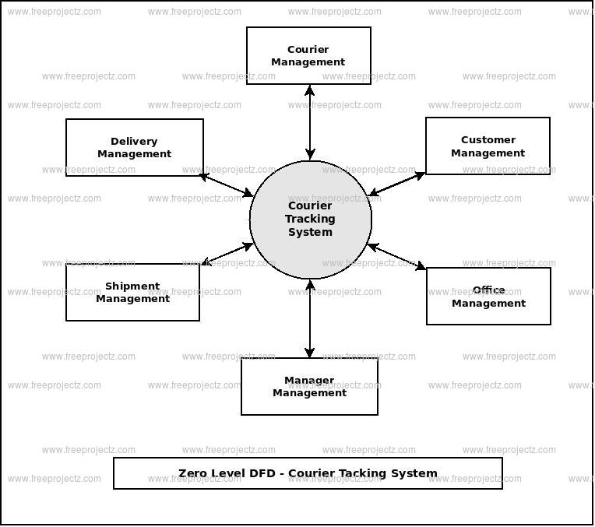
FRONT-END DEVELOPMENT
React
MediaQuery
HTML, CSS and JavaScript
BACK-END DEVELOPMENT
Firebase
React Router
Real Time Database

Slide 6
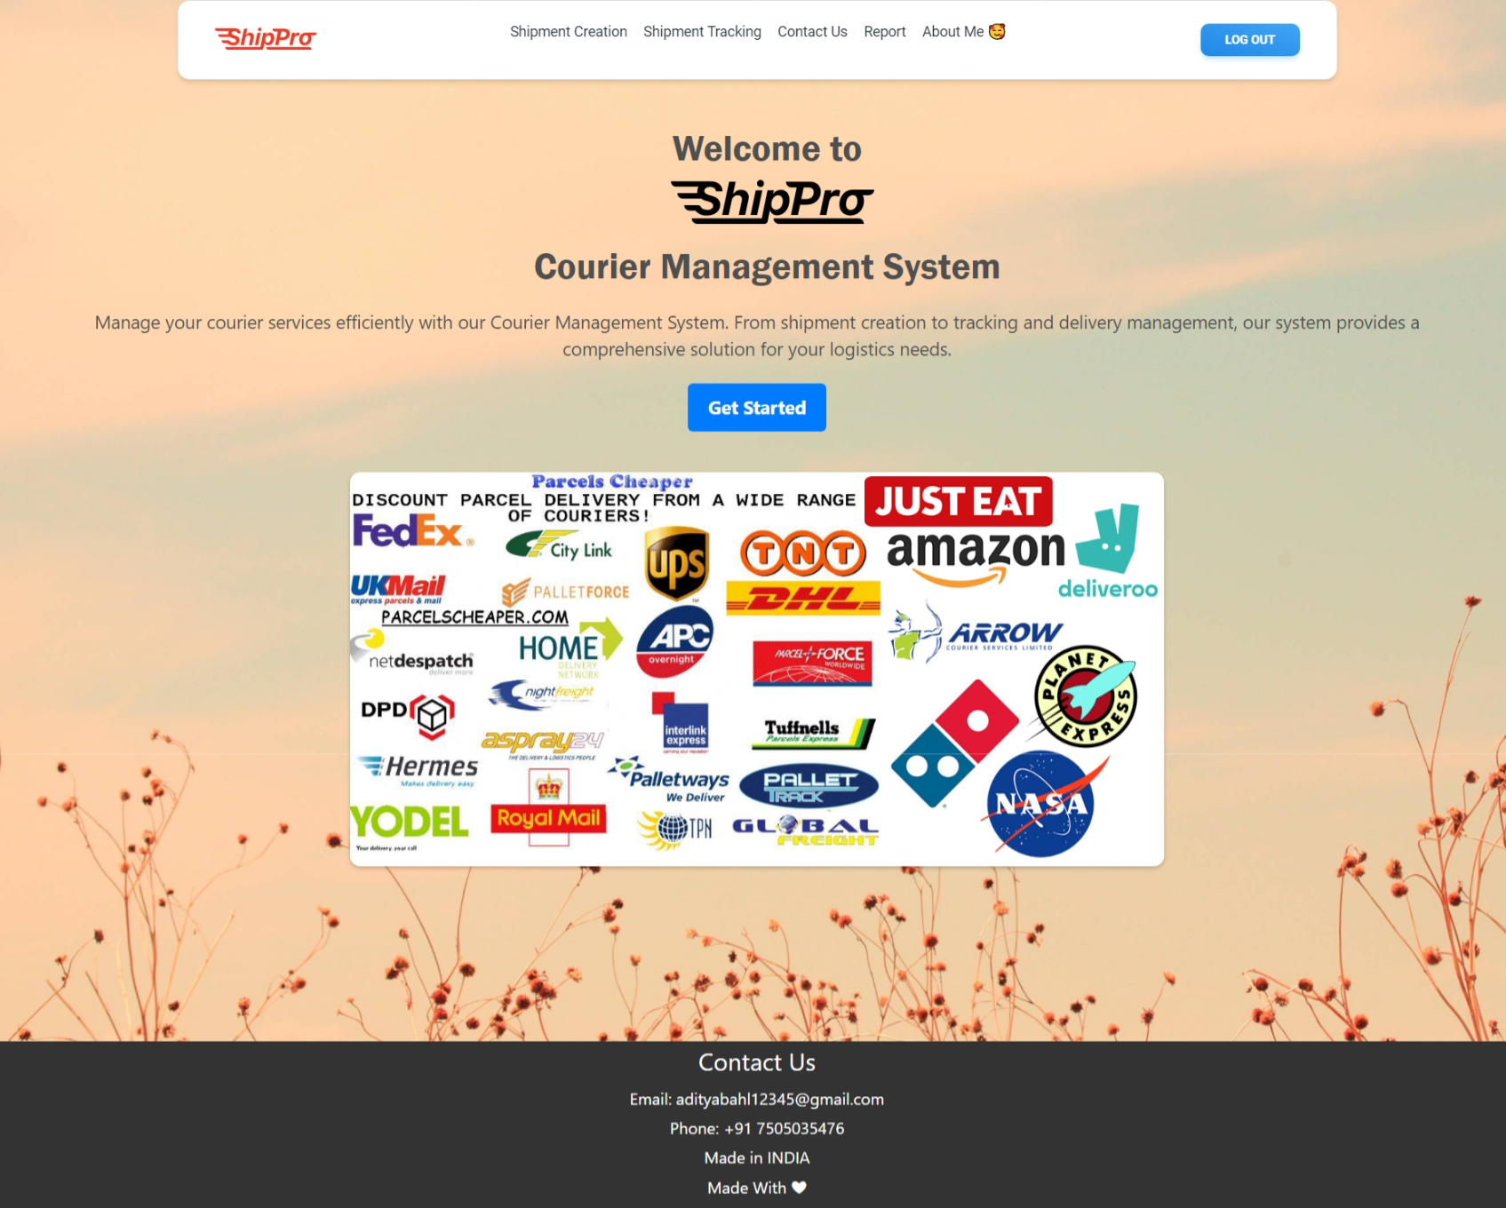
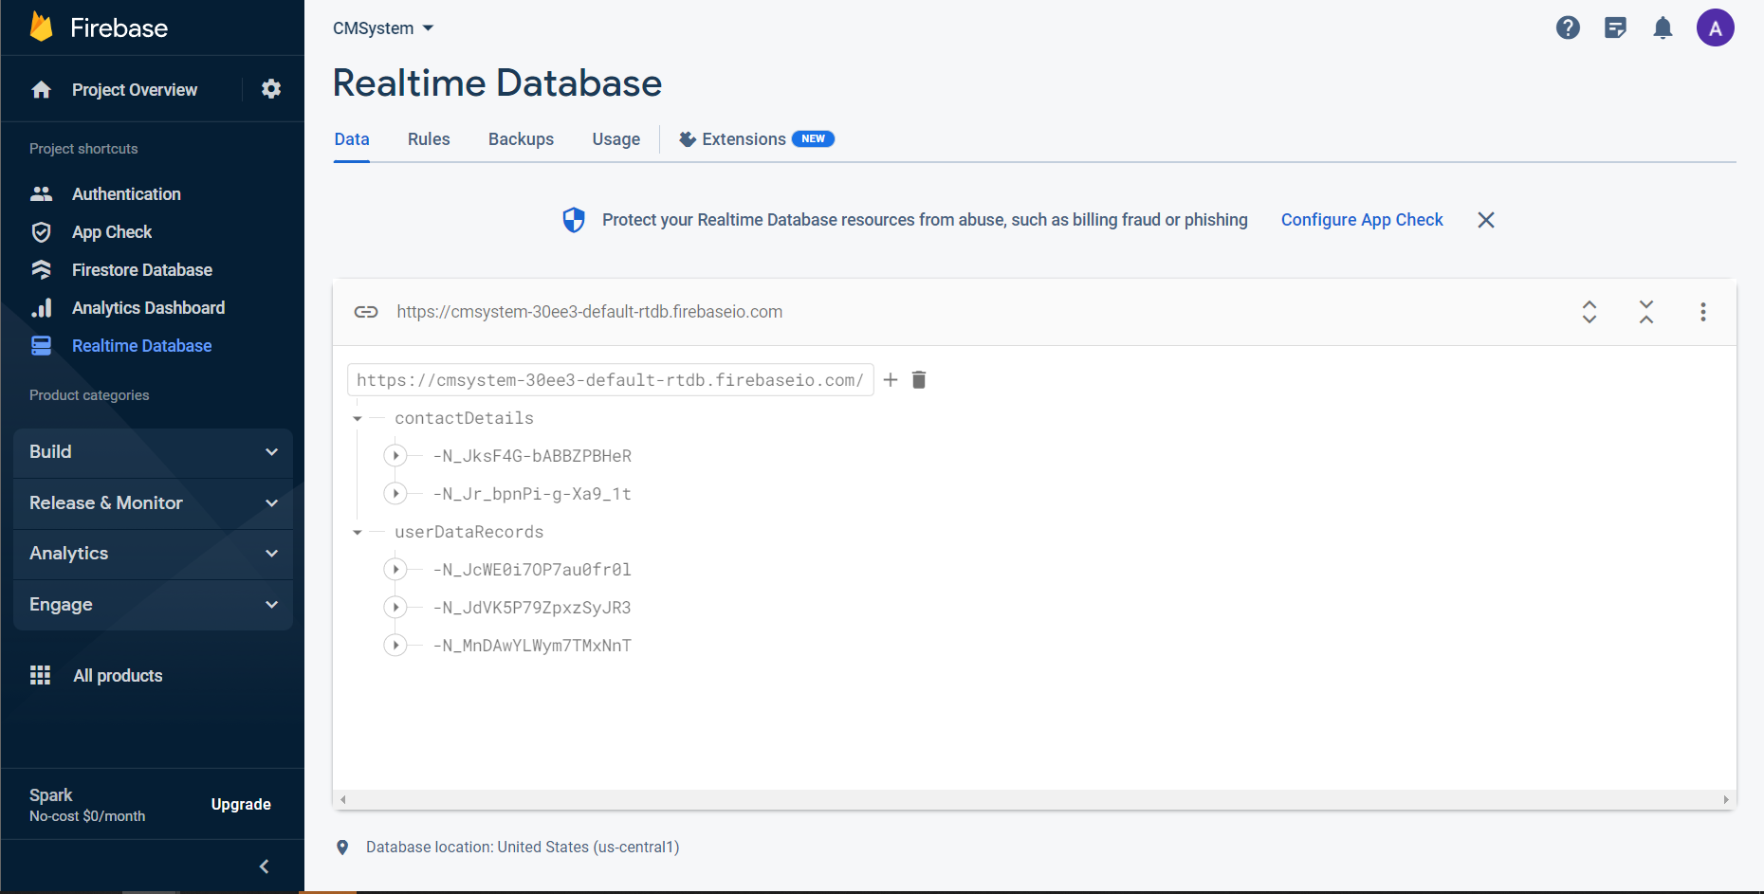
For students:
Go to the website and login with your Google Account or a new account exclusively for the website.
Fill details for a new shipment.
And or see the details in the database.
For any query fill the contact form or contact the admin team with details in footer.
For administrators:
Go to the website and login with your administrator ID and password.
Can check firebase for authentication, users and databases of contact form and shipment details.

Slide 7
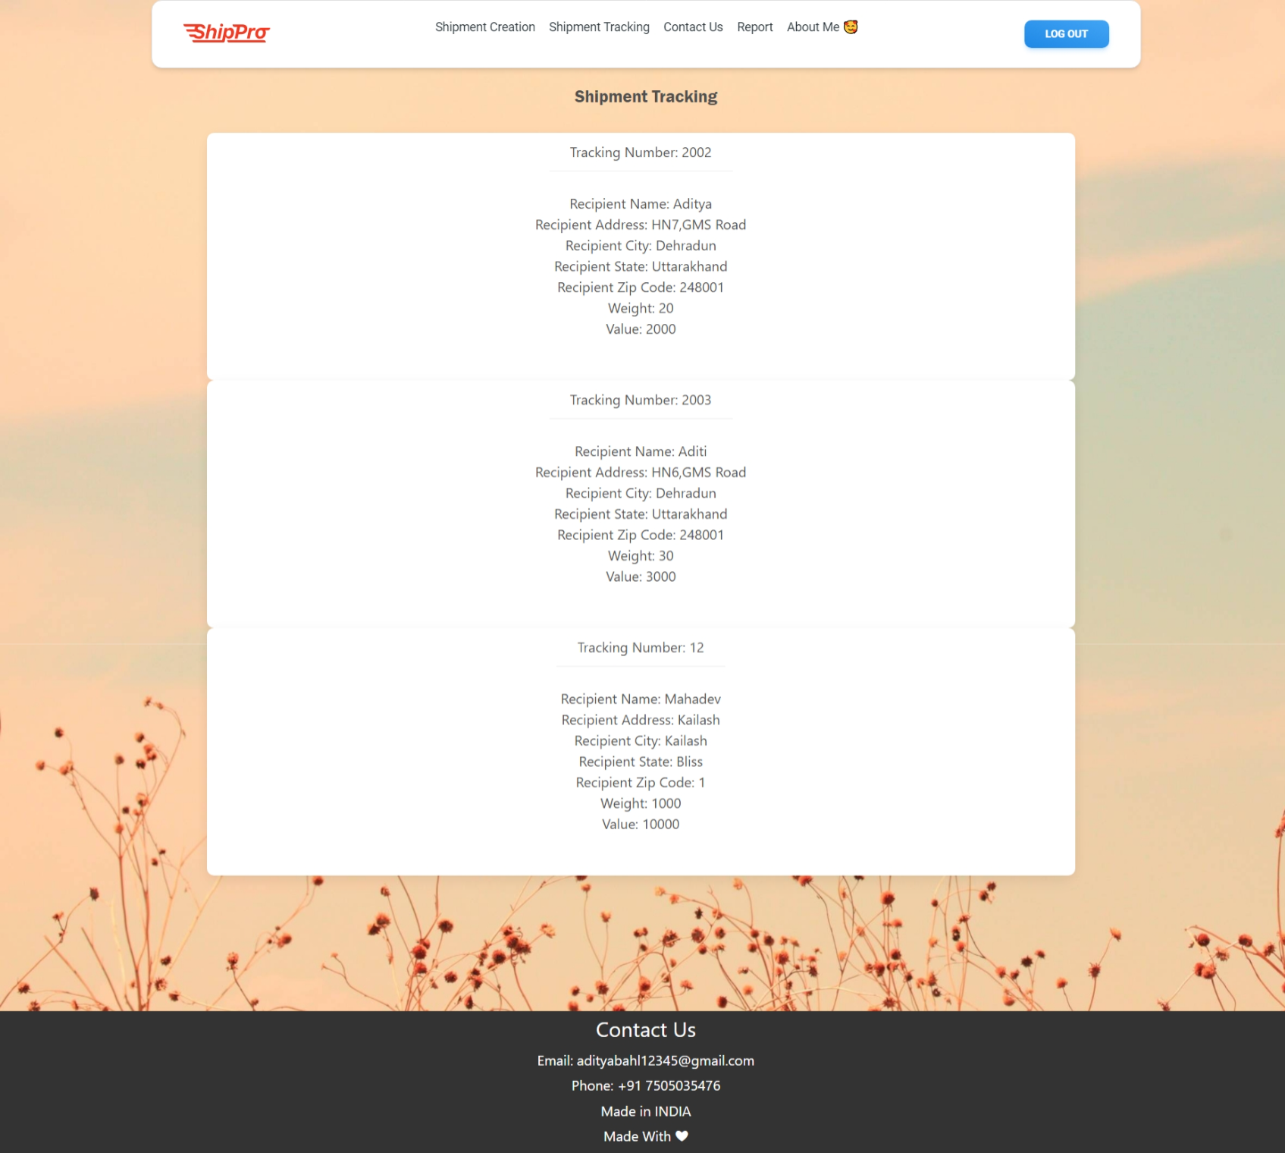
Continued……
Functions an administrator can perform :-
Adding Shipment Data.
Update Shipment Data.
Deleting Shipment Data.
Access Shipment Data.
Can see Shipment queries.

Slide 8
Future work
Integration with advanced route optimization algorithms for efficient delivery planning.
Integration with e-commerce platforms for seamless order placement and tracking.
Integration with voice assistants for hands-free tracking and delivery updates.
Implementation of machine learning algorithms for demand forecasting and resource allocation.
Integration with IoT devices for real-time package tracking and monitoring.

Slide 9
conclusion
In conclusion, the Online Courier Tracking and Delivery System using React and Firebase offers numerous benefits and advancements for efficient logistics management. By leveraging these technologies, it simplifies the process of managing courier services, improves efficiency, reduces manual errors, and enhances overall customer satisfaction. With the potential for future upgrades and advancements, the system can continue to evolve and adapt to the changing needs of the logistics industry. It has the potential to revolutionize the way courier services are managed, making it a valuable tool for businesses in the modern digital era.

Slide 10
THANK YOU

