Slide 1
A.L.E.C.
Artificial Linguistic Enquiry Chatbot
Aishwarya Sadana (2017CA12) Aditya Bhawsar(2017CA59) Mansi Sharma (2017CA79)
Pavan Chandravanshi (2017CA56)
Under the supervision of Dr. Anoj Kumar
Computer Science and Engineering Department MNNIT Allahabad, Prayagraj (U.P.)
May, 2019
A.L.E.C.

Slide 2
Content
Introduction Problem Statement About A.L.E.C.
Natural Language Tool Kit (NLTK) ChatterBot Python Library Python’s SimpleWebSocketServer Design
Implementation Experimental Results Conclusion & Future Aspect References
A.L.E.C.

Slide 3
Introduction
∗ What is CHATBOT ?
–a computer program or an artificial intelligence which conducts a conversation via auditory or textual methods.
–Helps to find answers to queries through chat
–Example : Cortana, Siri, Google Assistant etc.
A.L.E.C.

Slide 4
Problem Statement ( Why we need A.L.E.C. ?)
–Hard to find information on website.
–Student needs to visit department office manually.
–Limited information on Website.
–It can consumes lot’s of time and money.
–Lack of knowledge about department’s event.
A.L.E.C.

Slide 5
About A.L.E.C. (Artificial Linguistic Enquiry Chatbot )
–One place solution to all the queries ask by student.
–Attached with department notice board.
–Give information about departments Faculties, Events, Facilities, Exam, Assignment, Current Project and Courses etc.
–It also provides :
Chat View.
Active Communication Method.
27*7 Assistant.
A.L.E.C.

Slide 6
NLP (Natural Language Processing)
Before implementation we need to understand some basic working of any chatbot.
–It is the branch of machine learning which is about analyzing any text and handling predictive analysis.
–Natural language processing (NLP) is an area of computer science and artificial intelligence concerned with the interactions between computers and human (natural) languages.
–It uses Natural Language Tool Kit.
–The NLTK is a set of Python modules to carry out many common natural language tasks.
A.L.E.C.

Slide 7
ChatterBot Python library
–ChatterBot is a Python library that makes it easy to generate automated responses to a users input.
–ChatterBot uses a selection of machine learning algorithms to produce different types of responses.
–This makes it easy for developers to create chat bots and automate conversations with users.
A.L.E.C.

Slide 8
SimpleWebSocketServer
A python based websocket server.
Asynchronous WebSocket handler It uses 3 methods.
handelMessage().
handelConnected().
handelClose().
A.L.E.C.

Slide 9

Design
–Data Flow Diagram of A.L.E.C.
∗ Level 0 :
A.L.E.C.

Slide 10
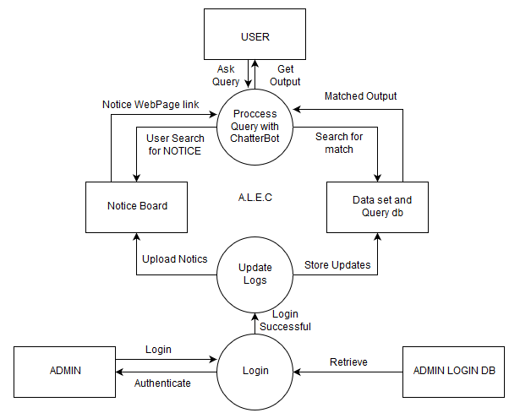
Design
∗ Level 1 :
A.L.E.C.

Slide 11
Implementation
A.L.E.C consist of 3 modules :
User.
–Ask Query.
–Submit New Query.
–View Notice Board.
Admin.
–Update/Delete information.
–Upload/Delete Notice.
–Register user to upload notice.
Notice.
–This module is defined for displaying the important notices issued by the department. Students can view the notice board by just typing Notice in the chatbot.
A.L.E.C.

Slide 12
Implementation
Corpus Data sets.
–Corpus is a large collection of texts. It is a body of written or spoken material upon which alinguistic analysis is based.
A.L.E.C uses text files with .yml (extension) text files for data sets. Like,
- What is full form of MCA ?
Master of Computer Application
- Number of seats in MCA.
93 seats.
- How many faculties are under CSED?
There are 21 faculties.
- Subjects taught by Neeraj Tyagi Sir in UG Courses.
Computer Network, Unix Shell Programming etc.
A.L.E.C.

Slide 13
Languages Used
–For Back-End
Python PHP MySQL
–For Front-End
HTML CSS
Java Script
A.L.E.C.

Slide 14
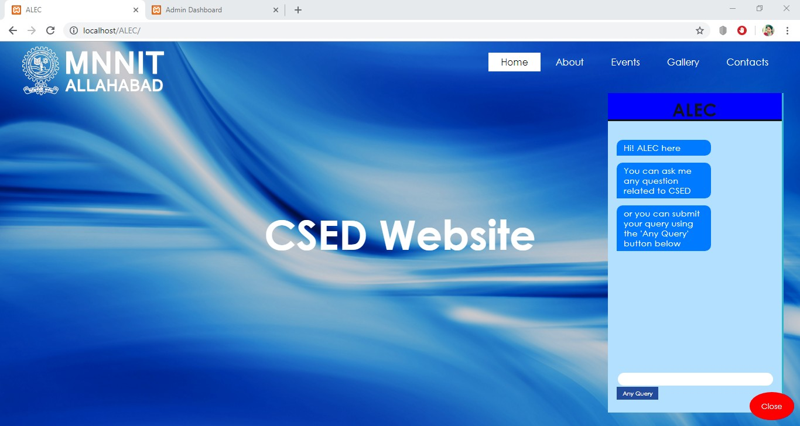
Experimental Results
A.L.E.C.

Slide 15
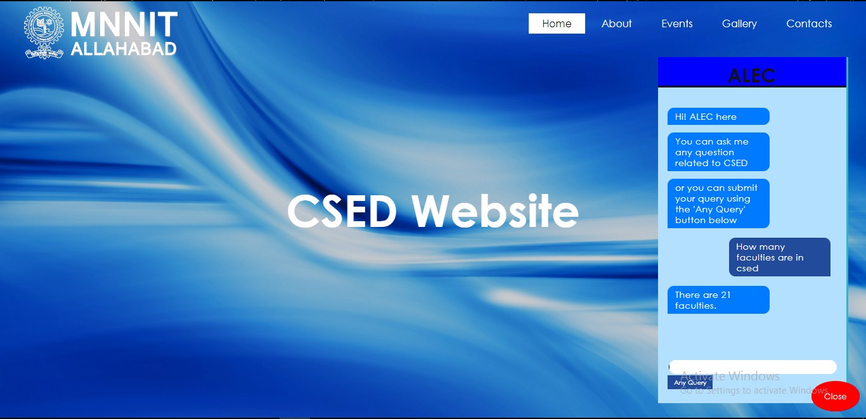
Experimental Results
A.L.E.C.

Slide 16
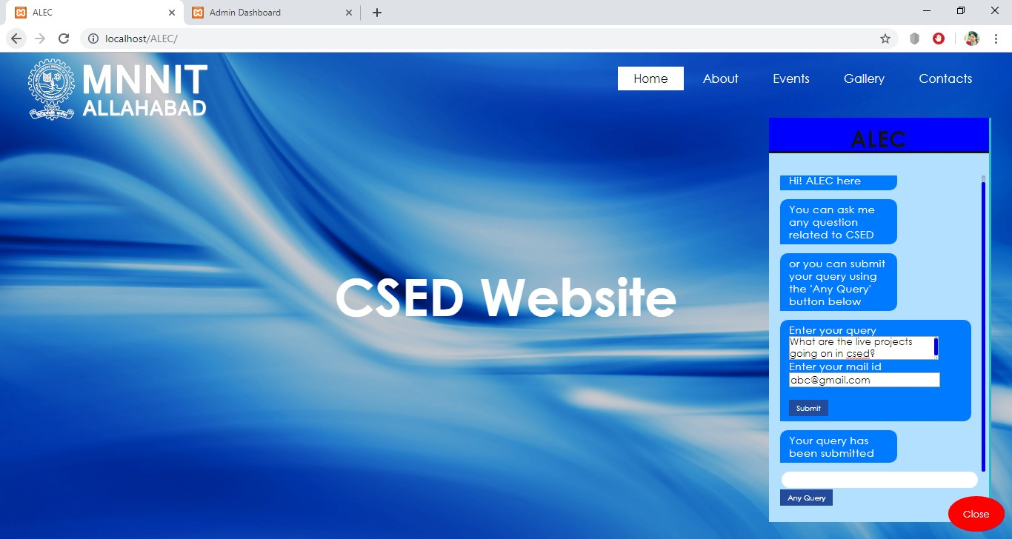
Experimental Results
A.L.E.C.

Slide 17
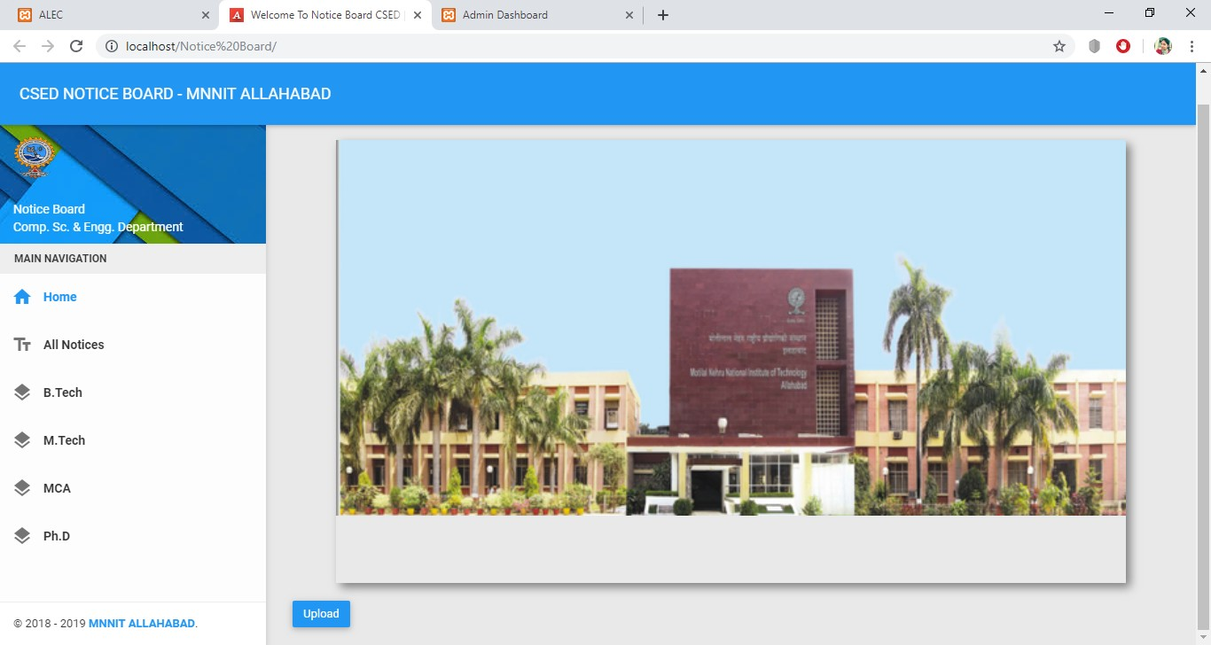
Experimental Results
A.L.E.C.

Slide 18
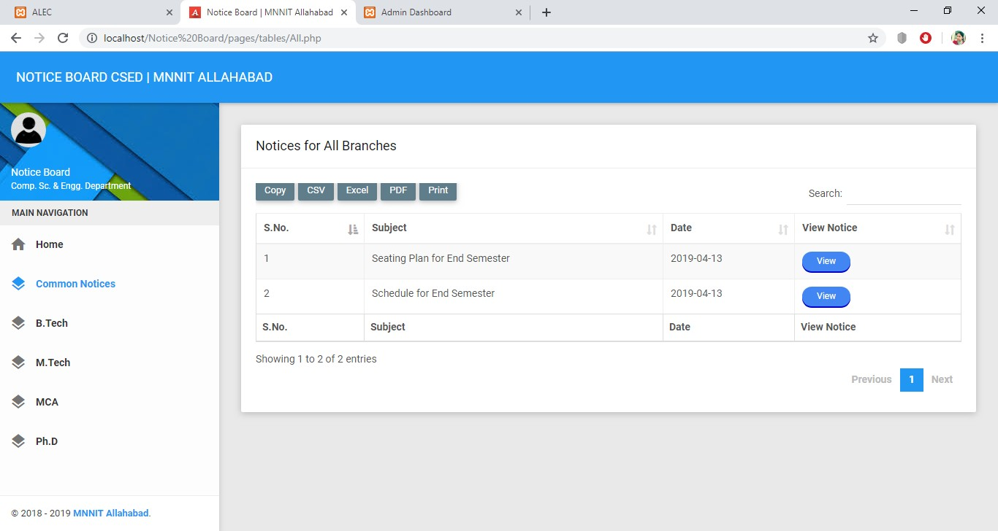
Experimental Results
A.L.E.C.

Slide 19
Conclusion & Future Aspect
We now have a Web-app for our CSED Department that will be useful for the students to find answers to their queries. Though it may have a very limited number of features as of now, it can very easily be modified to add new features.
In future many other functionalities can be added to the portal like:
–Answers with the available options.
–Image and PDF in the answers.
–Speech to text and text to speech feature.
–User login for more specific queries like assignment, marks or exam information.
–Publishing on social media platform like Telegram, Messenger etc.
A.L.E.C.

Slide 20
References
https://drive.google.com/file/d/0B- tCvLzyt01FYlQ2dVRBWEtTNkE/view
https://www.cleverbot.com/Normaluser friendly chatbot.
https://www.irctc.co.in/nget/Arailway guide on IRCEC website.
https://en.m.wikipedia.org/wiki/XamppXamppserver. https://chatterbot.readthedocs.io/en/stable/
A.L.E.C.

Slide 21
A.L.E.C
THANK YOU...
A.L.E.C.

