Slide 1


GROVIA: Intelligence That Sustains Trust
Aditya Biranje
Soham Jadhav
Joshua Theophilus
Prof. Sagar Yadav
College Name - Dr. D. Y. Patil School Of Science and Technology, Pune
Notes:
Let's delve deeper into the exciting world of sustainability and AI.
In this chapter, we'll explore how artificial intelligence can be a powerful tool for addressing environmental challenges and promoting sustainable practices. We'll discuss specific applications of AI in various sectors and analyze its potential to drive positive change.
Get ready to discover the innovative ways AI is contributing to a more sustainable future!

Slide 2

Project Objectives
Problem Statement
Project Overview – Introduction
End Users
Wow Factor in Project
Modelling/Block Diagram/Flow of Project
Result/outcomes
Conclusion
Future Perspective
Notes:
Let's outline what you'll learn in this presentation.
By the end, you'll be able to:
Understand how AI helps solve problems like climate change, resource depletion, and biodiversity loss.
Identify key AI uses in energy efficiency, waste management, and climate change.
Analyze AI's role in sustainable agriculture and cities.
Evaluate AI's use in environmental monitoring using satellites, real-time data, and predictions.
Apply AI strategies in logistics and transportation to make them more sustainable.
Get ready to discover how AI can help create a greener future!

Slide 3
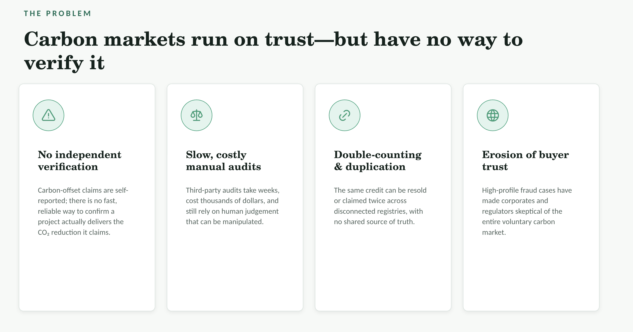
Notes:
Sustainability and AI
Sustainability is important because it helps meet our needs now and in the future. It includes protecting the environment, reducing pollution, and improving economic and social well-being.
AI can help us achieve sustainability. AI can process data, make predictions, and optimize systems to solve problems like resource management, environmental conservation, and energy efficiency.
Examples:
Smart grids: Reduce energy consumption.
Agriculture: Optimize water and fertilizer use.
Biodiversity: Monitor wildlife to protect biodiversity.
AI is a powerful tool for creating a more sustainable future.

Slide 4
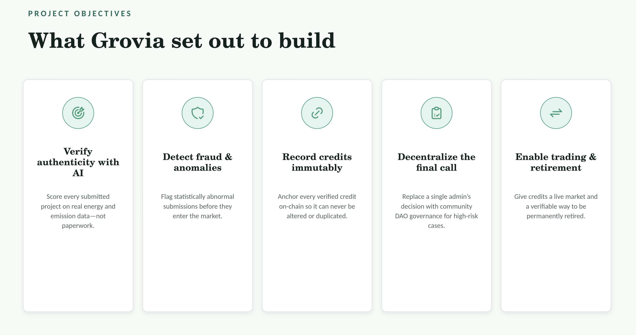

Slide 5
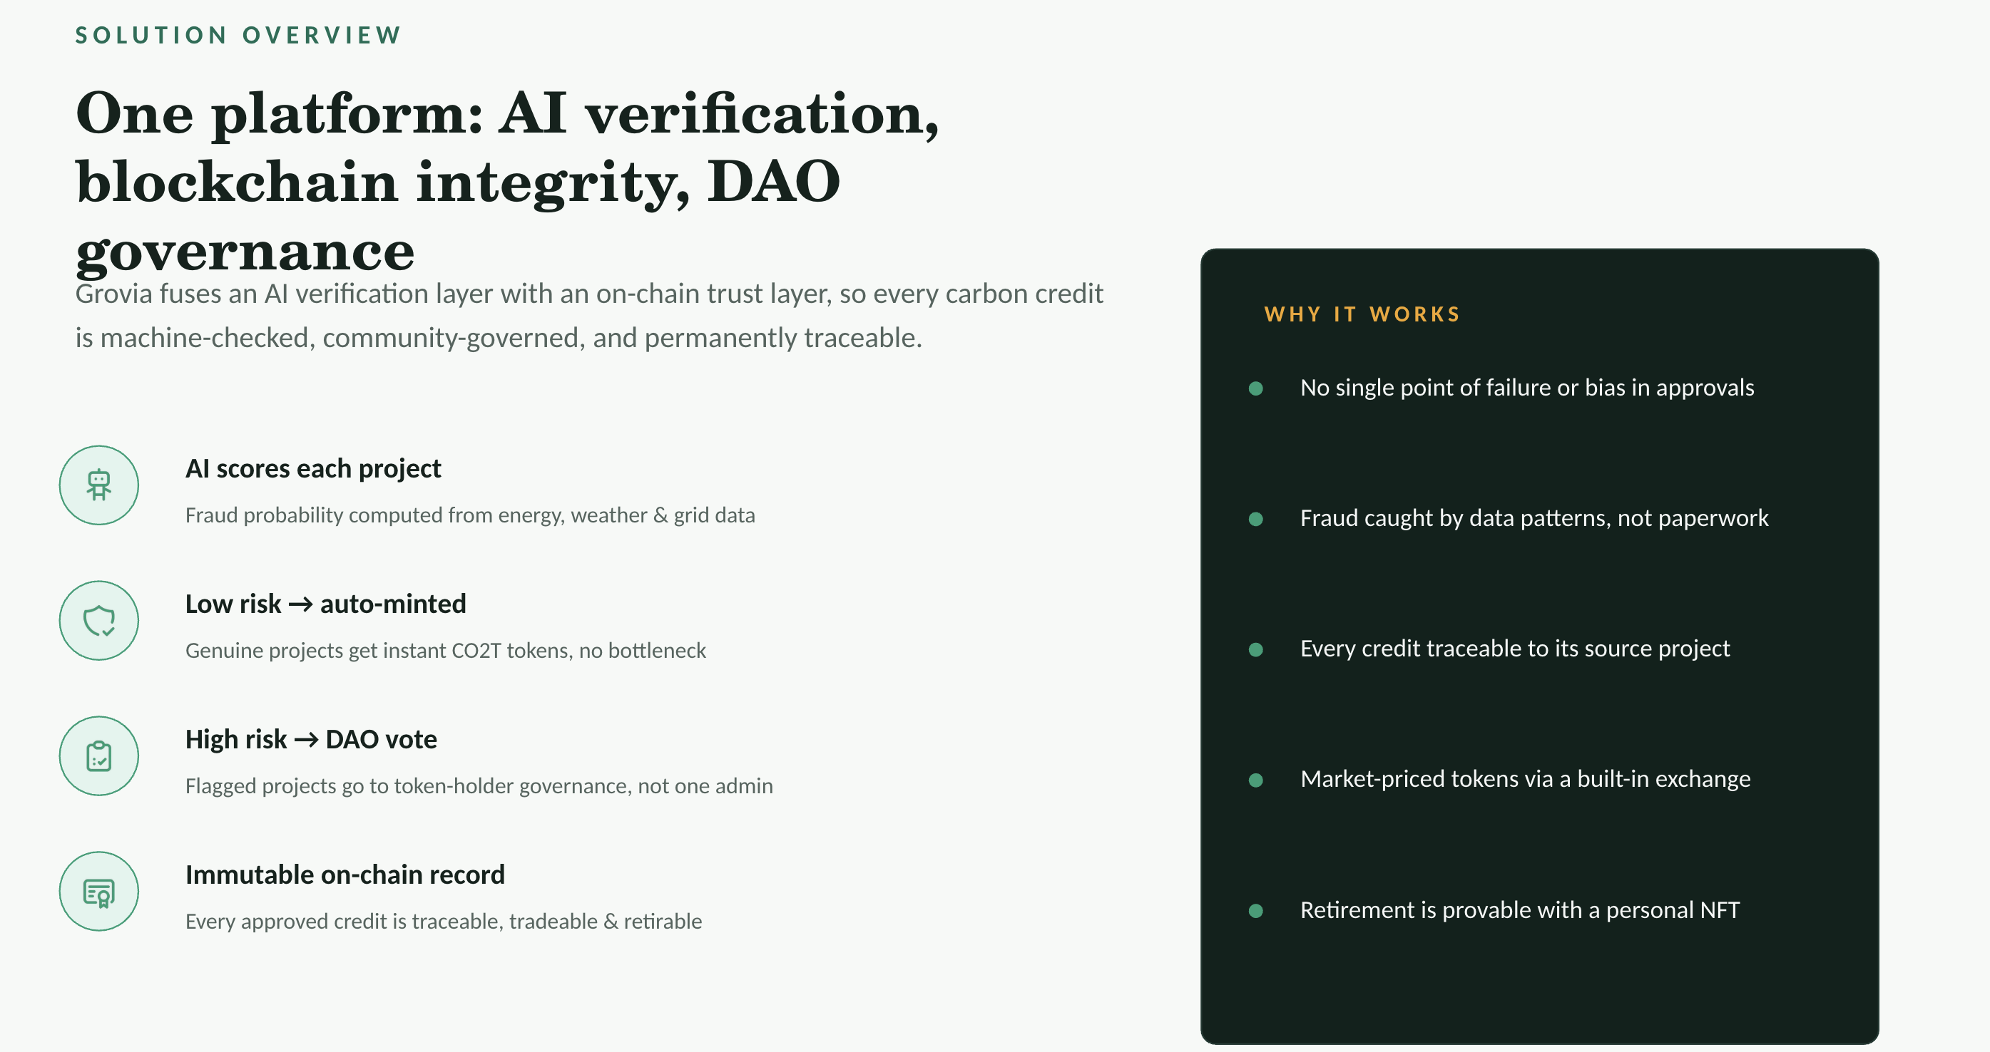
Notes:
Sustainability and AI
Sustainability is important because it helps meet our needs now and in the future. It includes protecting the environment, reducing pollution, and improving economic and social well-being.
AI can help us achieve sustainability. AI can process data, make predictions, and optimize systems to solve problems like resource management, environmental conservation, and energy efficiency.
Examples:
Smart grids: Reduce energy consumption.
Agriculture: Optimize water and fertilizer use.
Biodiversity: Monitor wildlife to protect biodiversity.
AI is a powerful tool for creating a more sustainable future.

Slide 6

Notes:
Sustainability and AI
Sustainability is important because it helps meet our needs now and in the future. It includes protecting the environment, reducing pollution, and improving economic and social well-being.
AI can help us achieve sustainability. AI can process data, make predictions, and optimize systems to solve problems like resource management, environmental conservation, and energy efficiency.
Examples:
Smart grids: Reduce energy consumption.
Agriculture: Optimize water and fertilizer use.
Biodiversity: Monitor wildlife to protect biodiversity.
AI is a powerful tool for creating a more sustainable future.

Slide 7
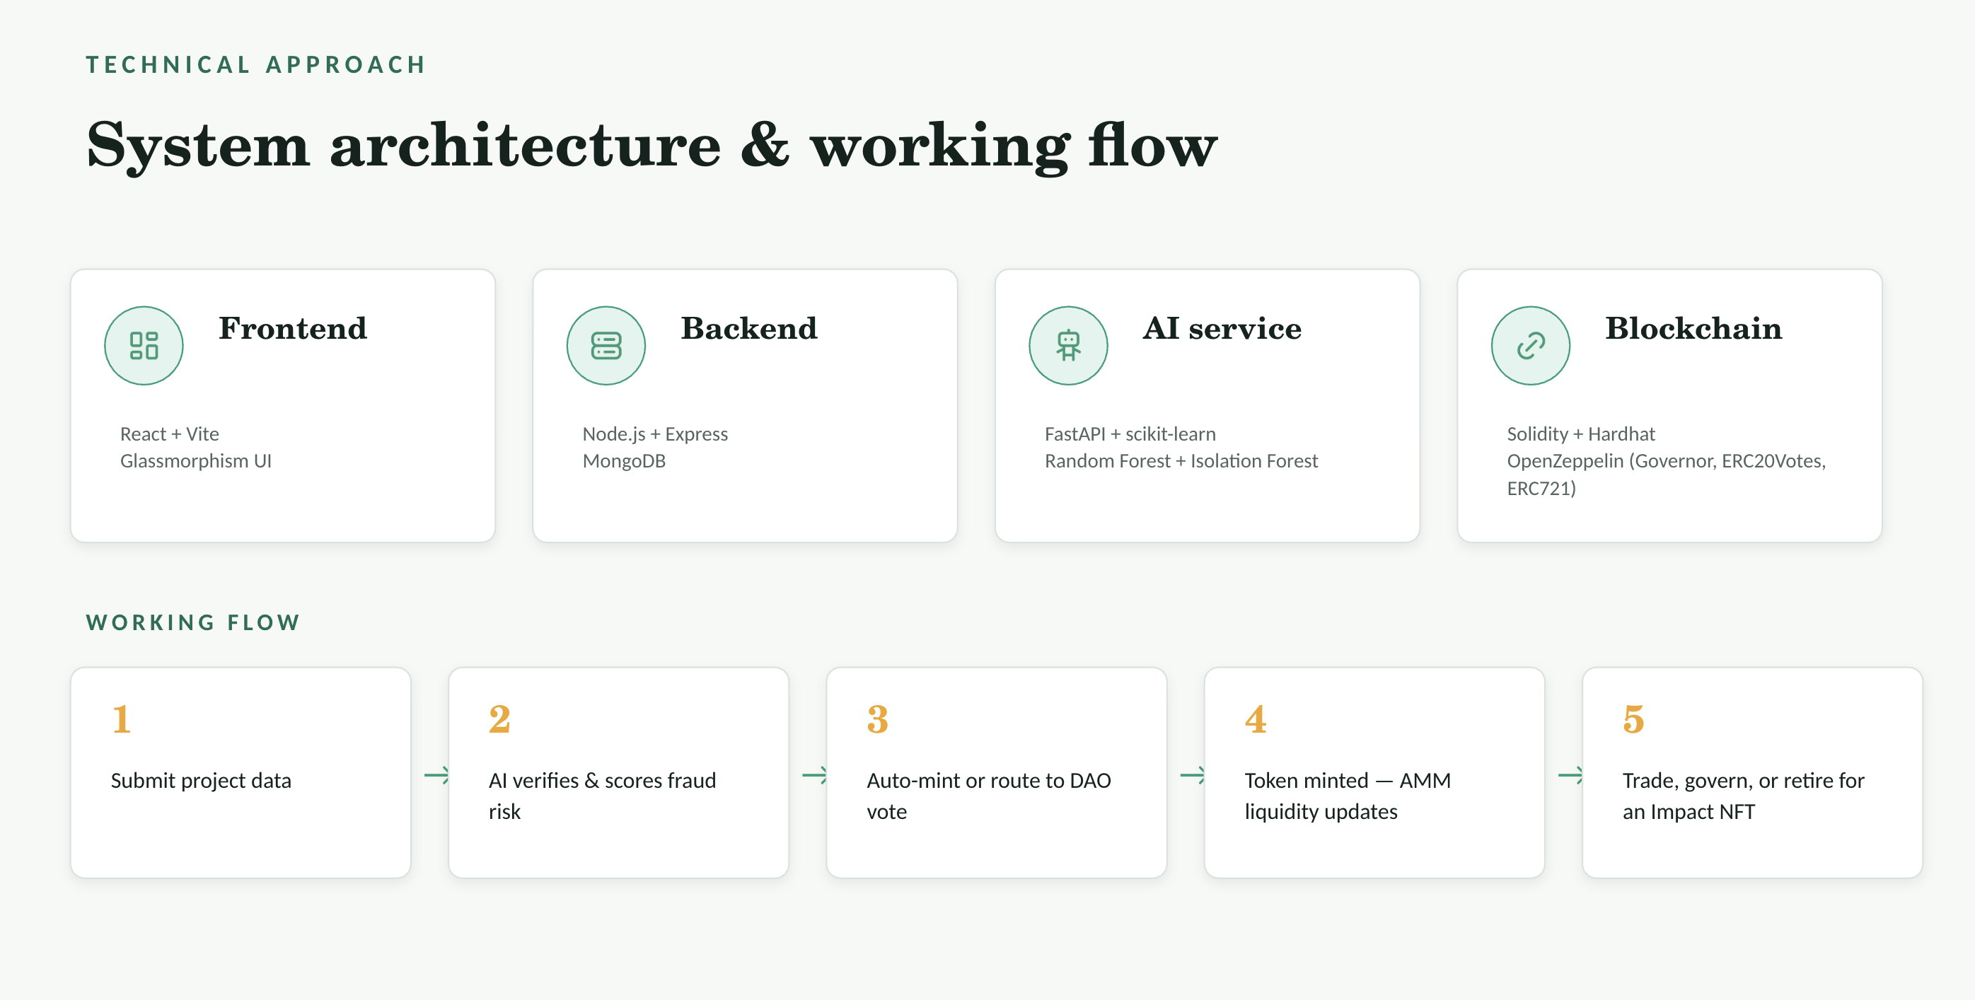
Notes:
Sustainability and AI
Sustainability is important because it helps meet our needs now and in the future. It includes protecting the environment, reducing pollution, and improving economic and social well-being.
AI can help us achieve sustainability. AI can process data, make predictions, and optimize systems to solve problems like resource management, environmental conservation, and energy efficiency.
Examples:
Smart grids: Reduce energy consumption.
Agriculture: Optimize water and fertilizer use.
Biodiversity: Monitor wildlife to protect biodiversity.
AI is a powerful tool for creating a more sustainable future.

Slide 8
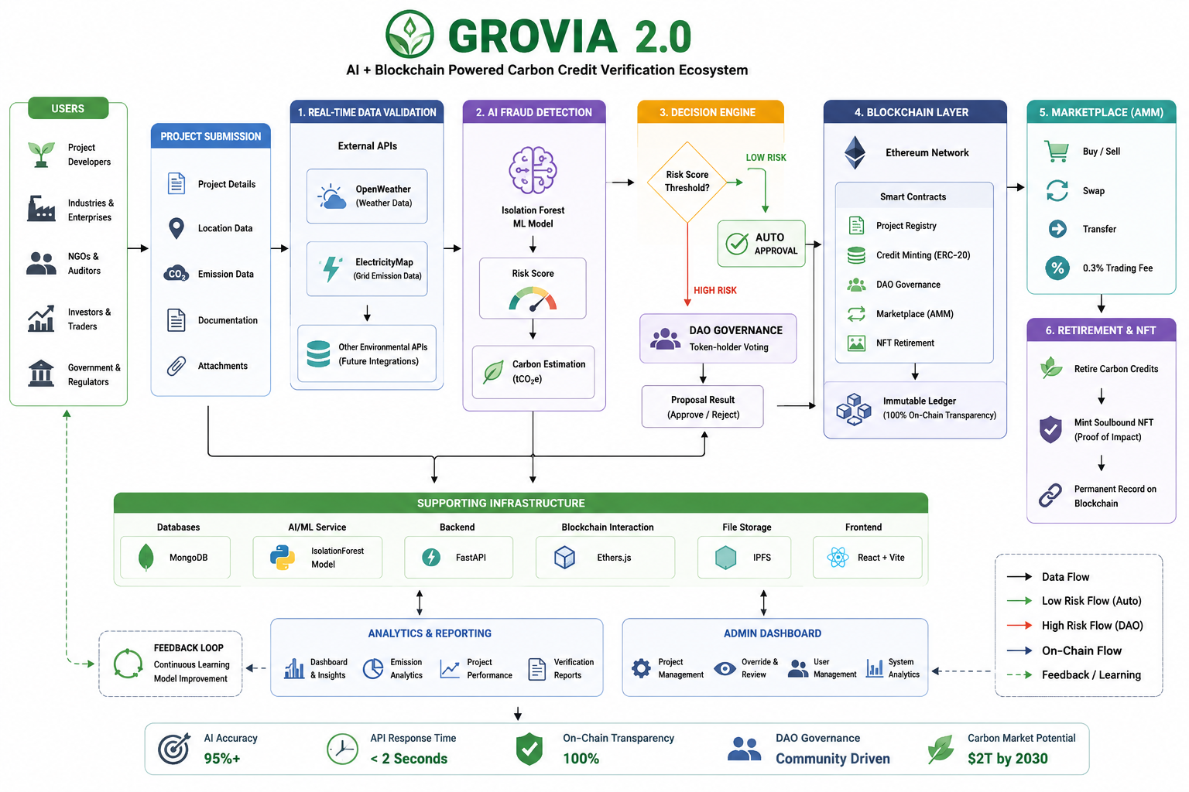

Slide 9
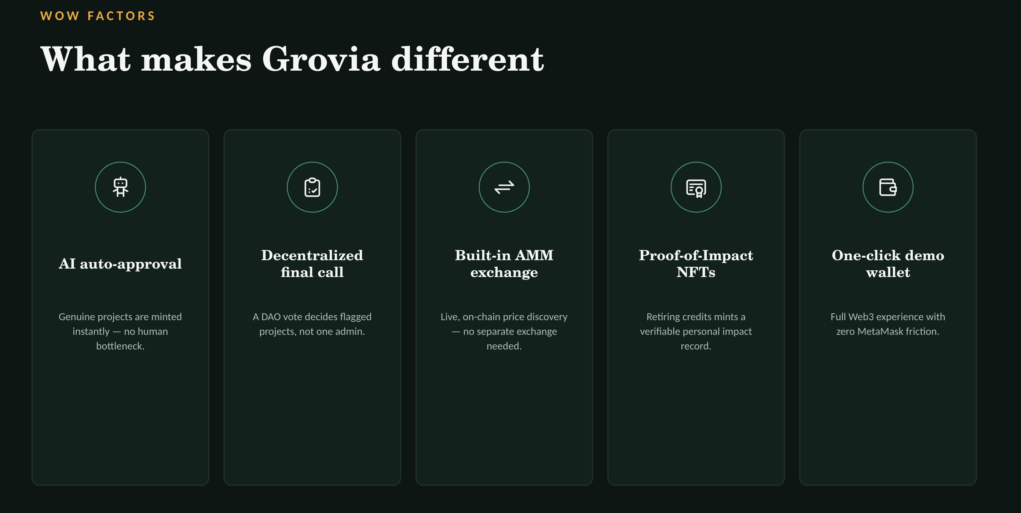
Notes:
Sustainability and AI
Sustainability is important because it helps meet our needs now and in the future. It includes protecting the environment, reducing pollution, and improving economic and social well-being.
AI can help us achieve sustainability. AI can process data, make predictions, and optimize systems to solve problems like resource management, environmental conservation, and energy efficiency.
Examples:
Smart grids: Reduce energy consumption.
Agriculture: Optimize water and fertilizer use.
Biodiversity: Monitor wildlife to protect biodiversity.
AI is a powerful tool for creating a more sustainable future.

Slide 10
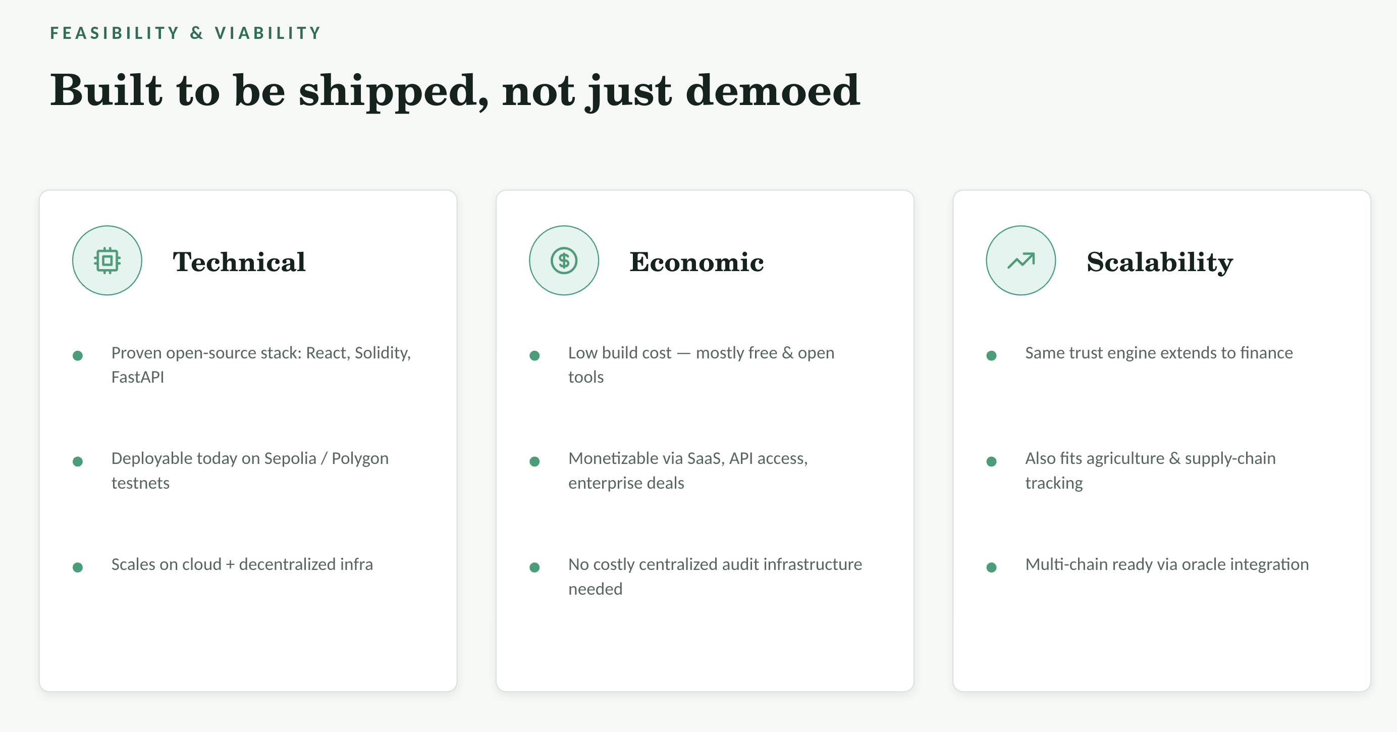
Notes:
Sustainability and AI
Sustainability is important because it helps meet our needs now and in the future. It includes protecting the environment, reducing pollution, and improving economic and social well-being.
AI can help us achieve sustainability. AI can process data, make predictions, and optimize systems to solve problems like resource management, environmental conservation, and energy efficiency.
Examples:
Smart grids: Reduce energy consumption.
Agriculture: Optimize water and fertilizer use.
Biodiversity: Monitor wildlife to protect biodiversity.
AI is a powerful tool for creating a more sustainable future.

Slide 11

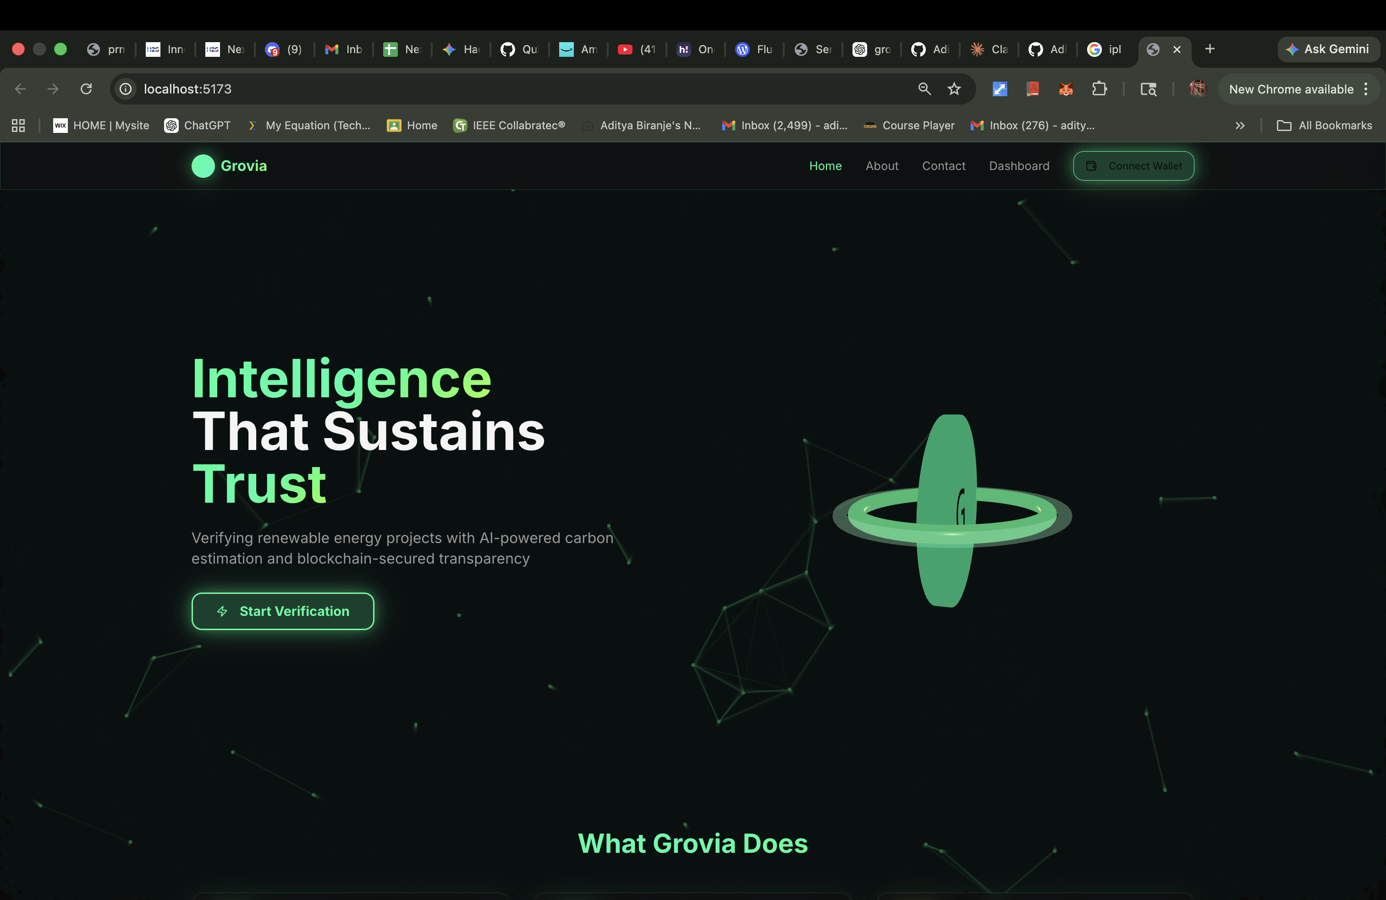
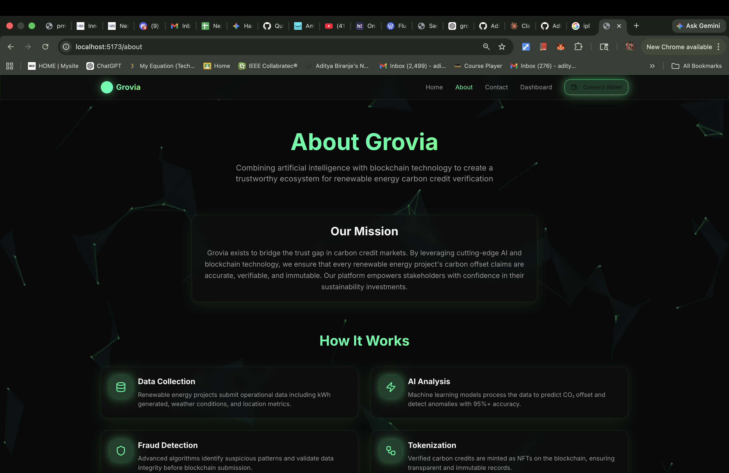
Notes:
Sustainability and AI
Sustainability is important because it helps meet our needs now and in the future. It includes protecting the environment, reducing pollution, and improving economic and social well-being.
AI can help us achieve sustainability. AI can process data, make predictions, and optimize systems to solve problems like resource management, environmental conservation, and energy efficiency.
Examples:
Smart grids: Reduce energy consumption.
Agriculture: Optimize water and fertilizer use.
Biodiversity: Monitor wildlife to protect biodiversity.
AI is a powerful tool for creating a more sustainable future.

Slide 12

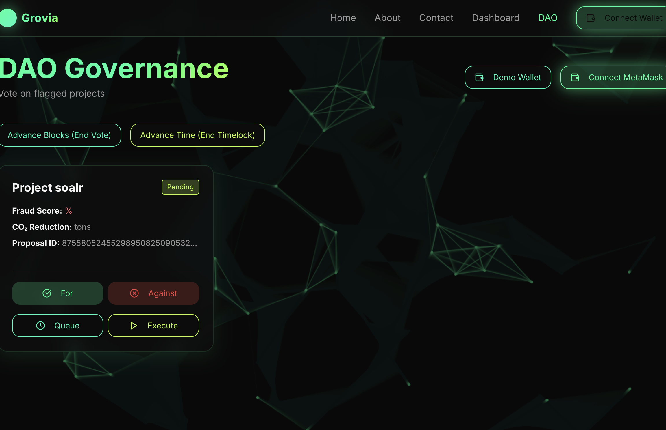
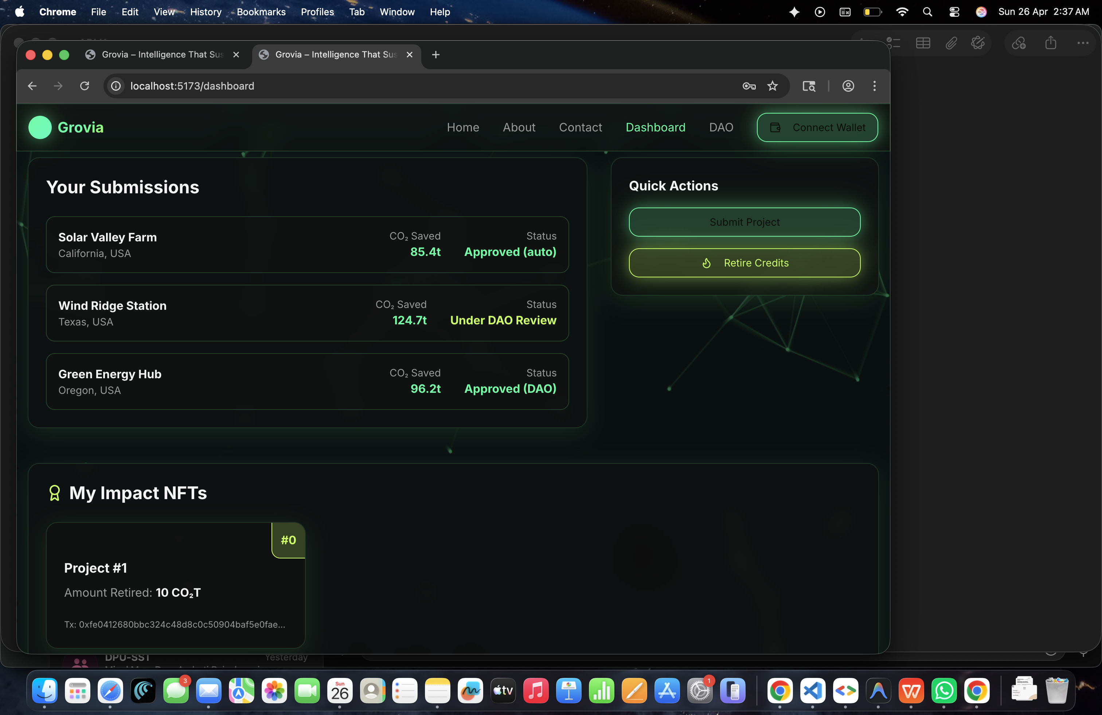
Notes:
Sustainability and AI
Sustainability is important because it helps meet our needs now and in the future. It includes protecting the environment, reducing pollution, and improving economic and social well-being.
AI can help us achieve sustainability. AI can process data, make predictions, and optimize systems to solve problems like resource management, environmental conservation, and energy efficiency.
Examples:
Smart grids: Reduce energy consumption.
Agriculture: Optimize water and fertilizer use.
Biodiversity: Monitor wildlife to protect biodiversity.
AI is a powerful tool for creating a more sustainable future.

Slide 13
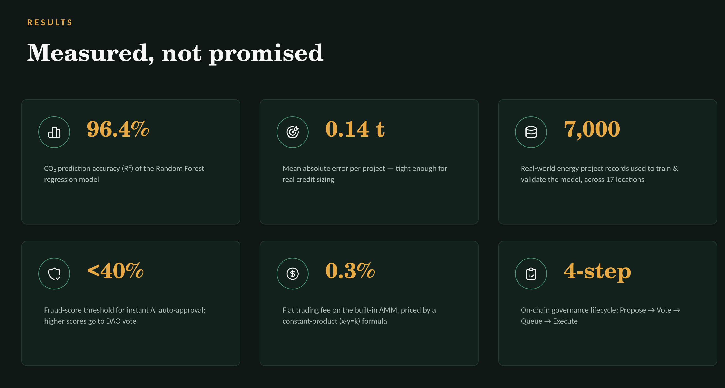
Thank You
Notes:
Thank You !!

Slide 14
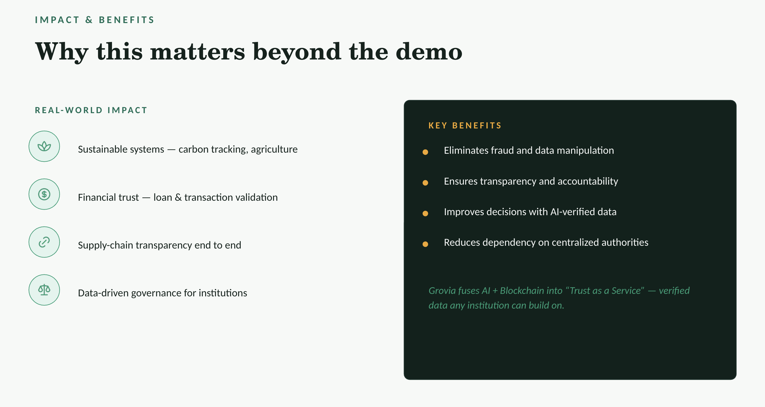

Slide 15
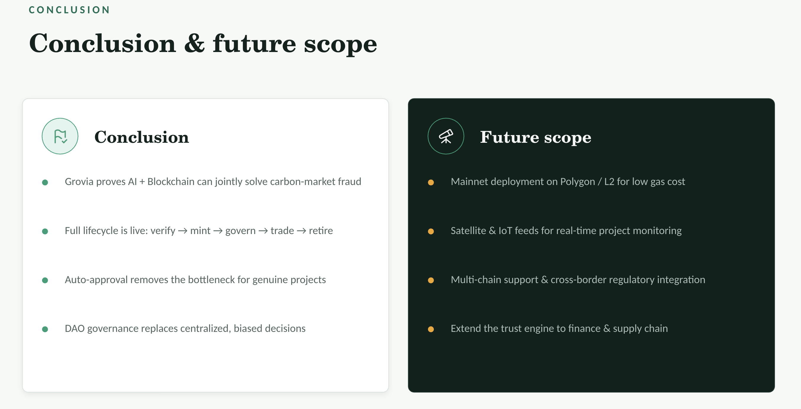

Slide 16
