Slide 1


SMART HOME SYSTEM

Slide 2

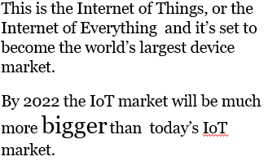
INTRODUCTION
.

Slide 3

FEATURES
Brand diversity and innovation

Slide 4
HOME IS WHERE WIFI CONNECTS AUTOMATICALLY
with home focused products leading the IoT market.
Smart Key
Automated Electric Appliances
Automated Temperature and Humidity Control
4

Slide 5
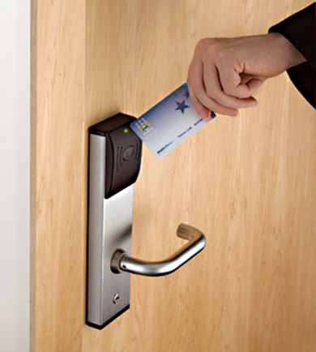
SMART KEY
A keycard lock is a lock operated by a keycard, a flat, rectangular plastic card. The card stores a physical or digital signature that the door mechanism accepts before disengaging the lock.
This gives high level security because only those can enter who have this card.
5

Slide 6
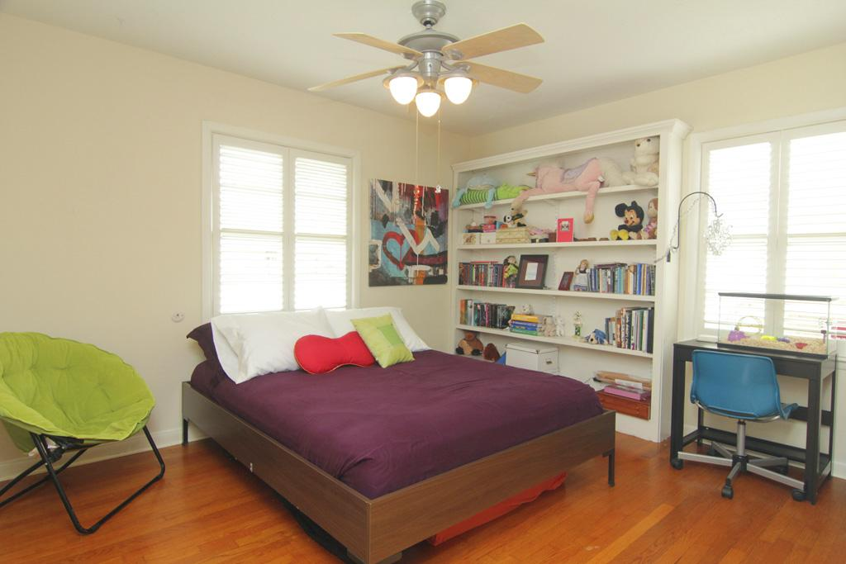
AUTOMATATED ELECTRIC APPLIANCES
Automated electric appliances will automatically turn on when any human is sensed in the room.
6

Slide 7
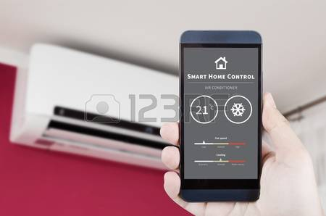
AUTOMATATED TEMPERATURE AND HUMIDITY CONTROL
When temperature and humidity of a room is increased then air conditions and fans are automatically turns on.
7

Slide 8
INTEGRATION
Making smart connection

Slide 9
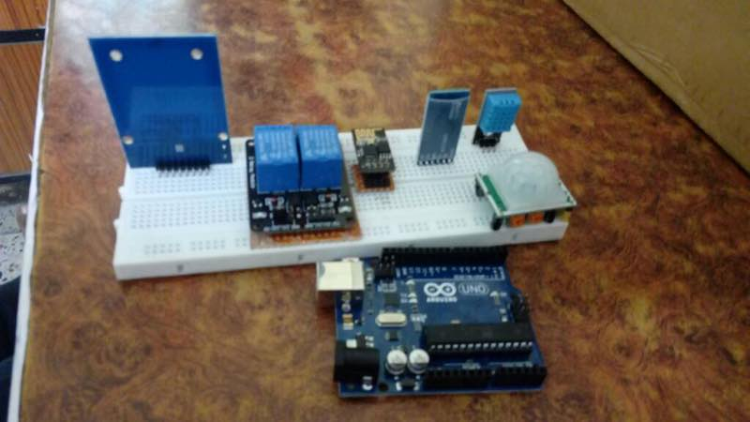
STEP 1
Here all the components( RFID, PIR Sensors and Humidity and Temperature Sensors, Wi-Fi Module, Bluetooth Module) are integrated on the bread board with Arduino UNO.

Slide 10
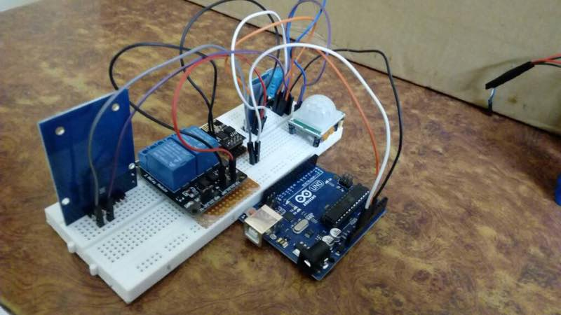
STEP 2
Initial connections has been done i.e.; VCC(5/3.3 volt) and GND.

Slide 11
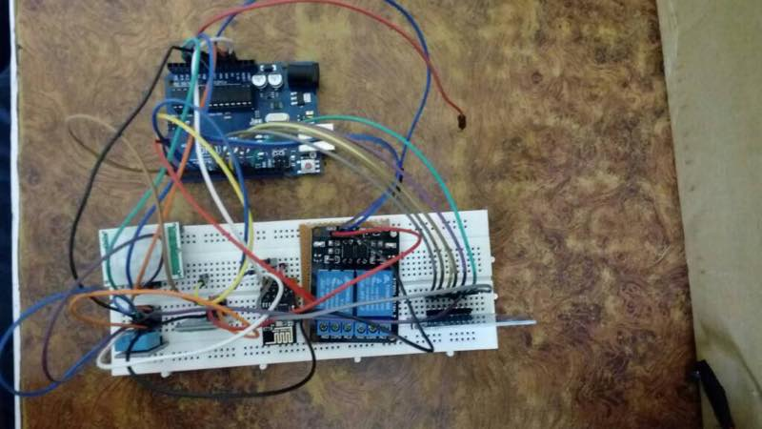
STEP 3
All the connections has been done here.

Slide 12
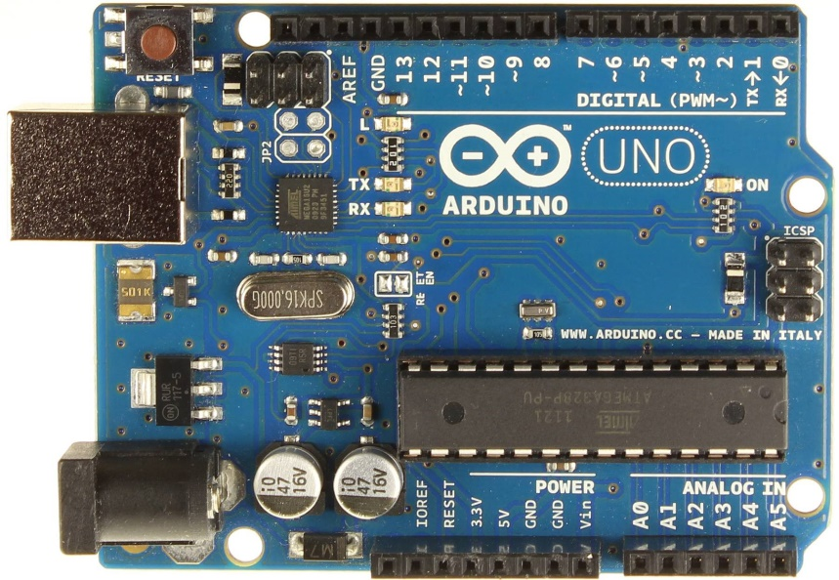
AUDRINO UNO R3
The Arduino Uno is a microcontroller board based on the ATmega328. It has 20 digital input/output pins (of which 6 can be used as PWM outputs and 6 can be used as analog inputs), a 16 MHz resonator, a USB connection, a power jack, an in-circuit system programming (ICSP) header, and a reset button. It contains everything needed to support the microcontroller; simply connect it to a computer (or appropriate wall power adapter) with a USB cable or power it with a AC-to-DC adapter or battery to get started.

Slide 13
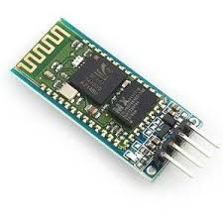
BLUETOOTH MODULE(HC-05)
The HC-05 Bluetooth Module has 6 pins- Vcc, GND, TX, RX, Key, and LED.
HC‐05 module is an easy to use Bluetooth SPP (Serial Port Protocol) module, designed for transparent wireless serial connection setup. The HC-05 Bluetooth Module can be used in a Master or Slave configuration, making it a great solution for wireless communication.

Slide 14
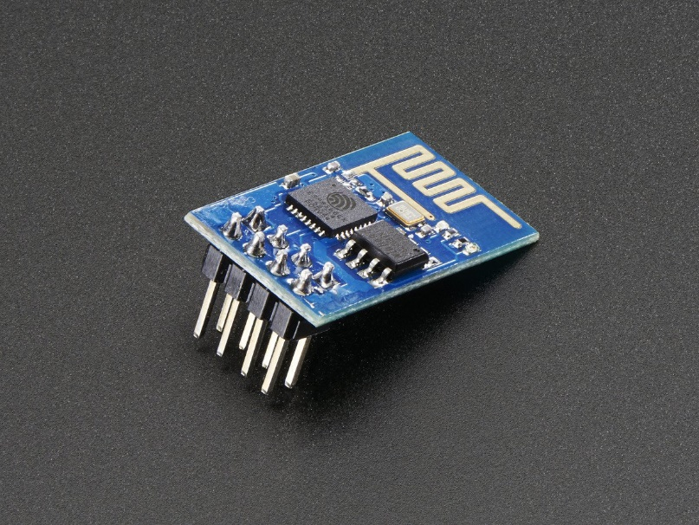
WI-FI MODULE(ESP8266)
The ESP8266 Wi-Fi Module is a self contained SOC with integrated TCP/IP protocol stack that can give any microcontroller access to your Wi-Fi network. The ESP8266 is capable of either hosting an application or offloading all Wi-Fi networking functions from another application processor.

Slide 15
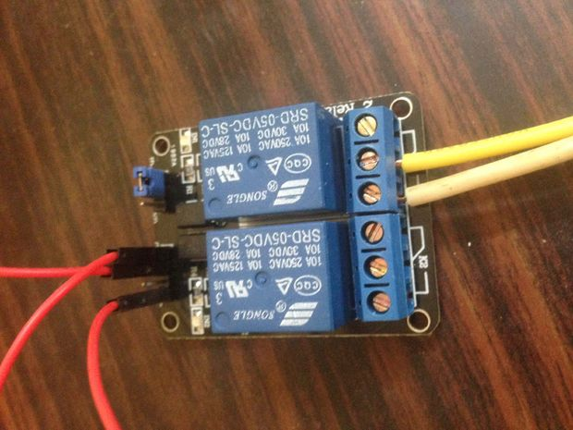
RELAY
A Relay is an electrically operated switch. Relays use an electromagnet to mechanically operate the switch and provide electrical isolation between two circuits.
Relays protect electrical circuits from overload and fault.

Slide 16
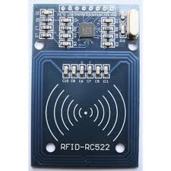
RADIO FREQUENCY IDENTIFICATION
Radio-frequency identification (RFID) uses electromagnetic fields to automatically identify and track tags attached to objects. The tags contain electronically stored information
RC522 is used in highly integrated 13.56MHz contactless communication card chip to read and write. RC522 use of advanced modulation and demodulation concept completely integrated in the 13.56MHz all kinds of passive contactless communication methods and protocols.

Slide 17
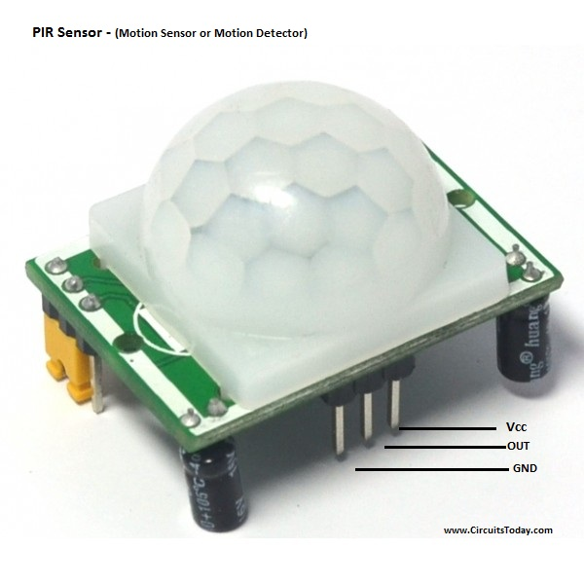
PASSIVE INFRARED SENSOR
PIR is an electronic appliance measures infrared radiation from objects in generated field by PIR detector. Sometimes it called PID – passive infrared detector.
It detects changes in amount of IR radiation, which is depends upon the outside characteristics and temperature of the objects in front of detector. It means if human or animal will come in range of detector it will detect movement because live body eliminates warm energy in form of IR radiation. So it will give you signal by light or alarm when any live object in front of PIR.

Slide 18
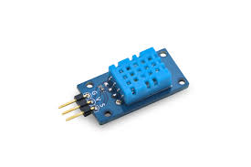
TEMPERATURE AND HUMIDITY SENSOR
A humidity sensor senses, measures and regularly reports the relative humidity in the air. It measures both moisture and air temperature.
The DHT11 is a basic, ultra low-cost digital temperature and humidity sensor. It uses a capacitive humidity sensor and a thermistor to measure the surrounding air, and spits out a digital signal on the data pin (no analog input pins needed).

Slide 19
FUTURE SCOPE
Automated Kitchen Appliances
Automated Coffee Makers
Dog Feeders
Automated Garage Doors
Automated Water Pumping System
Switches
Smoke Alarms
Thermostats
Watches
Fitness Trackers
Automated Smart Gardener
19

Slide 20
CONCLUSION
We have done IOT(Internet of Things) project on Smart Home System using Smart Key(RFID), electricity control(PIR) and Temperature control(DHT11) using relay(2-pin) in necessary time given with the above resources. There is also a scope of improvement of our project which we have discussed earlier. Through this project we contribute to a better future of the smart city which is the ultimate target of our project.
20

Slide 21
REFERENCE
21

Slide 22

THANK YOU

