Slide 1

DATA SCIENCE PROJECT Disease Prediction Using Symptoms
MIS :
112003004 : Advait Karmalkar
112003021 : Aditya Bornare
112003032 : Aneesh Damle

Slide 2
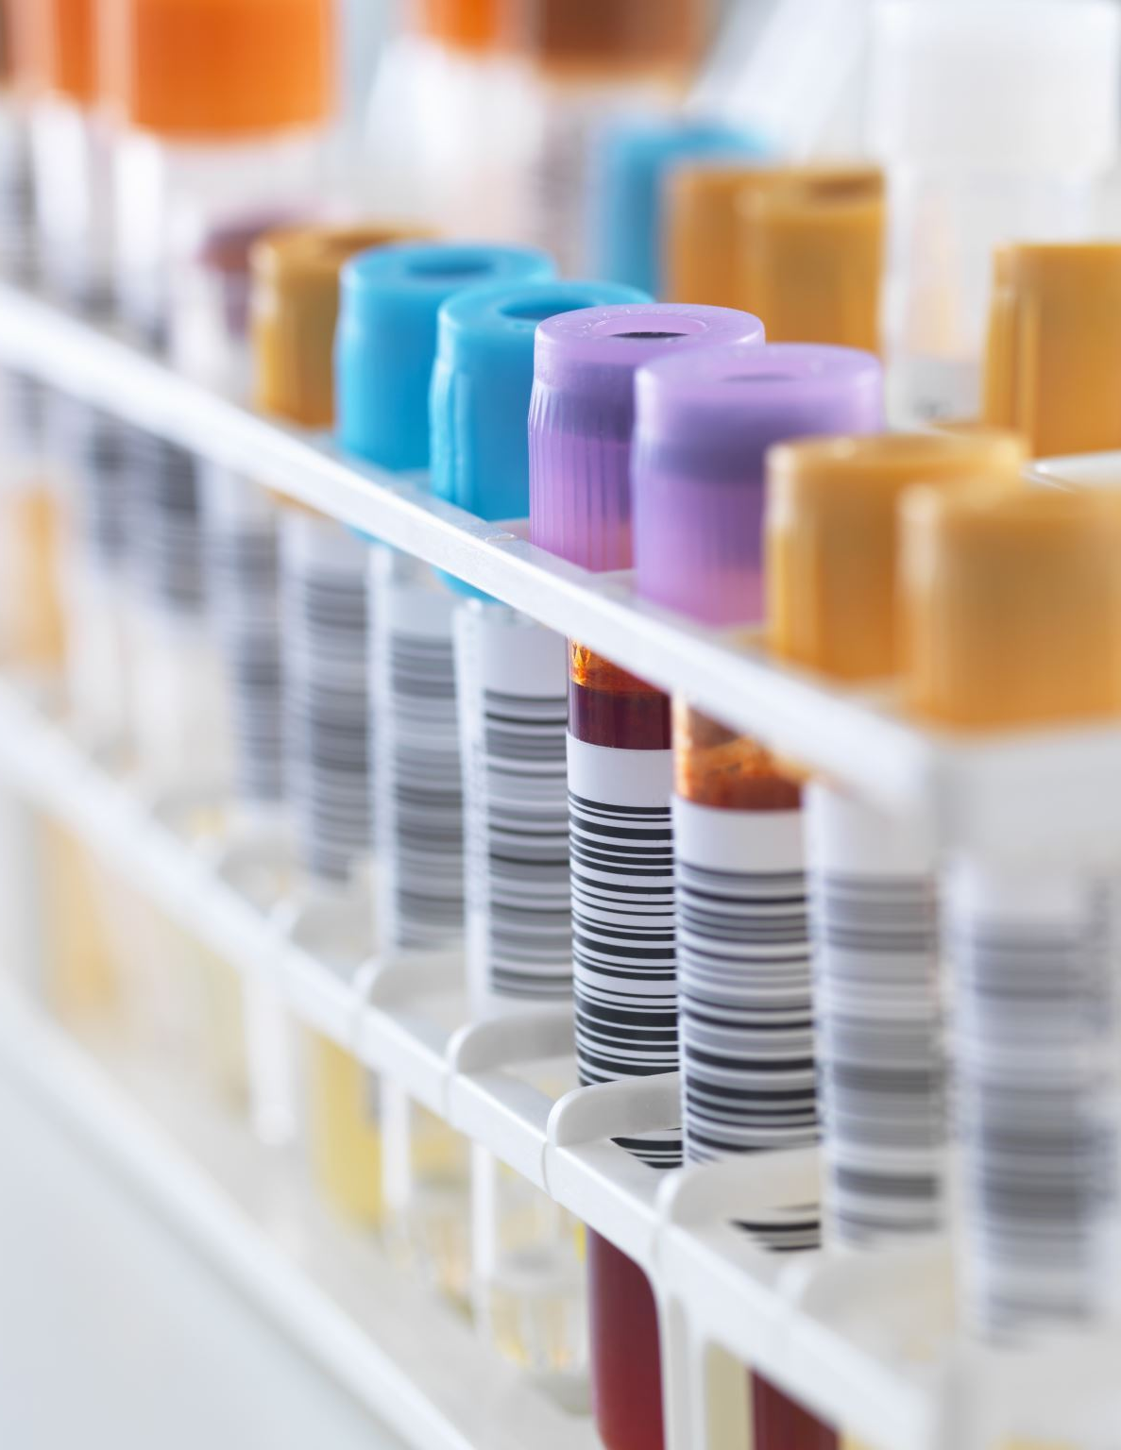
PROBLEM STATEMENT
Detection of Diseases is one of the preliminary steps in the treatment of a disease. Our project aims to predict diseases smartly based on the symptoms entered. We propose to implement a disease prediction system based on symptoms by processing and analyzing relevant symptom data.

Slide 3
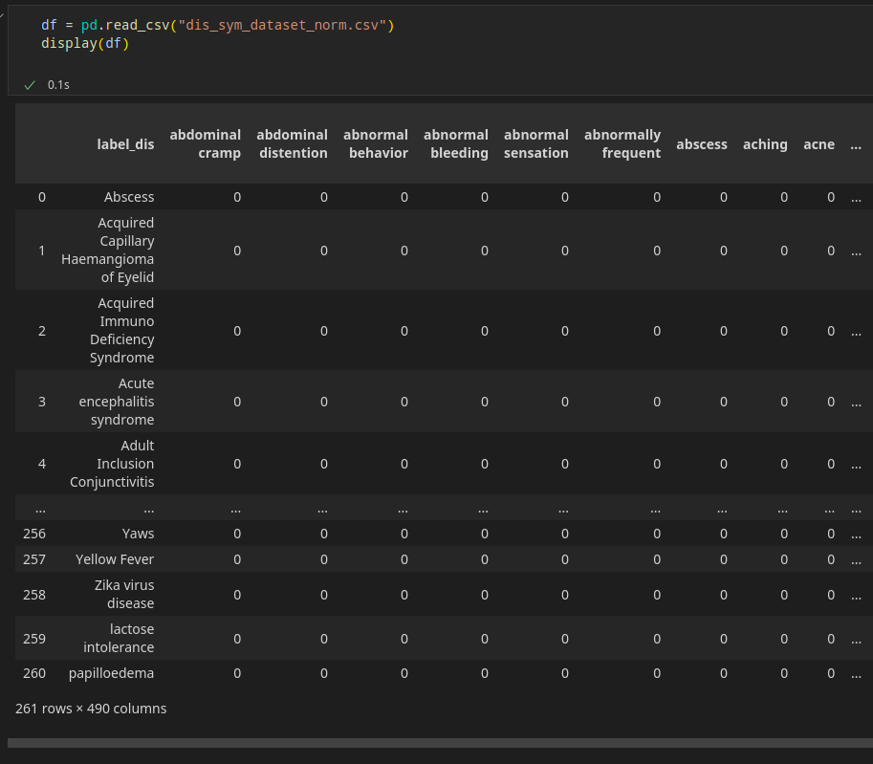
Web Scraping
Tools used: Beautiful Soup, Chrome Driver
Scraping consists of 2 parts:
Diseases
Disease data is scraped from https://www.nhp.gov.in/disease-a-z/
All the diseases [A-Z] act as rows in the dataset generated
2. Symptoms
Symptom data is generated by parsing the Wikipedia column for each disease fetched above
The HTML code of the page is processed to fetch the symptoms of the disease using the <infobox> available on the Wikipedia page
Symptoms act as columns in the generated dataset

Slide 4
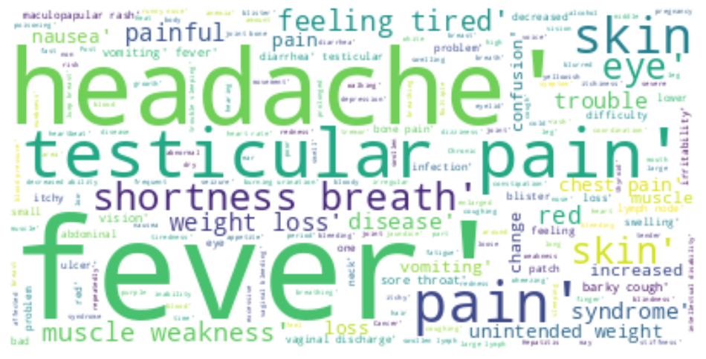
Visualization of Symptom Dataset

Slide 5
PREPROCESSING
DATA SET PREPROCESSING
The scraped symptoms are preprocessed to remove similar symptoms with different names.
To do so, symptoms are expanded by appending synonyms of terms in the symptom string and computing Jaccard Similarity Coefficient for each pair of symptoms.
We have used threshold as 0.75. The synonyms are taken from Thesaurus.com and Princeton University’s Wordnet.
If the score is greater than the threshold, both symptoms are alike and one can be used interchangeably used in place of other.
USER SYMPTOM PREPROCESSING
When user enters symptoms, following preprocessing steps are involved:
Split symptoms into a list based on comma
Convert the symptoms into lowercase
Removal of stop words
Tokenization of symptoms to remove any punctuation marks
Lemmatization of tokens in the symptoms
Symptom synonyms are considered from Thesaurus and NLTK Wordnet
2. Similarity score is matched with existing symptoms

Slide 6
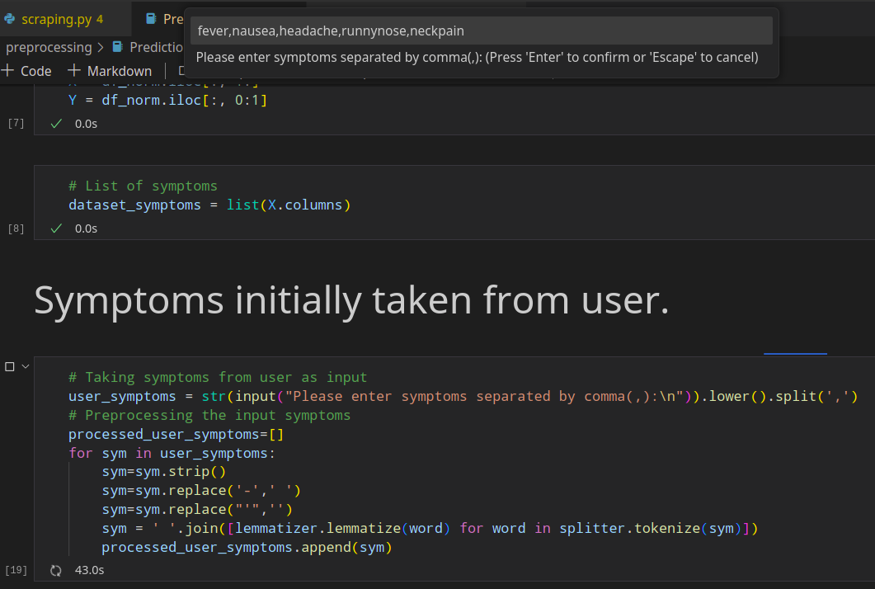
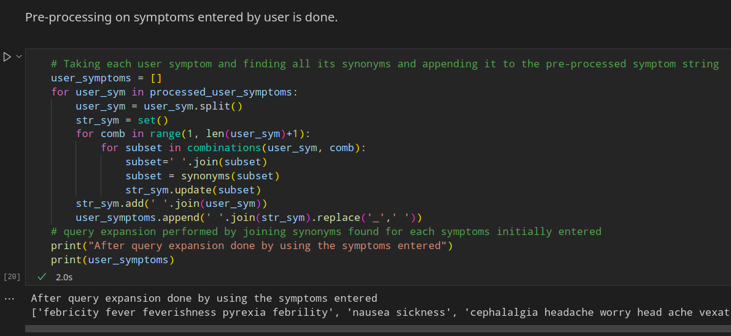

Slide 7

Symptom Matching and Selection
Each user symptom is expanded by appending a list of synonyms of the terms in the synonym string.
To find related symptoms, each symptom from the dataset is split into tokens and each token is checked for its presence in the expanded query. Based on this, a similarity score is calculated and if the symptom’s score is more than the threshold value, that symptom qualifies for being similar to the user’s symptom and is suggested to the user.
The user selects one or more symptoms from the list. Based on the selected symptoms, other symptoms are shown to the user for selection which is among the top co-occurring symptoms with the ones selected by the user initially. The user can select any symptom, skip, or stop the symptom selection process. The final list of symptoms is compiled and shown to the user.

Slide 8
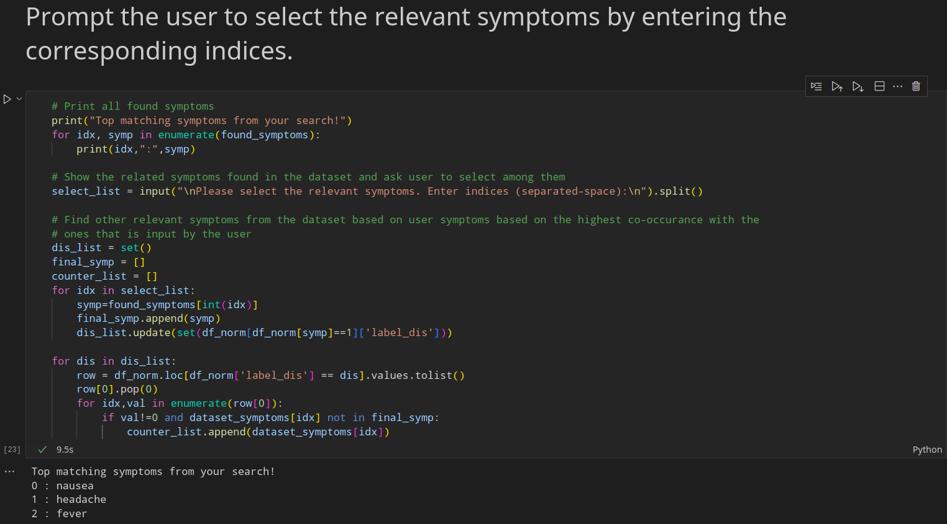

Slide 9
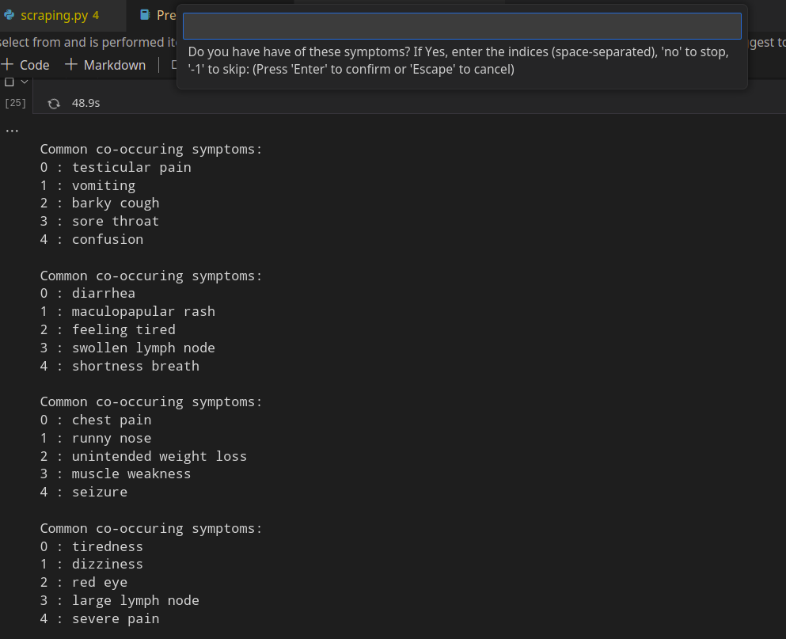
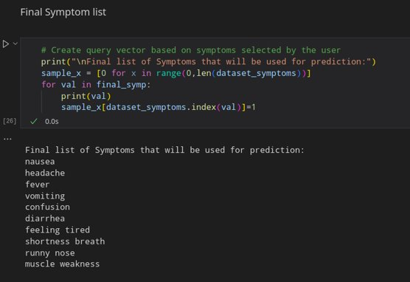

Slide 10
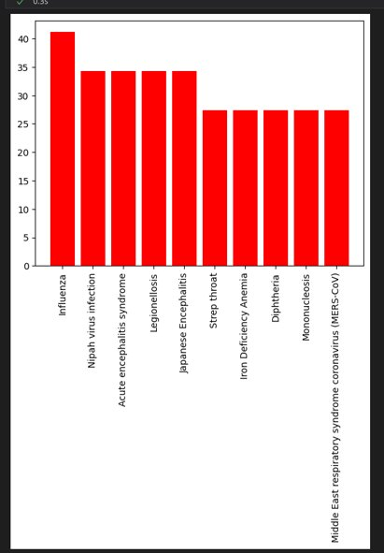
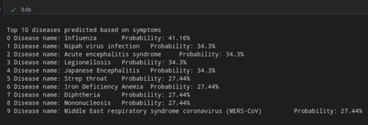

Slide 11
PREDICTION MODELS
A binary vector is computed that consists of 1 for the symptoms present in the user’s selection list and 0 otherwise.
A machine learning model is trained on the dataset, which is used here for prediction.
The model accepts the symptom vector and outputs a list of top 10 diseases, sorted in the decreasing order of individual probabilities
Models experimented with till now:
Logistic Regression
Random Forest Classifier
K-Nearest Neighbour Classifier
Multinomial Naïve Bayes Classifier
Decision Tree Classifier

Slide 12
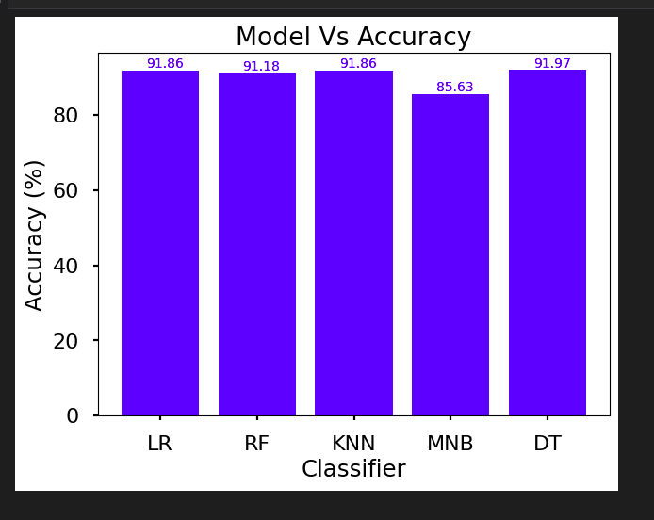

Slide 13
Challenges Faced
1) Web scraping - diseases were scraped from www.nhp.gov.in/disease-a-z/, but scraping symptoms was a difficult task as the same site mentioned them in paragraphs.
2) Symptom scraping - Hence we shifted to Wikipedia; the HTML code of the page is processed to fetch the symptoms of the disease using the <infobox> available on the Wikipedia page.
3) User input processing and co-occurrence – User input was a challenging task, as user is not bound to symptom set we generated. So, we had to match synonyms from Thesaurus for each user symptom and check their similarity scores with our symptom dataset, and provide a final appended list of symptoms for better disease prediction. Also, we had to mimic what doctors do by asking common co-occurring symptoms.

Slide 14
Future Scope
Dataset could be increased to incur more diseases and symptoms, and also updated periodically.
Treatment and precautions against the predicted diseases could be suggested to the user.
If the user enters a symptom not present in dataset, the symptom could be included in dataset by fetching it in real-time from the internet.
Deployment of the system on a public domain could help us to expand the scope of the project, with experts suggesting some inputs.
Regional classification of diseases using real-time updating of dataset, and giving more weightage to certain regional diseases

