Slide 1
BLUESTOCK FINTECH · JUNE 2026
Bluestock Mutual Fund Analytics Platform
An End-to-End Business Intelligence & Financial Analytics Solution
Aditya Bramhwanshi
Data Analyst Intern · Bluestocks

Slide 2





BUSINESS CONTEXT
Business Problem & Objectives
Business Challenges
Project Objectives
Fund performance difficult to compare across AMCs
Financial data scattered across 12 isolated sources
Investor behavior insights unavailable
Risk analytics not easily accessible
Automated ETL Pipeline
Automate ingestion across 12 financial datasets
Clean Financial Data
Standardize and validate all records
Interactive Executive Dashboards
Four interactive reporting modules
Advanced Analytics
VaR, Sharpe Ratio, Alpha & Beta
Actionable Insights
Risk-based fund recommendations

Slide 3
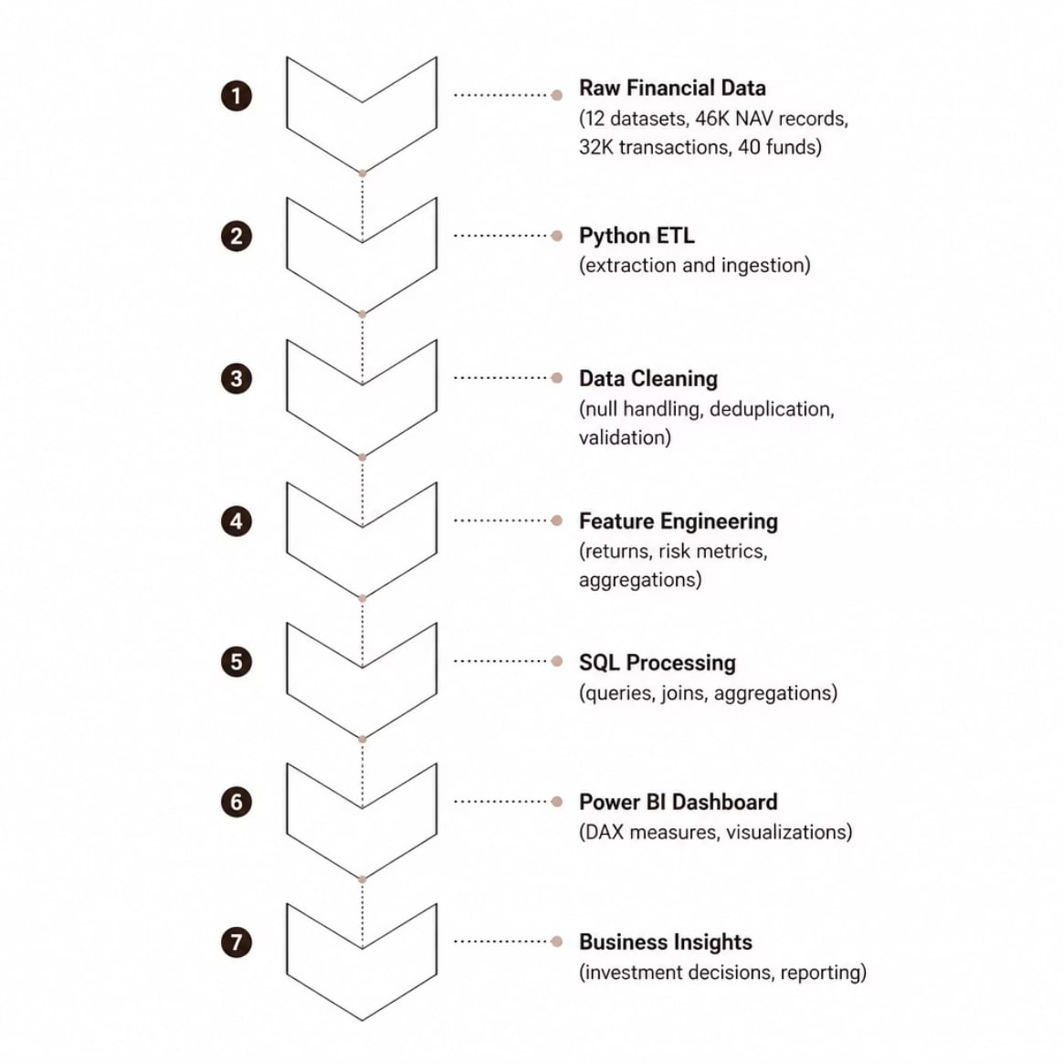
DATA ARCHITECTURE
Data Architecture & ETL Pipeline
Pipeline Scale
The end-to-end pipeline processes four data domains — fund data, NAV history, investor transactions, and portfolio holdings — through a standardized transformation workflow before surfacing in Power BI.
12
46,000
32,778
40
Datasets Integrated
NAV Records
Transactions
Mutual Funds

Slide 4
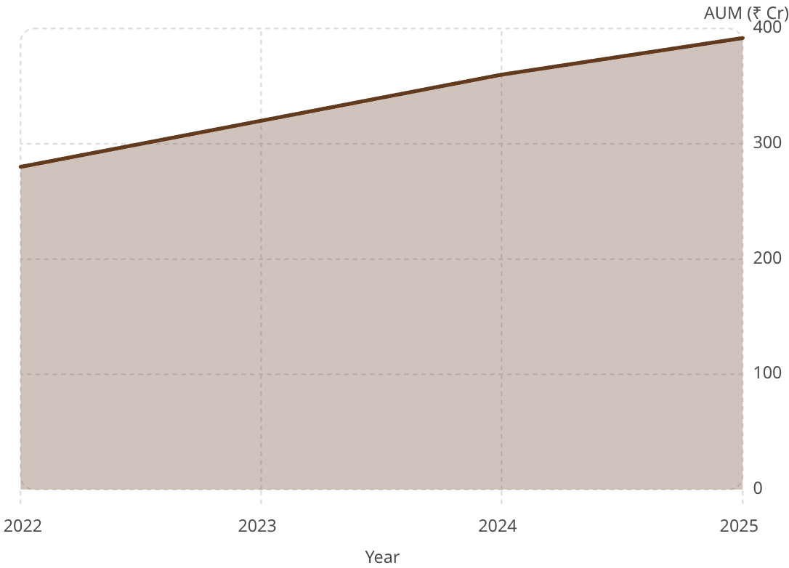
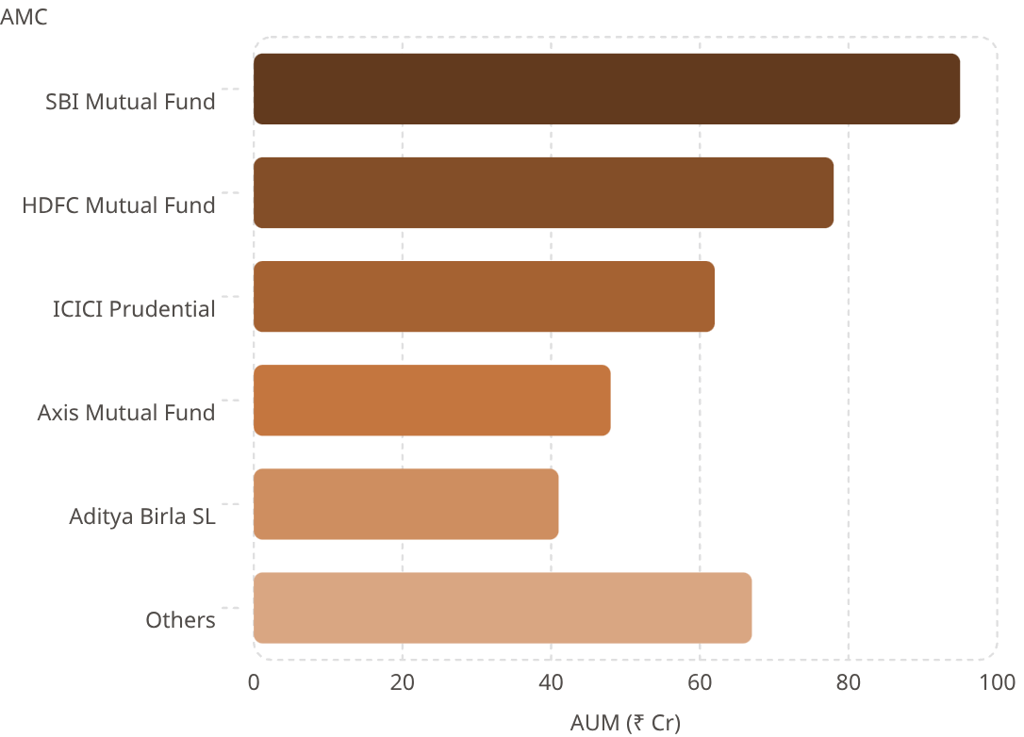

DASHBOARD 1
Industry Overview Dashboard
₹391Cr
₹939K
Total AUM
Total SIP Inflow
Across 40 schemes
Active SIP contributions
26.1K
40
Total Folios
Total Schemes
Active investor accounts
Funds under analysis
Industry AUM Growth (2022–2025)
Top AMCs by Assets Under Management
Business Insight: SBI Mutual Fund leads with highest AUM; industry AUM grew consistently from 2022–2025, reflecting sustained investor confidence.

Slide 5
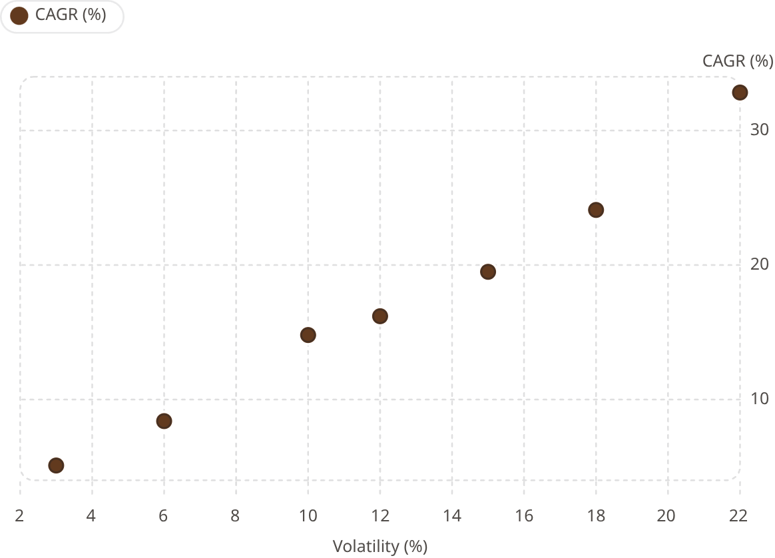
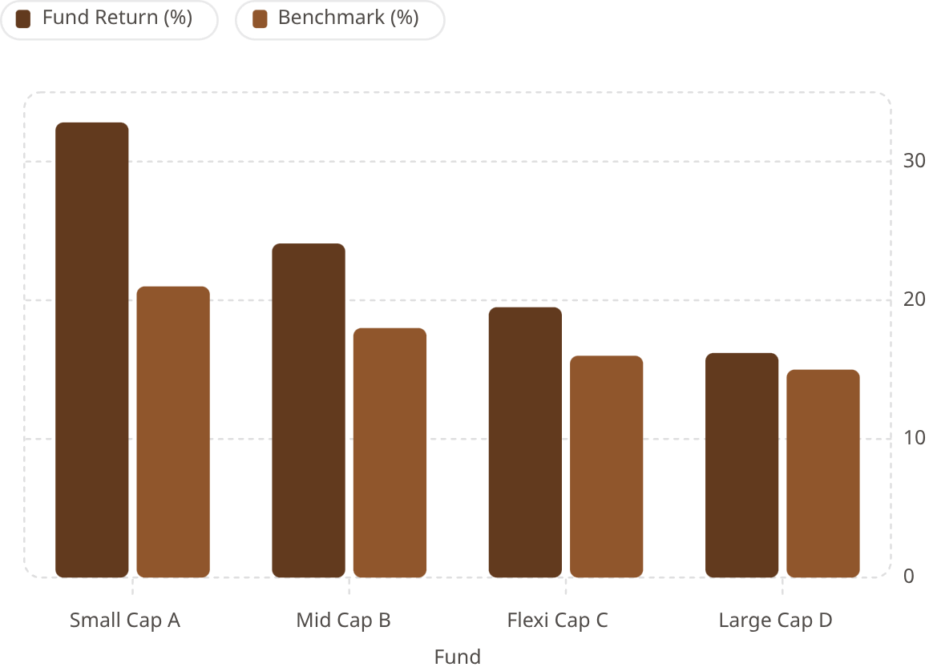

DASHBOARD 2
Fund Performance Analytics
32.83%
0.56
0.16
Highest CAGR
Avg Sharpe Ratio
Average Alpha
Small Cap category leader
Risk-adjusted return metric
Excess return over benchmark
Risk vs. Return Scatter Plot
Top Funds vs. Benchmark
Business Insight: Small Cap funds delivered the highest CAGR but carry elevated volatility; Sharpe Ratio confirms superior risk-adjusted performance for select funds.

Slide 6
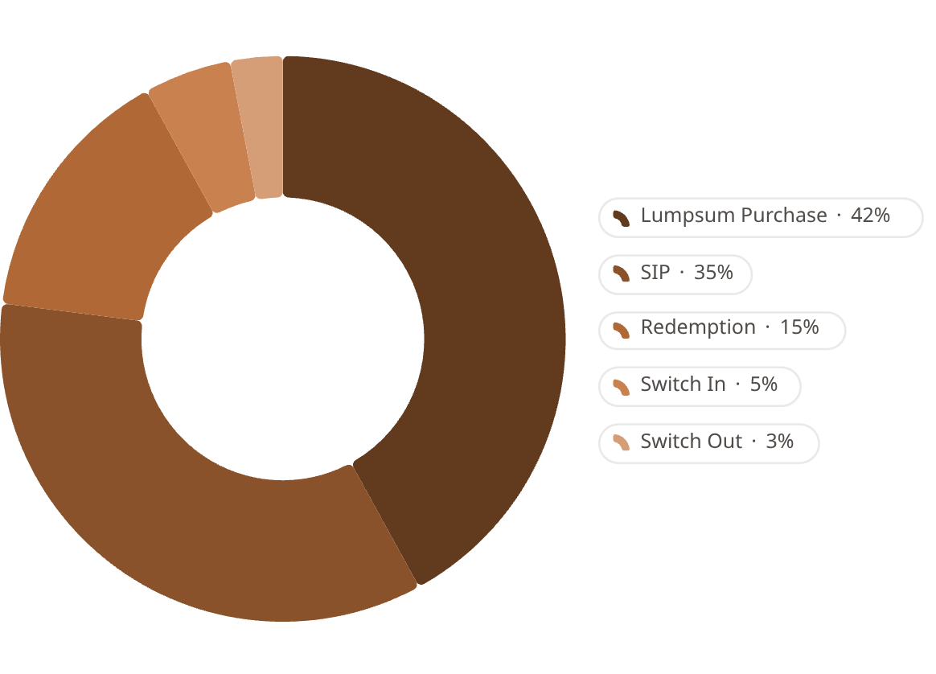
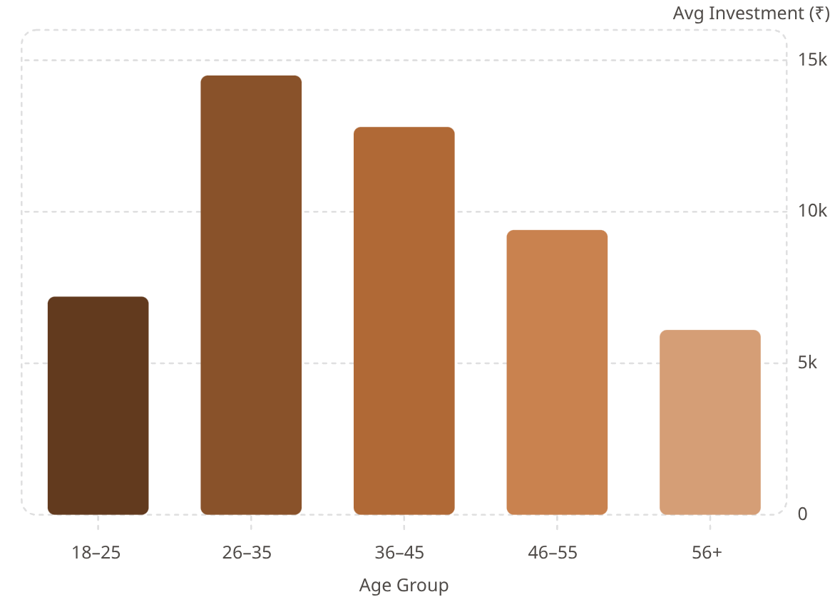

DASHBOARD 3
Investor Analytics Dashboard
5,000
33K
₹11K
Total Investors
Total Transactions
Avg Investment
Active investor base
Across all schemes
Per transaction
Transaction Type Distribution
Average Investment by Age Group
Business Insight: Lumpsum dominates transaction volume; investors aged 26–45 contribute the highest average investments; Tier-1 cities drive maximum transaction activity.

Slide 7
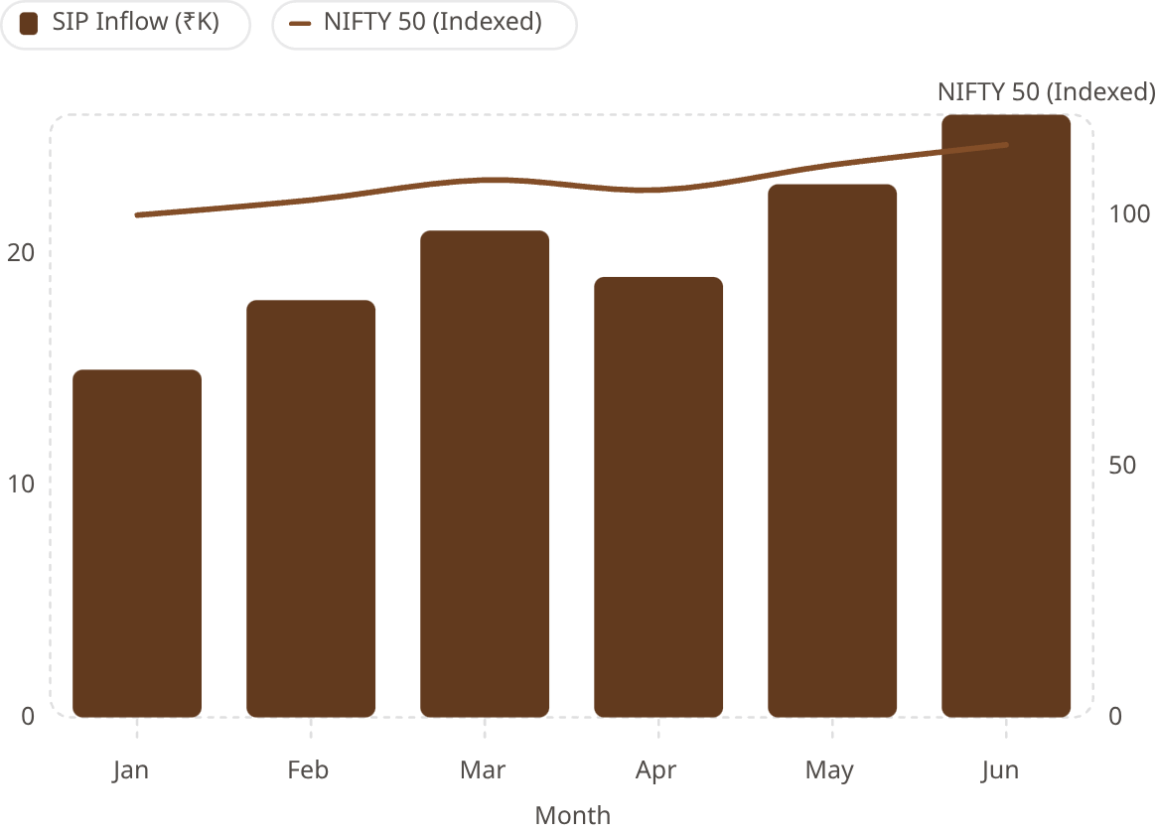
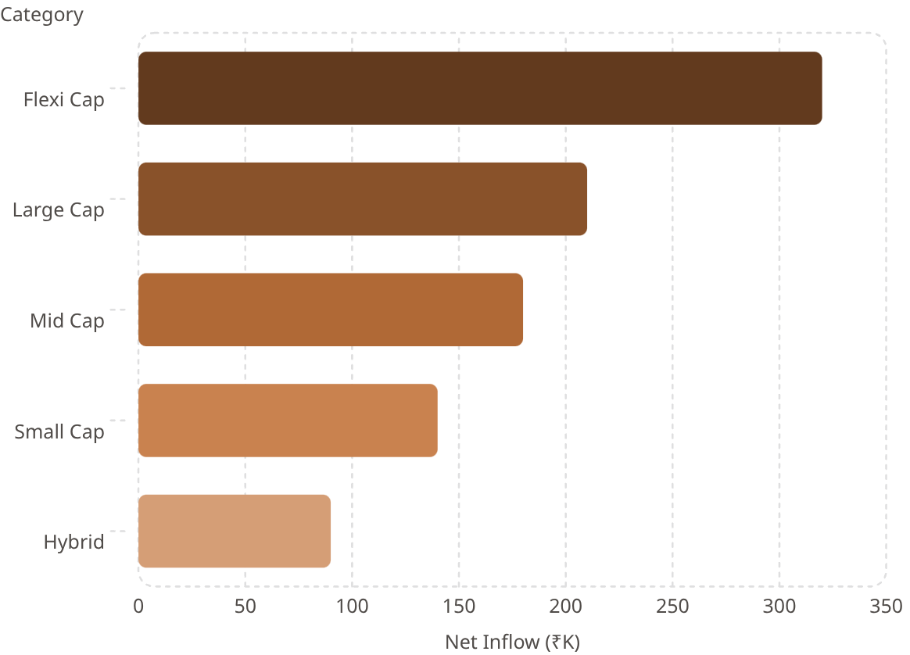
DASHBOARD 4
SIP & Market Trends Dashboard
₹939K
₹19.6K
₹15.9Cr
Total SIP Inflow
Avg Monthly SIP
Latest SIP AUM
Cumulative SIP contributions
Per active SIP account
Total SIP assets under management
SIP Inflow vs. NIFTY 50 Correlation
Category-wise Net Inflow
Business Insight: SIP participation is steadily increasing; Flexi Cap receives the highest net inflows; active SIP accounts continue growing, signaling rising retail investor confidence.

Slide 8




ADVANCED ANALYTICS
Advanced Financial Analytics
Risk Analytics Framework
Investor Analytics Framework
Historical VaR (95%)
Cohort Analysis
SIP Continuity Analysis
Maximum expected loss at 95% confidence across all 40 funds
Investor retention and behavior segmented by acquisition period
Measurement of SIP discipline and dropout rates
Conditional VaR (CVaR)
Tail-risk exposure beyond the VaR threshold
HHI Concentration
Recommendation Engine
Portfolio diversification measured using Herfindahl-Hirschman Index
Rolling 90-Day Sharpe
Risk-profile-based fund selection system
Time-series risk-adjusted performance for key funds

Slide 9

BUSINESS IMPACT
Key Findings & Business Impact
📈 AUM Growth
💰 SIP Momentum
Industry AUM grew steadily, reflecting strong investor confidence
SIP investments increasing year-over-year across all categories
⚡ Small Cap Returns
👤 Core Investor Profile
Highest CAGR at 32.83% but with elevated volatility
Ages 26–45 drive the highest investment volumes
🔀 Moderate Diversification
🎯 Smarter Selection
HHI analysis shows most portfolios are moderately diversified
Recommendation engine improves fund selection by risk profile
Business Value Delivered
Automated financial reporting replacing manual processes
Faster investment analysis with integrated data
Deeper investor insights through behavioral analytics
Interactive decision support for fund managers

Slide 10
SUMMARY
Conclusion & Future Scope
Project Achievements
Future Enhancements
01
Live AMFI API
ML Recommendation System
12 financial datasets fully integrated
Real-time fund data ingestion
02
Predictive fund selection models
4 interactive Power BI dashboards deployed
03
Power BI Service
Azure Cloud Deployment
Cloud-based report publishing
Scalable production infrastructure
End-to-end Python ETL pipeline developed
04
Portfolio Optimization
Advanced risk analytics (VaR, CVaR, Sharpe) implemented
Mean-variance & Black-Litterman models
05
Risk-based fund recommendation engine built
06
Business-ready insights generated for stakeholders
Thank You — Questions welcome · Aditya Bramhwanshi · Data Analyst Intern · Bluestock Fintech

