Slide 1
Expired by Climate
Store below 30 °C
Do medicine stability test conditions still cover the climates they were built for?
printed on medicines across the hot half of the world
EurekaDev 2026 · Research Track ·
Notes:
"Store below 30 °C" is printed on medicines across the hot half of the world. It looks like advice. It is really a climate forecast — and it was made decades ago. This project checks whether that forecast still holds.

Slide 2
“Store below 30 °C” is a climate forecast
Every medicine is approved after a year or more in a test chamber.
The chamber setting was chosen to sit, with a safety margin, above the climate where the medicine will be stored.
If the climate warms past it, approved shelf lives become optimistic.
25 °C · 60%
Temperate markets and ICH regions (EU, US, Japan)
30 °C · 65%
Hot and humid markets (Zone IVa)
30 °C · 75%
Hot and very humid markets (Zone IVb)
Long-term test conditions: WHO TRS 1010, Annex 10 (2018)
Notes:
Before a medicine is approved, batches sit in a test chamber for a year or more. WHO sets three chamber conditions: 25 °C for temperate markets, and 30 °C with 65% or 75% humidity for hot ones. Each setting was chosen to sit, with a safety margin, above the climate where the medicine will be stored. If the climate warms past it, every shelf life approved there becomes optimistic.

Slide 3
The numbers were set from yesterday’s climate
1971
1998
2006
2024
Nov 2026
Haynes
Grimm
WHO
Miura
ICH Q1
Mean kinetic temperature: the one number that captures heat damage
30 °C conditions set with a margin over the climate of the time
Adds 30 °C / 75% for very humid countries
Japan re-checked with 1991–2020 data: still fine
New global stability guideline due for adoption
The gap: no multi-decade, multi-country re-check of whether today’s climate still sits inside these conditions — we found none.
Notes:
The numbers come from 1971, when Haynes defined mean kinetic temperature — one number that captures heat damage. In 1998 Grimm set the 30 °C conditions with a margin over the climate of that time. In 2006 WHO added 75% humidity. The only recent re-check, for Japan in 2024, found no problem. A new global guideline, ICH Q1, is due in November 2026. The gap: we found no multi-decade, multi-country check of today's climate against these conditions.

Slide 4
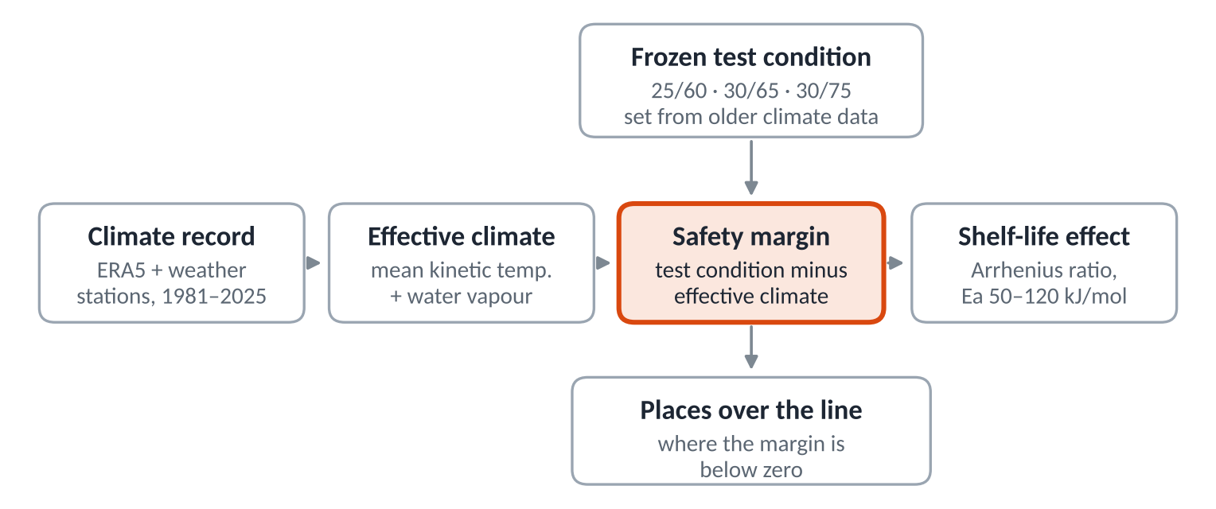
Our idea: test the standard against today’s climate
Re-run the regulators’ own climate calculation every year, 1981–2025 — not once. The formula is from 1971; what is new is the repeated, below-country, temperature-and-humidity audit.
Notes:
Our idea: treat the test condition as a hypothesis about the climate, and test it with the regulators' own method. Climate data become an effective temperature and humidity each year. We subtract them from the test condition. What is left is the safety margin. Below zero, the climate has crossed the line, and shelf life shrinks. The formula is from 1971. What is new is repeating the audit every year, below country level, for heat and humidity.

Slide 5
How it works
18
45
0.3 °C
3
places
years
bias removed
built-in checks
10 from ERA5 reanalysis, 8 from NOAA weather stations
1981–2000 compared with 2006–2025
measured against hourly station data
positive control (Tokyo), hourly bias check, reanalysis vs station
Effective temperature = mean kinetic temperature (MKT): the steady temperature that would cause the same total chemical damage as the real, fluctuating one. Hypotheses and pass/fail rules were written before any data were downloaded.
Notes:
We analysed 18 places: 10 from ERA5 reanalysis and 8 from NOAA weather stations. We compared 1981–2000 with 2006–2025, and wrote our hypotheses and pass/fail rules before downloading any data. Three built-in checks: Tokyo as a positive control, a bias check against hourly station data, and reanalysis versus stations. Our daily method read 0.3 °C high, so every level you see is corrected.

Slide 6
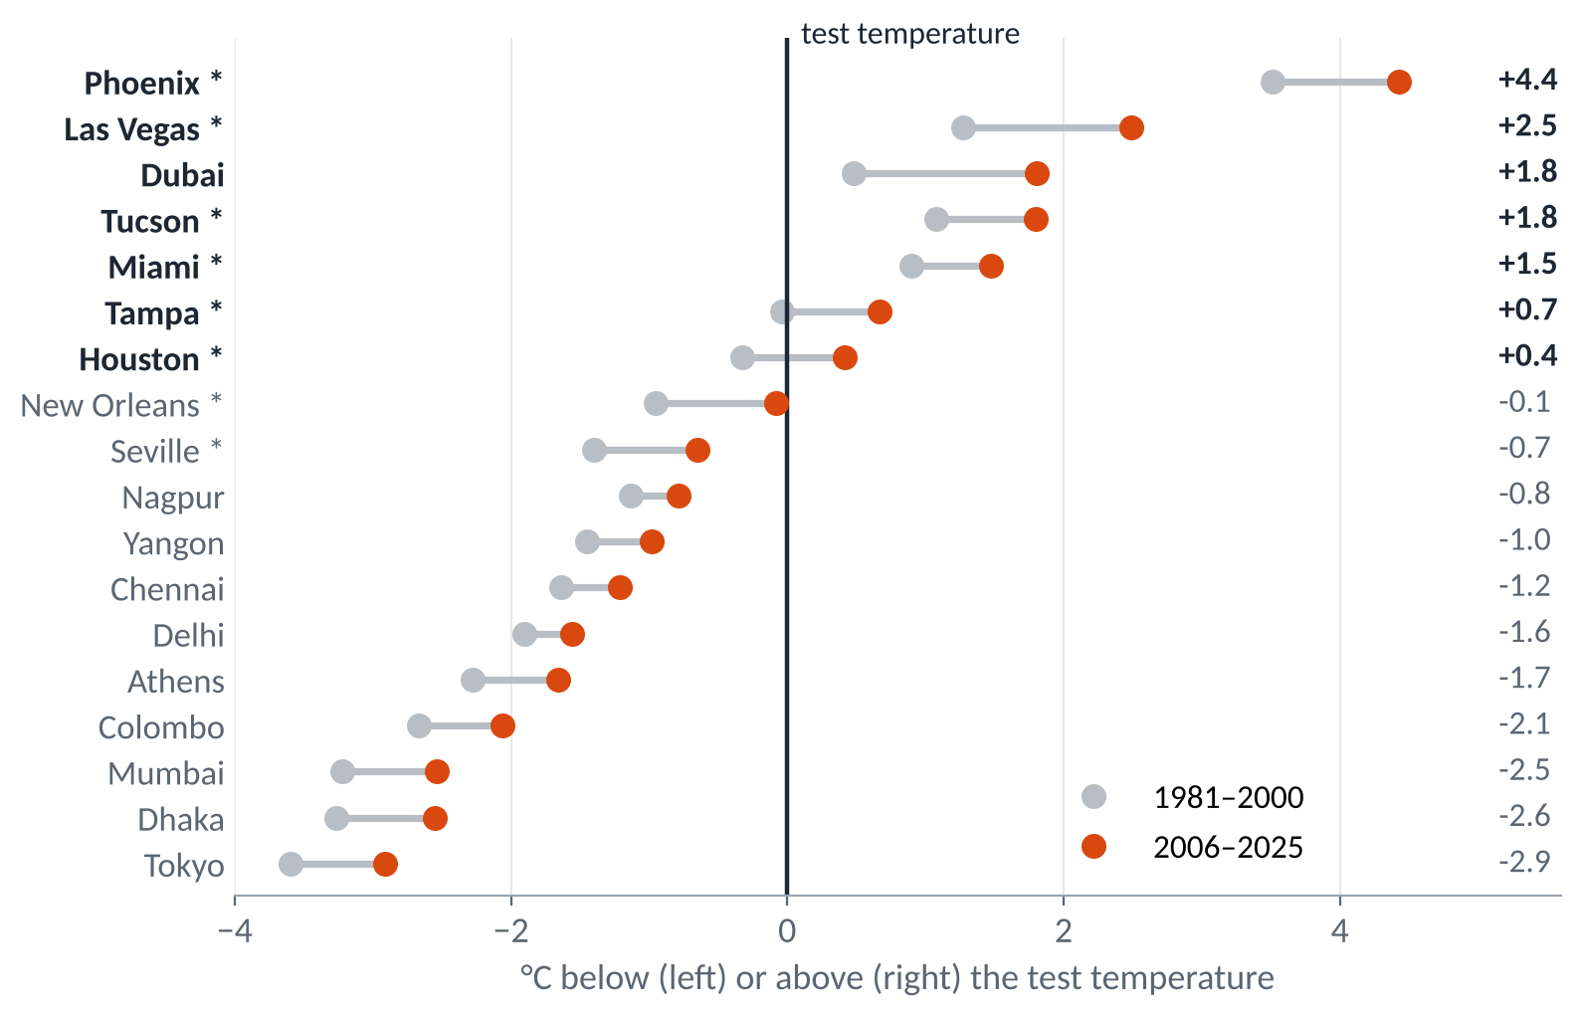
Every place warmed; 7 now run above the line
+0.35 to +1.33 °C
rise in effective temperature in all 18 places; every 95% interval above zero
7 of 18
now average above the test temperature their medicines are approved at
* weather station · values bias-corrected
Notes:
Result one: every one of the 18 places warmed, by 0.35 to 1.33 °C. Every 95% interval is above zero. Seven places now average above the test temperature their medicines are approved at. Tokyo, our control, stays safely inside Japan's 25 °C condition — exactly as the 2024 Japanese study found.

Slide 7
Inside the US, two cities crossed the 25 °C line
Houston
Tampa
New Orleans
24.68 → 25.41 °C
24.96 → 25.67 °C
24.92 °C
5 → 16 of 20 years above 25 °C
9 → 18 of 20 years above 25 °C
on the line: above in 9 of the last 20 years, none before
The US is an ICH region: its medicines are tested at 25 °C. Effective (mean kinetic) temperature, airport weather stations, 1981–2000 vs 2006–2025, bias-corrected. These stations were deliberately chosen among the warmest US cities.
Notes:
Result two: inside the United States, which tests at 25 °C, two cities crossed the line. Houston rose from 24.68 to 25.41 °C, and from 5 to 16 years above 25 °C out of 20. Tampa crossed too. New Orleans now sits right on the line, above it in 9 of the last 20 years. We chose these as the warmest US cities, so this shows the problem exists, not how common it is.

Slide 8
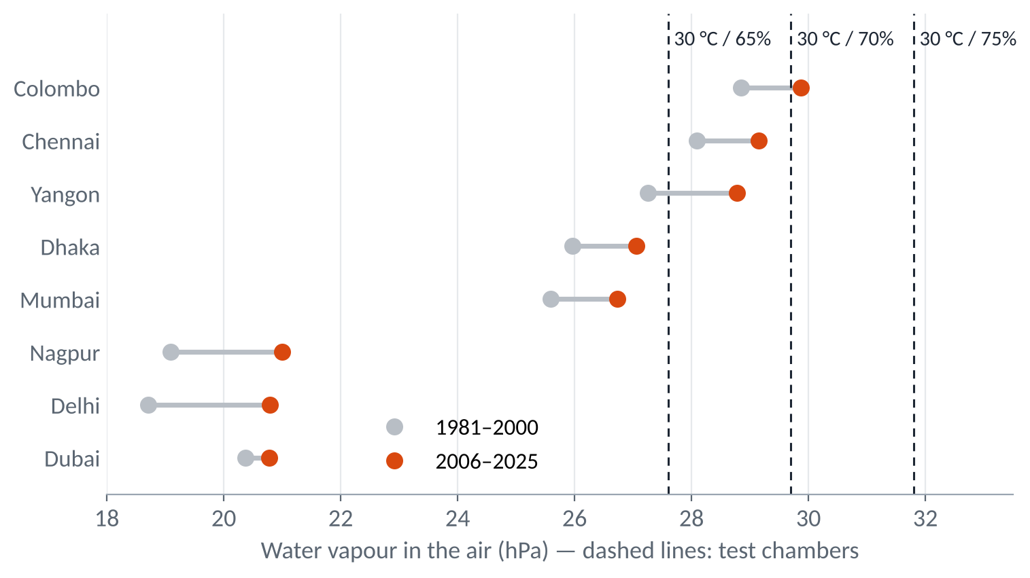
Humid coasts already exceed the 65% chamber
Chennai, Colombo and Yangon
already hold more water vapour than the 30 °C / 65% test chamber.
Colombo also exceeds 30 °C / 70%.
None yet reaches 30 °C / 75% — the reason WHO created that condition, now measured with current data.
Notes:
Result three: on humid coasts, water vapour breaks the chamber first. Chennai, Colombo and Yangon already hold more water vapour than the 30 °C, 65% chamber. Colombo exceeds 70% too. None yet reaches 75% — the reason WHO created that condition, now measured with current data.

Slide 9
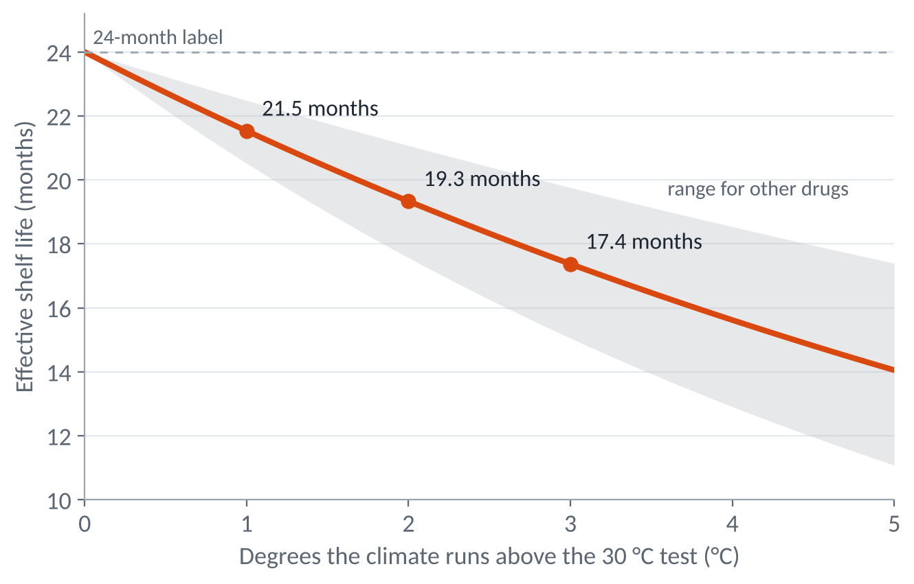
Why it matters: shelf life quietly shrinks
A 24-month label behaves like:
22.9 months
in Houston
19.7 months
in Dubai
14.7 months
in Phoenix
Outdoor climate, not measured product temperature: many buildings are cooled. Degraded antibiotics can under-dose patients and drive resistance (Kaplan et al., 2025).
Notes:
Why it matters: each extra degree speeds a typical degradation reaction by about 11%. So a 24-month label behaves like about 23 months in Houston, 20 in Dubai and 15 in Phoenix. This is outdoor climate, not measured product temperature — many buildings are cooled. But degraded antibiotics can under-dose patients and drive resistance.

Slide 10
What changes if this is right
1
2
3
Re-check every year
Target the hot spots
Act on humidity
Regulators can re-derive test conditions as the climate moves, with an open tool
Target post-market stability checks at places already over the line
Countries testing at 30 °C / 65% get evidence their coasts need more
Store below 30 °C
A standard is a forecast. Forecasts need checking.
Notes:
What changes: regulators can re-check test conditions every year with our open tool and data. Places already over the line can be targeted for stability checks, and humid coasts get evidence for stricter humidity. A standard is a forecast. Forecasts need checking.

