Slide 1
AB InBev Case Study
:Presented by Aditya Chaudhary

Slide 2
Employee Seat Booking Application
OBJECTIVES
User friendly application that operates on all operating systems.
Authentication of employees accessing the application.
Real time database to store the vaccination certificates/RTPCR report of employees.
Seat booking functionality on the basis of date,in-time and out-time of employees.

Slide 3
Technology Stack
Integrated Development Environment (IDE)
Android Studio - Official Android IDE, intelligent code editor, emulators for testing apps, code templates, firebase and google cloud integration.
Software Development Kit(SDK)
Flutter - Single codebase for deployment, automated testing and custom UI.
Programming Language
Dart - Works for both iOS/Android, scalable,quicker, mostly used in mobile applications and supports Google APIs.
Database
Firebase - Real time hosting of database,NoSQL, authentication features and analytics .

Slide 4
Functionalities
Authentication-
Authentication of employees and administrators will be via Firebase authentication using company provided google accounts.
Vaccination Certificates Repository-
The vaccination certificates of authorised employees will be stored in a NoSQL database hosted by Firebase Cloud Storage.
Seat Booking -
Vaccinated/Uninfected employees will be able to pick their date and time slots via date and time picker flutter widget.If the slots are available, the data will be stored in Firebase Cloud.

Slide 5
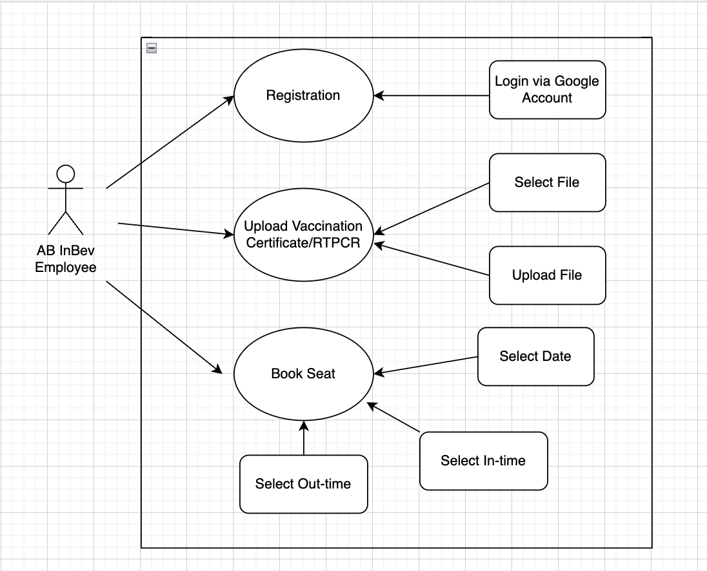
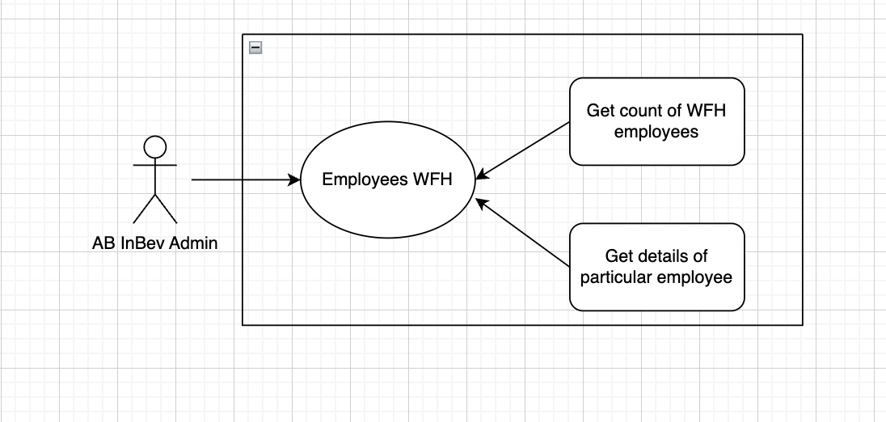
Use Case Diagrams

Slide 6
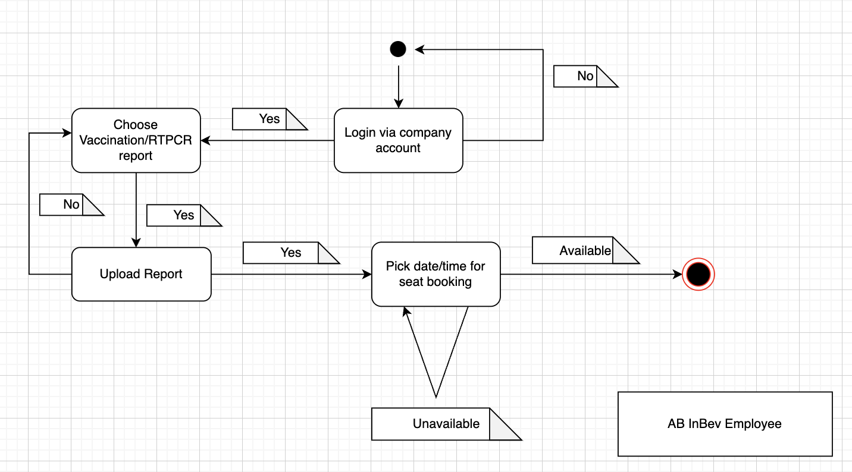
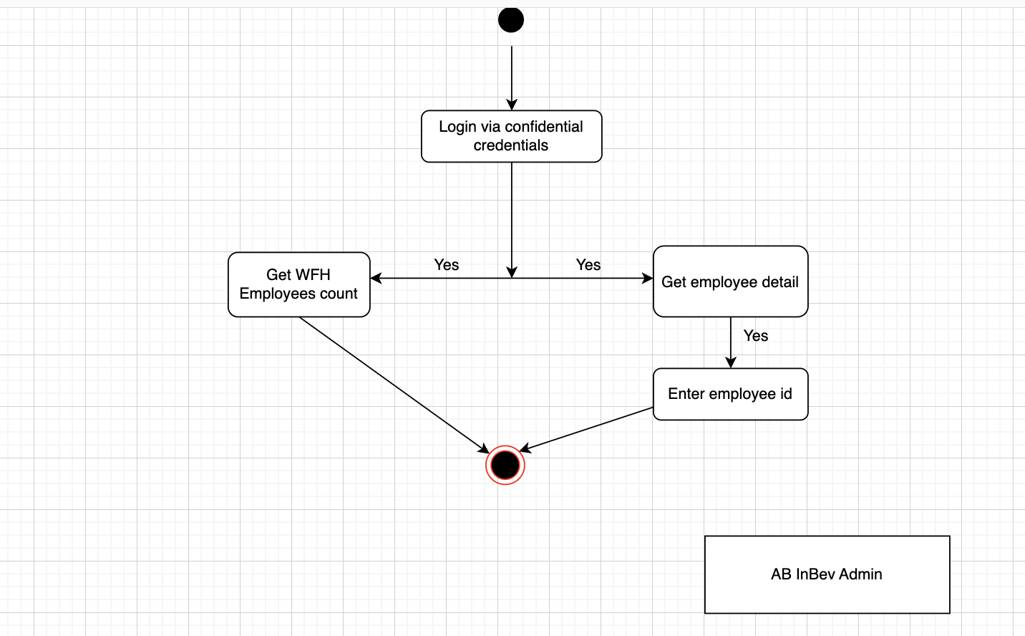
Activity Diagram

Slide 7

Prototype

Slide 8
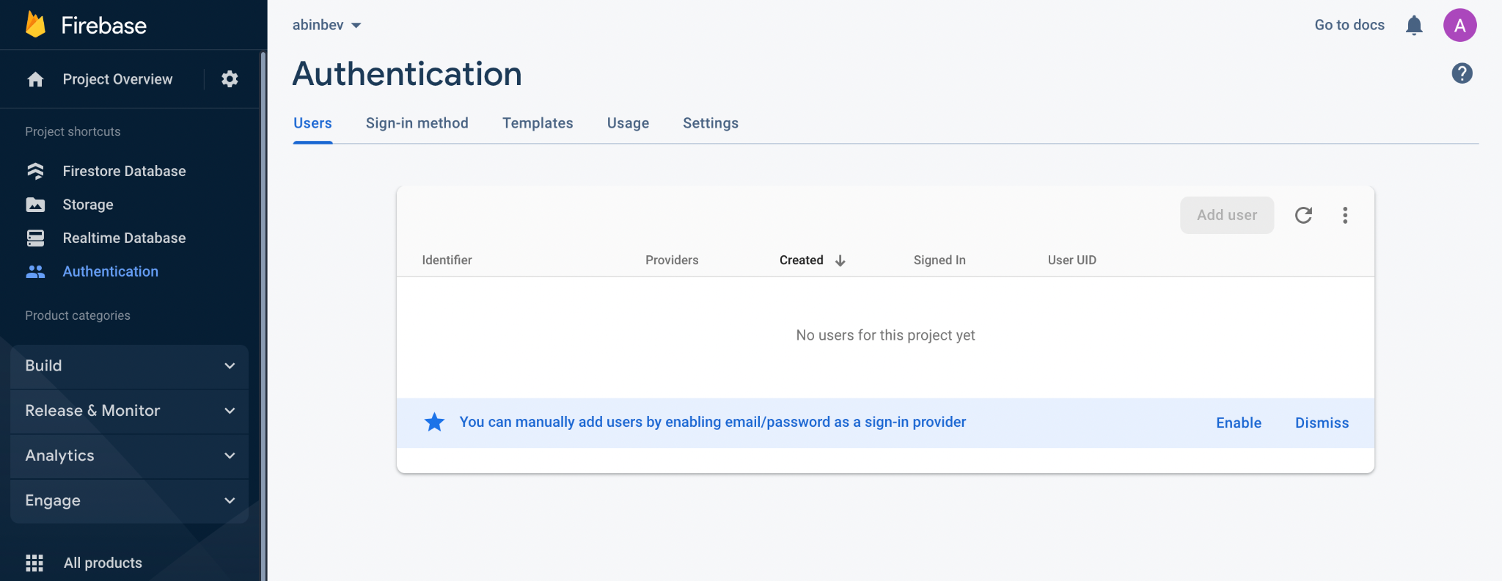
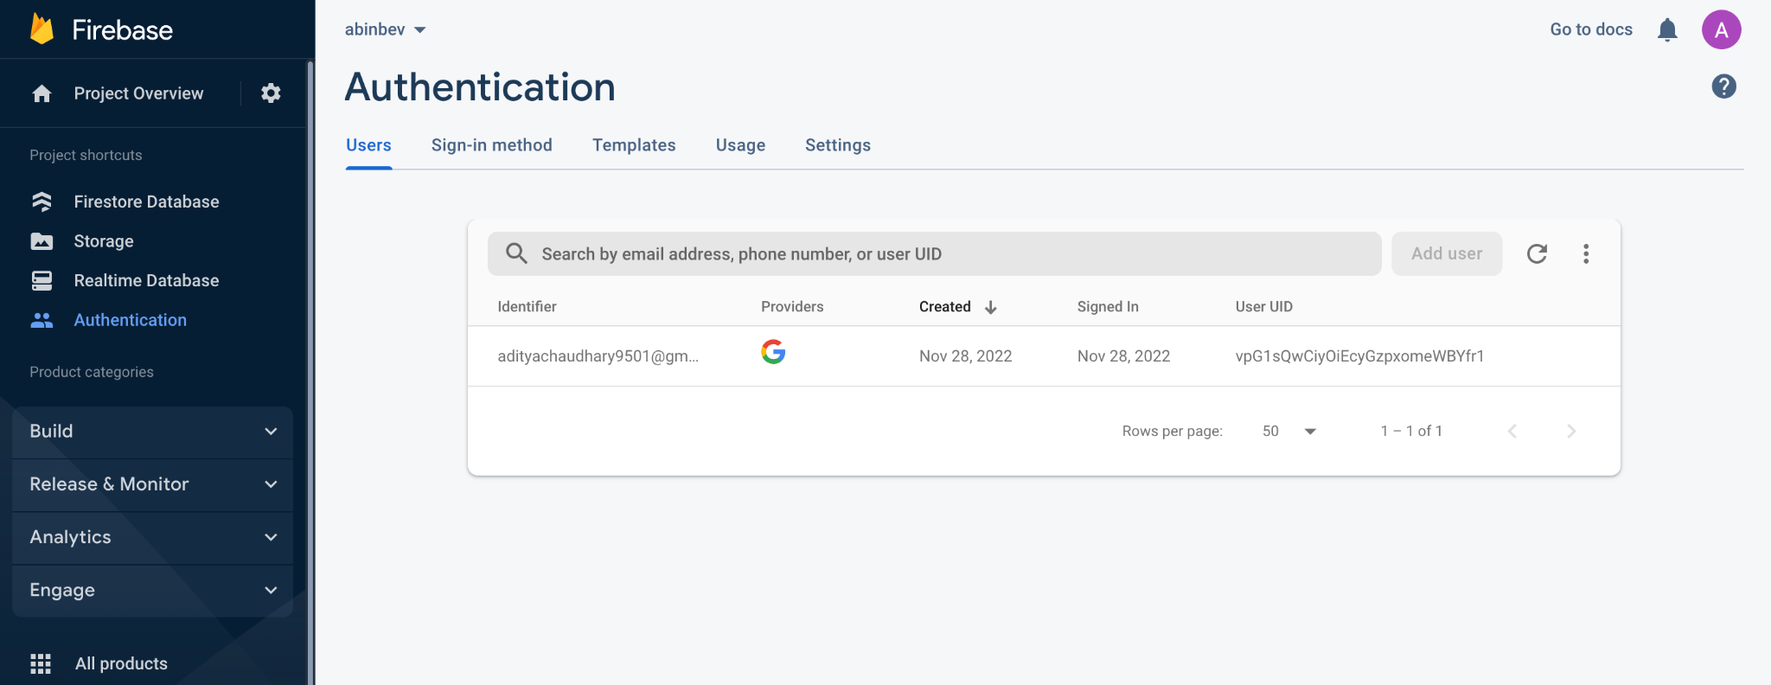
Firebase Authentication:Before/After

Slide 9
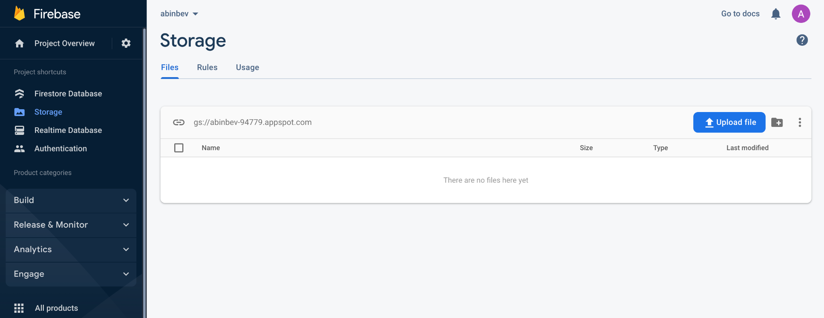
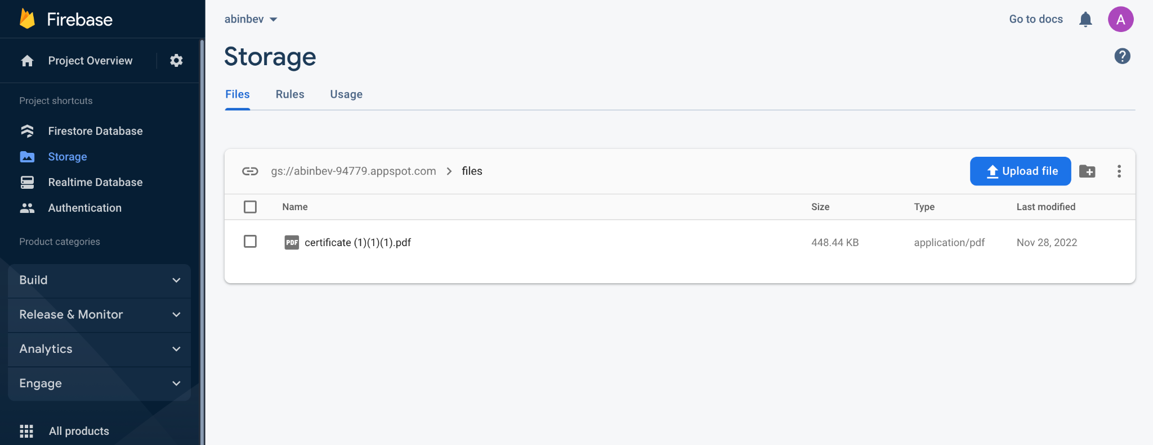
Real Time Database:Before/After

