Slide 1


CROWDFUNDING ANALYSIS
GROUP MEMBERS :
NAMRATA MHATRE
KIRAN BHARADWAJ
PRATYUSHA MEDAVARAM
NIKHIT CHOKHANDRE
ADITYA CHAVAN

Slide 2
Agenda
Factors that Contributes in Successful Kickstarter Campaign
Information
1
2
Project Objectives
3
What is Kickstarter?
4
Analysis on Failed Kickstarter Campaign
5
Project Insights
6
Dashboard

Slide 3
What is KICKSTARTER
”
Kickstarter is a platform where thousands of independent creators, including filmmakers, musicians, artists, and designers, fund their creative projects.
Creators have complete control over their projects, dedicating weeks to building project pages, creating videos, and planning rewards for backers.
Each project sets a funding goal and deadline, and backers can pledge money to support projects they like. Funding is all-or-nothing – if a project reaches its goal, backers are charged; otherwise, no charges occur.

Slide 4
This project aims to analyze Kickstarter crowdfunding data using tools like Microsoft Excel, Power BI, Tableau, and MySQL. The goal is to get a complete picture of crowdfunding trends and figure out important performance indicators to understand how crowdfunding works.
Here are the main points we're looking at:
1. Total Projects:
Checking how many projects are on the platform.
Looking at how project creation changes over time to see how the platform is growing.
2. Successful Projects:
Studying which factors (like category, funding goal, and duration) affects project's success.
Figuring out what makes a project successful and suggest ways to improve it.
PROJECT OBJECTIVES
3. Total Backers:
Exploring how many people back different projects.
Finding patterns in how backers behave, like which categories they prefer or how much they typically contribute.
4. Total Categories:
Sorting projects into categories to see the types of crowdfunding initiatives.
Highlighting which categories are the most popular and successful.
By doing this, we hoping to provide a clear and simple understanding of how crowdfunding works and what makes projects successful.

Slide 5


Factors that Contribute in Successful Kickstarter Campaign
About 38.35% of projects on Kickstarter succeed, showing that many creators bring their ideas to life. It's good, but there's still a chance to make it even better
The top 5 most successful projects based on the amount raised are: The Good Life with $81M, LM7 Black Rock Shooter Creator Figure Project with $52M, Dream Pen: True Ebonite Fountain Pens with Japanese Art with $33M, The VR Animation Spice and Wolf VR Production Project with $31M, and Venus Blood Frontier English Localization Project with $24M
Percentage of Successful Projects fluctuates throughout the Year, with the highest Percentage occurring in Q1 .
Projects with realistic and well-defined funding goals are more likely to succeed.
Looking at different categories, Tabletop Games have a success rate of 62.42%, making them the most successful Category.

Slide 6

Analysis on Failed Kickstarter Campaign
Approximately 51.45% of projects on the platform did not achieve their funding goals, indicating a notable percentage of unsuccessful crowdfunding initiatives.
Projects in Product Design, Documentary, Video Games, Music and Food categories have a higher number of failures compared to other categories.
Failing to identify popular project categories, backer demographics, and emerging funding trends can limit campaign's potential.

Slide 7
Identifying Peak Years for Project Launches:
Recognizing the peak year in Kickstarter project launches, such as the notable surge in 2014, is crucial for strategic planning.
Consider aligning major project launches with historically successful periods, leveraging the platform's heightened activity for increased visibility and support.
Addressing Project Outcome Disparities:
The analysis of project outcomes, as indicated by the donut chart, reveals a need for a targeted improvement strategy.
Focusing on reducing the percentage of failed projects and enhancing the success rate should be a priority.
This could involve refining project planning, conducting thorough market research, and implementing effective risk management to enhance overall project viability.
Strategic Resource Allocation Across Quarters:
The concentration of projects in quarter 3 suggests a potential strategic advantage during that period.
To optimize resource allocation, consider understanding the specific conditions that make quarter 3 favourable.
This insight can guide the scheduling of major launches, ensuring that resources are allocated efficiently to capitalize on the platform's dynamics during the most opportune times.
Project
Insights

Slide 8
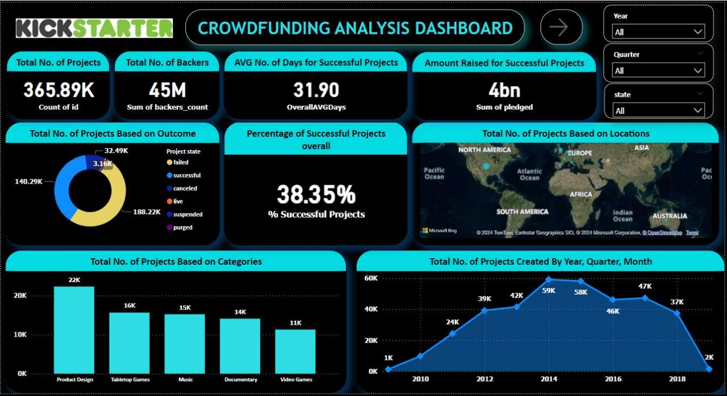
Dashboard

Slide 9
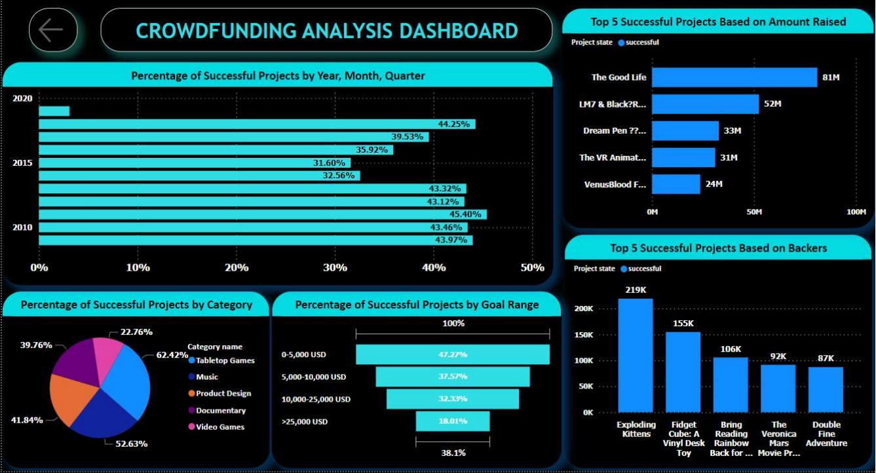
Dashboard

Slide 10
Tips to Improve Funding
Issues We Tackled While Working on Project
Our Company In Numbers
Milestone Rewards:
Offer special rewards as the project hits specific goals to attract more backers and make them feel part of the project's success.
Clear Project Explanation:
Ensure everyone understands your project by explaining its goals and plans in a straightforward way, building trust among potential backers.
Smart Advertising Strategies:
Use clever advertising methods to reach more people and create interest in your project, bringing in a larger community of backers.
Handling large amounts of data posed challenges when it was brought into the system, leading to potential issues with system performance due to the sheer volume of data.
Dealing with massive datasets caused problems for the system, slowing it down.
We encountered challenges in importing the data because of its sheer volume.
77%

Slide 11


