Slide 1
Approach – 3:
->Using PyPDF2 to rotate and read from the PDFs
ISSUE:
->PyPDF2 rotates it only by an angle of 90degrees and it couldn't detect Wall 3

Slide 2
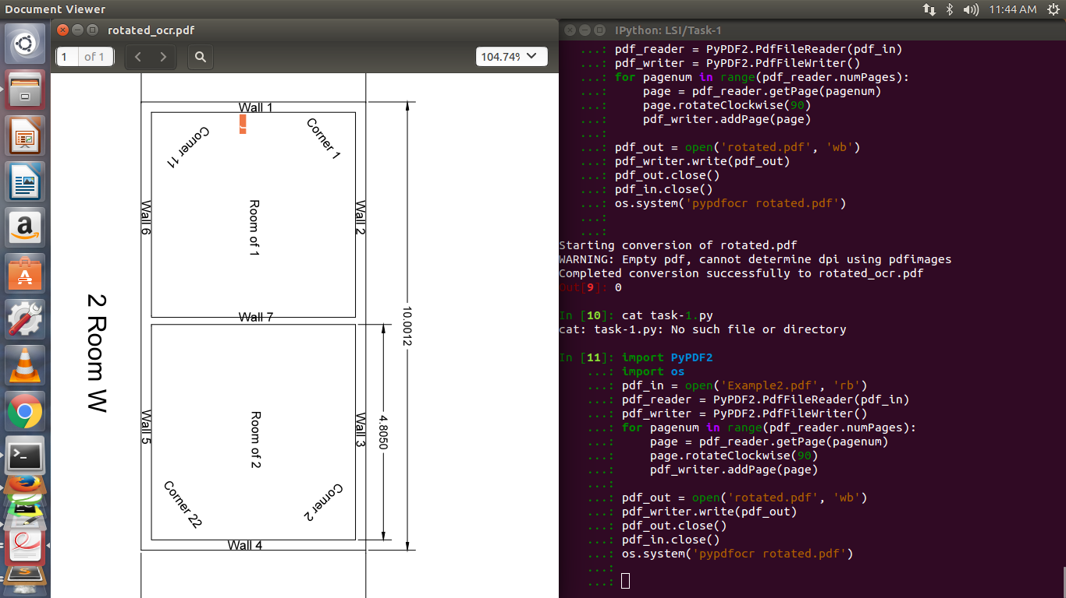

Slide 3
Alternate Approach
Extracting the text from the DXF file
“So you have bunch of DXF files now. Gather them in some empty temporary folder. Grab superuseful utility DXF2TEXT. Unzip it and place to the same directory as DXF files. Fire up command line there and type for %i in (*.dxf) DO (dxf2text.exe %~ni) - this command will cycle through all DXF and extract all text info from them to separate text files.”-taken from net.
Small issue:- This command line argument works only in Windows.

Slide 4
TASKS AHEAD
After extracting all the text from the PDF , I have to attach semantic value to it from the library.

Slide 5
THANK YOU

