Slide 1
Winter Internship at LSI
Presentation
-Soumya V

Slide 2
TASKS TARGETTED
Generate closed spaces by joining doors(openings).
Store doors seperately with attributes.
Generate polygons of the formed closed spaces.
Generate centroids of the polygons.
Give attributes to the centroids.
Generate a network from the centroid points.
Conversion to GML

Slide 3
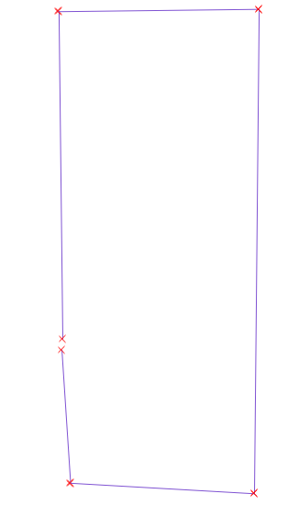
Joining Doors-1
Initial drawing:
A room with a gap
which is a door.
Program detects points
which are within a threshold
distance of each other, and
stores as doors.

Slide 4
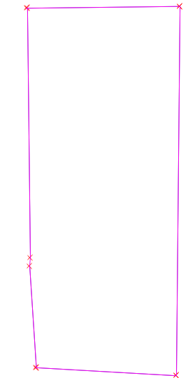

Joining Doors-2
It then does two things:
1. Produces a layer with
all walls and the gap between the
walls closed, and the new line
has “Type” attribute value set to
“door”.

Slide 5


Joining Doors-3
2. Represents each door by its
centroid generating a seperate
layer for that.
Each door-centroid is again
associated with the following
attributes:

Slide 6


Generating Polygons
Now that we have a closed figure,
a polygon is generated out of it.
As we do this we also count the number of doors being included.
The polygon detection algorithm joins all the lines having at least one common endpoint as of now, and can be extended to multiple rooms following a proper sequence.
Works accurately only for single rooms as of now.

Slide 7
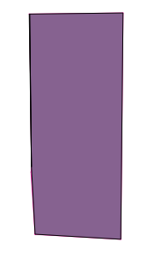
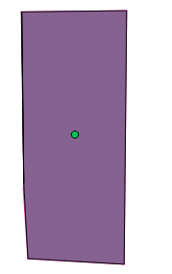
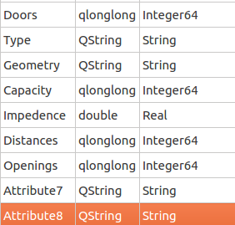
Centroid Generation
Now that we have a polygon we can generate centroids, and also associate attributes with them:
Each room-centroid also has a “Doors”
attribute which stores the number of doors in the room.

Slide 8
WORK AHEAD-1
Extending the existing polygon generation
algorithm to work accuately for multiple rooms
(with door detection).
ISSUES Faced:
  No in-built mechanisms, in any of the python libraries.
  Lines are stored as an array in shp files, not in the order we see them, so moving clockwise or in a particular direction is difficult.
  One hack is to sort on the basis of end-points,
  but that fails to address some cases.

Slide 9
WORK AHEAD-2
Discussion with Anurag:
The graph algorithm designed by him has the following prerequisites:
Every corridoor, or a path through which people can move through, is an edge.
Doors opening into either other rooms or the corridors are nodes
The points where edges cut each other, say corridor junctions will be nodes.

Slide 10
WORK AHEAD-3
Discussion with Anurag(contd):
So the final definitions are:
NODE: Areas where people wait to evacuate/Areas where a waiting cluster transforms into a cluster in motion.
    ALL DOORS AND CORRIDOR JUNCTIONS
    Associated attributes:Capacity.
EDGE: Allows movement between nodes.
    ALL CORRIDORS, HALLWAYS AND STAIRWAYS.
    Associated attributes:Length and Breadth

Slide 11
WORK AHEAD -4
Expected final Result:
A network on which the existing algorithm can be applied..

Slide 12
WORK AHEAD -5
Can improve the door detection algorithm being used.
Current one is based solely on distances and ranges.(Since the input is clean)
May lead to unforseen errors.
Extra doors may be detected.
Raw data, where arcs represent doors, can be of greater use, but leads it to new complications.

Slide 13
Sources
Research papers:
  A “Door to Door” Path Finding Approach for Indoor Navigation.
    L. Liu , S. Zlatanova
  A Semantic model to Define Indoor Space in context of Emergency Evacuation.
    Nishith Maheshwari , K. S. Rajan
Google, Wikipedia.
Py-ogrgdal-cookbook online.

Slide 14
THANK YOU

