Slide 1
Winter Internship at LSI
Presentation
-Soumya V

Slide 2
TASKS ALLOTED-1
Read Rahul’s code and understand it.
Familiarize yourself with basic ogr/gdal commands.
Extend existing center line code to generate closed spaces.

Slide 3
TASKS ALLOTED-2
Generate polygons of the given closed spaces.
Generate centroids of the polygons.
Generate a network from the centroid points.
Give field values to the point features.
Conversion to GML

Slide 4
TASKS PERFORMED
1. Generating Centroids
2. Points Regeneration
3. Basic Network Generation
4. GML File Regenerating

Slide 5
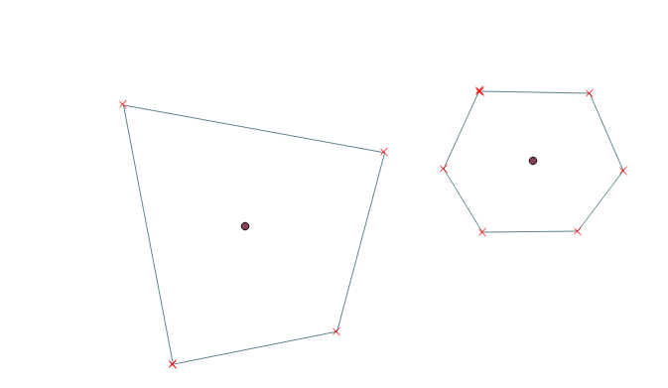

Generating Centroids
TASK:-Generate Centroid of any closed polygon.
Used OGR/GDAL libraries
Generate a seperate layer with points, which are the centroids of the input polygons.

Slide 6
Regenerating points
TASK:- Points in the shp file from need to be regenerated.
Using OGR/GDAL libraries.
Identifies those features, whose geometries are points, assigns them to an output feature, before creating a layer.

Slide 7
Basic Network Generation
TASK:- Generate a network out of input centroids.
Implemented a very basic version.
Wrote a python code, to generate three points, with field values, whether door, corridor, door opening to corridoor or a room centroid.
Wrote a python code to join centroid to door opening to corridoor and door opening to corridoor to corridoor.
The code works for a very small subset of cases, and needs to be revised to include more test cases.

Slide 8
GML File Regeneration
TASK:- Should be able to convert any input format to a standards complying GML file.
Used ogr2ogr library with necessary flags.
To cross check, reconverted to dxf,shp and opened with respective viewers.
Proper GML file conversion is achieved, including the field titles and values.

Slide 9
TASKS IN PROGRESS-1
Debugging Rahul’s code:
The code works only for 1 shape file (Vindhya_test).
Not all the test shape files had the ID field, which was creating problems.
Hence, dropped the extension task for now, explained the code to Aakash, and might take it up again, following his method, once he successfully implements line merging for dxf.

Slide 10
TASKS IN PROGRESS-2
Implementation of Algorithm for Polygon generation:
The clockwise-
anticlockwise
approach.
We loop through each wall in the design, and try to reach it again, first moving clockwise, then anticlockwise.

Slide 11
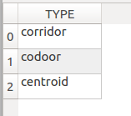
TASKS IN PROGRESS-3
Generating points with field values:
Tried generating some random points with different associated values such as ‘door’, ‘corridoor’, ‘room center’ etc.
Network Generation:
Can connect doors to corridoors, need to extend code by adding more kinds of points.

Slide 12
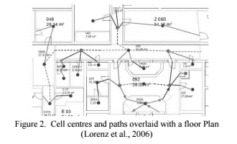
TASKS IN PROGRESS -4
Expected final Result:
A network on which the existing algorithm can be applied.

Slide 13
Next Steps
Modifying the shape file generated from the dxf file, to generate point features, and then connect pairs to form preliminary line features.
Polygon generation using the clockwise-anticlockwise technique discussed with Srishti mam.
Applying the existing centroid code on the polygons.
Extending the developing network code, for it to work on all the centroids, and generate a network.

Slide 14
Sources
Research papers:
  A “Door to Door” Path Finding Approach for Indoor Navigation.
    L. Liu , S. Zlatanova
  A Semantic model to Define Indoor Space in context of Emergency Evacuation.
    Nishith Maheshwari , K. S. Rajan
Google, Wikipedia.
Py-ogrgdal-cookbook online.

Slide 15
THANK YOU

