Slide 1
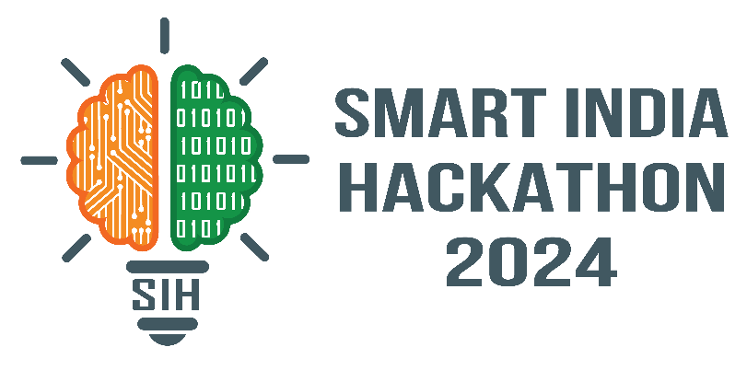
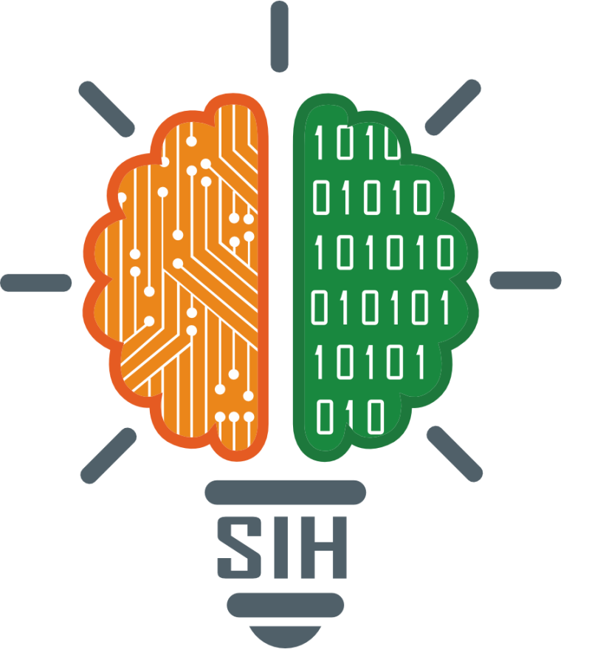
SMART INDIA HACKATHON 2024
TITLE PAGE
Problem Statement ID – SIH1715
Problem Statement Title- AI tool/mobile app for Indian Sign language(ISL) generator from audio-visual content in English/Hindi to ISL content and vice-versa
Theme- Miscellaneous
PS Category- Software
Team ID- 39883
Team Name - Tech Geeks

Slide 2
IDEA TITLE
Tech Geeks
Proposed Solution.
Hand Gesture Tracking Program: This is an AI-powered application which can track hand signs using technologies like computer vision to identify Indian sign language (ISL) gestures..
Sign-to-Text and Speech Conversion: This tool can convert recognized ISL gestures into text language and speech in English/Hindi to make communication better
Enhancing Accessibility: this app can bridge the communication gap between Individuals with disabilities and the rest of the population by enabling smooth two-way communication through ISL interpretation.
Real-Time Processing: the program offers real-time sign language recognition and converting it to text or speech ensuring smooth real-time interaction for users across various communication senarios
Adressing the problem.
The proposed AI application addresses the communication barriers faced by fosters community
Also integration of computer vison allows interpretation and generation of ISL gestures.
Unique Value Proposition (UVP).
The app specifically targets Indian Sign Language (ISL).
Users can engage with the app in real time for a dynamic experience.
The app has a simple, friendly interface for all users.

Slide 3
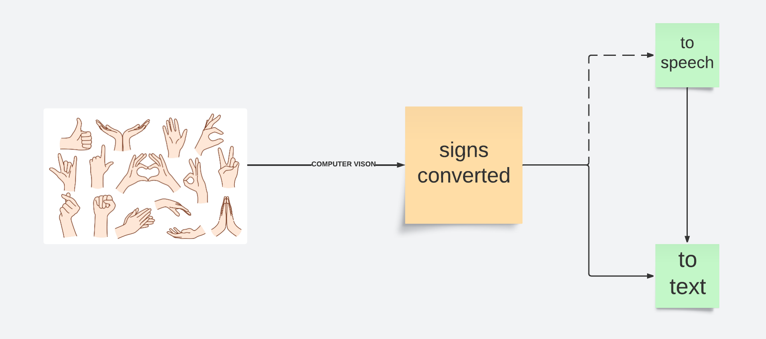
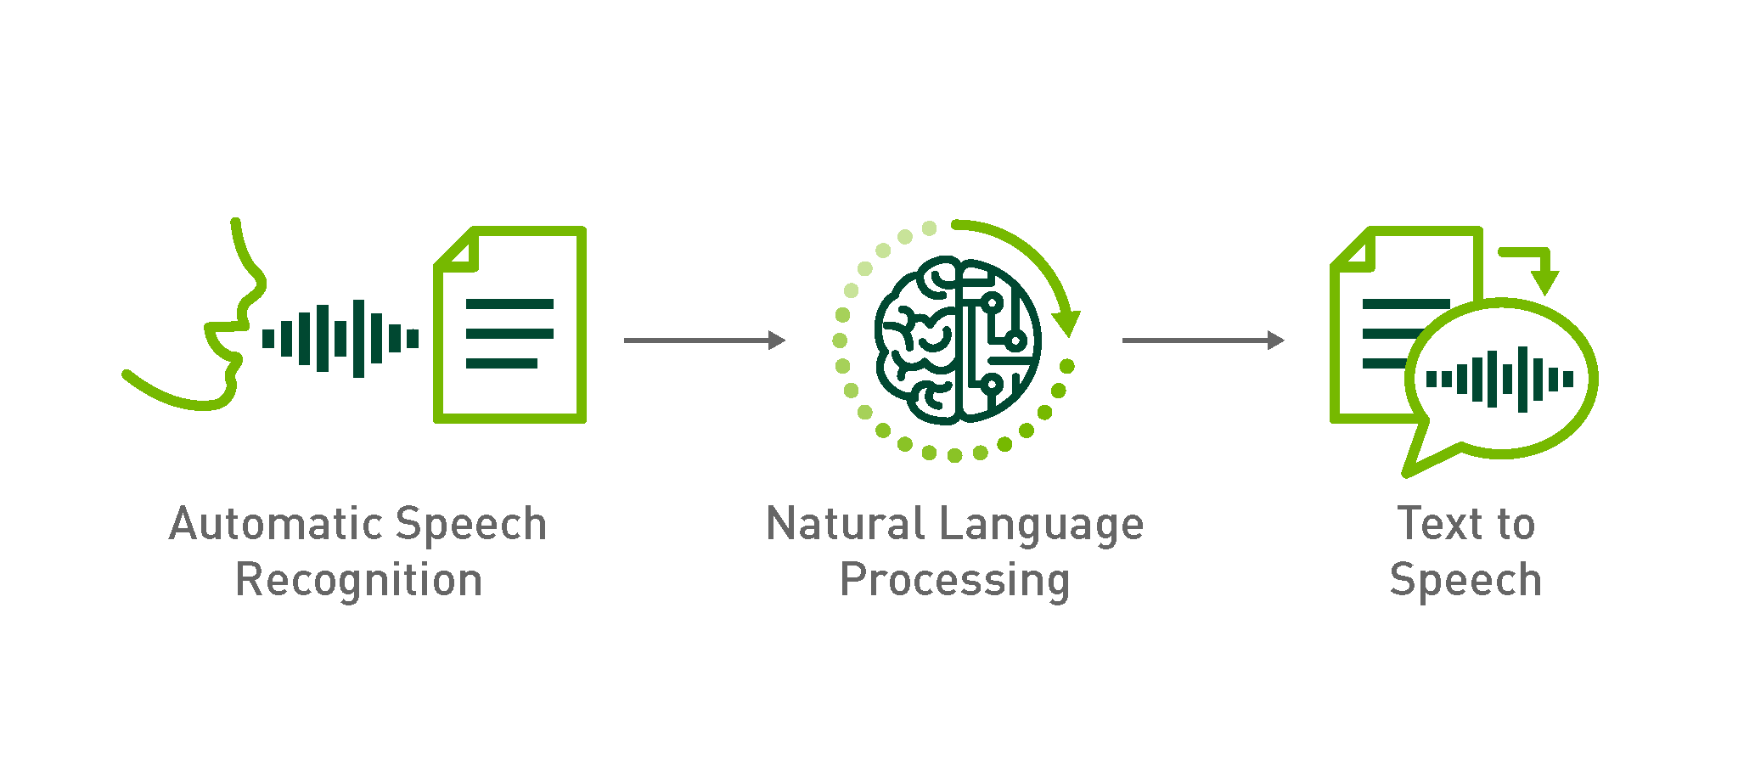
TECHNICAL APPROACH
Tech Geeks
MediaPipe (Computer Vision ): MediaPipe is used for Real-time hand gesture tracking and recognition using camera input.
TensorFlow (Machine Learning ): TensorFlow Training models for recognizing ISL gestures and converting them into text or speech.
Natural Language Processing (NLP): To handle the translation of text into speech (using Amazon Polly).
Google Speech API (Speech-to-Text API ): Google speech for converting spoken words into text for vice-versa translation.
React Native (Mobile App Development): React native for building user interface, ensuring cross-platform functionality for Android and iOS.
Node.js (Backend): To manage the processing of data between the client and AI models for real-time results node.js is used.
Amazon Web Services (Cloud Services ): AWS for hosting the AI models and manage heavy computations.

Slide 4
FEASIBILITY AND VIABILITY
Tech Geeks
Feasibility:
Existing tech like speech-to-text, NLP, and gesture recognition can be leveraged, but ISL-specific datasets and models are limited. Real-time translation and mobile performance require optimized AI models.
Challenges & Risks:
Lack of ISL datasets , Balancing cost, accessibility, and simplicity, Limited paying users in underserved communities.
Strategies:
Collaborate with NGOs/ISL experts for data, Basic free features, premium for advanced tools, Balance cloud and local processing for real-time performance.

Slide 5
IMPACT AND BENEFITS
Tech Geeks
IMPACT:
Enhanced Communication: the program facilitates real-time translation between disable individuals and Hindi/English speakers, improving social interaction.
Empowerment: it can enable the the differently-abled community to engage more actively in education, work, and public services.
Educational Benefits: the app can serve as a valuable tool for both individuals with disability learning to communicate and individuals wanting to learn ISL, enhancing educational opportunities.
BENEFITS:
The app bridges communication gaps faced by disable communities in daily life, education, and workplaces.
It open up more job opportunities for disable individuals, Supporting financial independence.
It can provide deaf students with better access to mainstream education through ISL content.
Application can help to raise awareness and understanding of ISL, contributing to broader societal acceptance of sign languages.

Slide 6
RESEARCH AND REFERENCES
Tech Geeks
Research Sources:
Research on Natural Language Processing (NLP) and computer vision, like Google Speech API and OpenPose, forms the technical foundation for speech-to-text and gesture translation.
Papers on edge computing and mobile AI optimization (TensorFlow Lite, PyTorch Mobile) discuss approaches to handling real-time video and audio processing on mobile devices.
References:
Camgoz, N. C., Koller, O., Hadfield, S., & Bowden, R. (2020). Sign language transformers: A new approach to sign language recognition using neural networks. IEEE Transactions on Pattern Analysis and Machine Intelligence, 42(6), 1417-1430.
John Pius Thayiparampil1, Kiran k2, T Binto Binu3, Sreejith Viju4. (2023) "Real-Time Sign Language Translation System for Indian Sign Language"

