Slide 1
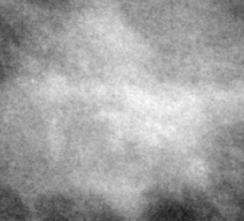
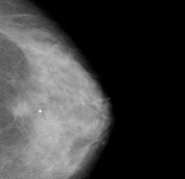
(2) Clip Feature Extraction
(4) Evaluation and Analysis
(1) Inputs
Post-Hoc Analysis
(3) Classification
Mammogram Images
CLIP Image Encoder (ViT-B/32)
Image Embeddings
Similarity-Guided Classifier (SimilarityFCClassifier)
Evaluation
(Classification Report, Accuracy, ROC AUC)
Zero-Shot Classification (Baseline)
Text Prompts (e.g., “Benign”, “Malignant”)
CLIP Text Encoder
Precomputed Text Embeddings

