Slide 1
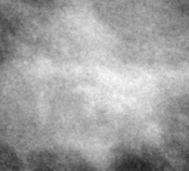
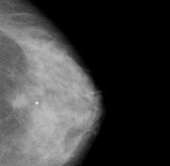
(4) Evaluation and Analysis
(2) Clip Feature Extraction
(1) Inputs
(3) Classification
Mammogram Images
CLIP Image Encoder (ViT-B/32)
Image Embeddings
Similarity-Guided Classifier (SimilarityFCClassifier)
Prompt Engineering: Prompt greatly influences model performance.
(e.g., "a mammogram showing no signs of suspicious malignancy"
Hyperparameter Tuning: Tuning Learning Rate (LR) and FC Layer Hidden Dimension improved results.
(e.g., LR 0.0005 and Hidden Dimension 256)
Post-Hoc Analysis
Evaluation
(Classification Report, Accuracy, ROC AUC)
Zero-Shot Classification (Baseline)
Text Prompts (e.g., “Benign”, “Malignant”)
CLIP Text Encoder
Precomputed Text Embeddings

