Slide 1
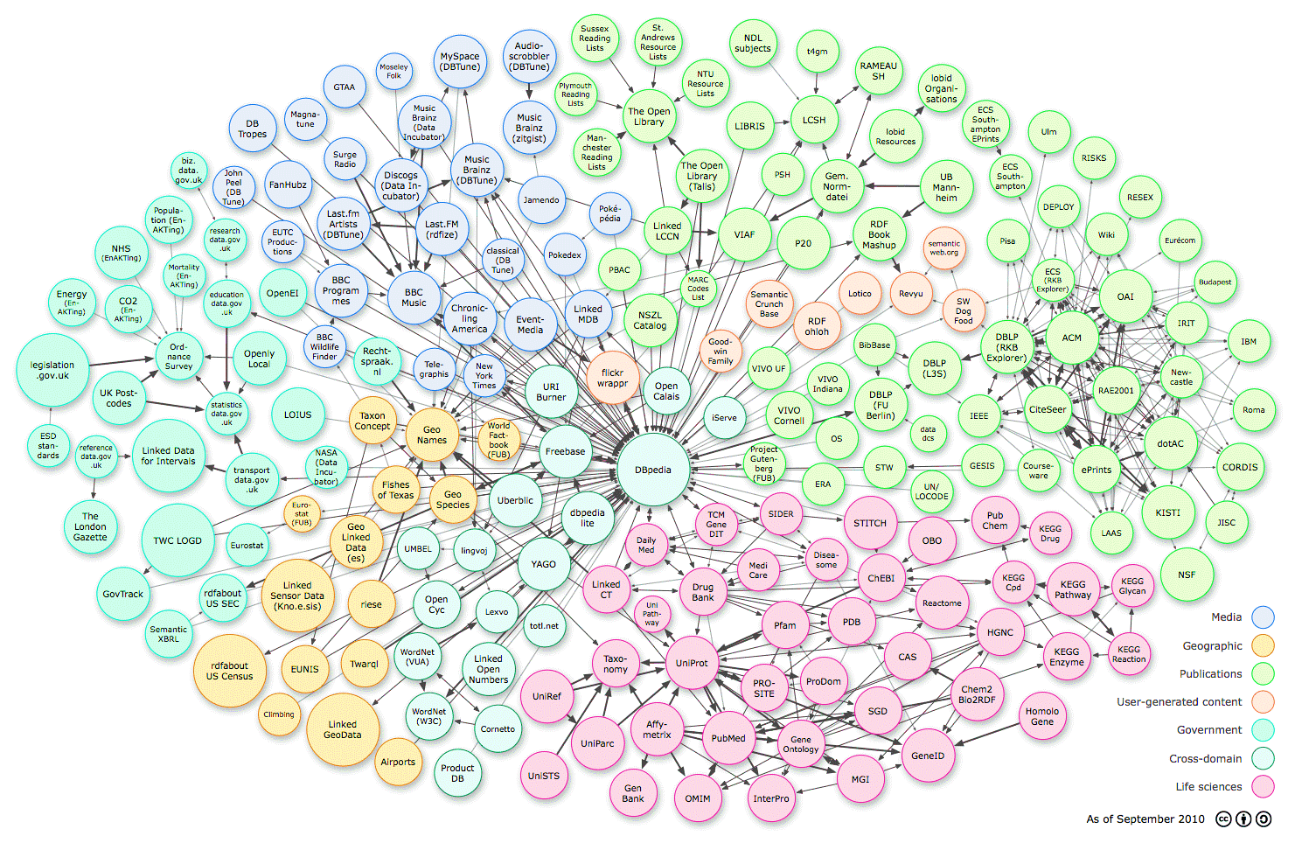

Capturing Dynamicity of Relations in Temporal Knowledge Graphs
PHASE 1 Presentation
for
MTech Project
titled
presented by:
ADITYA DANDRIYAL
142202003
under the guidance of:
Dr. Koninika Pal

Slide 2

An Overview
Before MID-TERM
Literature Review on:
Knowledge Graph Survey
Knowledge Graph Embeddings
TransE
TransH
HyTE
After MID-TERM
Literature Review on:
Incorporating Literals into KG
Understanding & Re-implementing HyTE code.
Using HyTE as backbone architecture, implemented these methodologies:
HyTE_Comb_Entity
HyTE_Comb_Classes
HyTE_Comb_LitTypeEntity

Slide 3
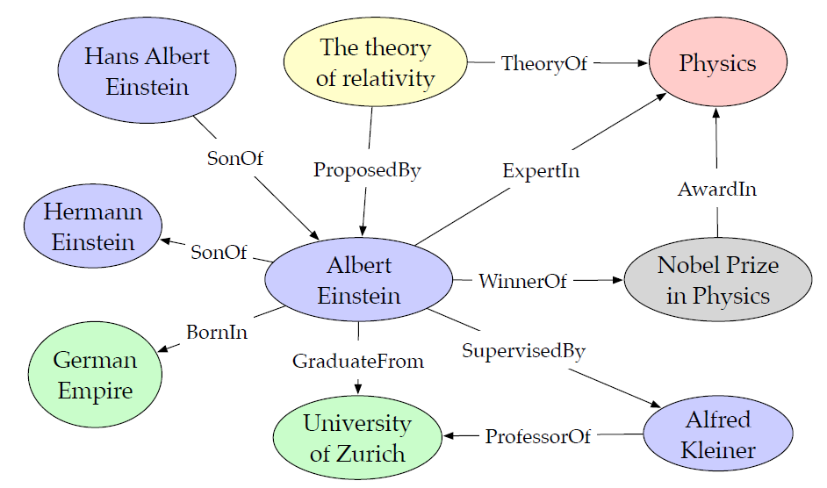
Knowledge Graphs [Wang et al., 2017]
Representing knowledge in structured form.
A multi-relational directed graph composed of entities (nodes) and relations (edges).
Facts stored as triples (h, r, t).
(Albert Einstein, WinnerOf, Nobel Prize).
Head entity
Relation
Tail entity

Slide 4
Knowledge Graph Embeddings [Wang et al., 2017]
KG’s are symbolic in nature.
KGE is to embed entities and relations in low dimensional continuous vector space.
Simplifies manipulation while preserving inherent structure.
Entity and Relation Representation
Defining a Scoring Function
Representation Learning
Auxiliary Information
Entities as vectors
Relations as Operations
Measures plausibility of facts
Translational Distance Models
(Distance-based scoring)
Initialize embeddings randomly
Generate negative samples
Minimizing a global loss function
(Margin based Pairwise Ranking Loss).
Embeddings learnt
Learn better Embeddings
Improve Prediction tasks

Slide 5
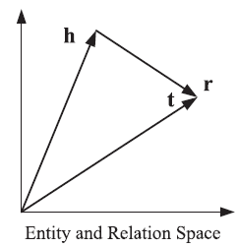
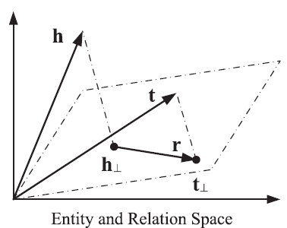




TransE [Bordes et al.,2013]
A fact (h, r, t) holds if h + r ≈ t .
Scoring Function:
Simple and Efficient.
Fails to model the many-to-one, one-to many types of relations.
TransH [Wang et al.,2014]
Introduces relation specific hyperplanes.
Entities have distributed representations specific to relations.
A fact (h, r, t) holds if h⊥ + r ≈ t ⊥ .
Scoring Function:
Overcomes flaws of TransE.

Slide 6
Temporally aware Embeddings [Dasgupta et al., 2018]
Not all KG beliefs universally true.
Some show temporal dynamics.
For e.g., (Bill Clinton, PresidentOf, USA) is only true from 1993 to 2001.
Most KGE methods ignore this temporal dimension.
Static KG
(h, r, t)
Dynamic/Temporal KG
(h, r, t, [𝜏_{s}, 𝜏_{e}])
KGE incorporates Temporal scope during learning
Dynamic/Temporal KG
(h, r, t, [𝜏_{s}, 𝜏_{e}])
Temporally aware embeddings

Slide 7
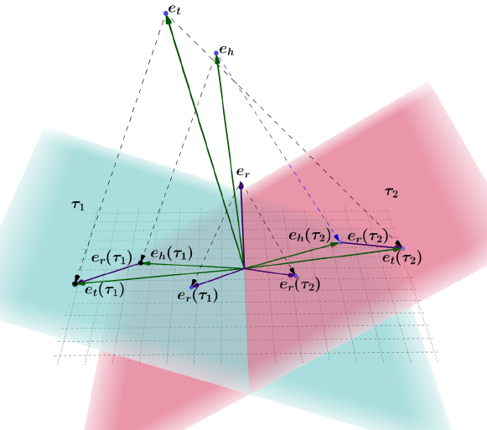
HyTE [Dasgupta et al., 2018]
Hyperplane based Temporally aware KGE approach.
Built over TransE.
Inspired by TransH, associates timestamps with
hyperplanes.
Learns KG embeddings distributed in time.

Slide 8

HyTE: framework [Dasgupta et al., 2018]
Dismantled into Multiple Static Subgraphs G𝜏_{i}
Scoring Function Definition
Learned Embeddings & Hyperplane Vectors
Temporally Scoped KG
(h, r, t, [𝜏s, 𝜏e])
Triples in G𝜏 projected onto w_{𝜏}
Minimizing Margin based Pairwise Ranking Loss
Include (h, r, t) in each G𝜏 where
𝜏s ≤ 𝜏 ≤ 𝜏e
P_{𝜏}(e_{h}) = e_{h} – (w_{𝜏}^{T} e_{h})w_{𝜏}
P_{𝜏}(e_{t}) = e_{t} – (w_{𝜏}^{T} e_{t})w_{𝜏}
P_{𝜏}(e_{r}) = e_{r} – (w_{𝜏}^{T} e_{r})w_{𝜏}
TANS
Entity Prediction
Relation Prediction
TDNS + Intervals
Temporal Scope Prediction

Slide 9
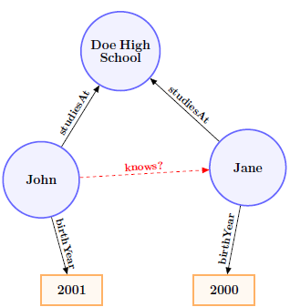
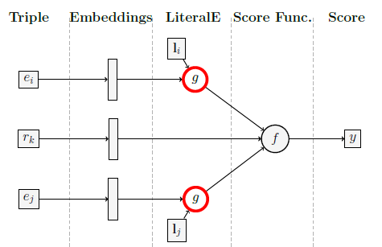
LiteralE [Kristiadi et al., 2019]
Relations can be of two types:
(entity, object relation, entity), e.g. (John, studiesAt, Doe High School)
(entity, data type relation, data value), e.g. (John, birthyear, 2001)
An entity’s attribute value is called a literal.
Most KGE’s don’t take literals into account.
LiteralE enriches entity embeddings with their literal information.
LiteralE is an extension module for any KGE method.

Slide 10
Objective
All KGE approaches learn facts having object relations only.
Data type relation facts → auxiliary information for learning entity embeddings.
Temporal
Object
Relation
Facts
Temporal Knowledge Graph
Learn Embeddings for Numerical Literals
(ent, rel, ent, [𝜏_{s}, 𝜏_{e}])
KGE
Prediction tasks on Numeric literals
Temporal
Numerical
Data-type
Relation
Facts
Analyse the dynamicity of
Data Type Relations
(ent, rel, num_lit, [𝜏_{s}, 𝜏_{e}])

Slide 11
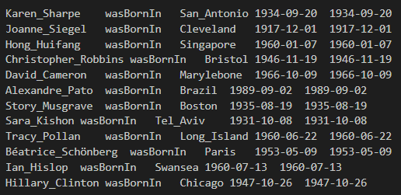
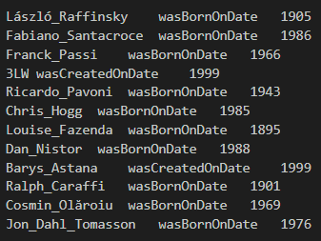
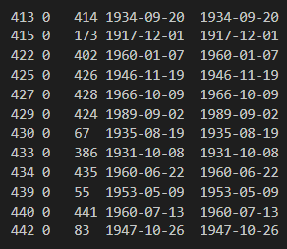
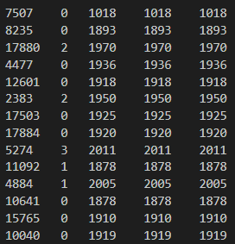
Base Framework and Datasets
Backbone framework → HyTE
HyTE paper uses YAGO11K dataset.
YAGO3-10 plus, Numerical Literal Dataset with only “year” literals.
Entity Mappings
Relation Mappings
Temporal Scoping
Entity Mappings
Relation Mappings

Slide 12
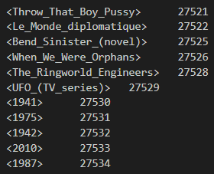
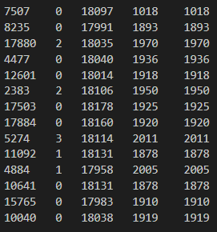
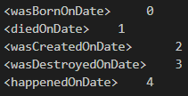
Methodology: HyTE_Lit_Entity
Used Numerical Literal dataset only.
Considered unique literals as entities.
Head entity never appears in tail & tail entity never appears in head.
No connectivity within the Knowledge Graph.
We combined the two datasets (YAGO11k + Literal data).
Entity Mappings
Pre-processing
Numerical Literal Data
DATASETS | #Total Data pts | #Relations
YAGO11K (HyTE) | 20.5k | 10
Literal Dataset | 37.2k | 5
Combined Dataset | 57.7k | 15
Relation Mappings
Mapped Data

Slide 13
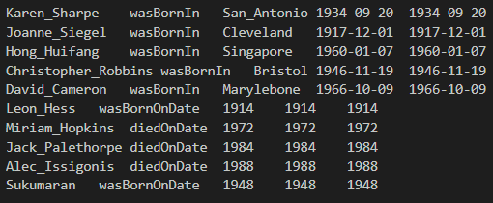
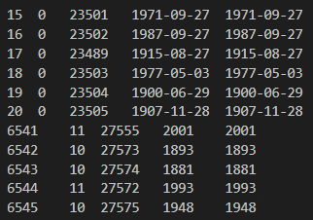
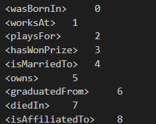
Methodology: HyTE_Comb_Entity
Considering each Unique Literal as Entity.
Numerical Literals can be infinite in number.
Entity Mappings
Pre-processing
Combined Data
Mapped Data
Relation Mappings

Slide 14
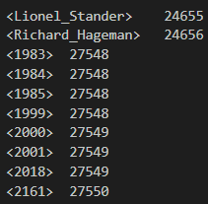
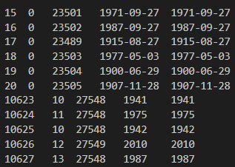
Methodology: HyTE_Comb_Classes
Considering literals within a class interval as a single entity.
Able to deal with infinite literal values.
High complexity for multiple different type
of numerical data type relations
(e.g. year, profit/loss, height).
Entity Mappings
Pre-processing
Combined Data
Mapped Data
Relation Mappings

Slide 15
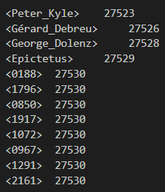
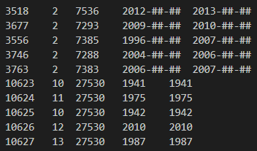
Methodology: HyTE_Comb_ LitTypeEntity
Considering a literal type as a single entity.
Can deal with infinite literal values as well
as multiple data type relations.
Entity Mappings
Pre-processing
Combined Data
Mapped Data
Relation Mappings

Slide 16
Evaluation Tasks & Data Distribution
Entity Prediction:
Head Entity Prediction: (?, r, t, 𝜏)
Tail Entity Prediction: (h, r, ?, 𝜏)
Relation Prediction: (h, ?, t, 𝜏)
Temporal Scope Prediction: (h, r, t, ?)
The evaluation metric used are:
Mean Rank (MR) over all the test queries. Lower is better.
Hits@10 (%) (only for entity prediction task). Higher is better.
DATASETS | #Total Data pts | #ENTITY | #Entities in head | #Entities in tail | #RELATIONS | Train/Valid/Test
YAGO11K (HyTE) | 20.5k | 10,623 | 6498 | 6351 | 10 | 16.4k/2k/2k (20.5k)
HyTE_Lit_Entity | 37.2k | 19,218 | 17948 | 1270 | 5 | 30.2k/3.5k/3.4k (37.2k)
HyTE_Comb_Entity | 57.7k | 28,800 | 23488 | 7621 | 15 | 47.7k/5k/5k (57.7k)
HyTE_Comb_Classes | 57.7k | 27,550 | 23488 | 6372 | 15 | 47.7k/5k/5k (57.7k)
HyTE_Comb_LitTypeEntity | 57.7k | 27531 | 23488 | 6352 | 15 | 47.7k/5k/5k (57.7k)

Slide 17
Evaluation Results
Entity Prediction | Mean Rank HEAD TAIL |  | HITS@10(%) HEAD TAIL |  | HITS@20(%) HEAD TAIL
HyTE | 1069 | 107 | 16.0 | 38.4 | --- | ---
HyTE Re-implementation | 1069 | 111 | 13.1 | 35.1 | 17.99 | 46.24
HyTE_Lit_Entity | 11361 | 302 | 0.0 | 30.38 | 0.0 | 43.72
HyTE_Comb_Entity | 6900 | 277 | 1.26 | 18.68 | 2.24 | 30.8
HyTE_Comb_Classes | 4955 | 218 | 1.68 | 58.38 | 3.0 | 63.68
HyTE_Comb_LitTypeEntity | 6999 | 177 | 2.10 | 62.95 | 3.26 | 66.05
Tail Entity Predictions score is good.
Head Entity Prediction’s score is quite poor

Slide 18
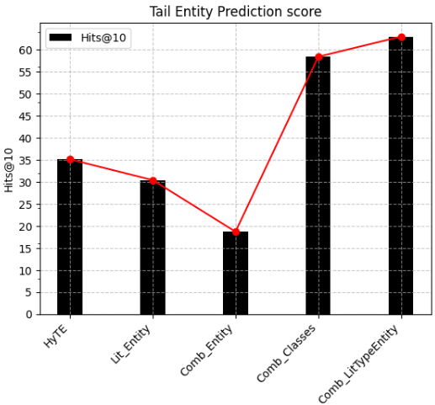
Result Analysis
Entity Prediction | #Total Data pts | #Entities in head | #Entities in tail | HITS@10(%) TAIL
HyTE Re-implementation | 20.5k | 6498 | 6351 | 35.1
HyTE_Lit_Entity | 37.2k | 17948 | 1270 | 30.38
HyTE_Comb_Entity | 20.5k + 37.2k | 23488 | 7621 | 18.68
HyTE_Comb_Classes | 20.5k + 37.2k | 23488 | 6372 | 58.38
HyTE_Comb_LitTypeEntity | 20.5k + 37.2k | 23488 | 6352 | 62.95
HyTE learns tails better.
Many-to-1 relations.
Entity: 1270 tail entities for a large chunk of data.
Classes: 21 classes/entities for 1270 literals for a large chunk of data.
LitTypeEntity: 1 class/entity for 1270 literals for a large chunk of data.

Slide 19
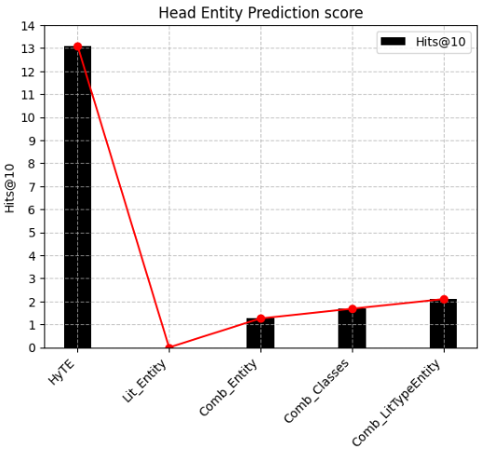
Result Analysis
Entity Prediction | #Total Data pts | #Entities in head | #Entities in tail | HITS@10(%) HEAD
HyTE Re-implementation | 20.5k | 6498 | 6351 | 13.1
HyTE_Lit_Entity | 37.2k | 17948 | 1270 | 0.0
HyTE_Comb_Entity | 20.5k + 37.2k | 23488 | 7621 | 1.26
HyTE_Comb_Classes | 20.5k + 37.2k | 23488 | 6372 | 1.68
HyTE_Comb_LitTypeEntity | 20.5k + 37.2k | 23488 | 6352 | 2.10
Lit_Entity: No connectivity
As unique tail entities that don’t appear in head decrease, more negative samples with head entities, which provides better context.

Slide 20
Note
Consistent poor results for head prediction.
In a real scenario, the number of literals as tail entities would be far greater.
Thus we’ll get opposite results(poor results for literals as tail entity), which can be dealt with using our approaches.

Slide 21
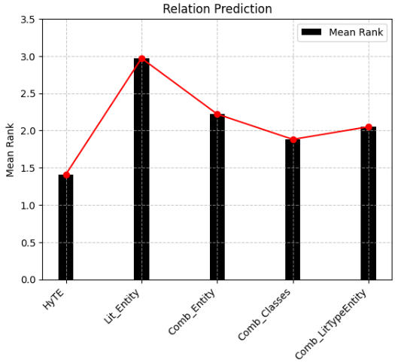
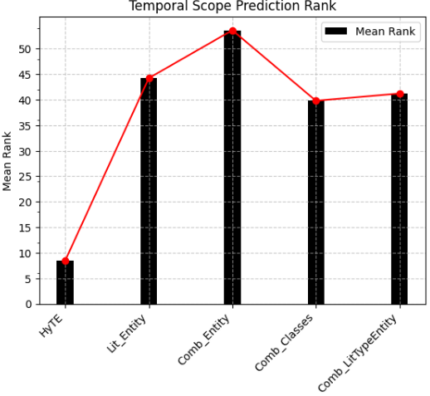
Evaluation Results & Analysis
Relation Prediction | #Relations | Mean Rank
HyTE | 10 | 1.23
HyTE Re-implementation | 10 | 1.41
HyTE_Lit_Entity | 5 | 2.97
HyTE_Comb_Entity | 15 | 2.22
HyTE_Comb_Classes | 15 | 1.88
HyTE_Comb_LitTypeEntity | 15 | 2.05
Temporal Scoping | Mean Rank (TDNS)
HyTE | 9.88
HyTE Re-implementation | 8.47
HyTE_Lit_Entity | 44.24
HyTE_Comb_Entity | 53.63
HyTE_Comb_Classes | 39.8
HyTE_Comb_LitTypeEntity | 41.23

Slide 22
Plan for Phase 2
Curating a dataset that reflects a real-world scenario (More literal than entities).
Our approach can even be extended to literal data that doesn’t carry temporal scopes.
Explore possible improvement in temporal scoping for HyTE_comb_classes scenario.
Coming up with a methodology that learns different flavors of embeddings for literals and entities, as numerical literals have their own unique semantics.

Slide 23
References
Shaoxiong Ji, Shirui Pan, Erik Cambria,Pekka Marttinen, Philip S. Yu, “A Survey on Knowledge Graphs: Representation, Acquisition and Applications,” in IEEE Transactions On Neural Networks And Learning Systems, 2021.
Q. Wang, Z. Mao, B. Wang and L. Guo, "Knowledge Graph Embedding: A Survey of Approaches and Applications," in IEEE Transactions on Knowledge and Data Engineering, vol. 29, no. 12, pp. 2724-2743, 1 Dec. 2017, doi: 10.1109/TKDE.2017.2754499.
Bordes, N. Usunier, A. Garc_ıa-Dur_an, J. Weston, and O. Yakhnenko, “Translating embeddings for modeling multi-relational data,” in Proc. Adv. Neural Inf. Process. Syst., 2013, pp. 2787–2795.
Z. Wang, J. Zhang, J. Feng, and Z. Chen, “Knowledge graph embedding by translating on hyperplanes,” in Proc. 28th AAAI Conf. Artif. Intell., 2014, pp. 1112–1119.
S. S. Dasgupta, S. N. Ray, and P. Talukdar, “Hyte: Hyperplane-based temporally aware knowledge graph embedding,” in EMNLP, 2018, pp. 2001–2011.
A. Kristiadi, M.A. Khan, D. Lukovnikov, J. Lehmann and A. Fischer,” Incorporating Literals into Knowledge Graph Embeddings”, in: ISWC2019, 2019.
Genet Asefa Gesese1, Russa Biswas1, and Harald Sack, “A Comprehensive Survey of Knowledge Graph Embeddings with Literals: Techniques and Applications”,2019.

Slide 24
Thank You

