Slide 1
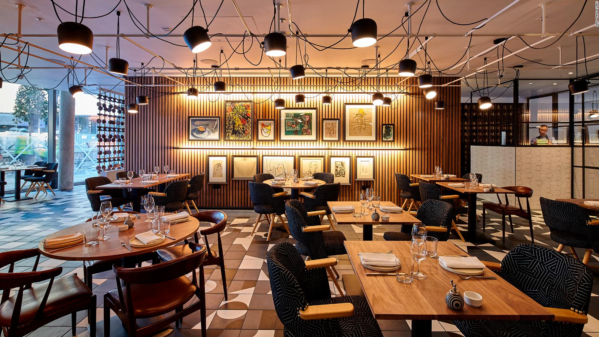
Group 42
Zomato Bangalore restaurants
Aditya Danturthi (0756019)
Anirudh Rajaram (0754920)
Meenakshi Jayakeerthi (0754457)
Sharanjit kaur (0755577)
Tejal Dalvi (0756090)

Slide 2

What is zomato and why we chose it ?
Zomato is an application which aggregates the restaurants and a food delivery app which offers many services for their customers. Zomato is more focused into the food ordering industry which is located in India.
It uses a mobile application which enables people to view restaurants nearby and allowing them to order from a restaurant of their choice.
Zomato was first introduced as an app which was used to find restaurants and people would critique the restaurants based on several parameters such as location, food, ambience, cost, and best service offered.

Slide 3
What is zomato and why we chose it ?
Later Zomato expanded their services when they entered the food delivering industry and now it is one of the top companies in India which competes with other food delivery applications such as uber eats, swiggy, and food panda.
Zomato also offers monthly and yearly subscription for their customers which provides great benefits to their customers such as one plus one offer in dining at selected restaurants per day. Discounts for customers if they use their membership and order food through their app.

Slide 4
What is zomato and why we chose it ?
From marketing perspective, it is interesting to see the factors which has influence in the popularity of a restaurant.
Our dataset contains Bangalore restaurant reviews. Bangalore is a famous city, and it is without a doubt one of the best cities which offers an amazing quality of food and food services at the restaurants.
We chose Zomato, because Zomato has compiled every restaurants info in their database and people can view the reviews for each restaurant in case if they are planning to dine in or order food through the mobile application.

Slide 5
Objective:
Our main goal is to accurately predict the rating of a restaurant based on several different factors such as restaurant name, location, type of restaurant, name, online order, online table booking, votes, average cost and cuisine.
This will help us understand what all factors to consider while starting a new restaurant and make it successful.

Slide 6
Dataset Description
Description: The dataset consists of 51717 rows and 17 columns. Following are the columns:
Dataset link: (kaggle): https://www.kaggle.com/himanshupoddar/zomato-bangalore-restaurants
url: URL of the restaurant on zomato website
address : Address of restaurant in bangalore
online_order : Whether the restaurant has online ordering
book_table : Whether restaurant offers online table booking
rate : Rating of restaurant on Zomato (target variable)
votes : Number of user votes the restaurant has
phone : phone number of the restaurant
localtion : neighbourhood in which the restaurant is located in
rest_type : Different restaurant types
dish_liked : Dishes people liked at the restaurant
cuisines : cuisines offered by the restaurant
avg_cost (cost for two people) : average cost for two people
review_list : Restaurant review on Zomato
menu_item : Items in the menu of the restaurant
listed_in(type) : type of restaurant
listed_in(city) : localities in bangalore

Slide 7
Number of restaurants with online ordering

Slide 8
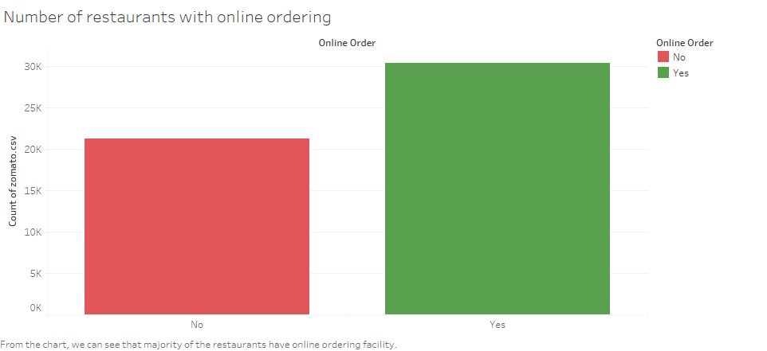

Slide 9
Number of restaurants with online table booking facility

Slide 10
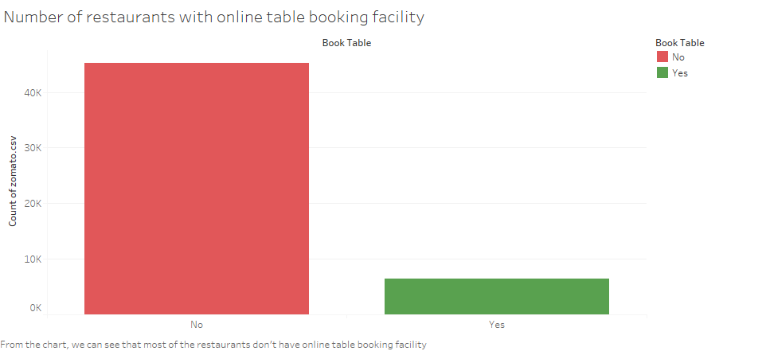

Slide 11
Top 10 locations with high concentration of restaurants

Slide 12
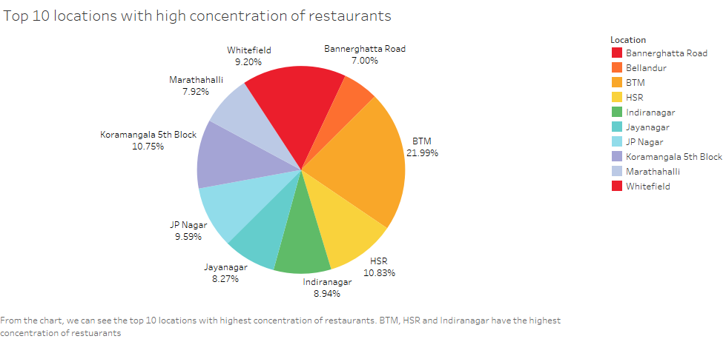

Slide 13
Types of restaurants

Slide 14
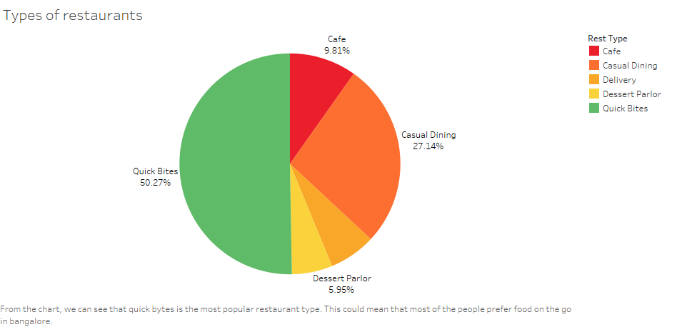

Slide 15
Distribution of average cost for two people

Slide 16
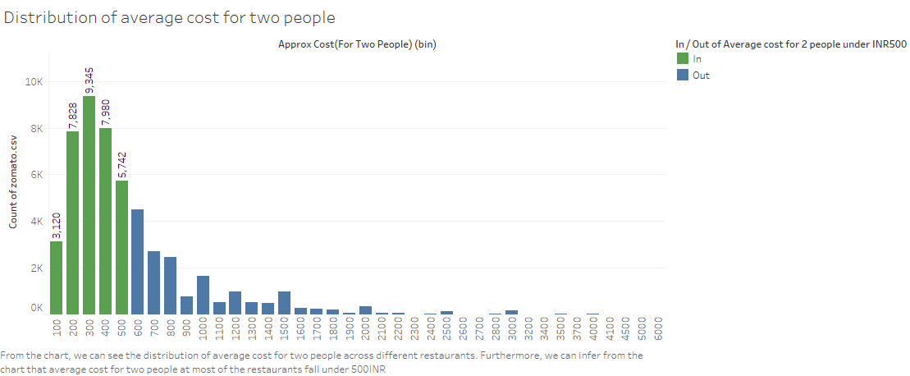

Slide 17
Top 10 restaurant with highest number of franchises

Slide 18
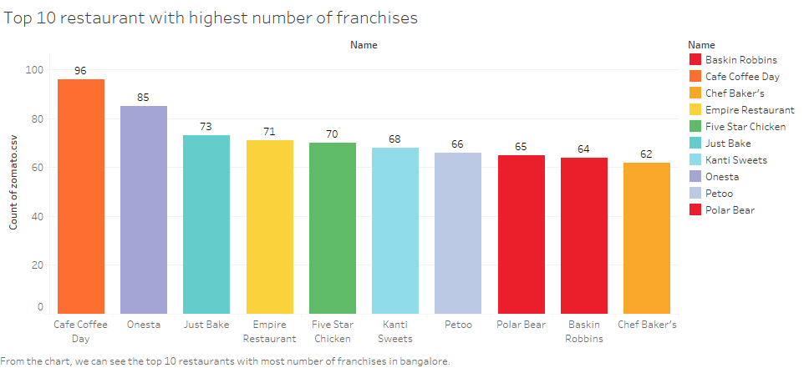

Slide 19
Distribution of ratings

Slide 20
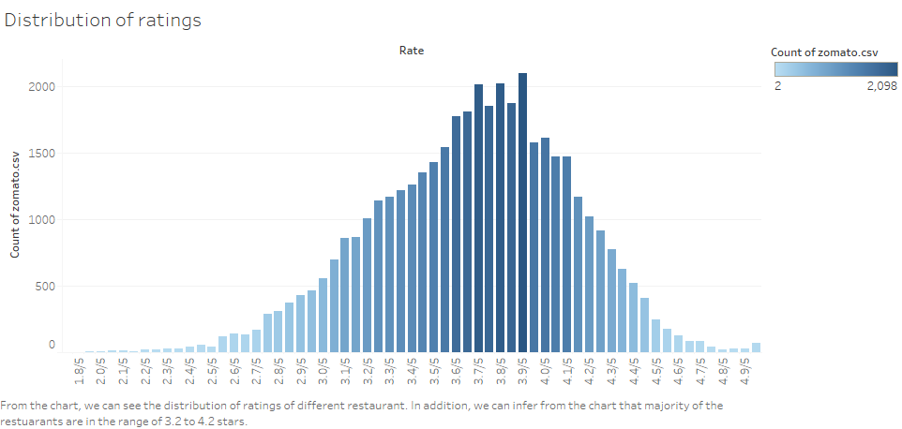

Slide 21
Top 10 restaurant with highest votes

Slide 22
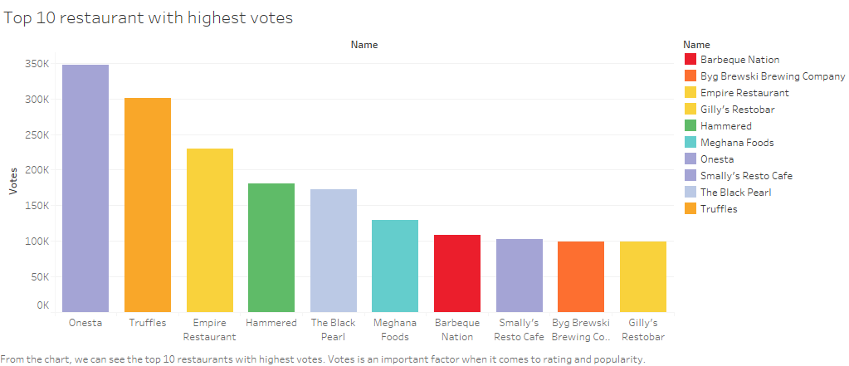

Slide 23
Top 10 most liked dishes

Slide 24
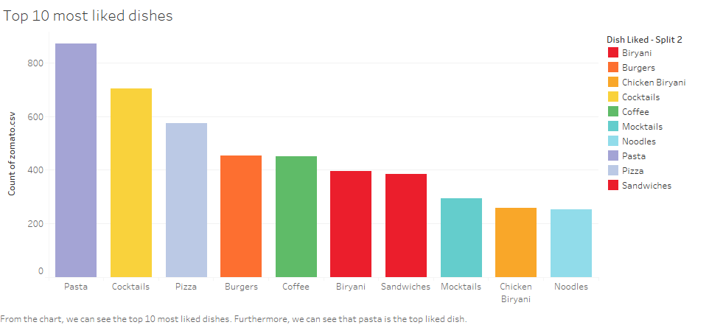

Slide 25
Most favorite cuisine in Bangalore

Slide 26
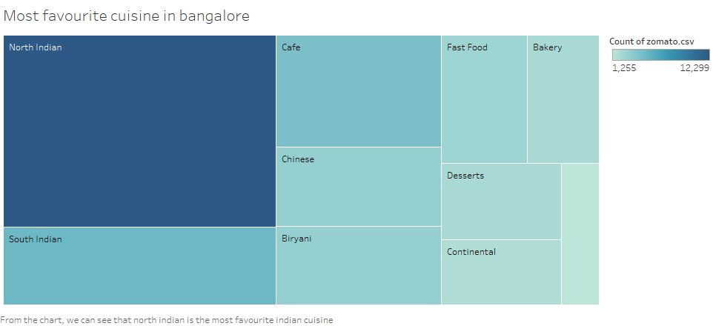

Slide 27
Dashboard: EDA Features (Part 1)

Slide 28
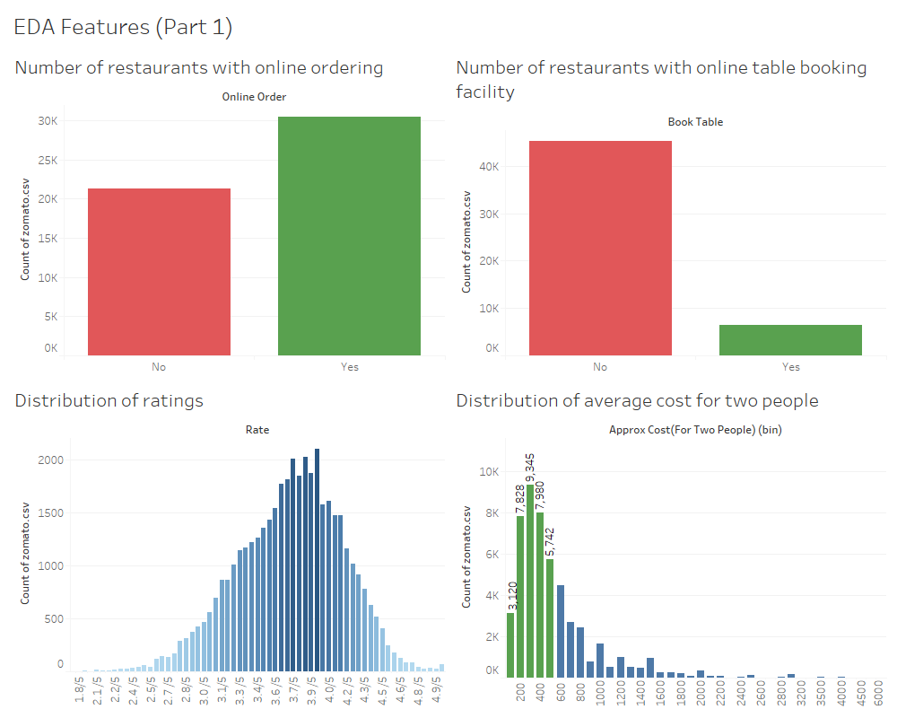

Slide 29
Dashboard: EDA Favorites (Part 2)

Slide 30
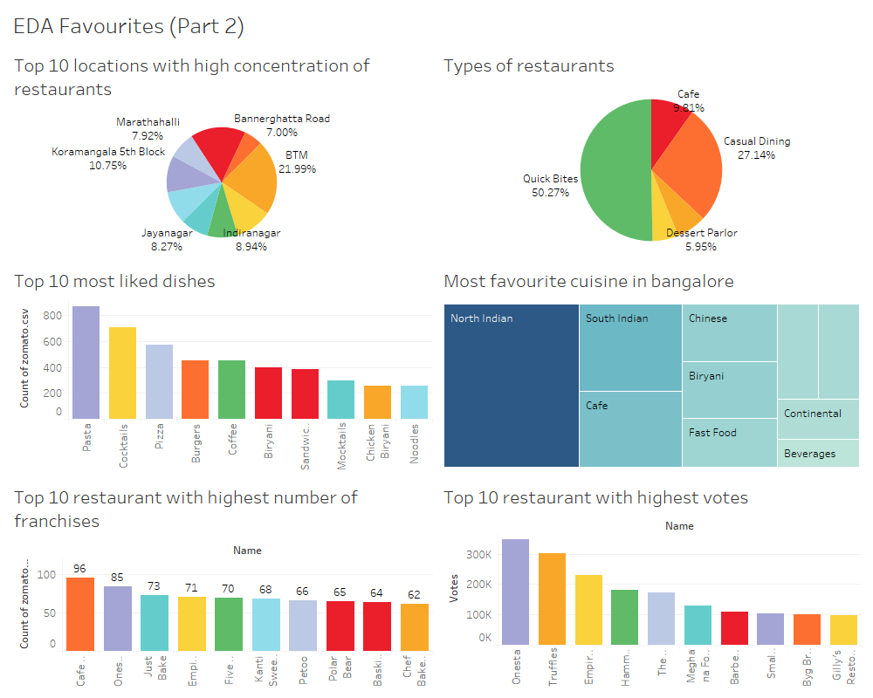

Slide 31
Why use machine learning?
Machine Learning will provide us the computational ability to process large data sets, use the data in different models, train the models using existing data to predict the test data and then perform evaluation metrics to see the accuracy of the model and if it is a good fit for real time data.

Slide 32
Comparing accuracies of all the algorithms

Slide 33
Algorithm | Accuracy
KNN | Train Accuracy : 63.56% Test Accuracy: 39.80%
Logistic Regression | Train Accuracy : 19.72% Test Accuracy: 18.34%
Random Forest | Train Accuracy : 100.00% Test Accuracy: 82.57%
XGBoost | Train Accuracy : 99.35% Test Accuracy: 82.74%

Slide 34
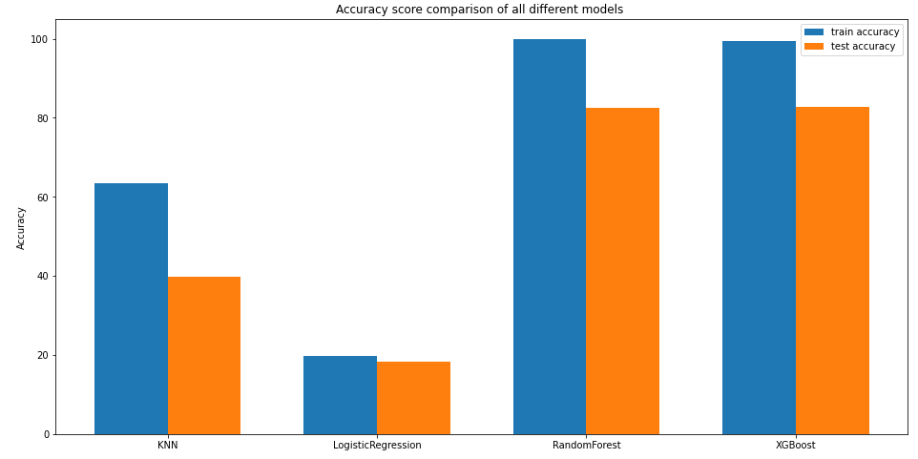

Slide 35
Comparing the accuracy, F1, precision and recall scores of the two best performing algorithms (Random Forest and XGBoost)

Slide 36
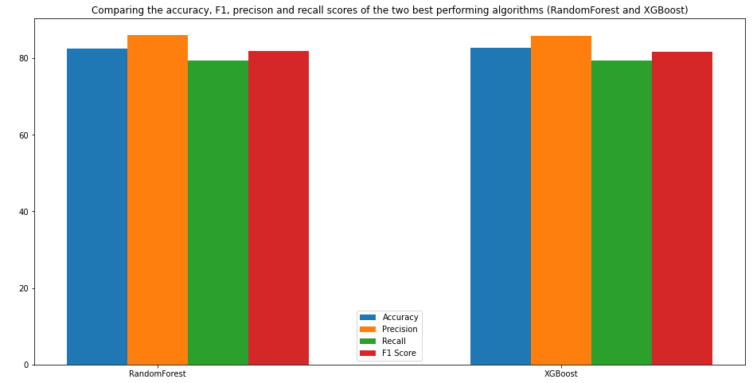

Slide 37
Conclusion:
Quick Bytes is the top restaurant type.
Cafe Coffee day has the highest number of franchises.
Majority of restaurants are accepting online orders
Most of the restaurants do not have online table booking facility.
BTM, Indiranagar and Koramangala has the highest concentration of restaurants.
Average cost for two people is 400INR
Most like casual dining dish is Biryani chicken
Most of the popular dishes are all non vegetarian
Indian, Mughalai and thai are the most popular cuisines.

Slide 38
From a marketing perspective to start a successful restaurant:
BTM, Koramangala and Indiranagar are good places to start a new restaurant because of a high concentration of restaurants it must be popular among foodies and it will be cheaper to operate in these areas.
Offering online order could affect overall rating
It is important to have all or at least one of the following cuisines Indian, Mughlai and Thai.
It is better to have an average cost for two under 500INR in the beginning.
Fast food could boost the rating of the restaurant.

Slide 39
Thank
you

Slide 40
References
https://www.freepik.com/free-photo/top-view-pepperoni-pizza-sliced-into-six-slices_7572611.htm#query=pizza&position=17
https://www.freepik.com/premium-photo/group-friends-eating-together_2695320.htm#query=restaurant&position=17
https://www.freepik.com/free-photo/restaurant-interior_1243339.htm#query=restaurant&position=18
https://www.freepik.com/

