Slide 1
Research Update

Slide 2
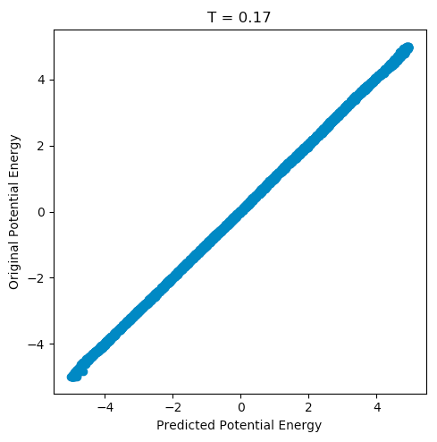
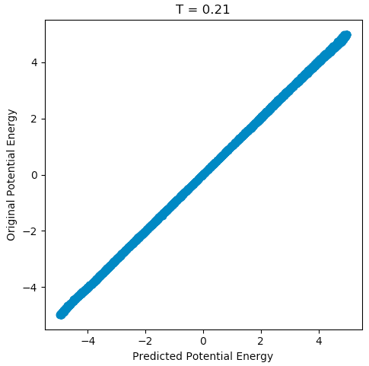
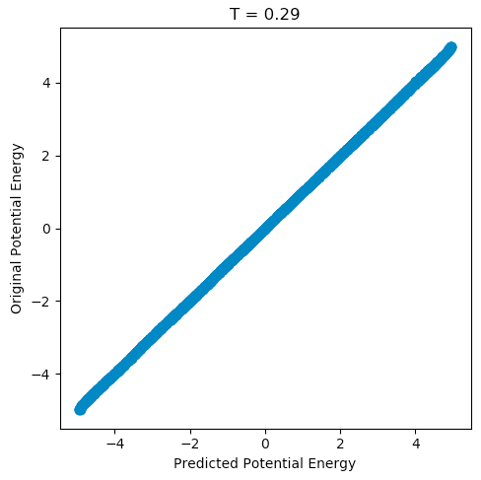
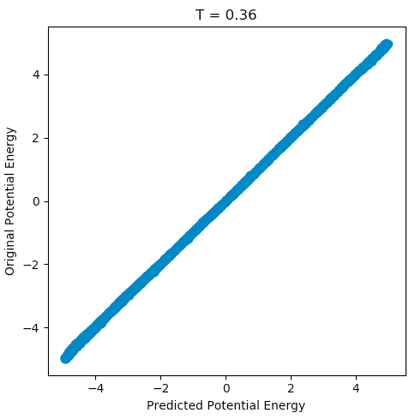
I have been running experiments on the 13 Particle datasets provided by Gulce.
I’ve used a different optimization technique for this and it learned to predict the potential with very high accuracy (smooth spectrum when colored reduced space with original potential values).
This is amazing since I trained the neural network using only raw coordinates and the neural net learnt to predict the potential energy accurately as shown below for 4 temperatures (0.17, 0.21, 0.29, 0.36).

Slide 3
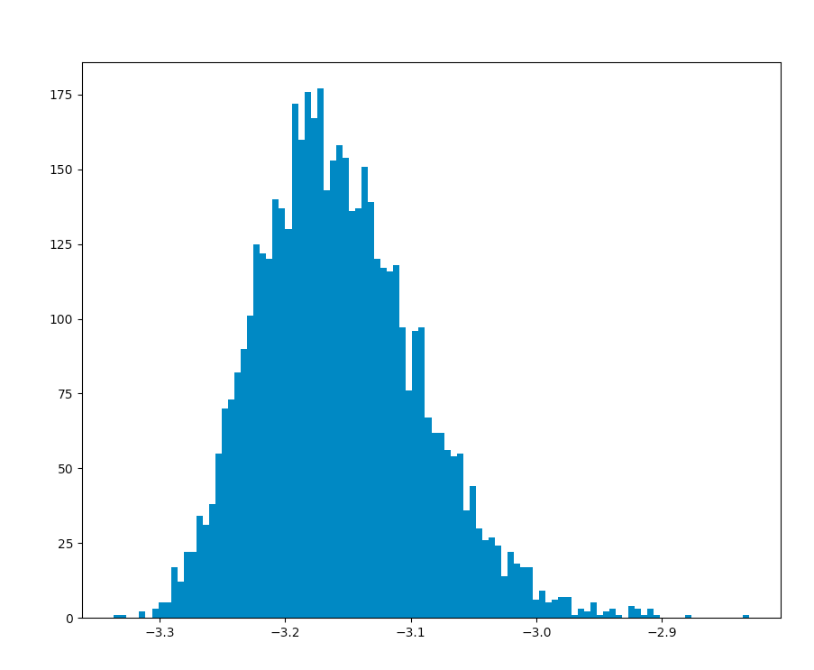
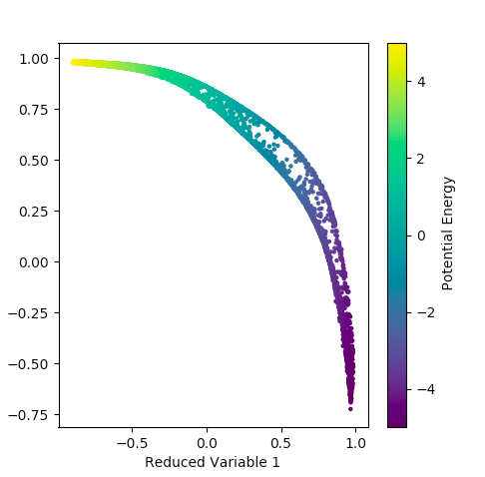
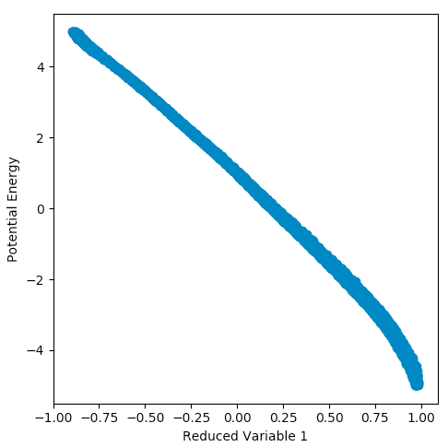
T = 0.17 Results
Reduced Variable 1 correlating well with potential energy
Potential Energy Histogram
Reduced Space: Colored by original potential energy. That shape seems hollow but seems like can be approximated as a smooth curve

Slide 4
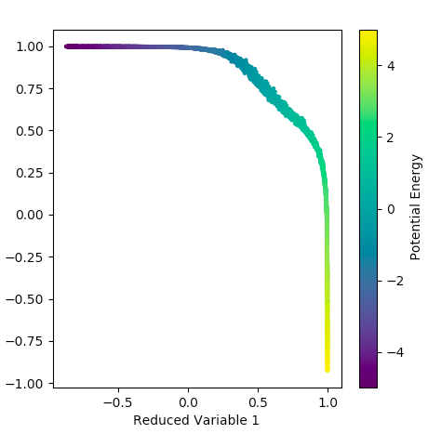
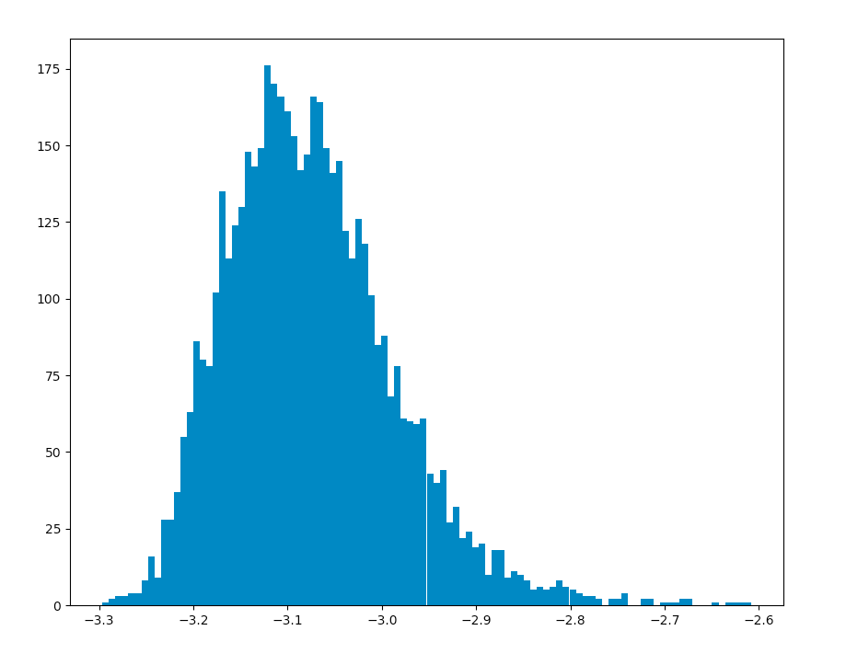
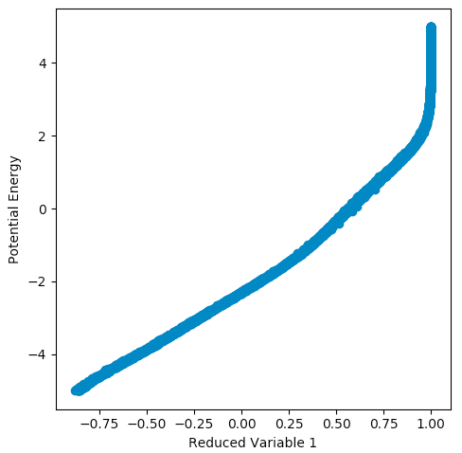
T = 0.21 Results
For 0.21, I got the same accuracy as 0.17. However for this (and for the rest of the temperatures I tried after this), The correlation is somewhat non-linear as it gets steeper in high energies. This may also be a result of the neural network not being accurate enough.

Slide 5
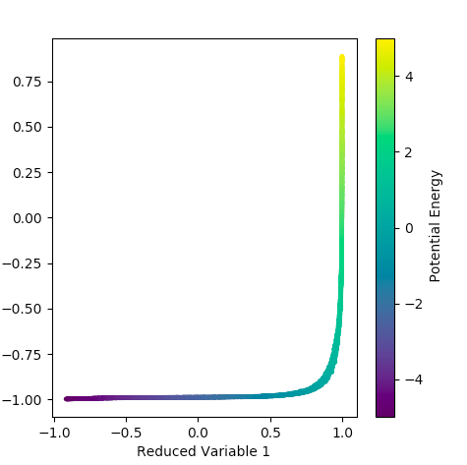
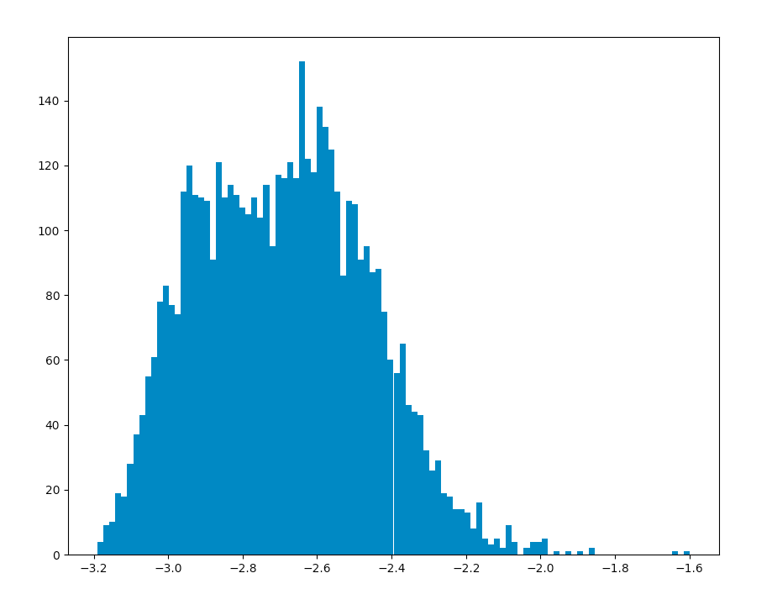
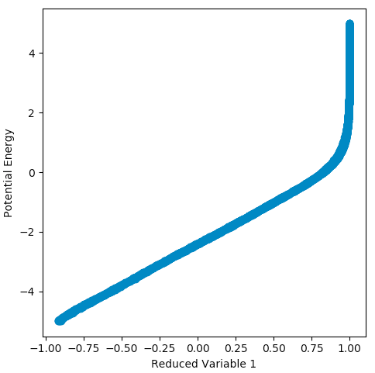
T = 0.29 Results
0.29 showed the smoothest reduced variable. However the correlation is similar to 0.21.

Slide 6
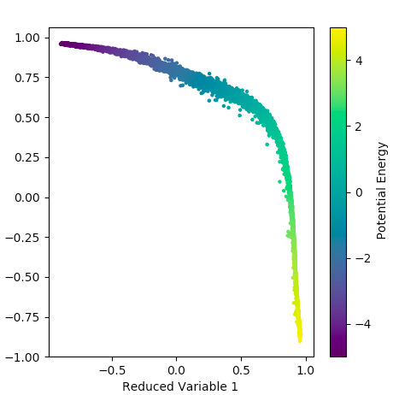
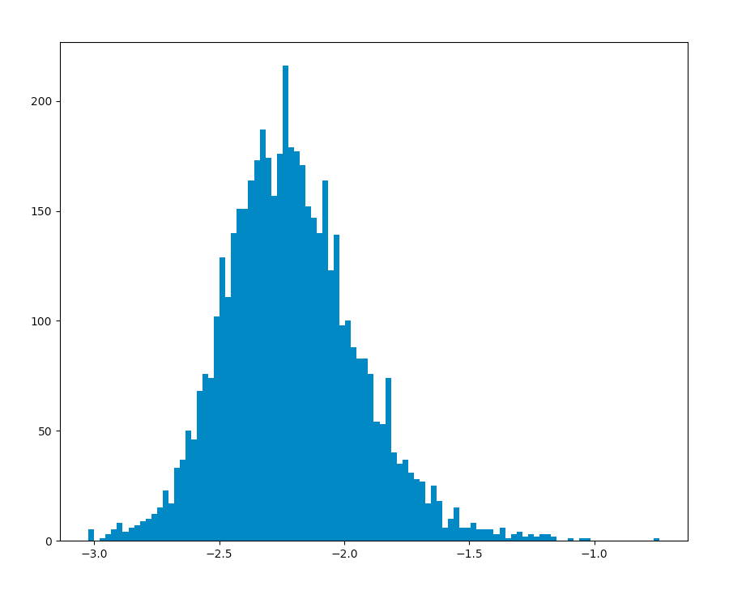
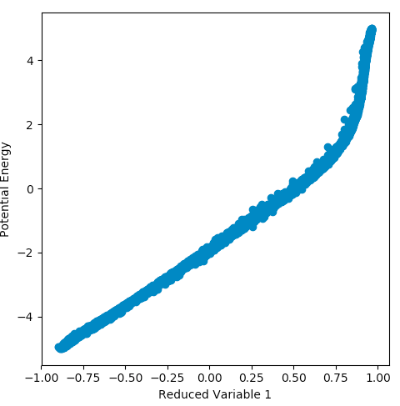
T = 0.36 Results
0.36 also generated similar spaces and correlations.

Slide 7
I’m surprised by how accurately the Neural Net learned the potential energy for 13 particles. I imagined it would be a lot more complicated.
Although there are difference in trends, it looks like the 13 particles may also be telling the same story as the 3 particles that dimension can be reduced to one variable.
I’m interested in why there is such a sharp increase in slope (for the reduced var vs potential figures) at high energies.
For the poster, should we add these plots? They look much better and 13 particles are more relevant for the field?

