Slide 1
Dimensionality Reduction of Thermodynamically Small Molecular Systems using Deep Learning
Aditya Dendukuri

Slide 2
Project Overview
Molecular Dynamics simulations are used in many fields (Nanotechnology, Self-Assembly systems, High Energy Physics etc)
Due to high complexity and dimensionality of the system, the simulations need a simpler and a lower dimensional system to describe the state of the simulation.
In this project, I implemented two approaches and both of these methods ended up with the same story:
Supervised Fully Connected Neural Network
Diffusion Maps (Non-Linear PCA)

Slide 3
The System and Dataset
A 10x10x10 box with three interacting SiO2 molecules.
They are controlled by the pairwise potentials between the particles.
The pairwise potentials can be manipulated by controlling the temperature of the box.
Under very specific conditions, the particles will assemble into very specific shapes and these of of extreme interest in the field of statistical physics.
Dataset: Features: {x1, y1, z1, x2, …, y3, z3} (Coordinates of 3 particles)
Labels : {V} (Potential Energy of the System)

Slide 4
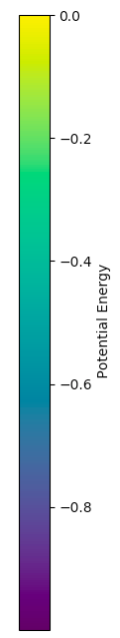
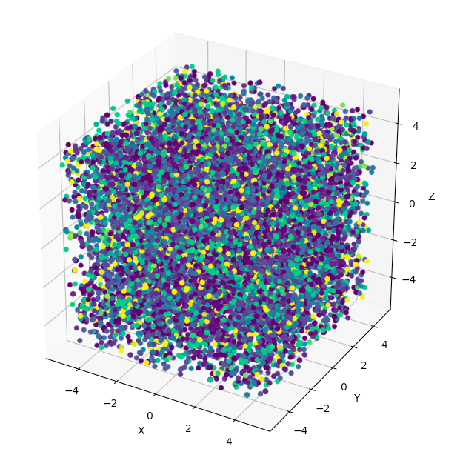
Problem Statement
We need a space that can well define the state of the system.
The most obvious representation is by using the system’s phase space which is just the coordinates of all the 3 particles * 3 coordinates = 9 dimensions.
Combine that with 5000 simulation steps = 9 * 5000 = 45000 dimensions for a single simulation.
Now imagine increasing number of particles to 13 …

Slide 5
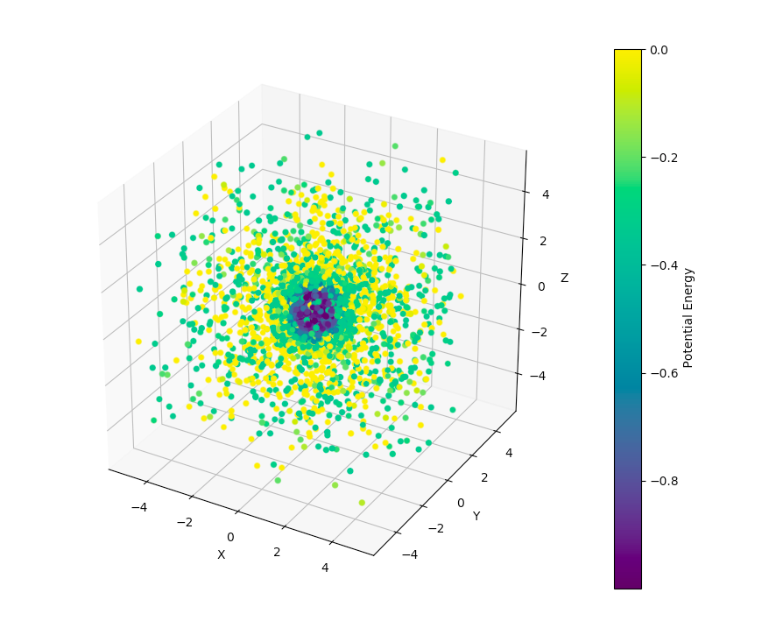
Dataset after removing translational degrees of freedom

Slide 6
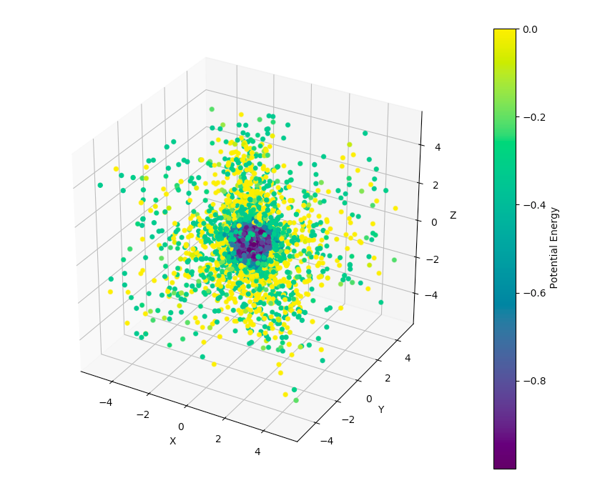

Dataset after removing rotational degrees of freedom

Slide 7
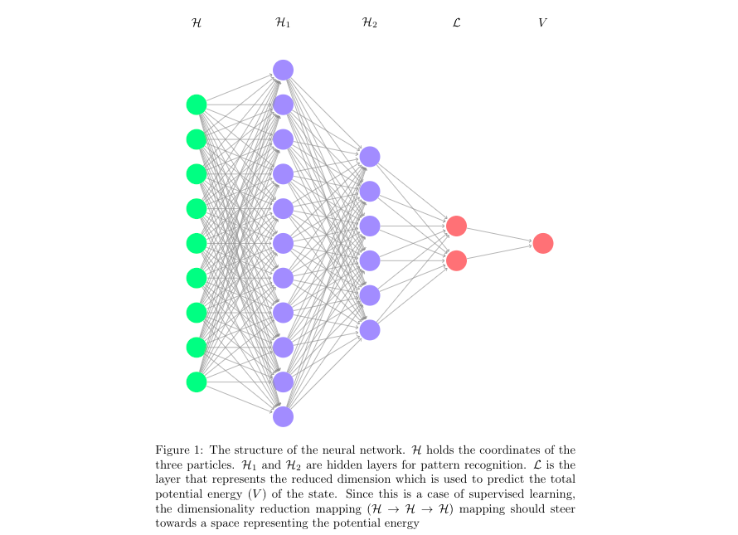
Supervised Neural Network Approach
Learning Rate = 0.1
No Regularization term
10000 epochs
H -> H1 : tanh
H1 -> H2 : tanh
H2 -> L : sigmoid
L -> V : linear
Gradient Descent Optimizer.
Train set size = 5001
Test set size = 200
Batch Gradient Descent

Slide 8
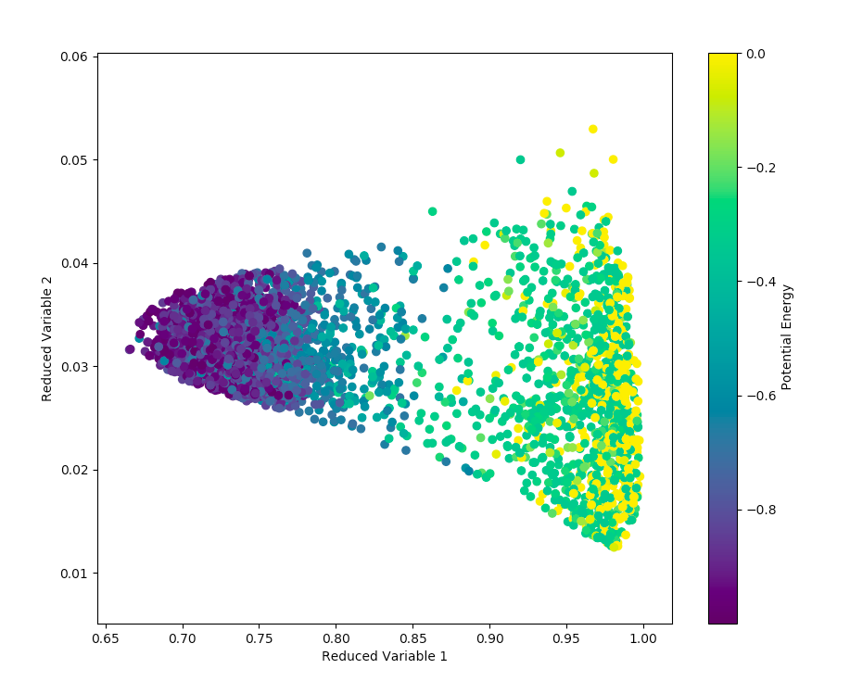
Results with Translational Dof’s removed

Slide 9
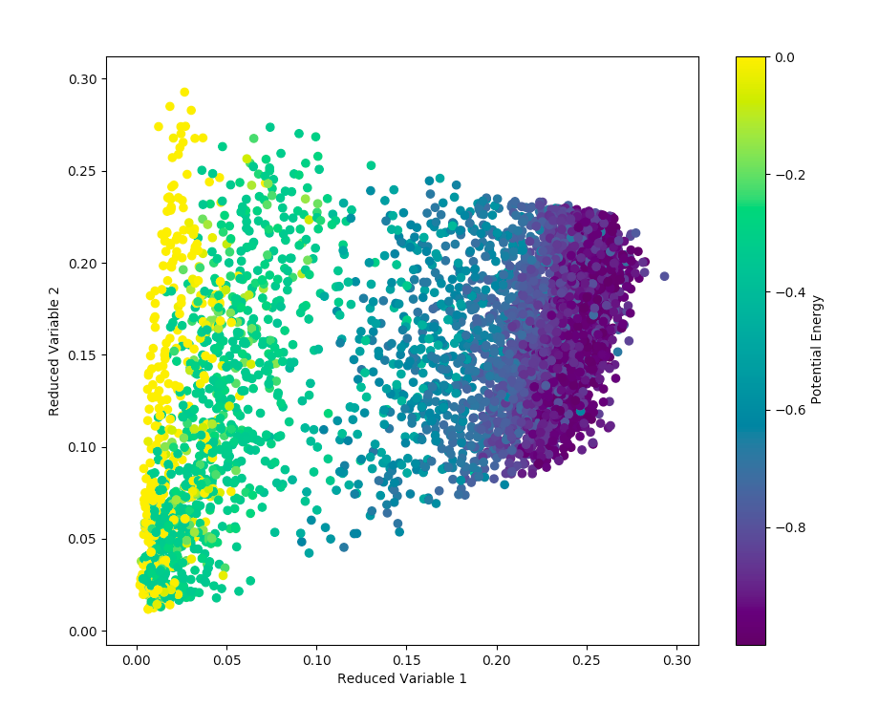
Results with both translational and rotational dof’s removed

Slide 10
Diffusion Maps (Unsupervised ML)
Diffusion maps is basically the non-linear version of PCA .
The kernel used for this is based on a non-linear distance metric (usually the Euclidean kernel).
However, for this case a graph theory based approach called Iso-Rank (Another technique in Molecular Dynamics).
Iso-Rank measures the connectivity among the data points in sets. Hence the invariant features in our dataset that we are looking for is:
Class 1: All the three particles are fully connected (3 bonds)
Class 2: Only two particles are fully connected (2 bonds)
Class 3: Only one particle is connected (1 bond)
Class 4: No bonds

Slide 11
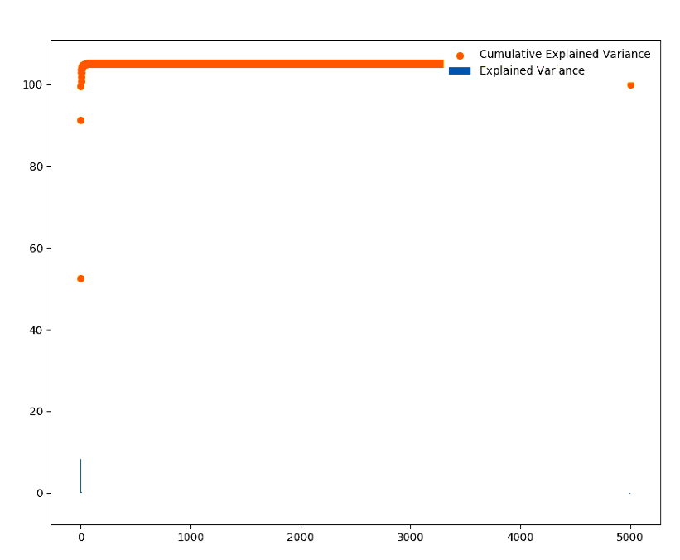
Results for Diffusion Maps
We need to ignore the first eigenvalue as it represents forming a bond by itself.
As we can see, the first three eigenvalues add up to 100% of the variance in the Eigen Space.
Especially the 2nd eigenvector (combined with first) explains almost ~ 90% of the variance in the set.

Slide 12
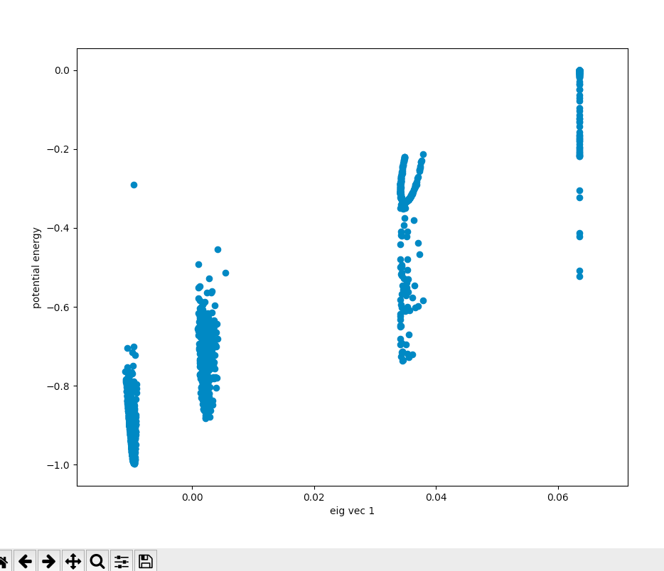
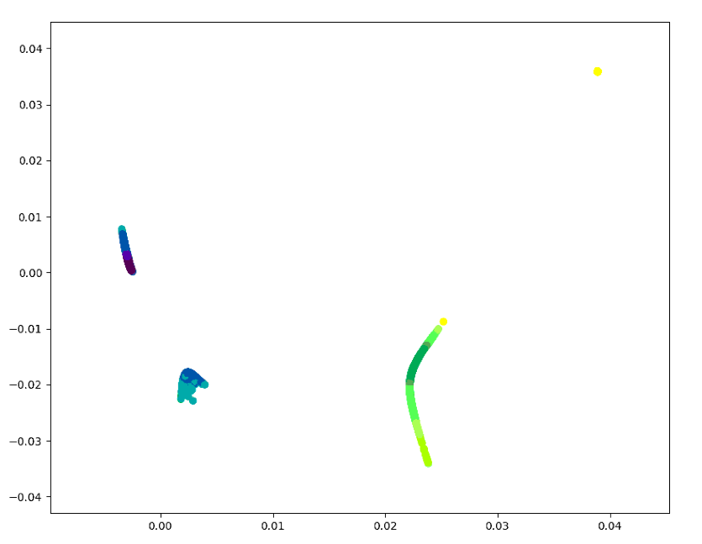
Results for Diffusion Map
Eigen vector 1 vs Eigen vector 2
Colored by potential energy
Eigen vector 1 vs Potential energy

Slide 13
Results for Diffusion Map
The separation is due to thresholding since having no bond is treated to be zero. The four clusters correspond to the below shapes
Fully bonded
Two bonds
One bond
No bonds

Slide 14
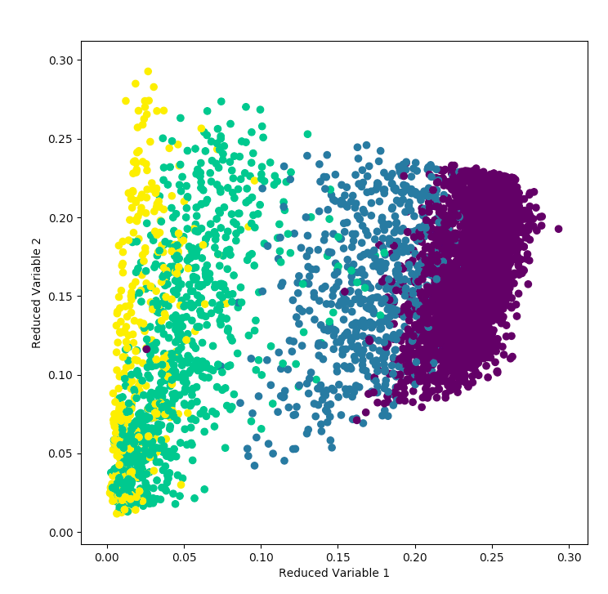
Coloring the Neural Network output with the 4 structural states from IsoRank
Fully bonded
Two bonds
One Bond
No Bonds

Slide 15
Conclusion and Future Work
Used two completely unrelated machine learning techniques to reduce dimensions of a high dimensional MD system and ended up with the same results.
Future work is to study the 13 particle problem which is way more complicated and can form many other structures.

Slide 16
QUESTIONS? COMMENTS?

