Slide 1
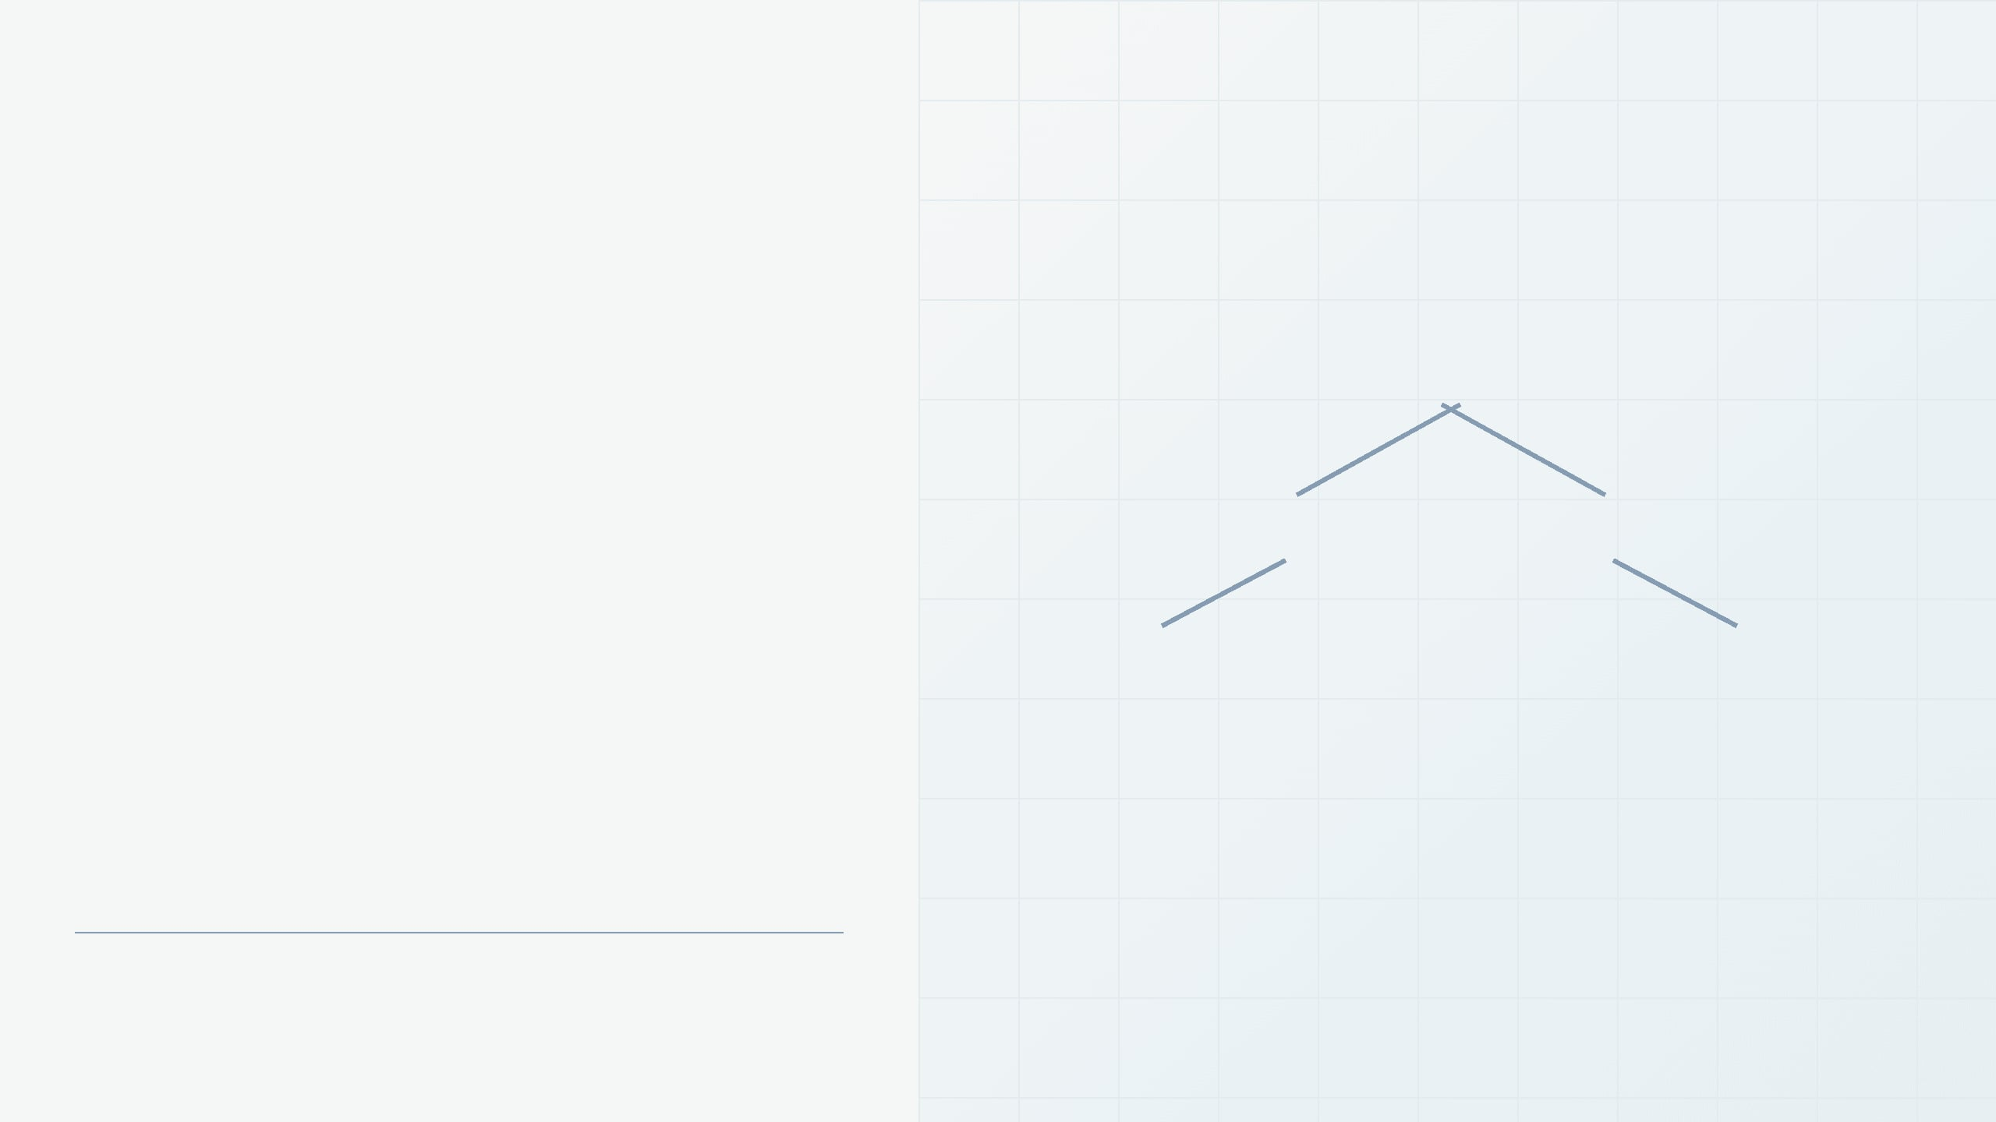
APPLIED DATA STRUCTURES
Case Study of Optimal Binary Search Tree Using Dynamic Programming
30
20
40
How search frequencies guide the structure of an efficient BST.
10
50
A SIMPLE BINARY SEARCH TREE
Presented by: Deokar Aditya Sandip
Class / Division: TY-A
College: Sanjivani College of Engineering, Kopargaon

Slide 2

01 / MOTIVATION
Why Search Structure Matters
Searching is one of the most common operations in computer science.
Balanced BST
Unbalanced BST
A Binary Search Tree stores ordered data, but its performance depends on its shape.
30
10
20
20
40
When frequently searched keys sit close to the root, the average search path becomes shorter.
30
10
50
40
This motivates the Optimal Binary Search Tree.
Shorter average paths
Longer search paths

Slide 3

02 / FOUNDATIONS
Binary Trees and Binary Search Trees
A binary tree is hierarchical: each node has at most two children.
Root
30
In a BST, left-subtree keys are smaller and right-subtree keys are greater than the root.
Internal node / Left child
Right child
20
40
Both subtrees must themselves satisfy the BST rule.
Example: keys 10, 20, 30, 40, 50.
Searching for 50 follows 30 → 40 → 50.
10
50
Leaf node

Slide 4

03 / THE PROBLEM
The Ordinary BST Problem
The insertion order can produce very different tree shapes—even when the keys are identical.
Balanced BST
Skewed BST
Keys are distributed across levels.
Sorted insertion creates a chain.
30
10
20
20
40
30
10
50
40
50
Short paths
Lower average cost
Long paths
Higher average cost
Balanced tree
shorter search paths.
Skewed tree
more comparisons per search.
Key insight
an ordinary BST is not automatically optimal.

Slide 5

03 / THE OBJECTIVE
What Makes a BST Optimal?
An Optimal Binary Search Tree is arranged so that the expected search cost is minimum, considering key frequencies or probabilities.
Frequency-weighted placement
30
LEVEL 1
01
Frequently searched keys should be closer to the root.
02
Rarely searched keys can be placed deeper in the tree.
10
20
LEVEL 2
03
The objective is to minimize the weighted path length.
Minimum expected search cost = Optimal
Illustration: if key 30 is searched most often, placing it near the root can lower total cost.
BST
Search frequency determines how valuable a shallow position is.
Applications
Dictionaries
•
Symbol tables
•
Compiler structures
•
Static lookup systems
•
Database-indexing concepts

Slide 6

05 / ALGORITHMIC THINKING
Dynamic Programming: The Core Idea
Dynamic Programming (DP) solves a complex problem by breaking it into smaller, overlapping subproblems and storing their solutions for reuse.
01
02
03
04
05
Large
problem
Smaller
subproblems
Store
solutions
Reuse
solutions
Final optimal
solution
Overlapping subproblems
Optimal substructure
The same smaller ranges or states appear repeatedly. DP solves each one once and records the result.
An optimal solution can be built from optimal solutions to its smaller subproblems.
Avoid repeated computation
Build the best answer from the best parts

Slide 7

06 / CASE STUDY LOGIC
Why OBST Uses Dynamic Programming
Finding the best root means comparing every valid root for each key range.
1
Choose a candidate root
Try each key as the root of the current range.
For a range such as [10, 20, 30], each candidate root creates a different left and right subtree.
2
Evaluate both subtrees
Calculate the best cost for the left and right ranges.
3
Add the weighted contribution
Root = 10
Root = 20
Root = 30
Include the frequency contribution of the current range.
10
20
30
4
Keep the minimum
Store the best result so it can be reused by larger ranges.
20
30
10
30
10
20
OBST → overlapping subproblems + optimal substructure → Dynamic Programming

Slide 8

07 / CASE STUDY
Case Study: Keys and Frequencies
We begin with three ordered keys and their successful-search frequencies.
Ordered keys with search frequencies
Key
Frequency
20
10
4
frequency 2
20
2
10
30
30
6
frequency 4
frequency 6
Observation: key 30 is searched most often, so placing it near the root may reduce the overall cost.
The next step is to test each key as a possible root and compare the weighted search costs.
Cost = Σ (frequency × level) | root level = 1

Slide 9
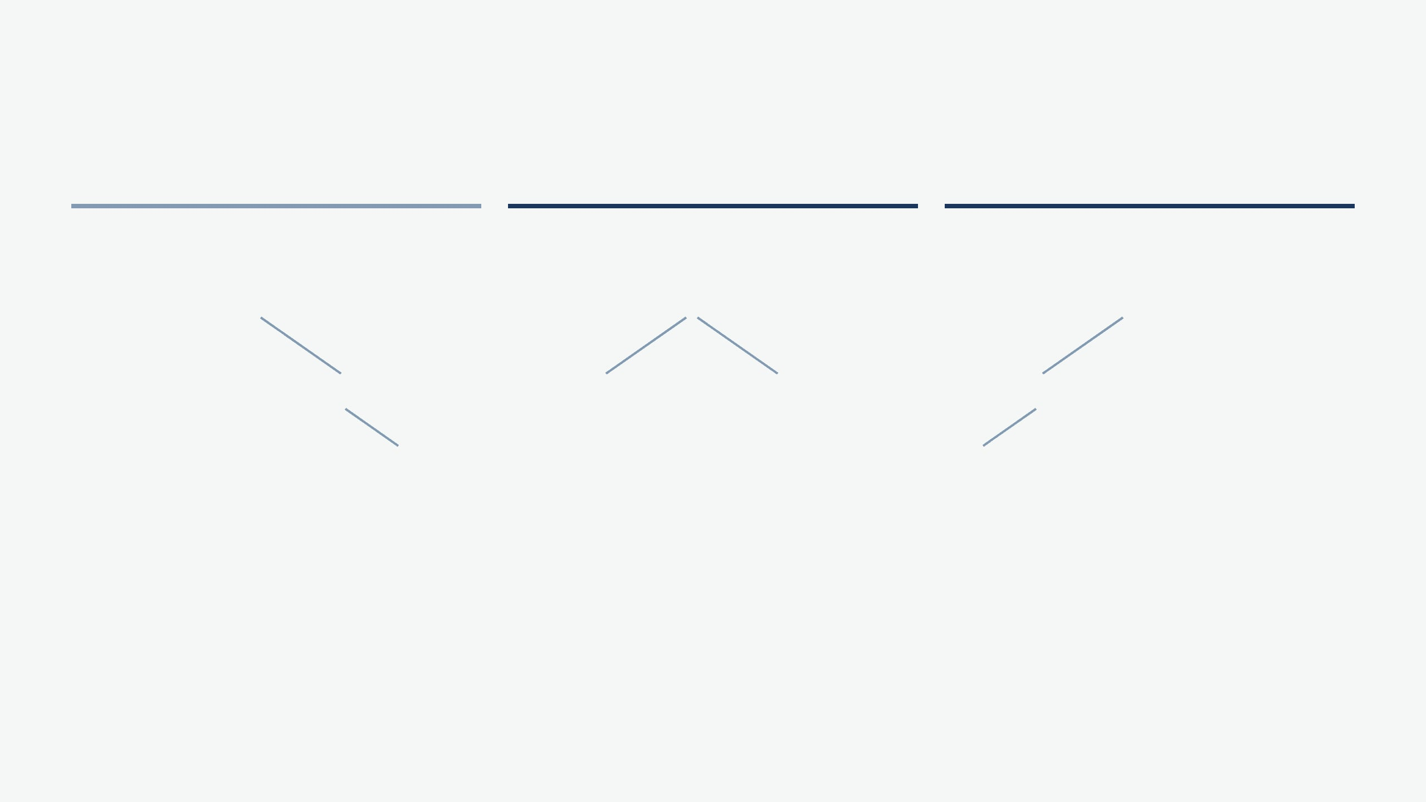
08 / CASE STUDY CALCULATION
Comparing the Three Root Choices
Using Cost = Σ (frequency × level), with the root at level 1.
Case 1: Root = 10
HIGHER COST
Case 2: Root = 20
OPTIMAL
Case 3: Root = 30
OPTIMAL
10
20
30
20
10
30
20
30
10
10 at level 1 → 4×1
20 at level 2 → 2×2
30 at level 3 → 6×3
20 at level 1 → 2×1
10 at level 2 → 4×2
30 at level 2 → 6×2
30 at level 1 → 6×1
20 at level 2 → 2×2
10 at level 3 → 4×3
Total = 26
Total = 22
Total = 22
Minimum search cost
Important result
Decision rule
22
Two structures are equally optimal for this frequency set.
Choose the root arrangement with the lowest weighted path length.

Slide 10

09 / DYNAMIC-PROGRAMMING TABLE
OBST Dynamic-Programming Table
C[i][j] stores the minimum search cost for the ordered keys from position i through position j.
How larger ranges are built
Cost table for keys 10, 20, 30
C[i][j]
10
20
30
1
Initialize single-key trees: 4, 2, 6.
10
4
8
22
2
For each two-key range, try both possible roots and store the smaller cost: 8 and 10.
3
For the full range [10, 20, 30], try roots 10, 20, and 30.
20
2
10
Full-range comparison
30
6
Root 10 → 26 | Root 20 → 22 | Root 30 → 22
Minimum C[1][3] = 22
Reading the table: diagonal cells are single-key base cases; cells above the diagonal represent larger key ranges.
The table records the best cost; a root table can record which key
produced it.

Slide 11

10 / IMPLEMENTATION
Algorithm and Working Flow
Working flow
OBST algorithm
1
2
Input keys + frequencies
Sort the keys if necessary.
Store the search frequencies.
BST order must be preserved.
Use successful-search
Create DP table
frequencies p₁ … pₙ.
3
Initialize the DP table.
4
Process ranges of increasing length.
Consider subranges
Single-key ranges are the base
cases.
Build larger solutions from
Try every possible root
smaller ones.
5
Try every key as a possible root.
6
Calculate and compare costs.
Calculate cost and choose minimum
Evaluate the left and right
Left cost + right cost + frequency
subtrees.
contribution.
Construct optimal BST
7
Store the minimum and selected root.
8
Reconstruct the optimal BST.
The selected roots define the final tree structure.
Root information supports
Output the minimum expected
Output minimum search cost
reconstruction.
search cost.
The table records both the best cost and the root that achieved it.

Slide 12

11 / TAKEAWAY
Benefits, Limitations, and Conclusion
Advantages
Limitations
01
Minimizes expected search cost using known frequencies.
01
Requires reliable frequency or probability information.
02
Places frequently accessed keys closer to the root.
02
More complex than constructing an ordinary BST.
03
Systematically compares all valid root arrangements.
03
Dynamic programming requires additional memory.
04
Avoids repeated calculations through dynamic programming.
04
The tree may need rebuilding when frequencies change significantly.
05
Works well for static or relatively stable datasets.
05
Less suitable when search patterns change continuously.
What the case study demonstrates
BST structure matters
Frequencies guide placement
DP finds the minimum
Different shapes create different search
The most frequently searched keys benefit
Comparing possible roots reveals the best
costs even for the same keys.
from shallow levels.
arrangement and cost.
“The goal is not just to build a BST, but to build the BST that makes the most frequently used searches as efficient
as possible.”
OPTIMAL BINARY SEARCH TREE — FINAL TAKEAWAY

