Slide 1
SonarQube
Continuous Code Quality & Security Analysis
An open-source platform for continuous inspection of code quality — surfacing bugs, code smells, and security vulnerabilities before they reach production.

Slide 2
What Is SonarQube?
▤
⚠
⚙
Single source of truth
Surfaces real risk
Automated review
One place to track the health of your source code across every project.
Flags bugs, code smells, security vulnerabilities, and maintainability issues early.
Runs a rules engine against your codebase every time you build or commit.
SonarQube
2

Slide 3
Purpose and Benefits
Make code quality visible, measurable, and actionable throughout the software development lifecycle.
Early detection of issues
Improved maintainability
Stronger security posture
Problems are caught close to the point where they're cheapest to fix.
Complexity, duplication, and inconsistent style are flagged.
Common vulnerability classes are detected automatically.
Objective, consistent feedback
Faster, more focused reviews
Historical tracking
Every commit is measured against the same rule set.
Automating mechanical checks frees reviewers to focus on design and logic.
Results are stored over time so teams can see quality trends across releases.
SonarQube
3

Slide 4
The "Clean as You Code" Principle
SonarQube's guiding philosophy for managing quality sustainably.
1
2
3
Every new or changed line of code must meet quality standards before it's merged.
Quality Gates are evaluated primarily against the "new code" introduced since a baseline (e.g., last release, or last N days).
Over time, as new code stays clean and old code is gradually touched and improved, overall codebase quality rises organically.
Result: incremental, sustainable quality improvement — not a disruptive, one-time cleanup project.
SonarQube
4

Slide 5
Static Code Analysis vs. Runtime Testing
Static Code Analysis
Runtime Testing
Examines source code without executing it. Parses code into an abstract syntax tree and applies rules for bug patterns, insecure constructs, complexity, duplication, and style.
SonarQube's primary mode — it finds issues that would otherwise surface only at runtime, or never surface until production.
Actually executes the code to verify behavior (unit, integration, load tests). Catches logical errors, performance problems, and issues dependent on real data or environment state.
SonarQube doesn't replace runtime testing — it ingests results (e.g., JaCoCo coverage) into one dashboard.
SonarQube
5

Slide 6
SonarQube Architecture
Four cooperating components make up the “server” side of a deployment.
▤
Web Server
▤
Compute Engine
Front-end app serving the UI (dashboards, issue lists, settings) and the web API scanners use.
Background processor that consumes analysis reports, calculates metrics, applies quality gates.
▤
Search Server (Elasticsearch)
▤
SonarQube Database
Indexes issues and other searchable data — powers fast filtering and sorting in the UI.
Relational store for config, profiles, gates, and historical data — the system of record.
SonarQube
6

Slide 7
Client, Server, and the Analysis Flow
Server — Web Server + Compute Engine + Search Server + Database, typically one logical deployment. Client — the scanners: SonarScanner CLI, Maven / Gradle plugins, SonarScanner for .NET, SonarLint, etc.
Scanner analyzes
code locally
→
Uploads report to
Web Server
→
Compute Engine
processes report
→
Results written to DB
& indexed in Elasticsearch
→
Dashboard displays
results
SonarQube
7

Slide 8
Quality Profiles
A named collection of rules used to analyze code in a given programming language. Each rule checks for a specific bug pattern, code smell, or vulnerability.
1 project
Enable or disable specific rules
Quality Profile per language
Adjust rule severity
Every project is analyzed against exactly one Quality Profile for each language present in that project.
Maintain different rule sets per project or team (e.g., a stricter profile for a security-critical service)
SonarQube
8

Slide 9
Quality Gates
A set of pass/fail conditions a project’s analysis must satisfy to be considered acceptable — turning SonarQube from a passive reporting tool into an active gatekeeper.
Zero new bugs
Coverage on new code ≥ 80%
No new critical vulnerabilities
PASSED
FAILED
Every configured threshold on the analyzed “new code” is met.
At least one condition was violated — dashboard shows exactly which one(s).
SonarQube
9

Slide 10
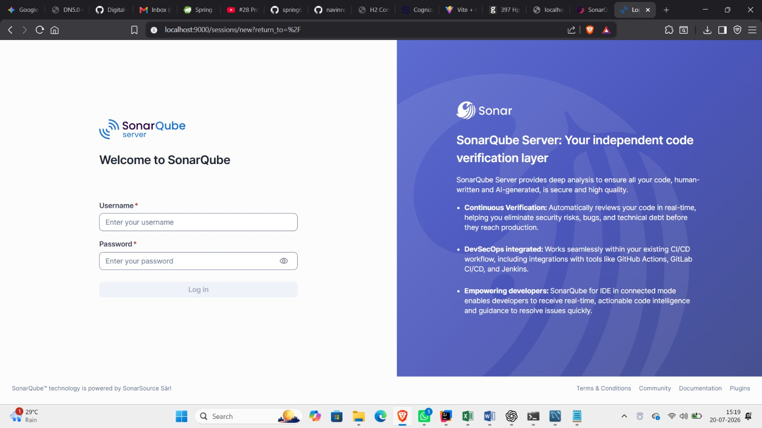
Integrating SonarQube with Maven
For Maven-based Java projects, SonarQube integrates via the SonarQube Scanner for Maven (sonar-maven-plugin), running as part of the normal build lifecycle.
Add the plugin to <build><plugins> in pom.xml:
<build>
<plugins>
<plugin>
<groupId>org.sonarsource.scanner.maven</groupId>
<artifactId>sonar-maven-plugin</artifactId>
<version>3.11.0.3922</version>
</plugin>
</plugins>
</build>
SonarQube Server login screen
SonarQube
10

Slide 11
Running the Analysis
mvn clean verify sonar:sonar
clean
verify
sonar:sonar
Wipes out artifacts from any previous build (the target/ directory), ensuring a fresh build rather than stale classes or reports.
Runs the full build lifecycle through the verify phase — compiles code and executes unit/integration tests, producing the test and coverage reports SonarQube consumes.
Invokes the Sonar Maven plugin's goal — gathers source code, bytecode, test results, and coverage reports, then submits them as an analysis report to the server.
SonarQube
11

Slide 12
Interpreting Sonar Logs
Your first troubleshooting resource when something goes wrong.
Successful run
Look for ANALYSIS SUCCESSFUL, the dashboard link, and often a background task URL.
Authentication errors
401 Unauthorized / Not authorized — usually an invalid, expired, or missing token.
Connectivity errors
Timeouts or Connection refused — wrong sonar.host.url, a blocking firewall/proxy, or the server is down.
Quality Gate failures in CI
With “wait for Quality Gate” enabled, the build fails, pointing to the unmet condition(s).
Background task failures
Scanner uploads succeed but server-side processing fails — dashboard shows failed even though Maven printed success.
SonarQube
12

Slide 13
Duplicate Code & Cyclomatic Complexity
Duplicate Code
Cyclomatic Complexity
SonarQube scans for identical or near-identical blocks across the codebase (a minimum of consecutive duplicated tokens/lines is required, so trivial repetition like boilerplate getters isn't flagged). Matters because:
Measures the number of linearly independent execution paths through a piece of code.
A bug fixed in one copy is often left unfixed in others
decision points + 1
It inflates the codebase and makes refactoring riskier
It signals a shared function, base class, or utility should be extracted
Counted from if, else if, for, while, case, &&, ||, catch, and ternary expressions. Each branch adds a path the code could take, and each path adds a test case needed to fully exercise the method.
SonarQube
13

Slide 14
Code Smells (Spaghetti Design)
Structural issues that don't necessarily cause incorrect behavior today, but make code harder to maintain and more likely to cause bugs later.
Excessively long methods or classes doing too many unrelated things
Deeply nested conditional logic (“spaghetti” control flow)
✕
✕
Methods with too many parameters
Classes with high coupling to many others (“feature envy”)
✕
✕
Dead or unreachable code left in place
Magic numbers/strings instead of named constants
✕
✕
SonarQube
14

Slide 15
Lack of Unit Tests / Coverage Metrics
SonarQube doesn't run your tests itself — it consumes coverage reports generated by tools like JaCoCo and displays them alongside its static analysis findings.
Line Coverage
Branch / Condition Coverage
Coverage on New Code
Percentage of executable lines exercised by at least one test.
Percentage of decision branches (true and false paths of an if) exercised by tests.
Under “clean as you code,” this is usually the metric that actually gates builds.
Low coverage doesn't mean the code is broken — it means regressions in that area are less likely to be caught automatically before release.
SonarQube
15

Slide 16
Coding Standards, Bugs & Vulnerabilities
Coding Standards
Bugs
Violations of naming, formatting, import order, and language-specific conventions. Lower severity individually, but consistency affects readability at scale.
Constructs highly likely to produce incorrect behavior — null pointer dereferences, resource leaks, off-by-one errors, incorrect exception handling.
Vulnerabilities
Security Hotspots
Exploitable constructs — SQL injection, XSS, insecure deserialization, hardcoded credentials, weak cryptography, insecure config defaults.
Code using a security-sensitive API correctly in some cases, incorrectly in others. Flagged for manual human review rather than auto-classified.
Both bugs and vulnerabilities are assigned a severity — Blocker, Critical, Major, Minor, Info — that factors into Quality Gate evaluation.
SonarQube
16

Slide 17
Insufficient Comments
“
SonarQube doesn't mandate a specific comment style, but it can flag files or complex methods with unusually sparse documentation — particularly where complexity is high enough that a reader would reasonably need explanation to follow the logic.
Treated as a lower-priority signal than bugs or vulnerabilities — more of a maintainability nudge than a hard requirement.
SonarQube
17

Slide 18
Interpreting the Quality Gate
Condenses everything into a single Passed or Failed verdict, based on configured conditions such as:
New Bugs ≤ 0
New Vulnerabilities ≤ 0
New Code Coverage ≥ 80%
New Duplicated Lines ≤ 3%
Security Hotspots Reviewed = 100%
Passed — the analyzed “new code” (per the clean-as-you-code model) meets every configured threshold. Failed — at least one condition was violated; the dashboard identifies exactly which one(s), including the measured value versus the required threshold.
In a properly configured CI/CD pipeline, a failed Quality Gate should block the merge or deployment — turning SonarQube into an enforced quality checkpoint, not just an informational dashboard.
SonarQube
18

Slide 19
From Passive Reporting to
Active Gatekeeping
SonarQube turns code quality from a once-in-a-while audit into a continuous, automated, and enforced part of every build.

