Slide 1

Title
Project Name: FlowGuard AI
Tagline: Agentic Smart Payment+ Fraud Guardian
Team Name: MATRIX
Event: DevCraft: Simon’s Command Line
Date: 06/04/2026
Domain: FINTECH

Slide 2
Problem Statement
Users and small businesses face high fraud risks amid rising AI-generated scams.
Real-time and cross-border payments suffer from delays and high fees.
Traditional systems lack intelligent routing and instant risk scoring to protect users effectively.

Slide 3
Target Audience
Individual users navigating the digital payments ecosystem (e.g., UPI users in India).
Small businesses requiring secure, real-time domestic and cross-border payment solutions.
Developers needing easy-to-integrate payment orchestration tools.

Slide 4
Existing Solutions
Traditional SWIFT/NEFT: Reliable but suffer from multi-day delays and high fees for
international transfers.
Standard UPI: Excellent for instant domestic payments but limited for cross-border routing
and advanced, real-time AI fraud detection.
Static Rule-Based Fraud Systems: Easily bypassed by modern AI-generated scams.

Slide 5
Gaps & Opportunities
The Gap: Current payment systems handle routing and fraud detection as separate,
often manual or slow processes.
The Opportunity: By creating a unified platform where an "agentic AI" acts as an
intelligent command center, we can seamlessly combine optimal payment
routing with millisecond fraud detection.

Slide 6
Your Solution
FlowGuard AI: An AI-powered payment orchestration platform acting as an
intelligent command center.
It analyzes transaction patterns (amount, recipient, behavior) and detects fraud risk in
milliseconds using ML models and rules.
The system autonomously routes transactions optimally (e.g., UPI for domestic, stablecoin
for cross-border) and delivers personalized financial insights.

Slide 7
Key Features
Dashboard & Analytics: Real-time balances, transaction history, risk heatmaps,
distribution charts, and agent activity logs.
Smart Payments: AI routing optimization across UPI, Stablecoin, and SWIFT channels.
Fraud Detection: ML-powered (Isolation Forest) and rule-based system that scores risk in ~2ms.
AI Agent & CLI: Autonomous routing decisions with natural language explanations,
paired with a developer-friendly CLI terminal (flowguard send, analyze).

Slide 8
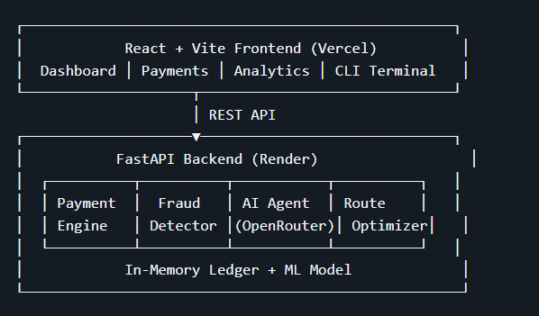
System Architecture

Slide 9
Tech Stack
Frontend: React 18 + Vite + Vanilla CSS (golden/dark theme)
Backend: FastAPI (Python) + Uvicorn
AI/LLM: OpenRouter (Meta LLaMA 3.1 8B — free tier)
Fraud ML: scikit-learn (Isolation Forest anomaly detection)
Payments: In-memory ledger with UPI, IMPS, NEFT, SWIFT, Stablecoin simulation
CLI: Built-in browser terminal + Python typer CLI

Slide 10
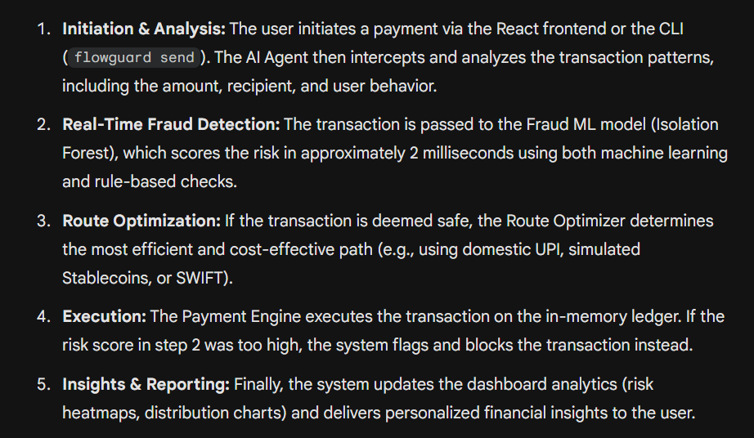
Workflow

Slide 11
Impact
"Reduces fraud losses by up to 60% while cutting cross-border fees and enabling instant settlement — perfect for India's UPI ecosystem and global expansion."

Slide 12
Future Scope
Production Database Integration: The current architecture uses an "In-memory ledger“
. A critical future step is migrating this to a robust, persistent database (like PostgreSQL
or MongoDB) to handle real user data and history.
Live Blockchain Integration: The platform currently relies on "Stablecoin simulation".
The future scope involves integrating with real Layer-2 blockchain testnets or mainnets
to execute actual crypto cross-border transfers.
Live Bank/Gateway APIs: Currently, UPI, IMPS, NEFT, and SWIFT are simulated within
the in-memory ledger. Future iterations will require integrating live APIs from banking
providers (like Stripe, Razorpay, or Plaid).
Enterprise AI Scaling: The MVP utilizes the free tier of Meta LLaMA 3.1 8B via OpenRouter.
As the application scales, moving to dedicated LLM hosting or more advanced enterprise models
will ensure faster, more reliable routing and insights.

Slide 13
Team Info
Member 1: Aditya Dugar (Team Leader & Backend developer)
Member 2: Raunak Bothra (Problem Statement finder & Solution giver)
Member 3: Vijaya Rupesh N(Frontend Developer)

